Slide 1




Climate Change Economics
Jennifer Alix-Garcia, Ph.D.
Rotary Club of San Francisco
June, 2022

Slide 2
National Economic Education Delegation
Vision
  One day, the public discussion of policy issues will be grounded in an accurate perception of the underlying economic principles and data.
Mission
  NEED unites the skills and knowledge of a vast network of professional economists to promote understanding of the economics of policy issues in the United States.
NEED Presentations
  Are nonpartisan and intended to reflect the consensus of the economics profession.

Slide 3
Who Are We?
Honorary Board: 54 members
  2 Fed Chairs: Janet Yellen, Ben Bernanke
  6 Chairs Council of Economic Advisers
    Furman (D), Rosen (R), Bernanke (R), Yellen (D), Tyson (D), Goolsbee (D)
  3 Nobel Prize Winners
    Akerlof, Smith, Maskin
Delegates: 590+ members
  At all levels of academia and some in government service
  All have a Ph.D. in economics
  Crowdsource slide decks
  Give presentations
Global Partners: 45 Ph.D. Economists
  Aid in slide deck development

Slide 4
Credits and Disclaimer
This slide deck was authored by:
  Shana Mcdermott, Trinity University
  Sarah Jacobson, Williams College
  Sharon Shewmake, Western Washington University
This slide deck was reviewed by:
  Jason Shogren, University of Wyoming
  Walter Thurman, North Carolina State University
Disclaimer
  NEED presentations are designed to be nonpartisan.
  It is, however, inevitable that the presenter will be asked for and will provide their own views.
  Such views are those of the presenter and not necessarily those of the National Economic Education Delegation (NEED).

Slide 5
How Can Economists Contribute to
Thinking about Climate Change?
By assessing behavioral reactions to climate change.
By measuring the damage and estimating the economic costs of fighting climate change.
By designing smart policies that minimize costs.
  Balance economic growth with GHG emission mitigation.

Slide 6
Climate Change Science

Slide 7
How Much Pollution Does Society Want?
Analogy: How Many Oranges Does Society Want?
People grow and sell oranges for a price that at least covers costs (supply).
People will not pay more for them than what they consider to be their value (demand).
Prices let supply and demand balance out. The price settles where:
This is the “right” number of oranges for society.
Prices reflect scarcity and the social value of the resource.
# of oranges people want to sell = # of oranges people want to buy

Slide 8
Electricity Is Different From Oranges
Many sources of electricity generate pollution.
Pollution is an EXTERNALITY:
  a side effect (cost or benefit) that affects someone
  else when something is bought or sold.
  This is a market failure.
The price of electricity does not reflect all of the costs.
  Electricity is too cheap.
  There is too much pollution.

Slide 9
Impacts of Climate Change

Slide 10
How These Impacts Affect Humans
Agriculture
Fisheries
Coastal damages
Direct health effects, including sickness and death (temperature & drought; also pollution)
Indirect health effects (vector-borne disease)
Reduced fresh water availability
Wildfires
Shifting zones for important ecosystems, and desertification
Reduced worker productivity
Increased violence
Some of these may cause human migration and/or conflict

Slide 11

Social Cost of Carbon
Cost above price paid.
The expected cost of damages from each unit of greenhouse gas emissions.
Current EPA estimate: ~$51 per metric ton of CO₂.
  About $32 Billion for all vehicles in the US.
Social cost of carbon will increase over time.

Slide 12
Economics of Responding to Climate Change

Slide 13
How Economists Decide How Much to Fight
Climate Change
Cost Benefit Analysis
Expected costs of reducing emissions
Weigh:
Expected damages from allowing climate change

Slide 14
Cost-Benefit Analysis of Fighting Climate
Change
Most economic models suggest the costs of keeping warming below 2°C are relatively small.
  Costs amount to 1-4% of GDP by 2030.
Costs of acting to keep warming below 2°C are almost certainly less than future economic damages they would avoid.
  Damages estimated to be between: 7 - 20% of worldwide GDP.
Caveats:
  Putting a monetary value on priceless things
  Inequality
  Uncertainty and risk

Slide 15
Addressing the Sources of Our Emissions

Slide 16
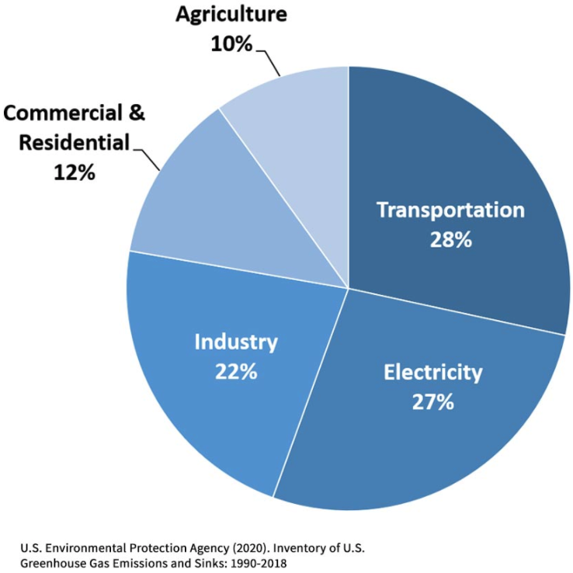
Total U.S. Greenhouse Gas Emissions by
Economic Sector in 2018

Slide 17
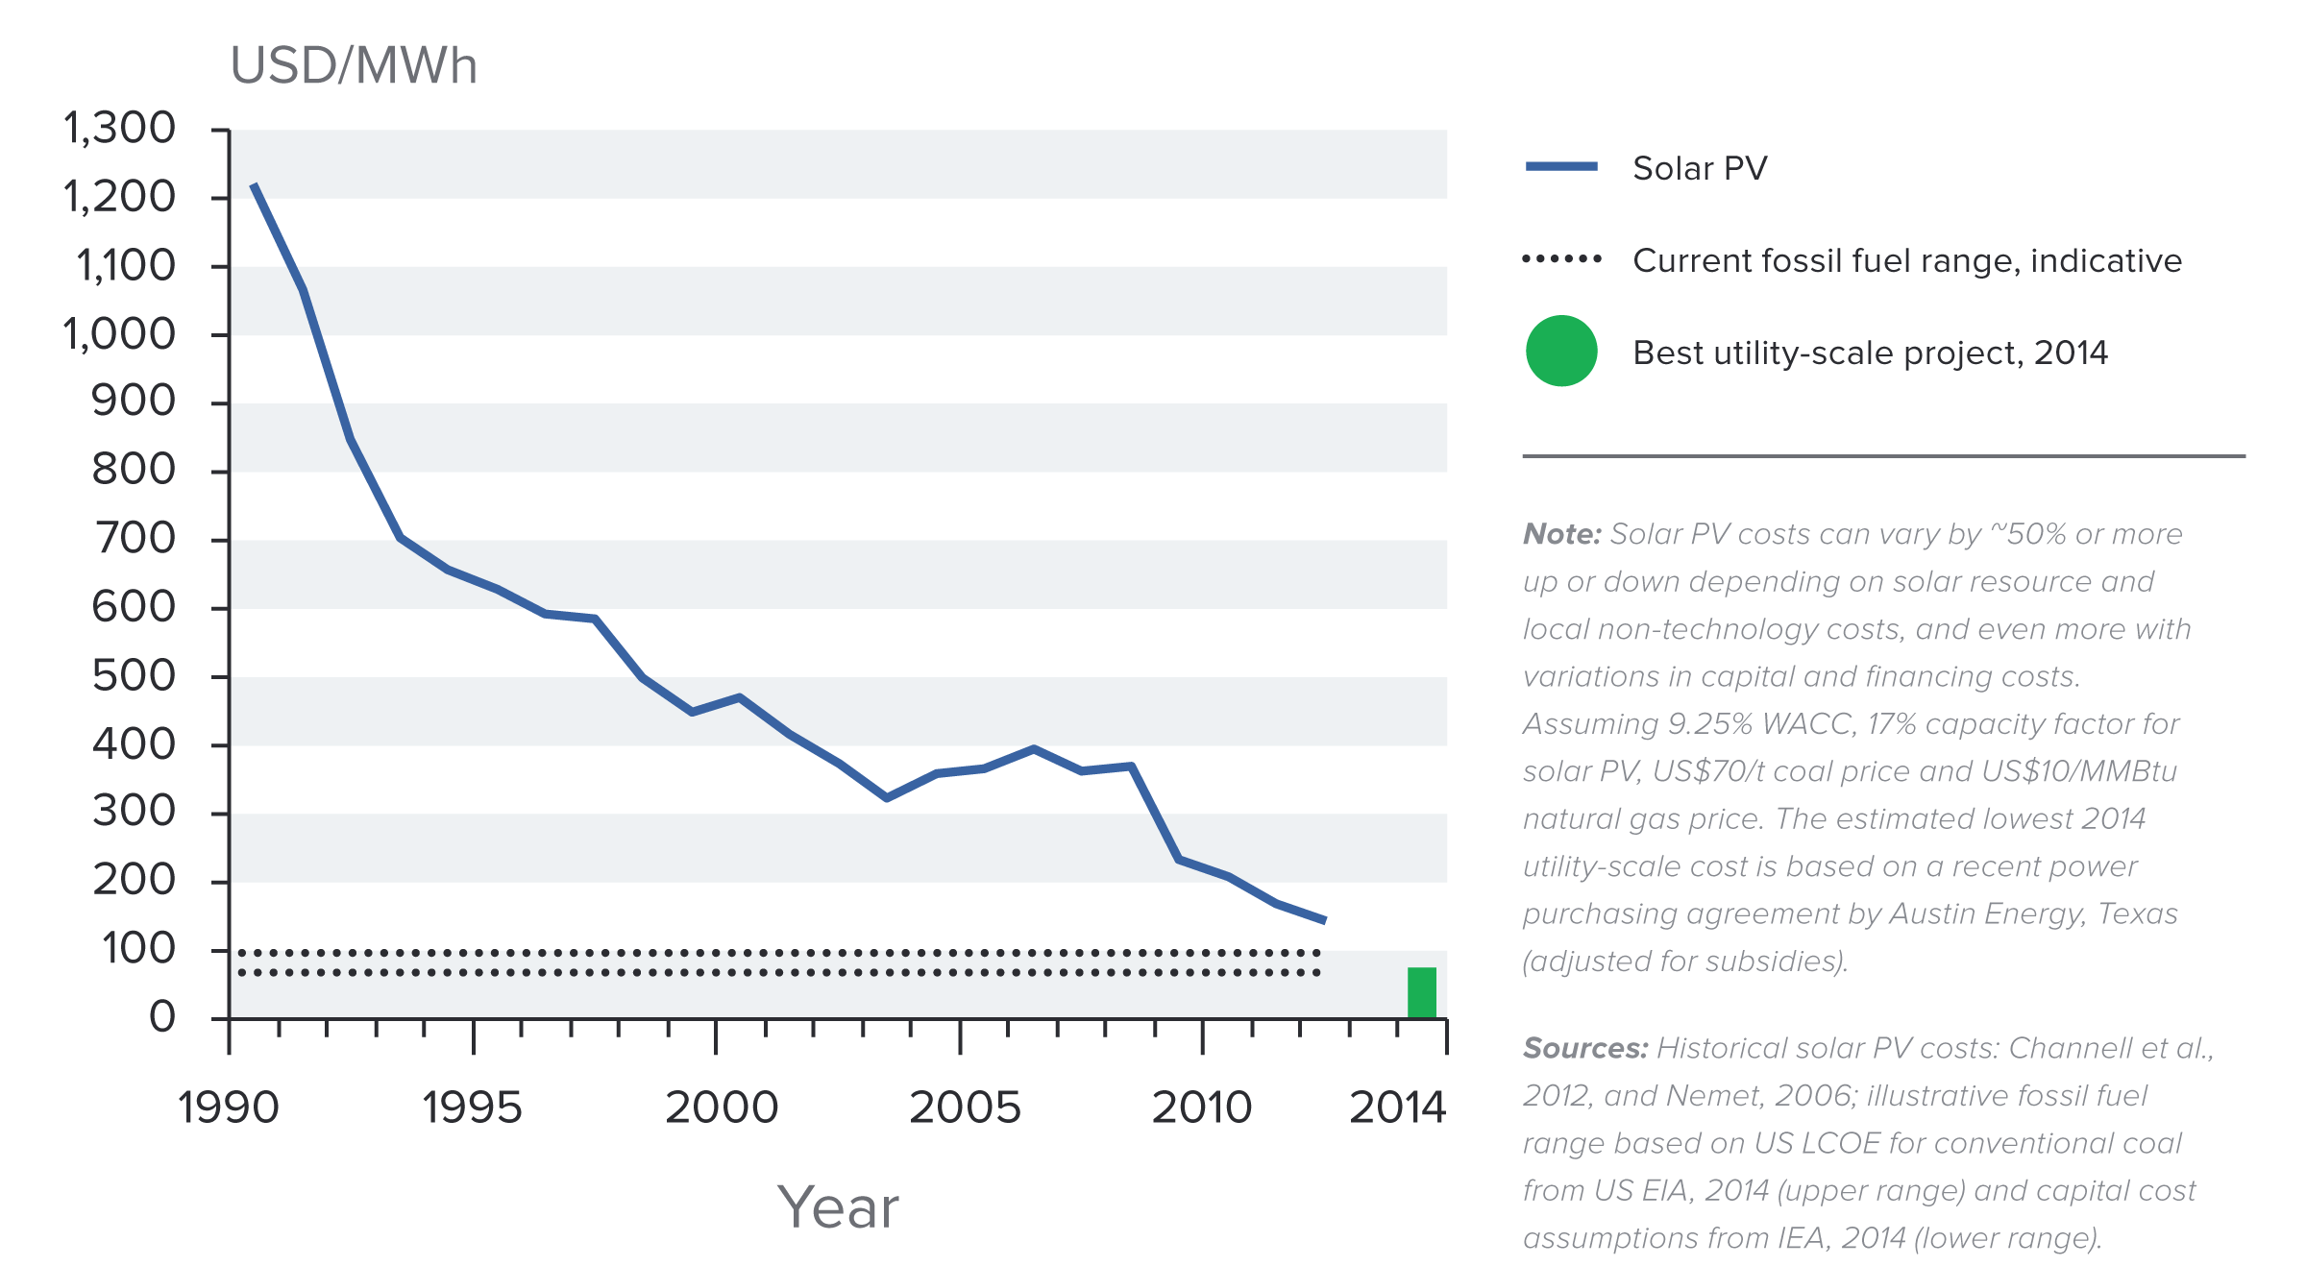
Indicative Solar Costs Over Time

Slide 18
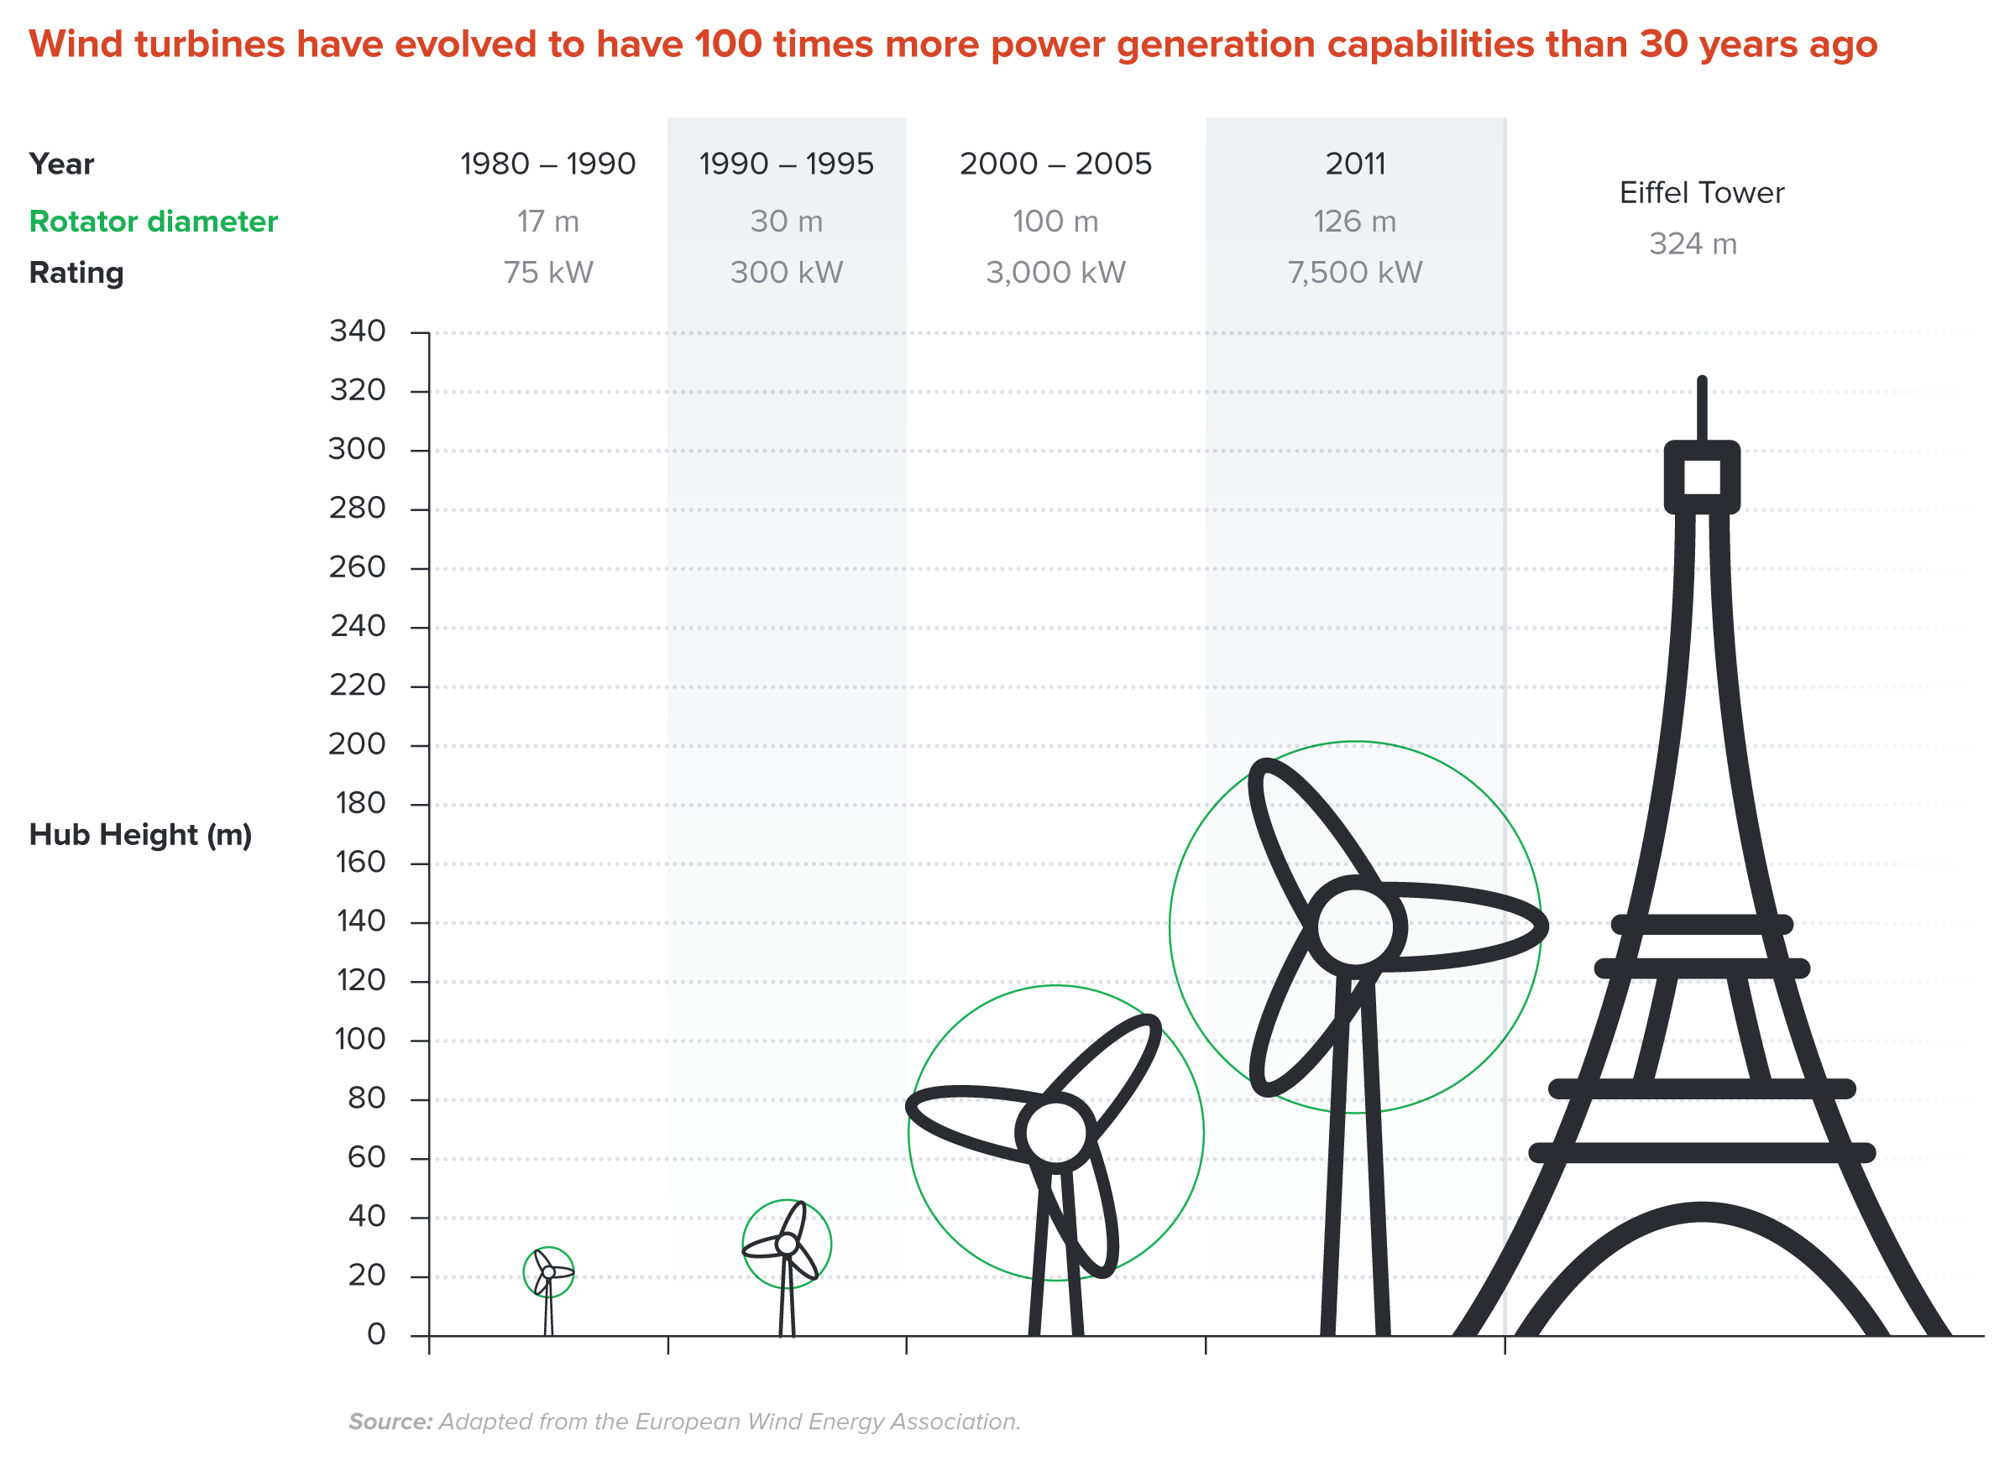
Wind Turbines Have 100 Times More Power
Generation Capabilities Than 30 Years Ago

Slide 19
Climate Change Policy

Slide 20
Policies That Reduce Emissions: Directly
Regulation
  Emissions standards or limits
    E.g., CAFE standards
Market-oriented policies
  Putting a price on emissions
    Subsidizing green energy (e.g., feed-in tariffs)
    Tax or cap & trade

Slide 21
Policies That Reduce Emissions: INDirectly
Subsidizing R&D
Grid / infrastructure
Energy efficiency mandates and subsidies
Mandating renewable energy (e.g., renewable portfolio standards)
Land use policies

Slide 22
Climate Change Policy in Action

Slide 23
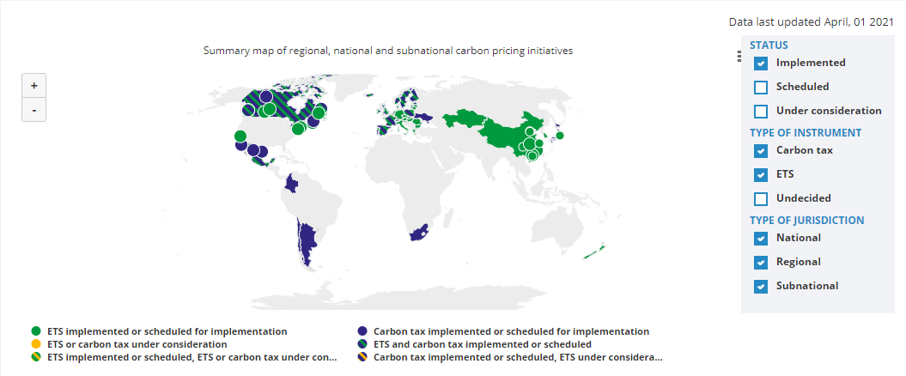
Carbon Policies Across the World
ETS = Emissions Trading System = Cap and Trade
Source: World Bank Carbon - Pricing Dashboard

Slide 24
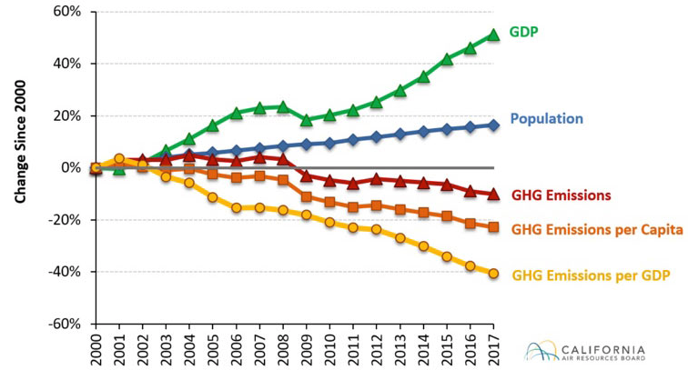
Change in California GDP, Population, and
GHG Emissions since 2000
Cap & Trade ->

Slide 25
Summary
Climate change is real, is caused by human actions, and has impacts we’re already feeling.
We need to reduce emissions to balance the costs of action against the costs of inaction.
Scientists and the IPCC recommend that we work to keep warming below 1.5 degrees celcius.
  Economists believe that this goal is well worth the costs!

Slide 26
Summary – continued
There are many ways to reduce emissions.
Economics-inspired policies can help us do this at the lowest cost.
Taxes and cap and trade are proven effective tools to fight climate change!
Other tools may also be necessary.

Slide 27
Thank you!
Any Questions?
www.NEEDelegation.org
Jennifer Alix-Garcia
jennifer.alix-garcia@oregonstate.edu
Contact NEED: Info@NEEDelegation.org
Submit a testimonial: www.NEEDelegation.org/testimonials.php

Slide 28
Available NEED Topics Include:
Coronavirus Economics
US Economy
Climate Change
Economic Inequality
Economic Mobility
Trade and Globalization
Minimum Wages
Immigration Economics
Housing Policy
Federal Budgets
Federal Debt
Black-White Wealth Gap
Autonomous Vehicles
US Social Policy

