Slide 1




Climate Change Economics
Jennifer Alix-Garcia, Ph.D.
Capital City Kiwanis Club
April 6, 2021

Slide 2
National Economic Education Delegation
Vision
  One day, the public discussion of policy issues will be grounded in an accurate perception of the underlying economic principles and data.
Mission
  NEED unites the skills and knowledge of a vast network of professional economists to promote understanding of the economics of policy issues in the United States.
NEED Presentations
  Are nonpartisan and intended to reflect the consensus of the economics profession.

Slide 3
Who Are We?
Honorary Board: 48 members
  2 Fed Chairs: Janet Yellen, Ben Bernanke
  6 Chairs Council of Economic Advisers
    Furman (D), Rosen (R), Bernanke (R), Yellen (D), Tyson (D), Goolsbee (D)
  3 Nobel Prize Winners
    Akerlof, Smith, Maskin
Delegates: 500+ members
  At all levels of academia and some in government service
  All have a Ph.D. in economics
  Crowdsource slide decks
  Give presentations
Global Partners: 45 Ph.D. Economists
  Aid in slide deck development

Slide 4
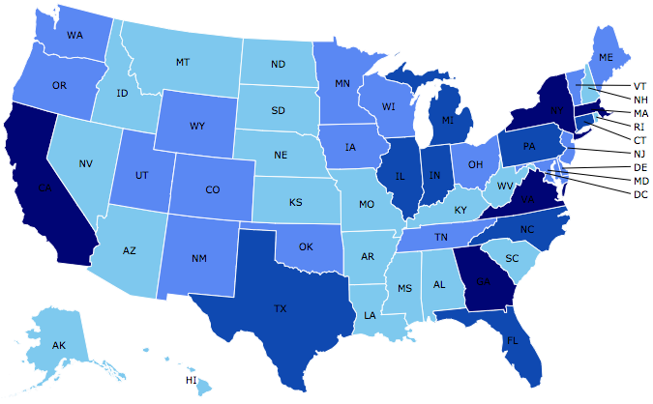
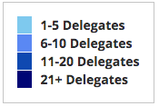
Where Are We?

Slide 5
Credits and Disclaimer
This slide deck was authored by:
  Shana Mcdermott, Trinity University
  Sarah Jacobson, Williams College
  Sharon Shewmake, Western Washington University
This slide deck was reviewed by:
  Jason Shogren, University of Wyoming
  Walter Thurman, North Carolina State University
Disclaimer
  NEED presentations are designed to be nonpartisan.
  It is, however, inevitable that the presenter will be asked for and will provide their own views.
  Such views are those of the presenter and not necessarily those of the National Economic Education Delegation (NEED).

Slide 6
Outline
Climate change science
Impacts of climate change
Economics of responding to climate change
Addressing the sources of our emissions
Climate change policy
Policy in action

Slide 7
How Can Economists Contribute to
Thinking about Climate Change?
By assessing behavioral reactions to climate change.
By measuring the damage and estimating the economic costs of fighting climate change.
By designing smart policies that minimize costs.
  Balance economic growth with GHG emission mitigation.

Slide 8
Climate Change Science

Slide 9
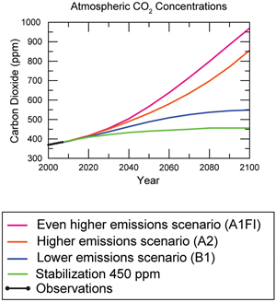
Atmospheric CO₂ Concentrations
Projections →
Source: IPCC data distribution center and climate.gov

Slide 10
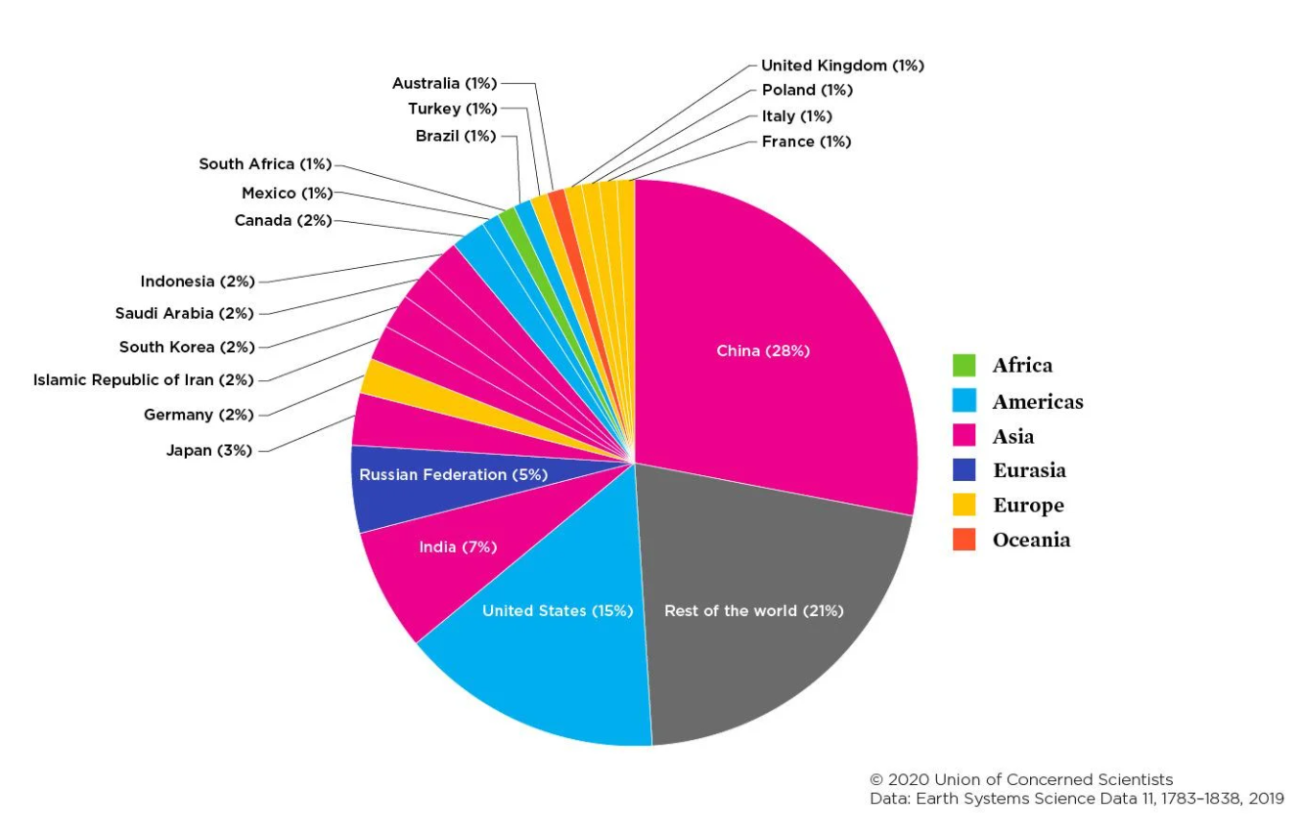
10 countries emit over 60% of GHG emissions**
**This slide was not reviewed by NEED.

Slide 11
How Much Pollution Does Society Want?
Analogy: How Many Oranges Does Society Want?
People grow and sell oranges for a price that at least covers costs (supply).
People will not pay more for them than what they consider to be their value (demand).
Prices let supply and demand balance out. The price settles where:
This is the “right” number of oranges for society.
Prices reflect scarcity and the social value of the resource.
# of oranges people want to sell = # of oranges people want to buy
Notes:
Simple Supply and demand game.
Ask who likes oranges and then ask how much a few students would pay for an orange right now.
If I supply them for some price in the middle – who gets them?
Not everybody who wants an orange.
- This also illustrates how value gets created with trade

Slide 12
Electricity Is Different From Oranges
Many sources of electricity generate pollution.
Pollution is an EXTERNALITY:
  a side effect (cost or benefit) that affects someone
  else when something is bought or sold.
  This is a market failure.
The price of electricity does not reflect all of the costs.
  Electricity is too cheap.
  There is too much pollution.

Slide 13
Impacts of Climate Change

Slide 14
Global Warming Indicators

Slide 15
How These Impacts Affect Humans
Agriculture
Fisheries
Coastal damages
Direct health effects, including sickness and death (temperature & drought; also pollution)
Indirect health effects (vector-borne disease)
Reduced fresh water availability
Wildfires
Shifting zones for important ecosystems, and desertification
Reduced worker productivity
Increased violence
Some of these may cause human migration and/or conflict
Notes:
This could be a series of slides with pictures for each one

Slide 16

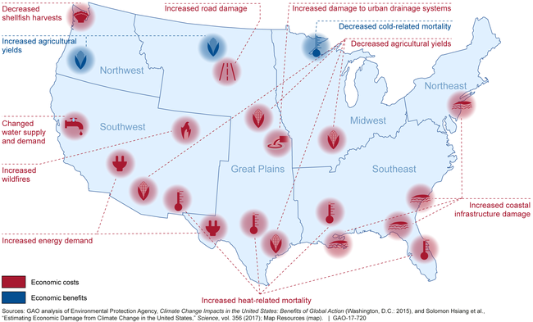
Most Vulnerable People and Places
Tropical areas
Low-lying coastal areas
Low-income people
Notes:
Add pictures or replace words with pictures

Slide 17
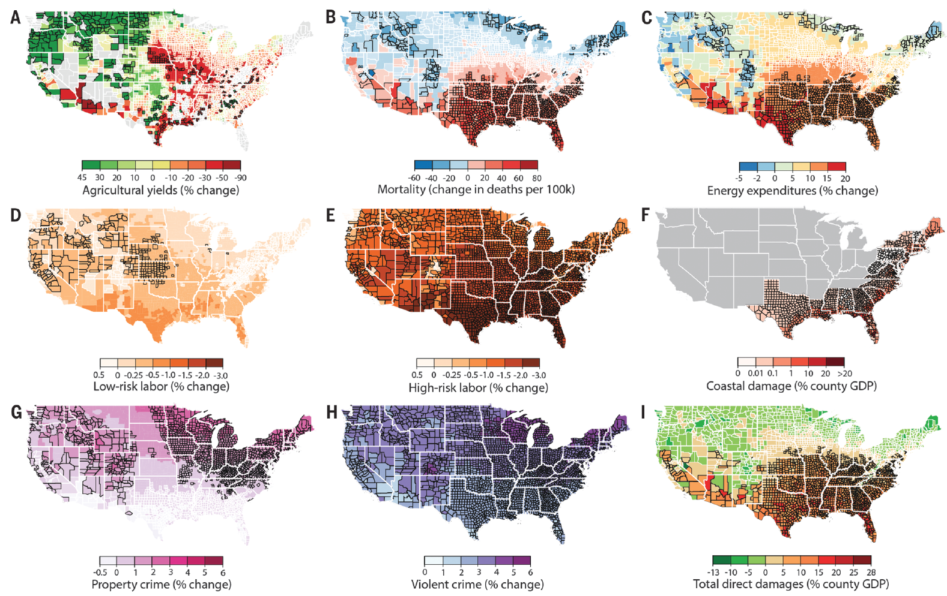
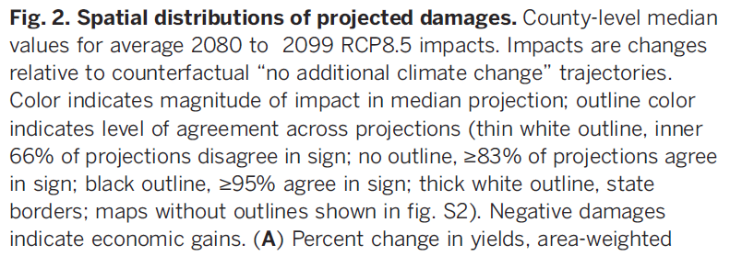
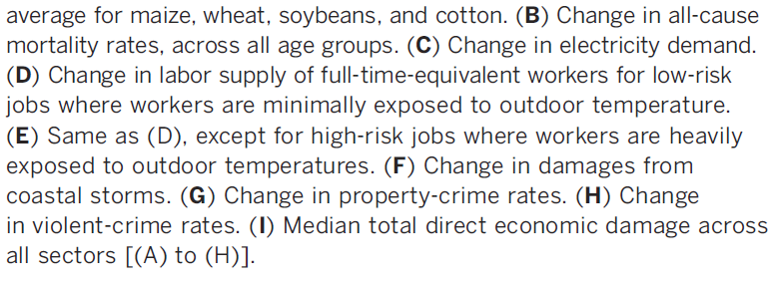
Projected Effects Vary Across the U.S. but Are Estimated at 1.2% of GDP per 1C Increase

Slide 18
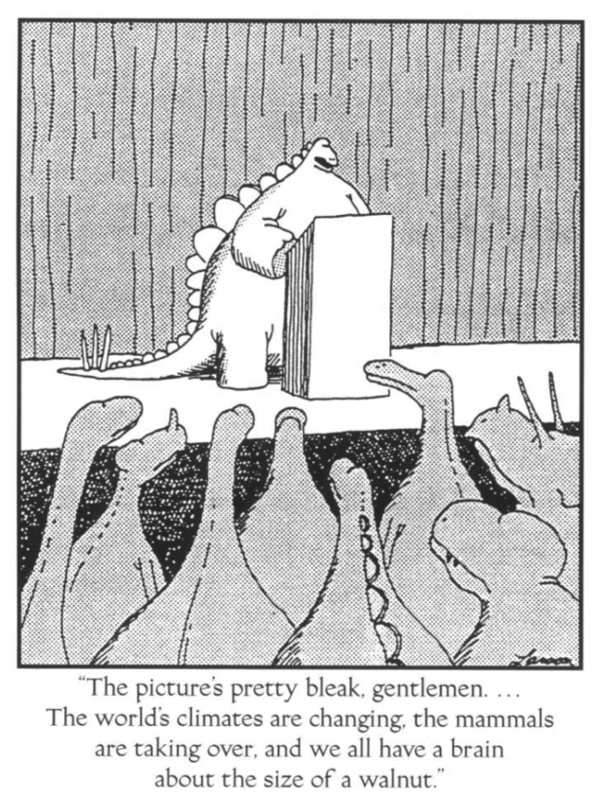

Slide 19
Economics of Responding to Climate Change

Slide 20
International Climate Policy Goals
Intergovernmental Panel on Climate Change (IPCC)
  Global effort to fight climate change
  Reports on consensus of climate science, including economics
IPCC report in 2007:
  Recommended goal: < 2 degrees C (3.6 degrees F)
  Industrialized countries should reduce GHG emissions between 25% and 40% below 1990 levels by 2020.
2016 Paris Agreement:
  Basic goal of 2 degrees C: requires 40-70% GHG reduction 2010 → 2050
  Reach goal of 1.5 degrees C: requires 70-95% GHG reduction 2010 → 2050
IPCC report in 2018:
  Temperature has already increased by 1.0 degrees C - Recommended: < 1.5 C

Slide 21
How Economists Decide How Much to Fight
Climate Change
Cost Benefit Analysis
Expected costs of reducing emissions
Weigh:
Expected damages from allowing climate change

Slide 22
Cost-Benefit Analysis of Fighting Climate
Change
Most economic models suggest the costs of keeping warming below 2°C are relatively small.
  Costs amount to 1-4% of GDP by 2030.
Costs of acting to keep warming below 2°C are almost certainly less than future economic damages they would avoid.
  Damages estimated to be between: 7 - 20% of worldwide GDP.
Caveats:
  Putting a monetary value on priceless things
  Inequality
  Uncertainty and risk

Slide 23
Economic Growth and Climate Change Action
Are Compatible
Abating greenhouse gas emissions is costly…
… but climate change damages are even more costly.
Economic growth comes with consequences that we have to deal with, including climate consequences.
Economies with environmental regulations can still be dynamic.
Goal: design policies that reach climate goals at the least possible cost.

Slide 24
Addressing the Sources of Our Emissions

Slide 25
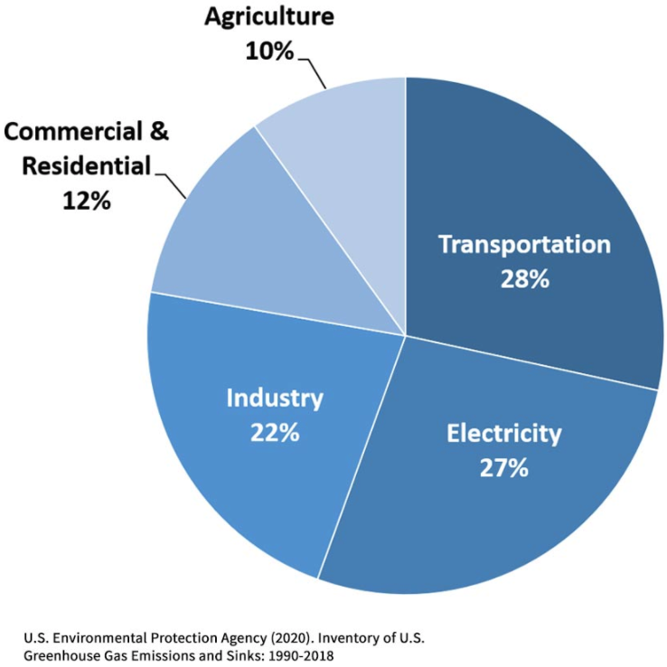
Total U.S. Greenhouse Gas Emissions by
Economic Sector in 2018
Notes:
https://www.epa.gov/ghgemissions/sources-greenhouse-gas-emissions

Slide 26
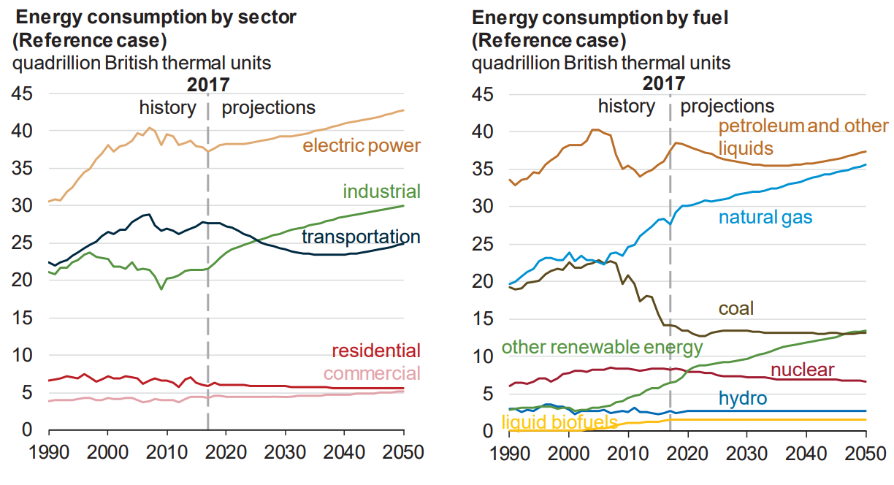
Fossil Fuels Dominate U.S. Energy Production
Notes:
US Energy Information Agency Annual Energy Outlook 2018

Slide 27
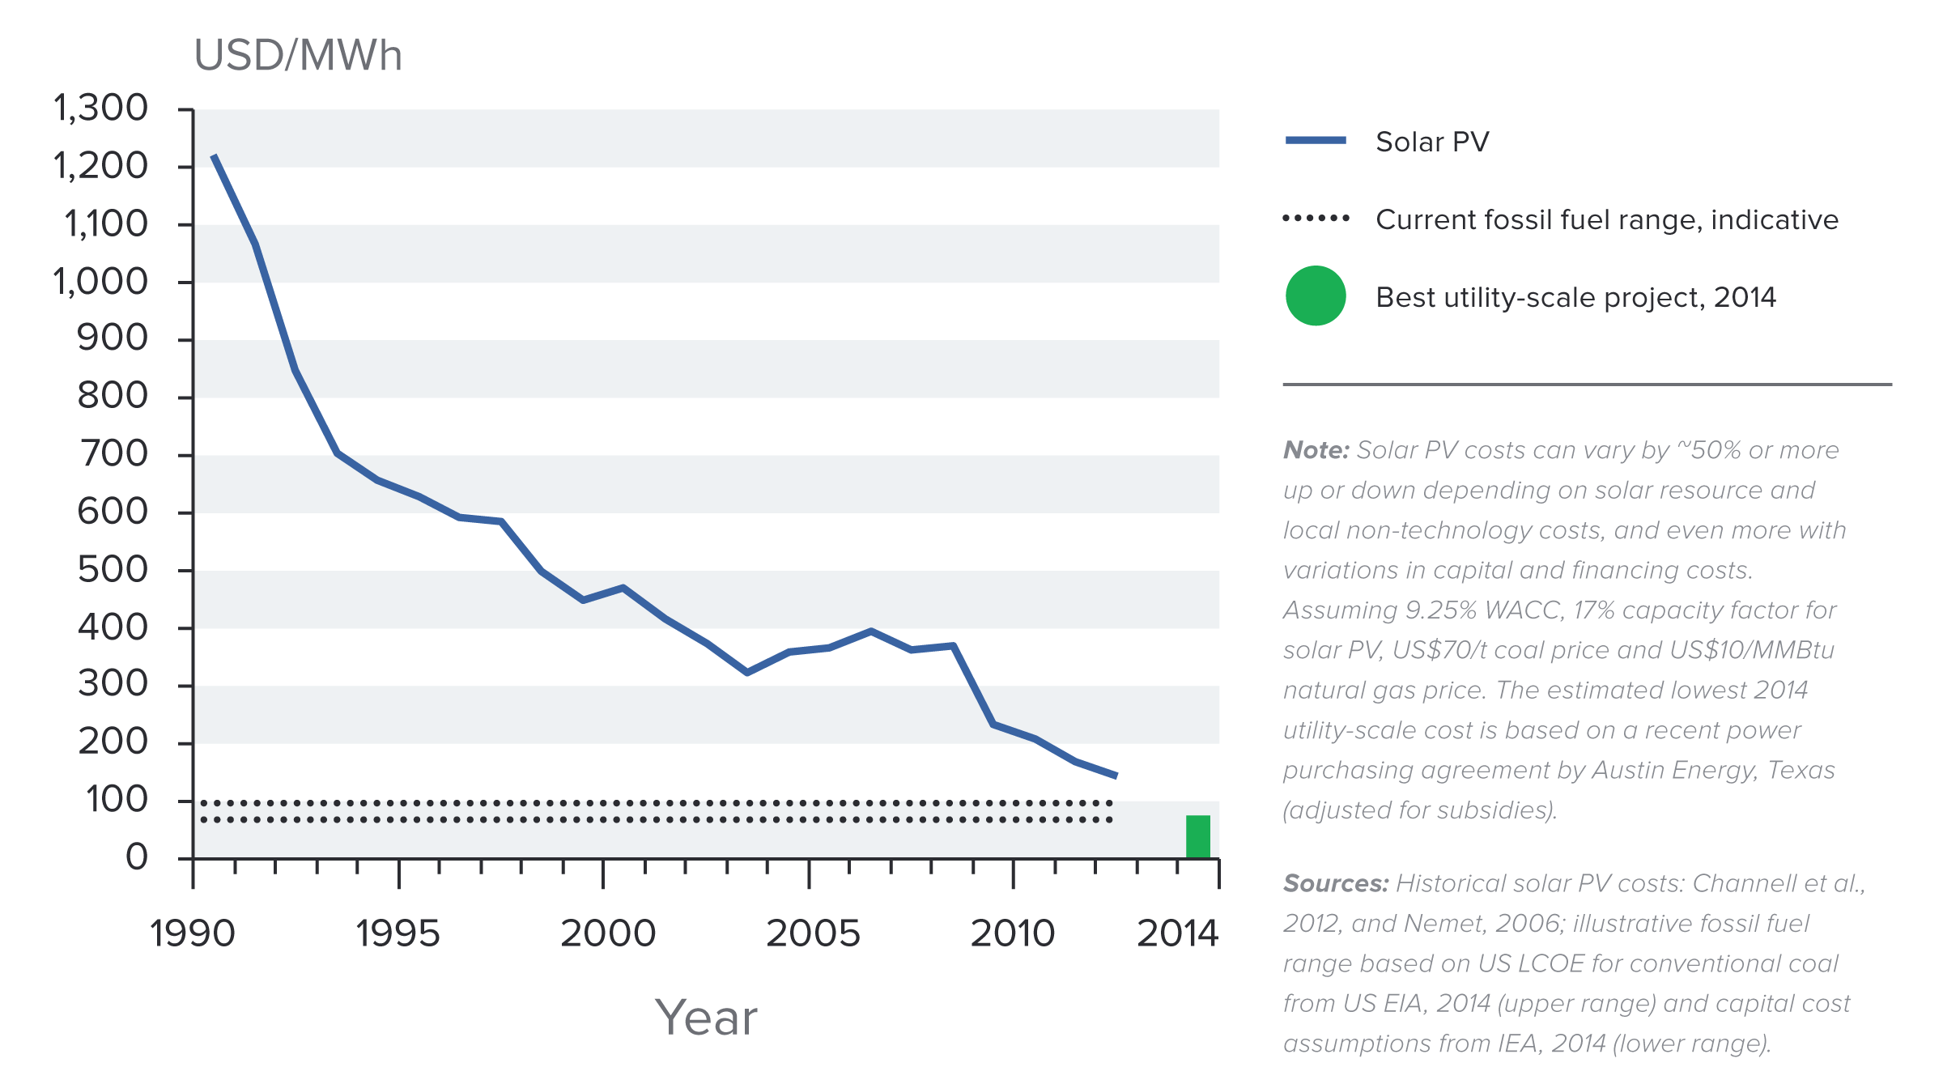
Indicative Solar Costs Over Time
Notes:
Source: New Climate Economy Report

Slide 28
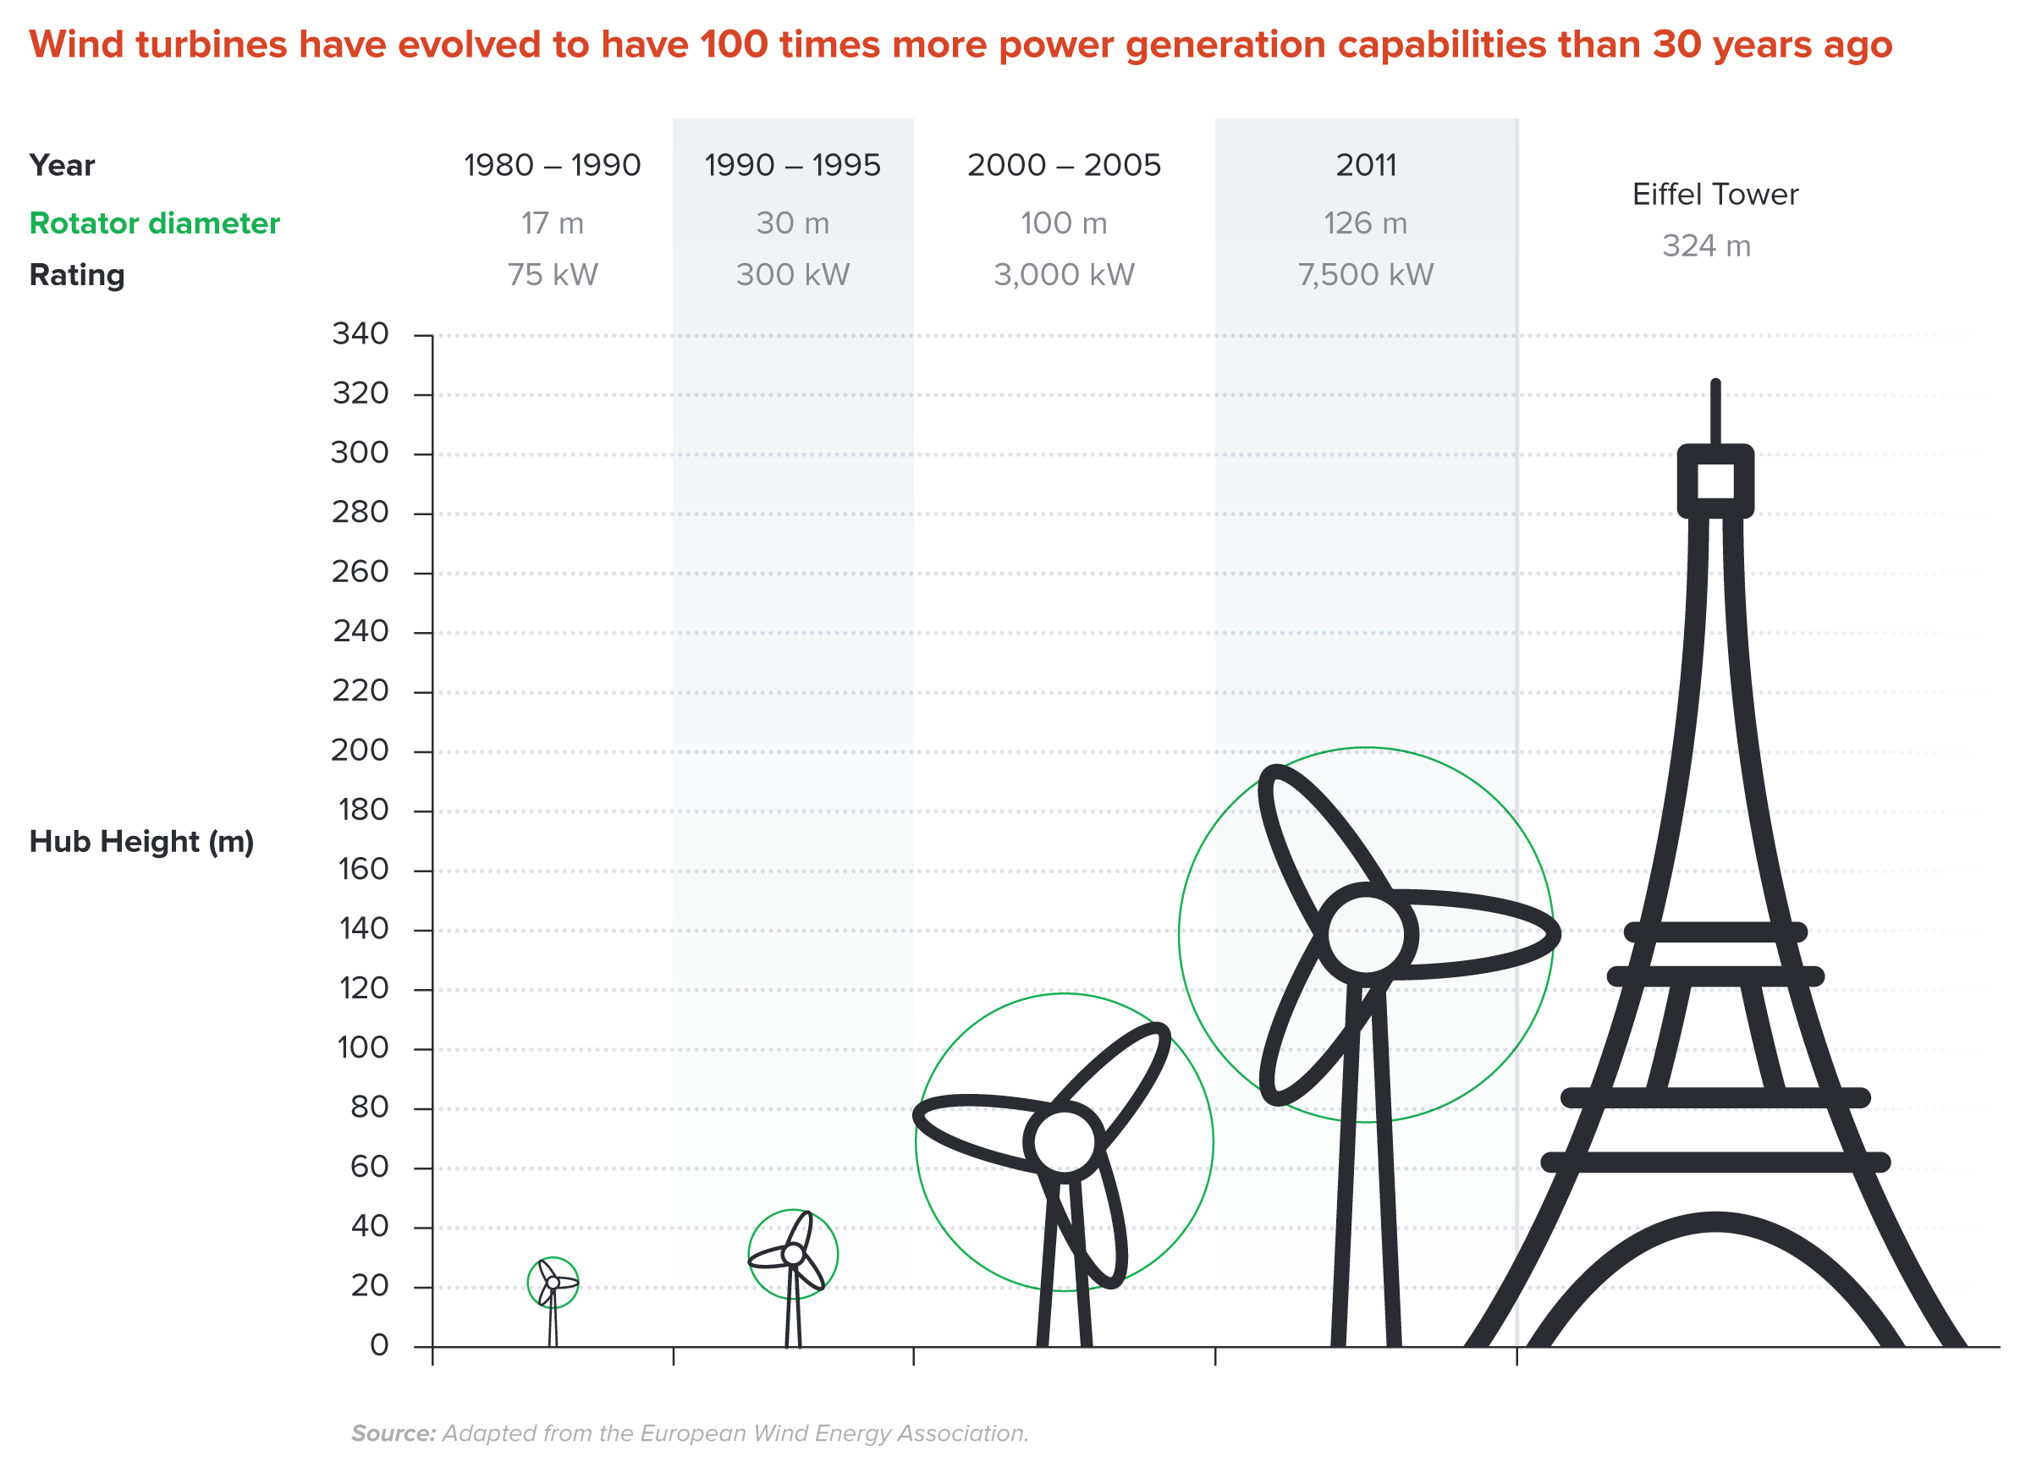
Wind Turbines Have 100 Times More Power
Generation Capabilities Than 30 Years Ago
Notes:
Source: New Climate Economy Report

Slide 29


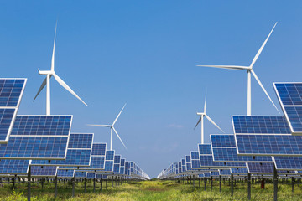
Challenges with Renewable Energy
It’s intermittent - only produced if there is sun or wind.
Energy is needed all day and night, with peak times.
Limited w/o storage.
  Creative storage options are under development.

Slide 30
Climate Change Policy

Slide 31
Policies That Reduce Emissions: Directly
Regulation
  Emissions standards or limits
    E.g., CAFE standards
Market-oriented policies
  Putting a price on emissions
    Subsidizing green energy (e.g., feed-in tariffs)
    Tax or cap & trade
Notes:
These are the favored policies. Address a problem head on and let the market deal with it.

Slide 32
How Does Cap and Trade Work?
Activities to be covered are determined.
Acceptable emissions levels are indicated.
“Permits” that allow acceptable emissions levels are issued.
  How?
    According to historical emissions?
    Evenly across emitters?
    Sold at some price?
A “market” is developed.
Those desiring to emit will have to buy sufficient permits to accommodate their emissions.
Those wishing to abate will offer their permits on the “market”.
  The price of a permit indicates:
    The benefit of eliminating further emissions.
    The cost of emitting.
Gov’t agency determines equality of permits in possession and emissions.

Slide 33
How Does a Carbon Tax Work?
Activities to be covered are determined.
The price of emissions is determined.
  Presumably some relation to the social cost of polluting.
Emissions are measured.
Taxes are determined.
Q: What to do with the tax revenue?

Slide 34
Policies That Reduce Emissions: INDirectly
Subsidizing R&D
Grid / infrastructure
Energy efficiency mandates and subsidies
Mandating renewable energy (e.g., renewable portfolio standards)
Land use policies

Slide 35
Climate Change Policy in Action

Slide 36
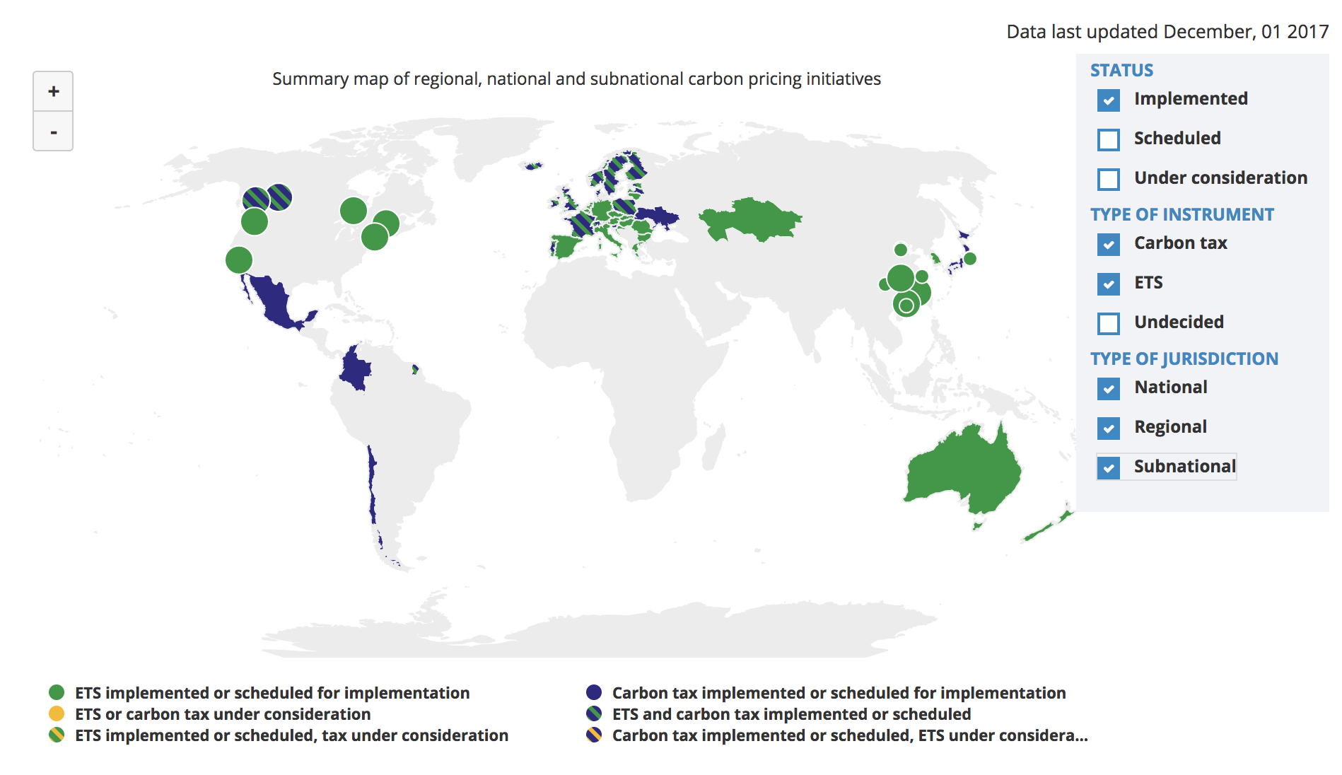
Carbon Policies Across the World
ETS = Emissions Trading System = Cap and Trade
Source: World Bank Carbon - Pricing Dashboard

Slide 37
Cap and Trade
Notes:
Does NEED want transition (section-starter) slides to maybe ALL look like this? If not, maybe these slides should be plain text like the rest of them?

Slide 38
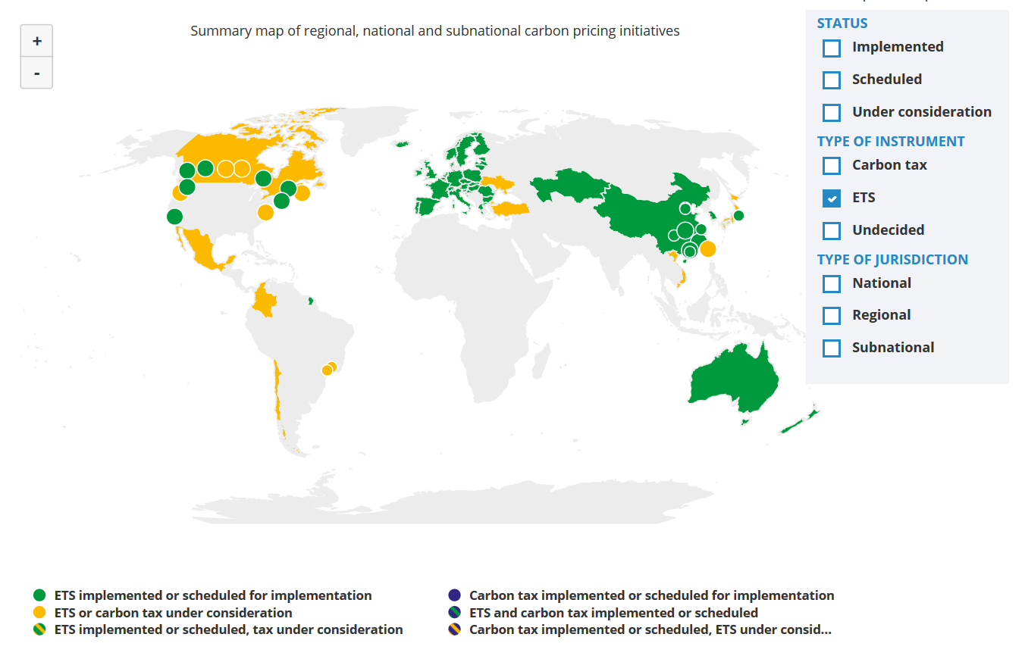
Cap and Trade Policies Around the World
ETS = Emissions Trading System = Cap and Trade
Source: World Bank - Carbon Pricing Dashboard

Slide 39

California’s Cap and Trade System: 2012+
0.7%
of global greenhouse gas emissions

Slide 40
California’s System Is Flexible
California’s goals:
  Reduce emissions to 1990 levels by 2020
  An 80% reduction in emissions from 1990 levels by 2030
California’s Tools:
  Cap and Trade
  Renewable Portfolio Standard
  Clean Cars Program
  Low Carbon Fuel Standard

Slide 41
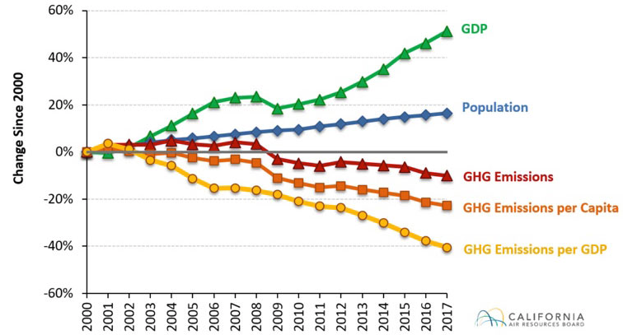
Change in California GDP, Population, and
GHG Emissions since 2000
Cap & Trade ->
Notes:
This would be nice animated.
Source: https://www.arb.ca.gov/newsrel/newsrelease.php?id=933

Slide 42
Summary
Climate change is real, is caused by human actions, and has impacts we’re already feeling.
We need to reduce emissions to balance the costs of action against the costs of inaction.
Scientists and the IPCC recommend that we work to keep warming below 1.5 degrees celcius.
  Economists believe that this goal is well worth the costs!

Slide 43
Summary – continued
There are many ways to reduce emissions.
Economics-inspired policies can help us do this at the lowest cost.
Taxes and cap and trade are proven effective tools to fight climate change!
Other tools may also be necessary.

Slide 44
Thank you!
Any Questions?
www.NEEDelegation.org
<presenter name>
<presenter email>
Contact NEED: Info@NEEDelegation.org
Submit a testimonial: www.NEEDelegation.org/testimonials.php

Slide 45
Available NEED Topics Include:
Coronavirus Economics
US Economy
Climate Change
Economic Inequality
Economic Mobility
US Social Policy
Autonomous Vehicles
Trade and Globalization
Trade Wars
Immigration Economics
Housing Policy
Federal Budgets
Federal Debt
2017 Tax Law

