Slide 1




Climate Change Economics
Sarah E. West, Ph.D.
Macalester College
680 CIX
August 18, 2021

Slide 2
National Economic Education Delegation
Vision
  One day, the public discussion of policy issues will be grounded in an accurate perception of the underlying economic principles and data.
Mission
  NEED unites the skills and knowledge of a vast network of professional economists to promote understanding of the economics of policy issues in the United States.
NEED Presentations
  Are nonpartisan and intended to reflect the consensus of the economics profession.

Slide 3
Who Are We?
Honorary Board: 53 members
  2 Fed Chairs: Janet Yellen, Ben Bernanke
  6 Chairs Council of Economic Advisers
    Furman (D), Rosen (R), Bernanke (R), Yellen (D), Tyson (D), Goolsbee (D)
  3 Nobel Prize Winners
    Akerlof, Smith, Maskin
Delegates: 585+ members
  At all levels of academia and some in government service
  All have a Ph.D. in economics
  Crowdsource slide decks
  Give presentations
Global Partners: 45 Ph.D. Economists
  Aid in slide deck development

Slide 4
Credits and Disclaimer
This slide deck was authored by:
  Shana Mcdermott, Trinity University
  Sarah Jacobson, Williams College
  Sharon Shewmake, Western Washington University
This slide deck was reviewed by:
  Jason Shogren, University of Wyoming
  Walter Thurman, North Carolina State University
Disclaimer
  NEED presentations are designed to be nonpartisan.
  It is, however, inevitable that the presenter will be asked for and will provide their own views.
  Such views are those of the presenter and not necessarily those of the National Economic Education Delegation (NEED).

Slide 5
Outline
Climate change science
Impacts of climate change
Economics of responding to climate change
Addressing the sources of our emissions
Climate change policy
Policy in action

Slide 6
How Can Economists Contribute to
Thinking about Climate Change?
By assessing behavioral reactions to climate change.
By measuring the damage and estimating the economic costs of fighting climate change.
By designing smart policies that minimize costs.
  Balance economic growth with GHG emission mitigation.

Slide 7
Climate Change Science

Slide 8
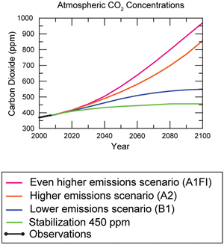
Atmospheric CO₂ Concentrations
Projections →
Source: IPCC data distribution center and climate.gov

Slide 9
The Atmospheric Greenhouse Effect
Sun
Atmosphere
Light reflected back
onto earth
Light reflected back
into space

Slide 10




Uncertainty
?
?
?

Slide 11
How Much Pollution Does Society Want?
Analogy: How Many Oranges Does Society Want?
People grow and sell oranges for a price that at least covers costs (supply).
People will not pay more for them than what they consider to be their value (demand).
Prices let supply and demand balance out. The price settles where:
This is the “right” number of oranges for society.
Prices reflect scarcity and the social value of the resource.
# of oranges people want to sell = # of oranges people want to buy
Notes:
Simple Supply and demand game.
Ask who likes oranges and then ask how much a few students would pay for an orange right now.
If I supply them for some price in the middle – who gets them?
Not everybody who wants an orange.
- This also illustrates how value gets created with trade

Slide 12
Electricity Is Different From Oranges
Many sources of electricity generate pollution.
Pollution is an EXTERNALITY:
  a side effect (cost or benefit) that affects someone
  else when something is bought or sold.
  This is a market failure.
The price of electricity does not reflect all of the costs.
  Electricity is too cheap.
  There is too much pollution.

Slide 13
Impacts of Climate Change

Slide 14
How These Impacts Affect Humans
Agriculture
Fisheries
Coastal damages
Direct health effects, including sickness and death (temperature & drought; also pollution)
Indirect health effects (vector-borne disease)
Reduced fresh water availability
Wildfires
Shifting zones for important ecosystems, and desertification
Reduced worker productivity
Increased violence
Some of these may cause human migration and/or conflict
Notes:
This could be a series of slides with pictures for each one

Slide 15
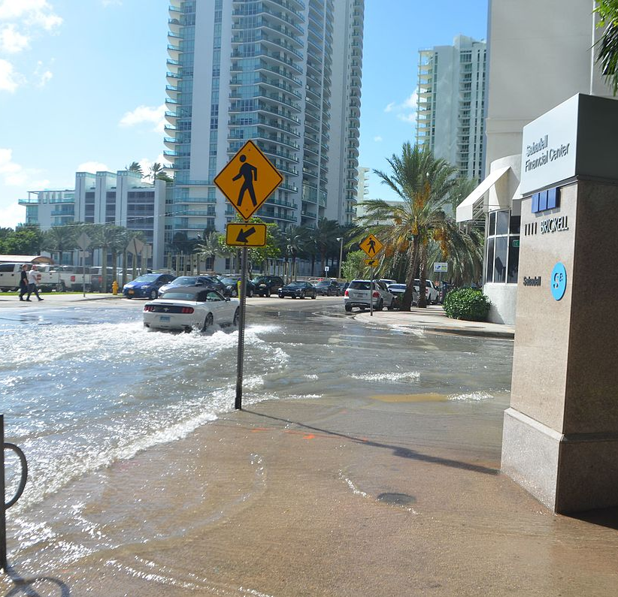
Real Estate Markets
Sea level rise
Wildfire risk
Extreme weather events
  Hurricanes
  Extreme rainfall
  Drought
Water supplies, electricity reliability
Residential markets affected
Turnover leading indicator
This Photo by Unknown Author is licensed under CC BY-SA
Notes:
Add pictures or replace words with pictures

Slide 16
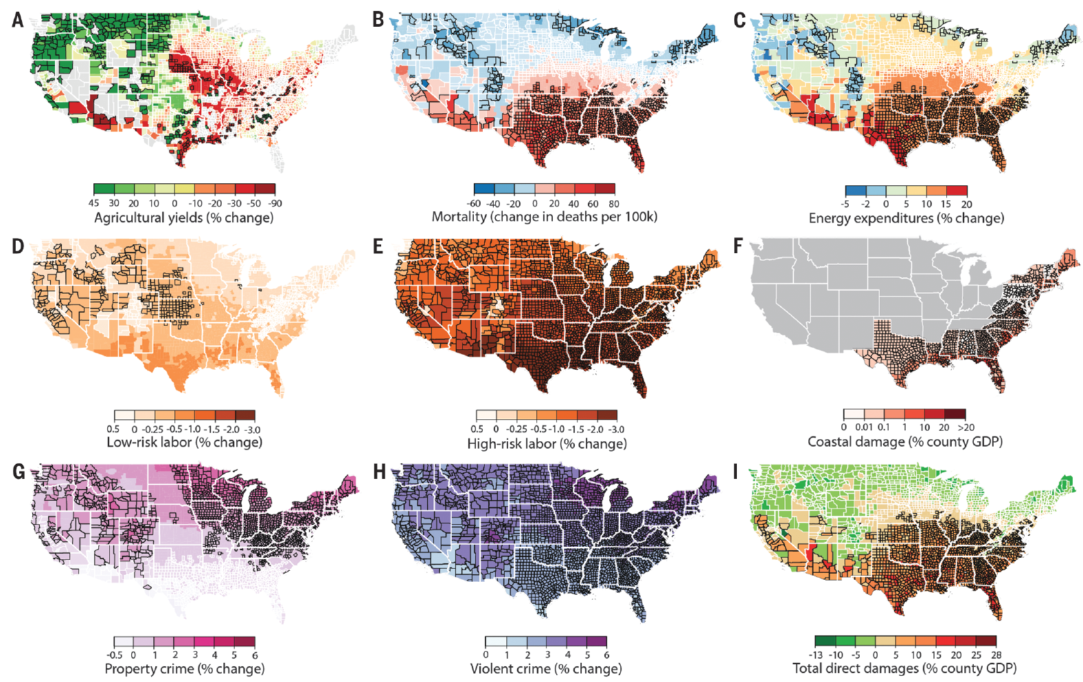
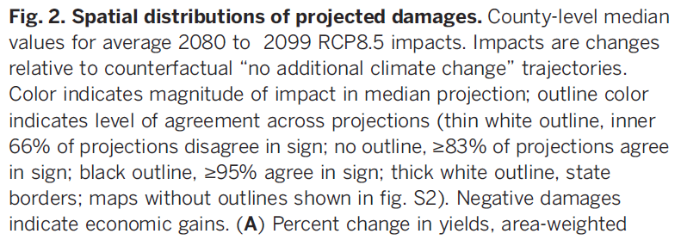
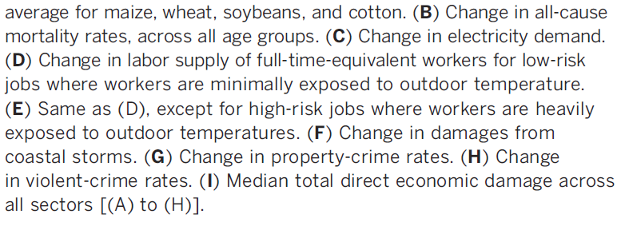
Projected Effects Vary Across the U.S. but Are Estimated at 1.2% of GDP per 1C Increase

Slide 17
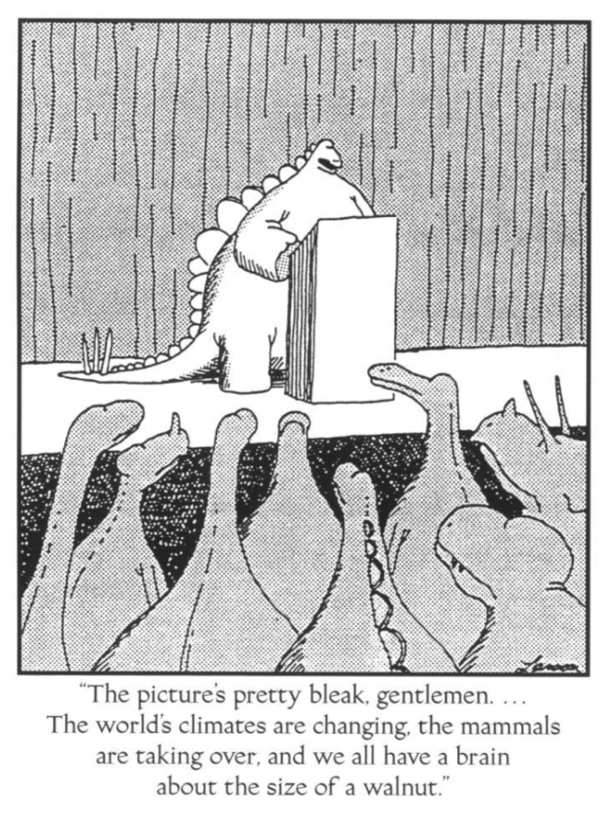

Slide 18
Economics of Responding to Climate Change

Slide 19
International Climate Policy Goals
Intergovernmental Panel on Climate Change (IPCC)
  Global effort to fight climate change
  Reports on consensus of climate science, including economics
IPCC report in 2018:
  Temperature has already increased by 1.0 degrees C - Recommended: < 1.5 C
2016 Paris Agreement:
  Reach goal of 1.5 degrees C: requires 70-95% GHG reduction 2010 → 2050

Slide 20
How Economists Decide How Much to Fight
Climate Change
Cost Benefit Analysis
Expected costs of reducing emissions
Weigh:
Expected damages from allowing climate change

Slide 21
Economic Growth and Climate Change Action
Are Compatible
Abating greenhouse gas emissions is costly…
… but climate change damages are even more costly.
Economic growth comes with consequences that we have to deal with, including climate consequences.
Economies with environmental regulations can still be dynamic.
Goal: design policies that reach climate goals at the least possible cost.

Slide 22
Addressing the Sources of Our Emissions

Slide 23
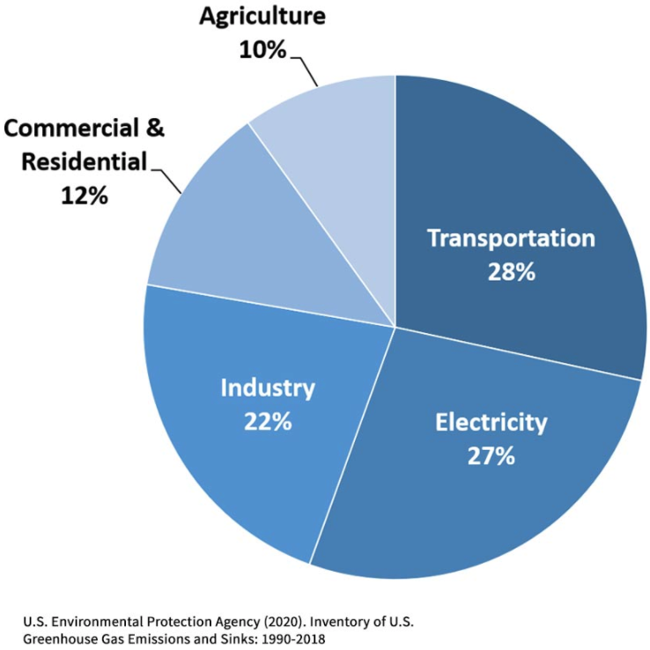
Total U.S. Greenhouse Gas Emissions by
Economic Sector in 2018
Notes:
https://www.epa.gov/ghgemissions/sources-greenhouse-gas-emissions

Slide 24
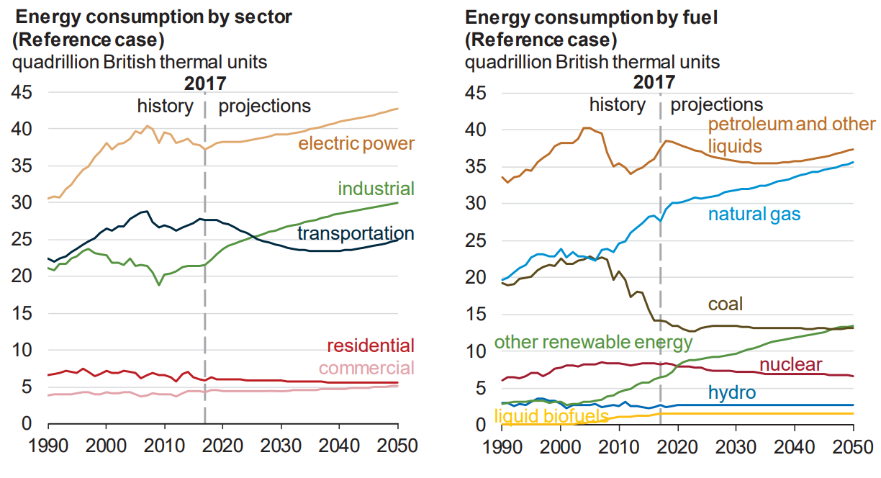
Fossil Fuels Dominate U.S. Energy Production
Notes:
US Energy Information Agency Annual Energy Outlook 2018

Slide 25
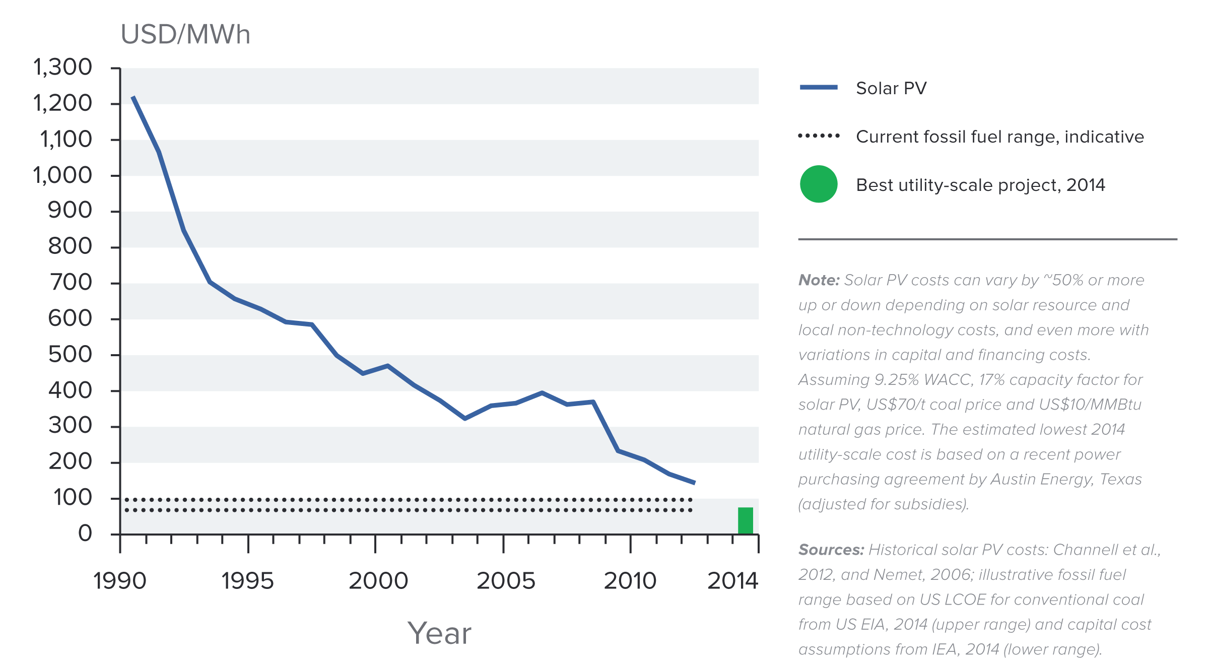
Indicative Solar Costs Over Time
Notes:
Source: New Climate Economy Report

Slide 26
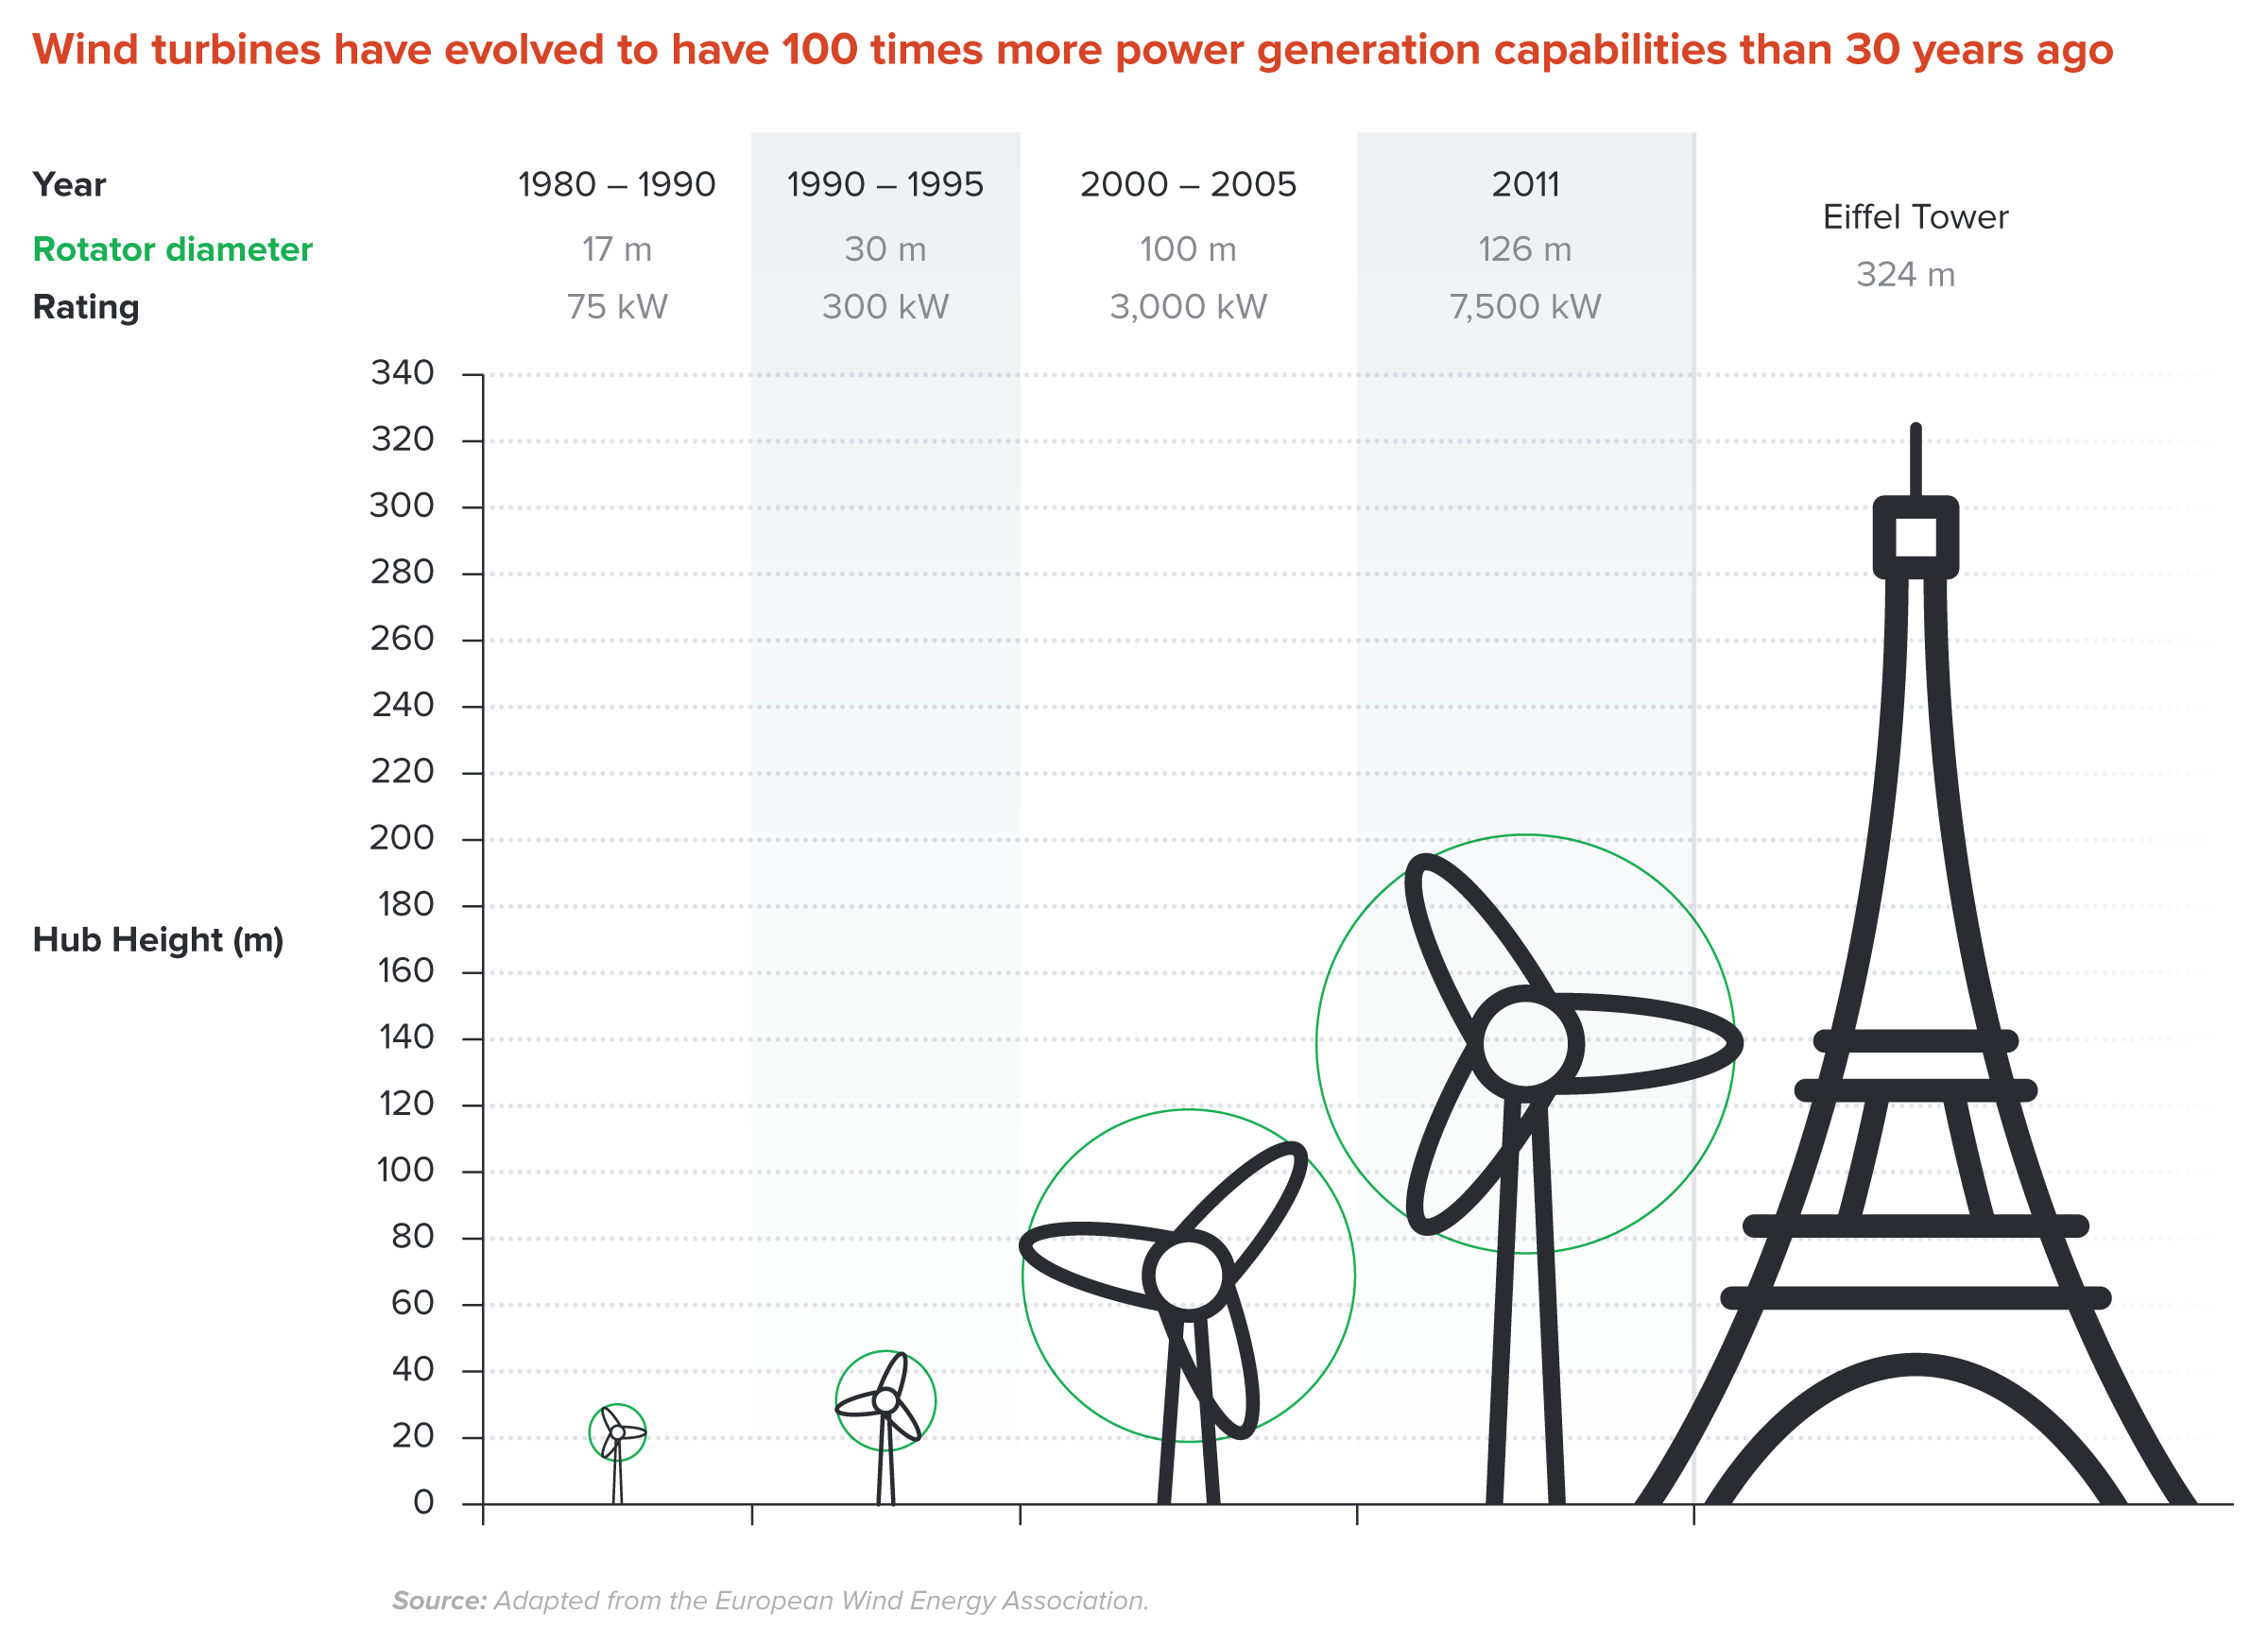
Wind Turbines Have 100 Times More Power
Generation Capabilities Than 30 Years Ago
Notes:
Source: New Climate Economy Report

Slide 27
Climate Change Policy

Slide 28
Policies That Reduce Emissions: Directly
Regulation
  Emissions standards or limits
    E.g., CAFE standards
Market-oriented policies
  Putting a price on emissions
    Subsidizing green energy (e.g., feed-in tariffs)
    Tax or cap & trade
Notes:
These are the favored policies. Address a problem head on and let the market deal with it.

Slide 29
Thoughts on Regulation vs Market-Oriented
Equity.
  Both types of policies are regressive.
    Cap and Trade and a Carbon Tax can offset the regressivity.
    Regulations do not.
Efficiency.
  Market-oriented policies tend to achieve emissions reduction at much lower cost.
    Example: CAFÉ Standards vs Carbon Tax
      Tax is significantly more efficient.
      Why?

Slide 30
Climate Change Policy in Action

Slide 31

California’s Cap and Trade System: 2012+
0.7%
of global greenhouse gas emissions

Slide 32
California’s System Is Flexible
California’s goals:
  Reduce emissions to 1990 levels by 2020
  An 80% reduction in emissions from 1990 levels by 2030
California’s Tools:
  Cap and Trade
  Renewable Portfolio Standard
  Clean Cars Program
  Low Carbon Fuel Standard

Slide 33
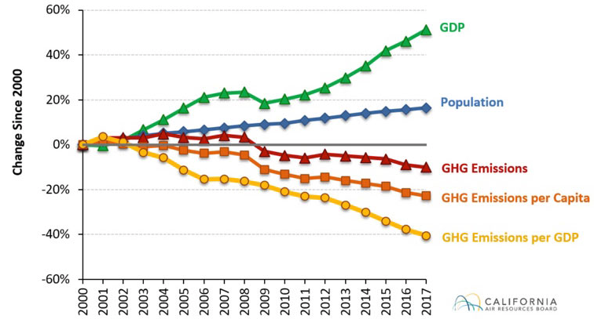
Change in California GDP, Population, and
GHG Emissions since 2000
Cap & Trade ->
Notes:
This would be nice animated.
Source: https://www.arb.ca.gov/newsrel/newsrelease.php?id=933

Slide 34
Summary
Climate change is real, is caused by human actions, and has impacts we’re already feeling.
We need to reduce emissions to balance the costs of action against the costs of inaction.
Scientists and the IPCC recommend that we work to keep warming below 1.5 degrees celsius.
  Economists believe that this goal is well worth the costs!

Slide 35
Summary – continued
There are many ways to reduce emissions.
Economics-inspired policies can help us do this at the lowest cost.
Taxes and cap and trade are proven effective tools to fight climate change!
Other tools may also be necessary.

Slide 36
Thank you!
Any Questions?
www.NEEDelegation.org
Sarah E. West
wests@macalester.edu
Contact NEED: Info@NEEDelegation.org
Submit a testimonial: www.NEEDelegation.org/testimonials.php

