Slide 1




Climate Change Economics
Bevin Ashenmiller, Ph.D.
Occidental College
Grass Valley Rotary Club
April 12, 2021

Slide 2
National Economic Education Delegation
Vision
  One day, the public discussion of policy issues will be grounded in an accurate perception of the underlying economic principles and data.
Mission
  NEED unites the skills and knowledge of a vast network of professional economists to promote understanding of the economics of policy issues in the United States.
NEED Presentations
  Are nonpartisan and intended to reflect the consensus of the economics profession.

Slide 3
Who Are We?
Honorary Board: 48 members
  2 Fed Chairs: Janet Yellen, Ben Bernanke
  6 Chairs Council of Economic Advisers
    Furman (D), Rosen (R), Bernanke (R), Yellen (D), Tyson (D), Goolsbee (D)
  3 Nobel Prize Winners
    Akerlof, Smith, Maskin
Delegates: 500+ members
  At all levels of academia and some in government service
  All have a Ph.D. in economics
  Crowdsource slide decks
  Give presentations
Global Partners: 45 Ph.D. Economists
  Aid in slide deck development

Slide 4
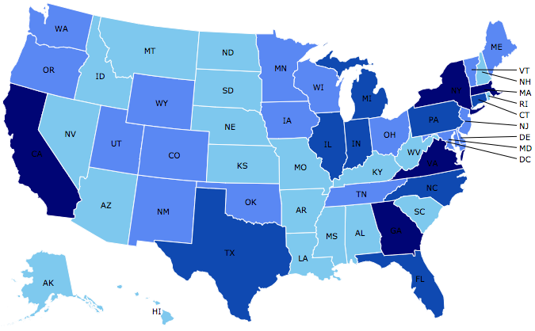
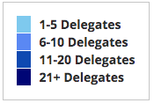
Where Are We?

Slide 5
Credits and Disclaimer
This slide deck was authored by:
  Shana Mcdermott, Trinity University
  Sarah Jacobson, Williams College
  Sharon Shewmake, Western Washington University
This slide deck was reviewed by:
  Jason Shogren, University of Wyoming
  Walter Thurman, North Carolina State University
Disclaimer
  NEED presentations are designed to be nonpartisan.
  It is, however, inevitable that the presenter will be asked for and will provide their own views.
  Such views are those of the presenter and not necessarily those of the National Economic Education Delegation (NEED).

Slide 6
Outline
Climate change science
Impacts of climate change
Economics of responding to climate change
Addressing the sources of our emissions
Climate change policy
Policy in action

Slide 7
What is Economics?
Economics breaks down into two basic fields: Microeconomics and Macroeconomics.
Microeconomists…“who are wrong about specific things.”
and Macroeconomists…“who are wrong about things in general”.
Yoram Bauman, PhD
Mankiw’s 10 Principles of Economics Translated
Notes:
To explain Environmental Economics I have to explain a little bit of economics.

Slide 8
But First: What Is Economics?
Economics is about making choices under scarcity.
  Individuals and firms
How do goods and services get allocated among entities in society?
How is value created by trade?
How do “market failures” restrict that value creation?

Slide 9
The First Theorem of Welfare Economics
…is that private markets are perfectly efficient on their own, with no interference from government, provided certain conditions are met.
What is the profit of buyers?
What is the profit of sellers?
Economic Efficiency: When the sum of the profits of buyers and the profit of sellers is maximized.
*You can’t make anyone better off without making someone worse off.
Notes:
So you go into the Green Bean to get a cup of coffee. Your profits are what you are willing to pay for the coffee minus what you actually have to pay. The Green Bean’s profits are what they sell you the cup of coffee for minus what is cost them to make it. Economics Efficiency is when the total is at a maximum. We don’t care about whose profits are bigger or distribution.

Slide 10
What are “certain conditions”?
No public goods No information problems
No externalities No transaction costs
No taxes No common property
No monopoly buyers or sellers
No increasing returns to scale
No other ‘distortions’ between the costs paid by buyers and the benefits received by sellers.
Environmental Economists are microeconomists
who believe that markets sometimes fail.
Notes:
So I am not going to go through all of these – but suffice it to say that there are a lot of conditions under which markets fail. And in the field of environmental economics it is a rare thing to find a market that doesn’t have at least one of these problems.

Slide 11
Characteristics of Goods
Excludable: Goods that you can exclude people from using.
Rival: One person’s use of the good diminishes other’s ability to use the good.
Public Goods (Not Rival or Excludable): Benefits additional users at no cost to society.
Common Resources (Rival, but not Excludable): Common property, or open access resources, where anyone can extract or harvest the resource freely and no one recognizes the full cost of using the resource.
Notes:
PG: We share the level of the public good and additional consumers do not use up the good. But you can not prevent someone from using it. Lighthouse.
Externalities: Pollution
CR: Fisheries

Slide 12
Characteristics of Goods & Environmental Economics
Externalities: some costs or benefits of producing, consuming, or disposing of a good or service are external to the market.
Missing Markets Problem: some goods (or inputs) into production are not sold on a market. Firms and individuals then sometimes value the good at what they pay for it, $0, instead of what it is worth.
Notes:
PG: We share the level of the public good and additional consumers do not use up the good. But you can not prevent someone from using it. Lighthouse.
Externalities: Pollution
CR: Fisheries

Slide 13
Economics Informs Almost Everything
Prices
Incentives
Externalities
Cost-Benefit Analysis
Growth
Inflation
Interest Rates
Climate Change
International Trade
Immigration
Housing
Education
Health Care
Gun Control

Slide 14
How Can Economists Contribute to
Thinking about Climate Change?
By assessing behavioral reactions to climate change.
By measuring the damage and estimating the economic costs of fighting climate change.
By designing smart policies that minimize costs.
  Balance economic growth with GHG emission mitigation.

Slide 15
Climate Change Science

Slide 16
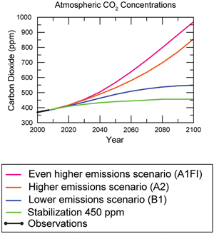
Atmospheric CO₂ Concentrations
Projections →
Source: IPCC data distribution center and climate.gov

Slide 17
The Atmospheric Greenhouse Effect
Sun
Atmosphere
Light reflected back
onto earth
Light reflected back
into space

Slide 18




Uncertainty
?
?
?

Slide 19


Annual Snowfall
Mid-Century
Business As Usual
52”
Wrightwood
22”
Lake Arrowhead
53”
Idyllwild
Source: Berg N, A Hall, F Sun, SC Capps, D Walton, B Langenbrunner, and D Neelin, 2014: 21st-century precipitation changes over the Los Angeles region.
Journal of Climate, submitted
Slide credit: Alex Hall, UCLA, 2013
Notes:
Here are examples at key locations important ecologically and economically.

Slide 20


Very Hot Days Per Year
Santa
Clarita
Porter
Ranch
San Fernando
Sunland
Pasadena
Woodland
Hills
Studio City
El Sereno
Hollywood
Westwood
Downtown LA
Santa Monica
Baldwin Hills
Venice
100 days >
Watts
2041–2060
Business As Usual
Long Beach
Santa Ana
60 days >
1981–2000
Slide credit: Alex Hall, UCLA, 2013
Notes:
Coastal areas like Santa Monica and Long Beach are likely to warm an average of 3 or 4 degrees, with other areas experiencing more warming. The study predicts a likely tripling in the number of extremely hot days in the downtown area and quadrupling in the valleys and a high elevations. This change will mean that adaptation is necessary.

Slide 21
How Much Pollution Does Society Want?
Analogy: How Many Oranges Does Society Want?
People grow and sell oranges for a price that at least covers costs (supply).
People will not pay more for them than what they consider to be their value (demand).
Prices let supply and demand balance out. The price settles where:
This is the “right” number of oranges for society.
Prices reflect scarcity and the social value of the resource.
# of oranges people want to sell = # of oranges people want to buy
Notes:
Simple Supply and demand game.
Ask who likes oranges and then ask how much a few students would pay for an orange right now.
If I supply them for some price in the middle – who gets them?
Not everybody who wants an orange.
- This also illustrates how value gets created with trade

Slide 22
Electricity Is Different From Oranges
Many sources of electricity generate pollution.
Pollution is an EXTERNALITY:
  a side effect (cost or benefit) that affects someone
  else when something is bought or sold.
  This is a market failure.
The price of electricity does not reflect all of the costs.
  Electricity is too cheap.
  There is too much pollution.

Slide 23

Social Cost of Carbon
Cost above price paid.
The expected cost of damages from each unit of greenhouse gas emissions.
Current EPA estimate: ~$40 per metric ton of CO₂.
  About $123/car per year.
  $26 Billion for all vehicles in the US.
Social cost of carbon will increase over time.
Notes:
18.07 lbs/mile
2204.62 lbs/metric ton
1.8 cents/mile

Slide 24
Examples of Externalities
Negative Externalities:
  Heating your house
  Smoking
  Getting a dog
  Pig farming
Positive Externalities
  Education
  Growing apples
  Getting a vaccination
  Basic scientific research

Slide 25
Addressing a Negative Externality
Set thermostat to:
68 degrees
$.14/Kwh
Social cost = $.02/Kwh
$.16/Kwh
Set thermostat to:
65 degrees
The social cost of $.02/Kwh has been INTERNALIZED.

Slide 26
Impacts of Climate Change

Slide 27
Global Warming Indicators

Slide 28
How These Impacts Affect Humans
Agriculture
Fisheries
Coastal damages
Direct health effects, including sickness and death (temperature & drought; also pollution)
Indirect health effects (vector-borne disease)
Reduced fresh water availability
Wildfires
Shifting zones for important ecosystems, and desertification
Reduced worker productivity
Increased violence
Some of these may cause human migration and/or conflict
Notes:
This could be a series of slides with pictures for each one

Slide 29
Adaptation Reduces Damages
Human adaptations are costly actions that can reduce damages from climate change.
The net cost to society is the cost of adaptation plus the cost of the remaining damages.
People will take some actions on their own, up to the point where they find it worthwhile.
Some responses require government involvement: large-scale actions or actions with shared benefits.
Adaptation is already underway.

Slide 30

Individual-Level Adaptation Examples
Do you behave differently on a hot day?
  Staying inside more.
  Turn on the air conditioning.
  Plant at different times.
  Plant new crops.
  Think about moving.
Notes:
Could be one or several slides with images to represent

Slide 31
Public Adaptation
Governments can help:
  When collective action is less costly than everyone acting alone.
  When individual action is not possible or likely.
  When some people can’t protect themselves.
Sea walls
Ecosystems that provide protection
Supporting low-income and vulnerable populations
Moving residents of a town
Notes:
Could be one or several slides with images to represent

Slide 32
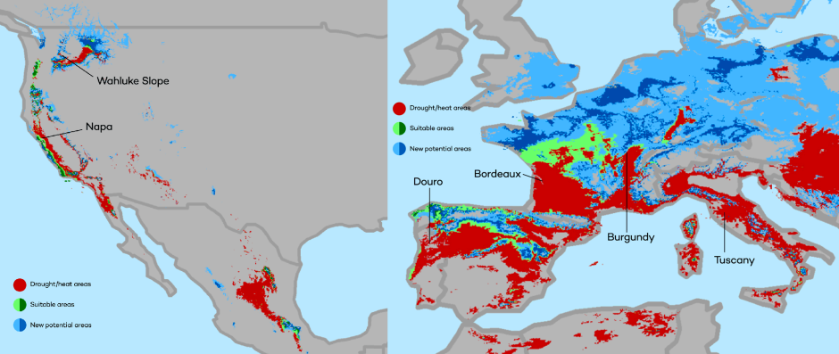
Market Based Adaptation
Prices and costs influence behavior.
  Where to live.
  Where/when/what to plant.
Avoid barriers to market adjustment.
  Trade barriers, immigration restrictions, federal flood insurance, agricultural subsidies, and zoning regulations.
The changing map of the world’s wine-growing regions.

Slide 33

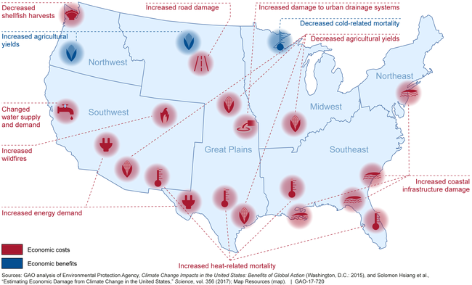
Most Vulnerable People and Places
Tropical areas
Low-lying coastal areas
Low-income people
Notes:
Add pictures or replace words with pictures

Slide 34
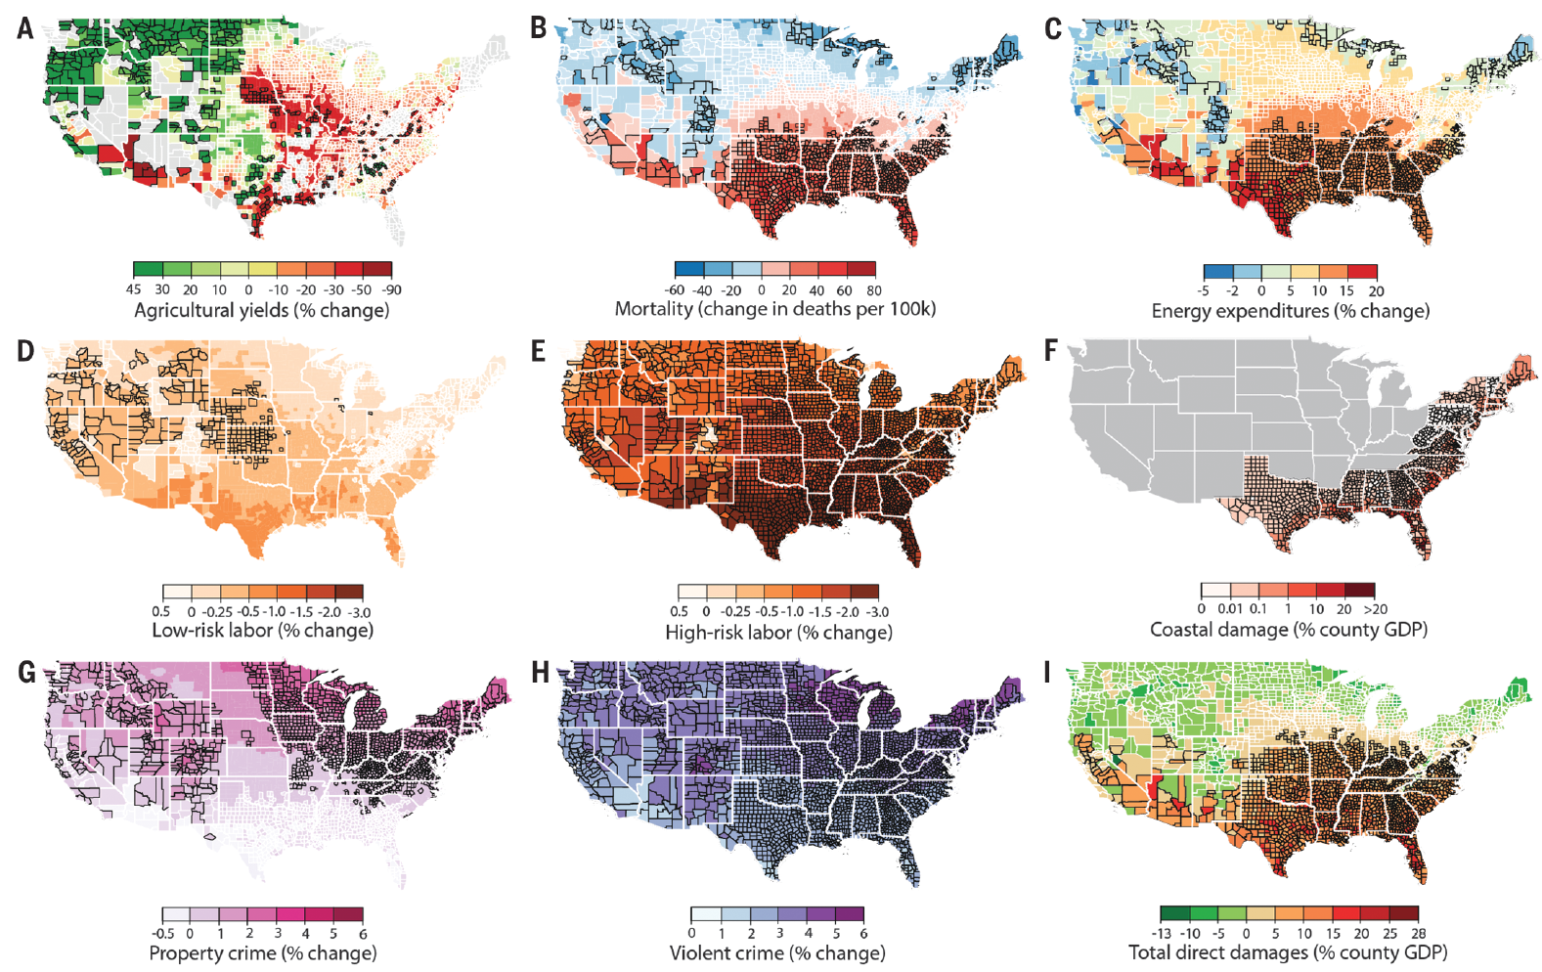
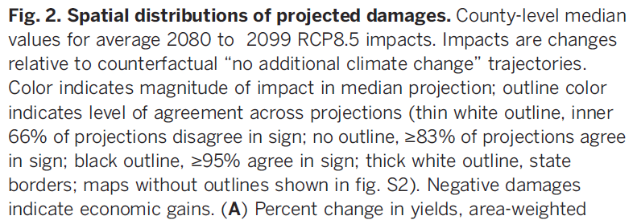
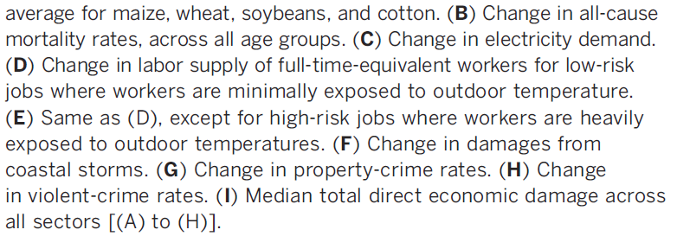
Projected Effects Vary Across the U.S. but Are Estimated at 1.2% of GDP per 1C Increase

Slide 35
Use Evidence to Drive Change
1) What is the Market Failure associated with School Greening? Positive Externalities and Public Goods
2) Goods with positive externalities are underprovided by the market.
3) School Greening Benefits Include
Improving children’s social, physical and educational well-being.
Actively managing storm water.
As components of urban ecological infrastructure: mitigating urban heat island effects and climate change, while increasing renewable energy production, wildlife habitat provision, and related ecosystem services.

Slide 36

INEQUITY
CWH
Rodriguez vs LAUSD
Image: Council for Watershed Health
Notes:
There are 509 elementary schools and over 1000 total schools in the Los Angeles Unified School District. The Council for Watershed Health studied all 509 elementary schools and found that those in predominantly black or brown neighborhoods had less tree canopy and landscape area than elementary schools in predominantly white neighborhoods.

Slide 37
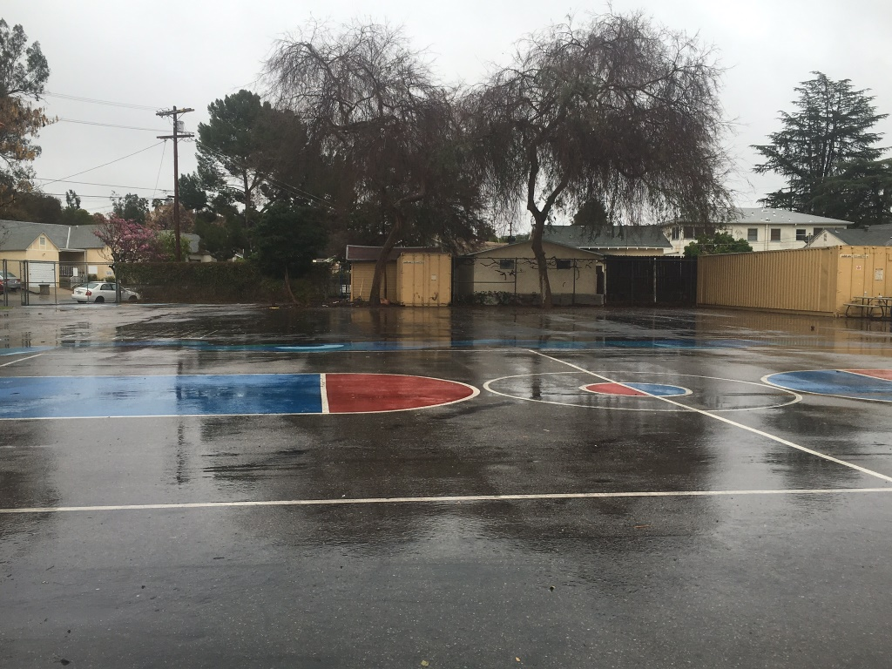
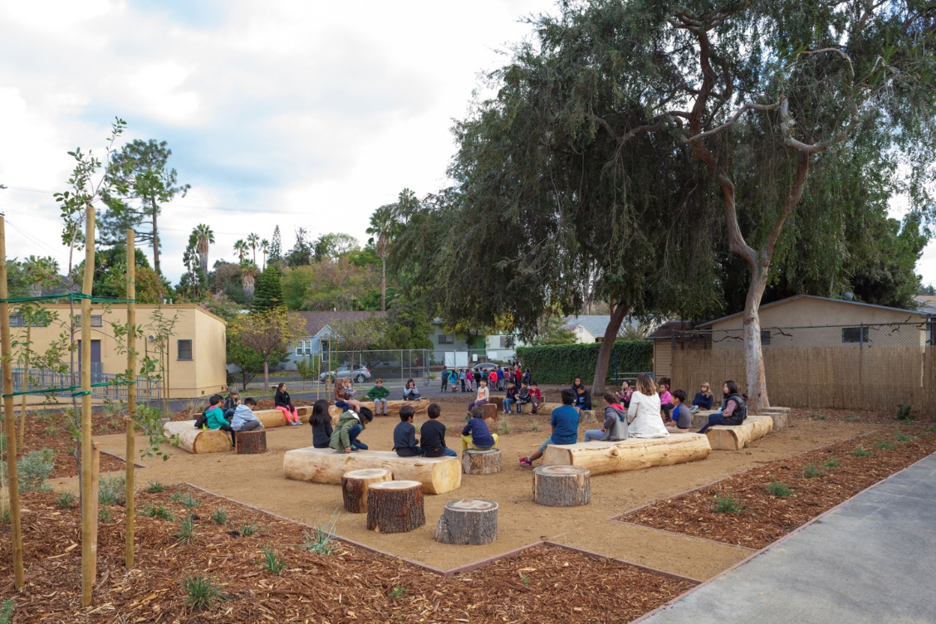
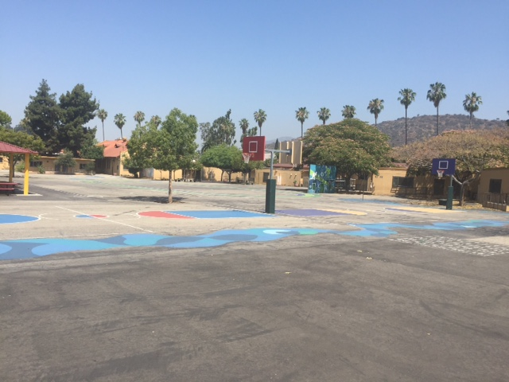


Slide 38
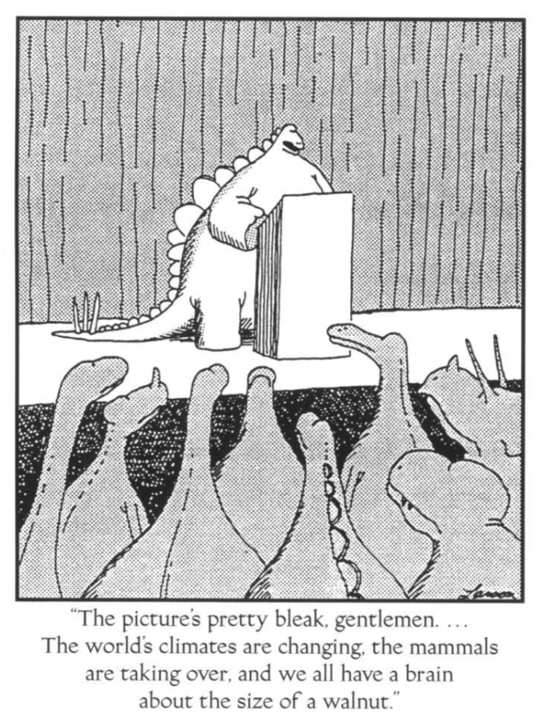

Slide 39
Economics of Responding to Climate Change

Slide 40
International Climate Policy Goals
Intergovernmental Panel on Climate Change (IPCC)
  Global effort to fight climate change
  Reports on consensus of climate science, including economics
IPCC report in 2007:
  Recommended goal: < 2 degrees C (3.6 degrees F)
  Industrialized countries should reduce GHG emissions between 25% and 40% below 1990 levels by 2020.
2016 Paris Agreement:
  Basic goal of 2 degrees C: requires 40-70% GHG reduction 2010 → 2050
  Reach goal of 1.5 degrees C: requires 70-95% GHG reduction 2010 → 2050
IPCC report in 2018:
  Temperature has already increased by 1.0 degrees C - Recommended: < 1.5 C

Slide 41
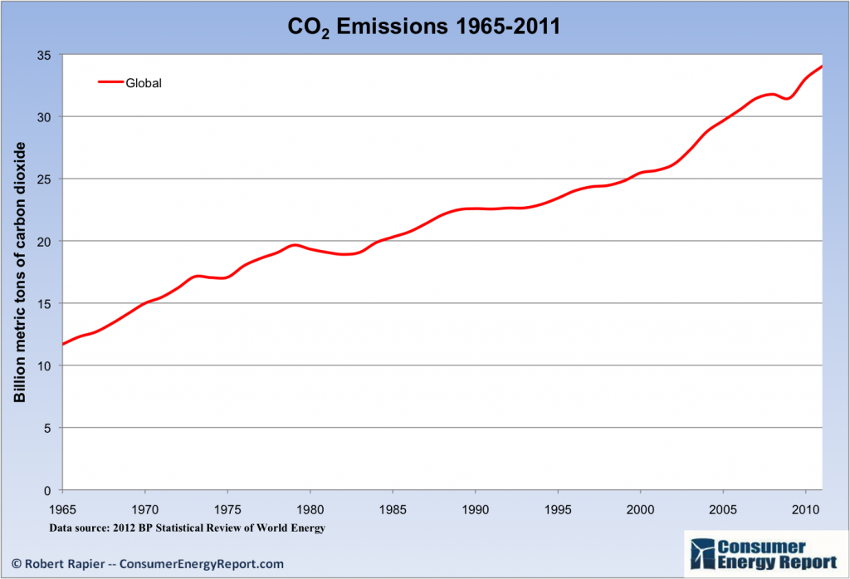
Recent Progress on Climate Goals
IPCC’s Fifth Assessment Report (2014)
  Goals from previous report (2007) were met!
  … but mainly because of the Great Recession…
  … which is not the preferred method of reducing emissions.
Notes:
Could use this graph of emissions over time or energy use over time, as it clearly shows a dip where the recession is; from the US Energy Information Administration International Energy Outlook

Slide 42
How Economists Decide How Much to Fight
Climate Change
Cost Benefit Analysis
Expected costs of reducing emissions
Weigh:
Expected damages from allowing climate change

Slide 43
Cost-Benefit Analysis of Fighting Climate
Change
Most economic models suggest the costs of keeping warming below 2°C are relatively small.
  Costs amount to 1-4% of GDP by 2030.
Costs of acting to keep warming below 2°C are almost certainly less than future economic damages they would avoid.
  Damages estimated to be between: 7 - 20% of worldwide GDP.
Caveats:
  Putting a monetary value on priceless things
  Inequality
  Uncertainty and risk

Slide 44
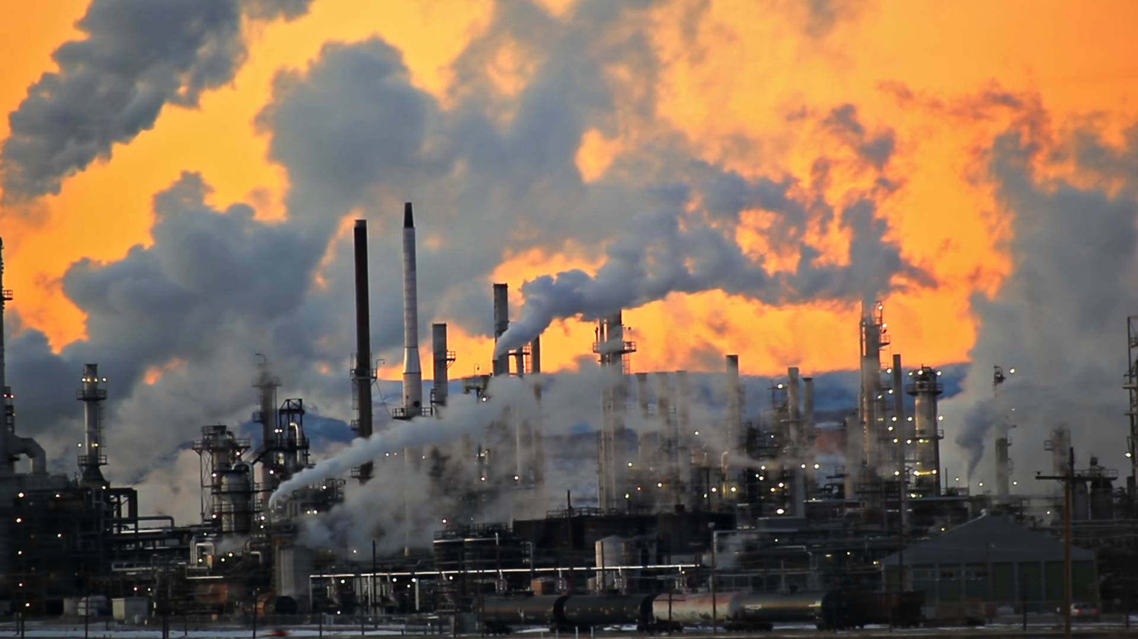
Present Value of a Future $100 Cost or Benefit
“
It is better to be roughly right
than precisely wrong.
- John Maynard Keynes
“

Slide 45
This is What Precisely Wrong Looks Like
The changing map of the world’s wine-growing regions.

Slide 46
Economic Growth and Climate Change Action
Are Compatible
Abating greenhouse gas emissions is costly…
… but climate change damages are even more costly.
Economic growth comes with consequences that we have to deal with, including climate consequences.
Economies with environmental regulations can still be dynamic.
Goal: design policies that reach climate goals at the least possible cost.

Slide 47
Addressing the Sources of Our Emissions

Slide 48
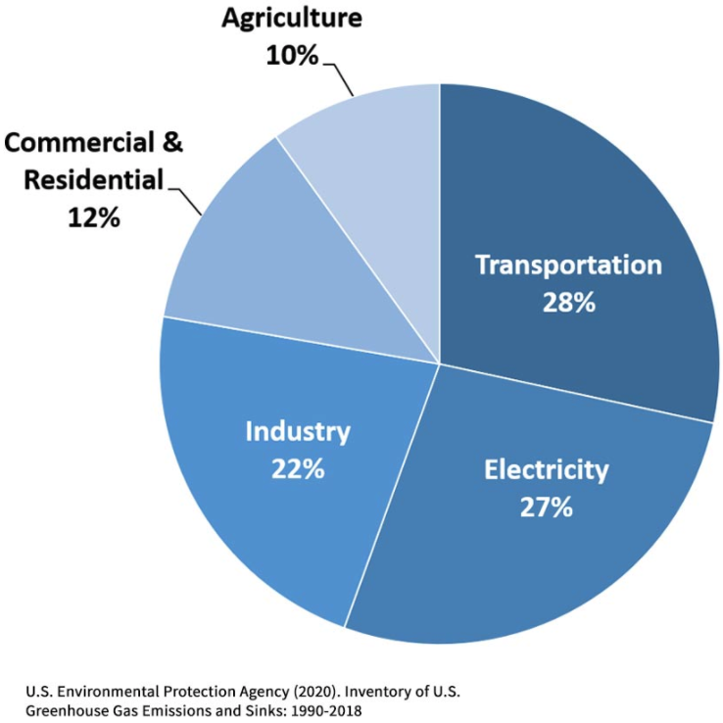
Total U.S. Greenhouse Gas Emissions by
Economic Sector in 2018
Notes:
https://www.epa.gov/ghgemissions/sources-greenhouse-gas-emissions

Slide 49
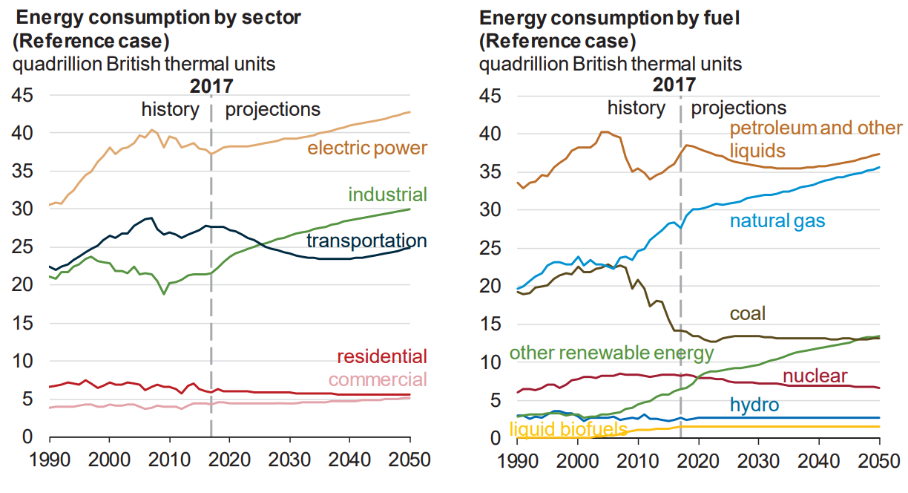
Fossil Fuels Dominate U.S. Energy Production
Notes:
US Energy Information Agency Annual Energy Outlook 2018

Slide 50
Global GHG Abatement Cost Curve
Lighting
Appliances
Hybrid cars
Solar?
Wind?
Notes:
McKinsey report

Slide 51
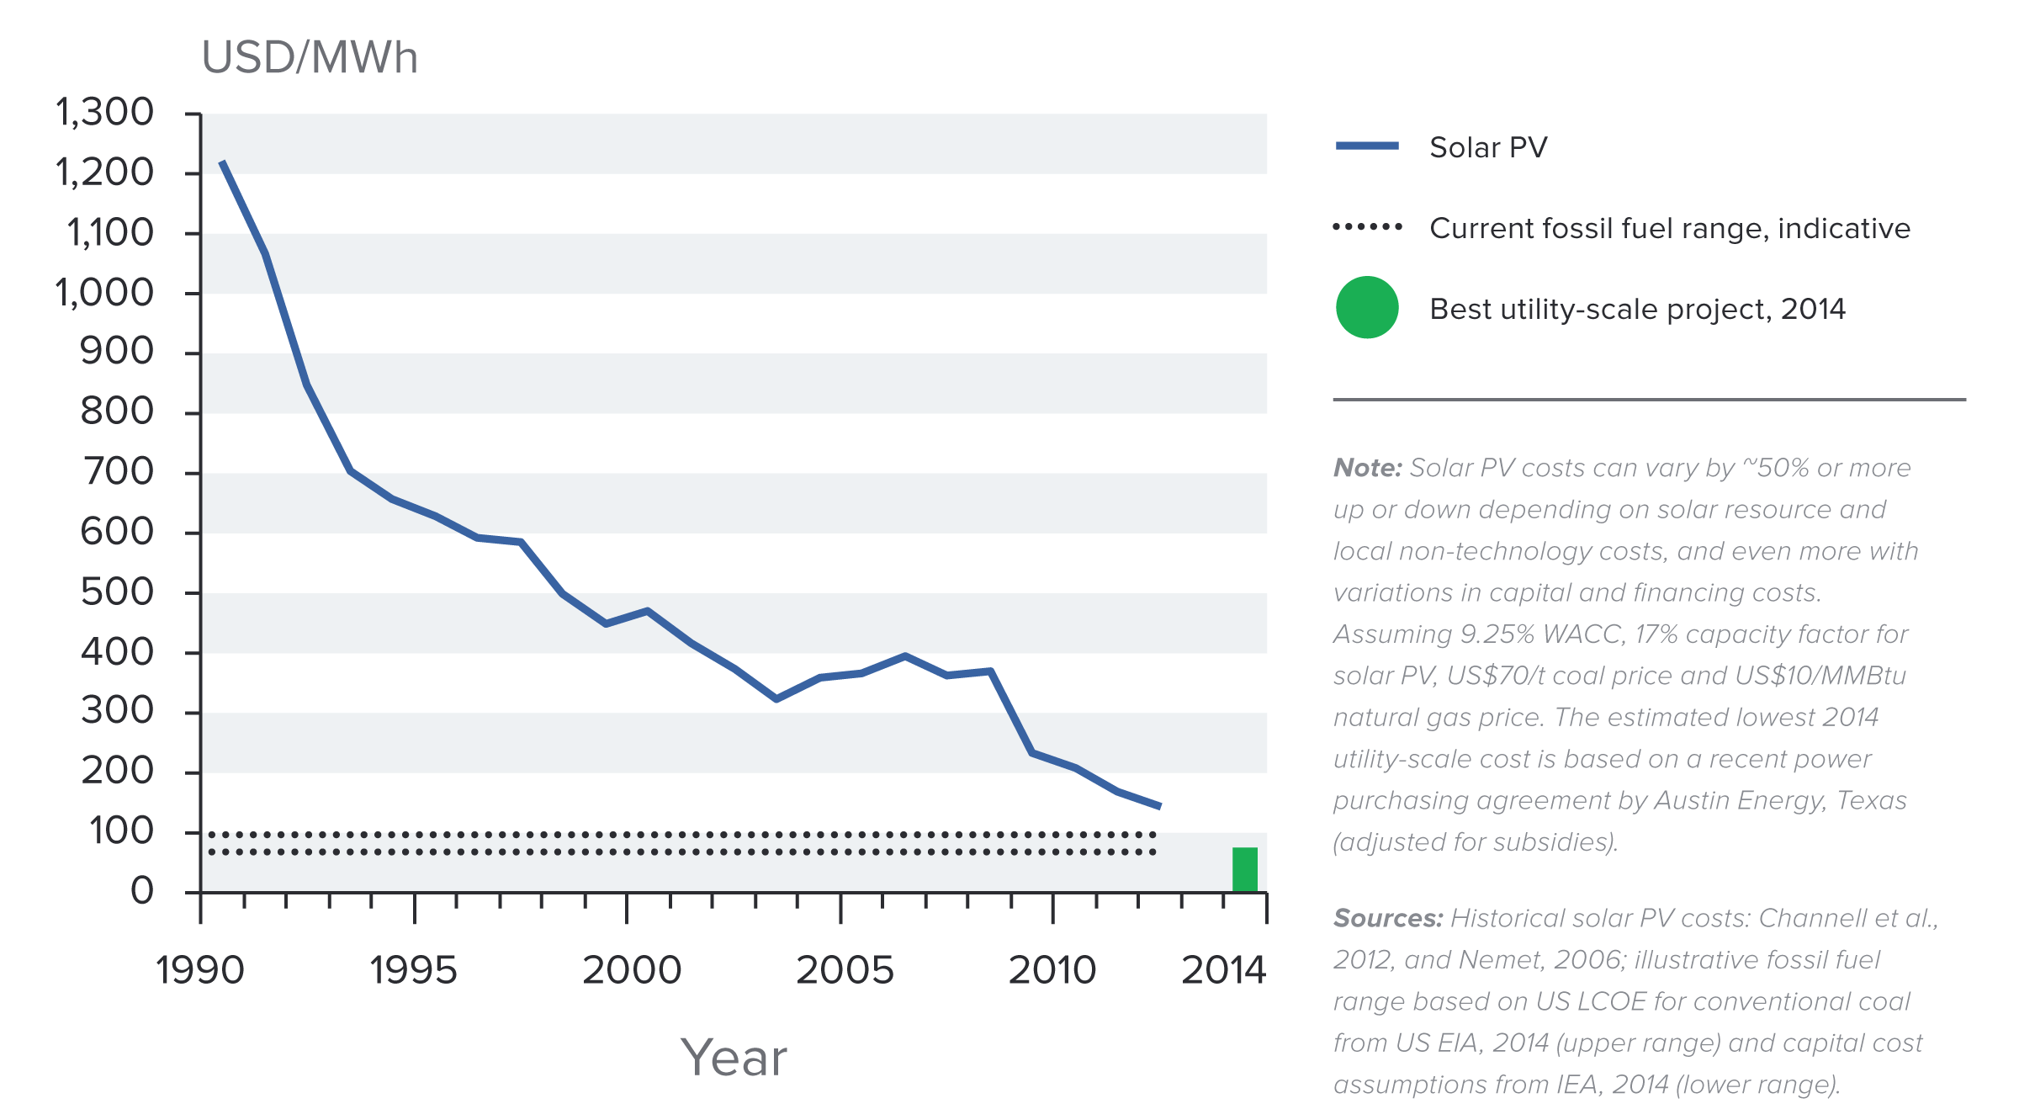
Indicative Solar Costs Over Time
Notes:
Source: New Climate Economy Report

Slide 52
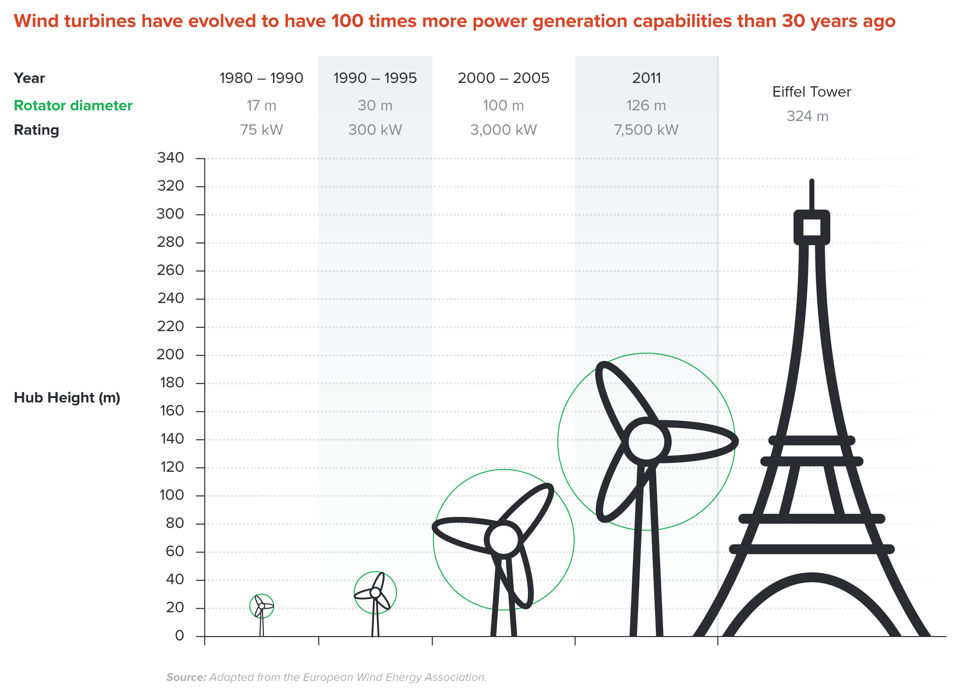
Wind Turbines Have 100 Times More Power
Generation Capabilities Than 30 Years Ago
Notes:
Source: New Climate Economy Report

Slide 53


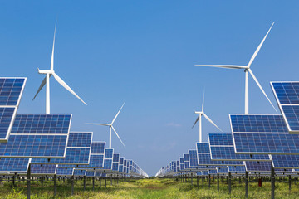
Challenges with Renewable Energy
It’s intermittent - only produced if there is sun or wind.
Energy is needed all day and night, with peak times.
Limited w/o storage.
  Creative storage options are under development.

Slide 54
Infrastructure and Climate Change
$90 trillion in investment will be needed for U.S. infrastructure, 2015-2030.
Add $4 trillion (< 5%) to make it low-carbon infrastructure.
  This would also reduce climate damage to infrastructure.
  Railway, urban transport, renewables.
The electrical grid is particularly troublesome.
  It is outdated and not suited for renewable energy storage.
  Those with solar panels use the grid but contribute little to its upkeep.
Notes:
Sources for these
Some examples of low-carbon infrastructure are:
Railway infrastructure, which can reduce the number of carbon-emitting trucks
Urban transport projects, such as Metros and Light Rail projects which reduce car usage- one of the more notable sources of carbon emissions
Renewable energy projects (solar, wind, and hydropower), which have much lower carbon emissions compared to fossil fuels

Slide 55
Climate Change Policy

Slide 56
Policies That Reduce Emissions: Directly
Regulation
  Emissions standards or limits
    E.g., CAFE standards
Market-oriented policies
  Putting a price on emissions
    Subsidizing green energy (e.g., feed-in tariffs)
    Tax or cap & trade
Notes:
These are the favored policies. Address a problem head on and let the market deal with it.

Slide 57
How Does Cap and Trade Work?
Activities to be covered are determined.
Acceptable emissions levels are indicated.
“Permits” that allow acceptable emissions levels are issued.
  How?
    According to historical emissions?
    Evenly across emitters?
    Sold at some price?
A “market” is developed.
Those desiring to emit will have to buy sufficient permits to accommodate their emissions.
Those wishing to abate will offer their permits on the “market”.
  The price of a permit indicates:
    The benefit of eliminating further emissions.
    The cost of emitting.
Gov’t agency determines equality of permits in possession and emissions.

Slide 58
How Does a Carbon Tax Work?
Activities to be covered are determined.
The price of emissions is determined.
  Presumably some relation to the social cost of polluting.
Emissions are measured.
Taxes are determined.
Q: What to do with the tax revenue?

Slide 59
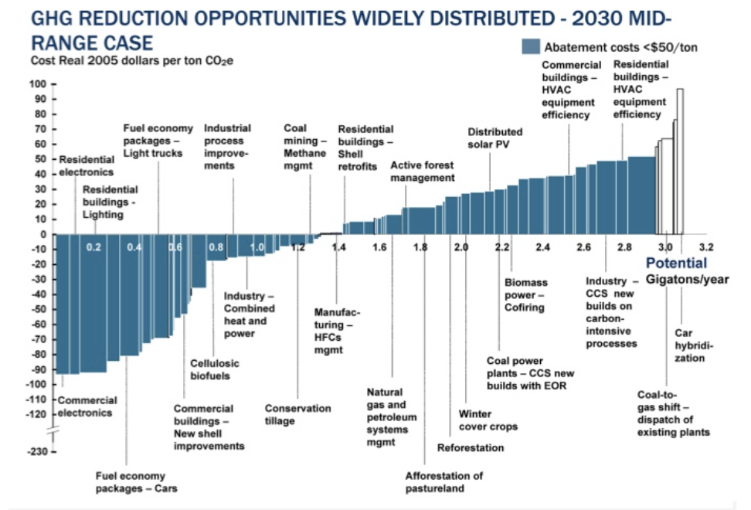
Putting a Price on Carbon
Suppose a Social Cost
Of Carbon of $50
Notes:
Shana: perhaps another infographic is beneficial here. Reintroduce the original cost graph. Fade out the costs and leave the MAC. Then introduce a price. If it’s cheaper to abate, then firms will do that, otherwise they will buy a permit or pay the tax. I know this is super simplified. I introduce specifics at the start of the emissions trading section and the tax section below.

Slide 60
Putting a Price on Carbon
TAX
=
Permit Price =
Carbon Price
MAC
Abate
Buy permit
or pay tax
CAP
Notes:
Shana: perhaps another infographic is beneficial here. Reintroduce the original cost graph. Fade out the costs and leave the MAC. Then introduce a price. If it’s cheaper to abate, then firms will do that, otherwise they will buy a permit or pay the tax. I know this is super simplified. I introduce specifics at the start of the emissions trading section and the tax section below.

Slide 61

Carbon Prices: the Good and Bad
Good:
  Provide price signal to lower emissions.
  They yield low-cost reductions in emissions.
  They spur innovation in clean technologies.
Bad:
  Firms might leave to flee regulation.
  It is necessary to monitor emissions.
  Potentially regressive
    Costs may weigh more heavily on low-income households.

Slide 62
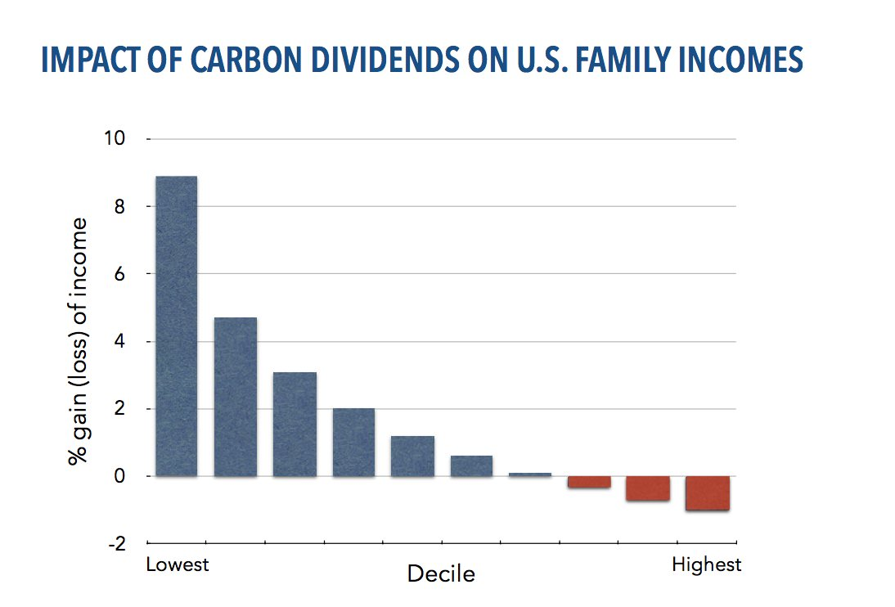
Revenue Dividend Eliminates Regressivity
Source: U.S. Treasury, 2017

Slide 63
Carbon Tax and Cap & Trade: the Differences
 | Carbon Tax | Cap & Trade
Carbon Price | Certain | Uncertain
Emissions | Uncertain | Certain
Ease of Implementation | May be easier to implement
Additional concerns | Always generates revenue May require legislation to change | May be more susceptible to lobbying Only generates revenue if government sells permits Cap can be changed by regulator

Slide 64
Carbon Tax and Cap & Trade: the Differences
 | Carbon Tax | Cap & Trade
Carbon Price | Certain | Uncertain
Emissions | Uncertain | Certain
Ease of Implementation | May be easier to implement
Additional concerns | 1) Always generates revenue 2) May require legislation to change 3) Predictability | 1) Susceptible to lobbying. 2) Only generates revenue if government sells permits. 3) Cap can be changed by regulator. 4) Less certainty over future. 5) Regulations reduce efficacy of Cap & Trade

Slide 65
One Other Thing: Cap and Trade vs. Carbon Tax
Emissions regulations and Cap and Trade can work at cross purposes.
  Regulations that lower emissions from big polluters…
    Lower the demand for permits
    Lowers the price of permits
    Reduces incentives for other industries to cut emissions
Regulations can undermine the effectiveness of Cap and Trade.
The same is not true of a carbon tax.
  Though regulations might cut tax revenue, revenue is not the goal of the carbon tax.

Slide 66
Thoughts on Regulation vs Market-Oriented
Equity.
  Both types of policies are regressive.
    Cap and Trade and a Carbon Tax can offset the regressivity.
    Regulations do not.
Efficiency.
  Market-oriented policies tend to achieve emissions reduction at much lower cost.
    Example: CAFÉ Standards vs Carbon Tax
      Tax is significantly more efficient.
      Why?

Slide 67
Efficiency: CAFÉ vs Carbon Tax
CAFÉ = Corporate Average Fuel Efficiency
  A fuel economy standard mandating that an auto‐maker’s vehicle fleet must meet minimum fuel economy standards.
Horse Race
  Tax on fuel applies to ALL vehicles, not just new.
  Rebound Effect:
    Driving a more efficient vehicle lowers the cost per mile driven
      leading to more miles driven.
  Slower turnover of inefficient vehicles: higher cost of new.
Summary
  A given level of emission reductions costs 3-14 times more with CAFÉ standards than under a comparable carbon tax.

Slide 68
Policies That Reduce Emissions: INDirectly
Subsidizing R&D
Grid / infrastructure
Energy efficiency mandates and subsidies
Mandating renewable energy (e.g., renewable portfolio standards)
Land use policies

Slide 69
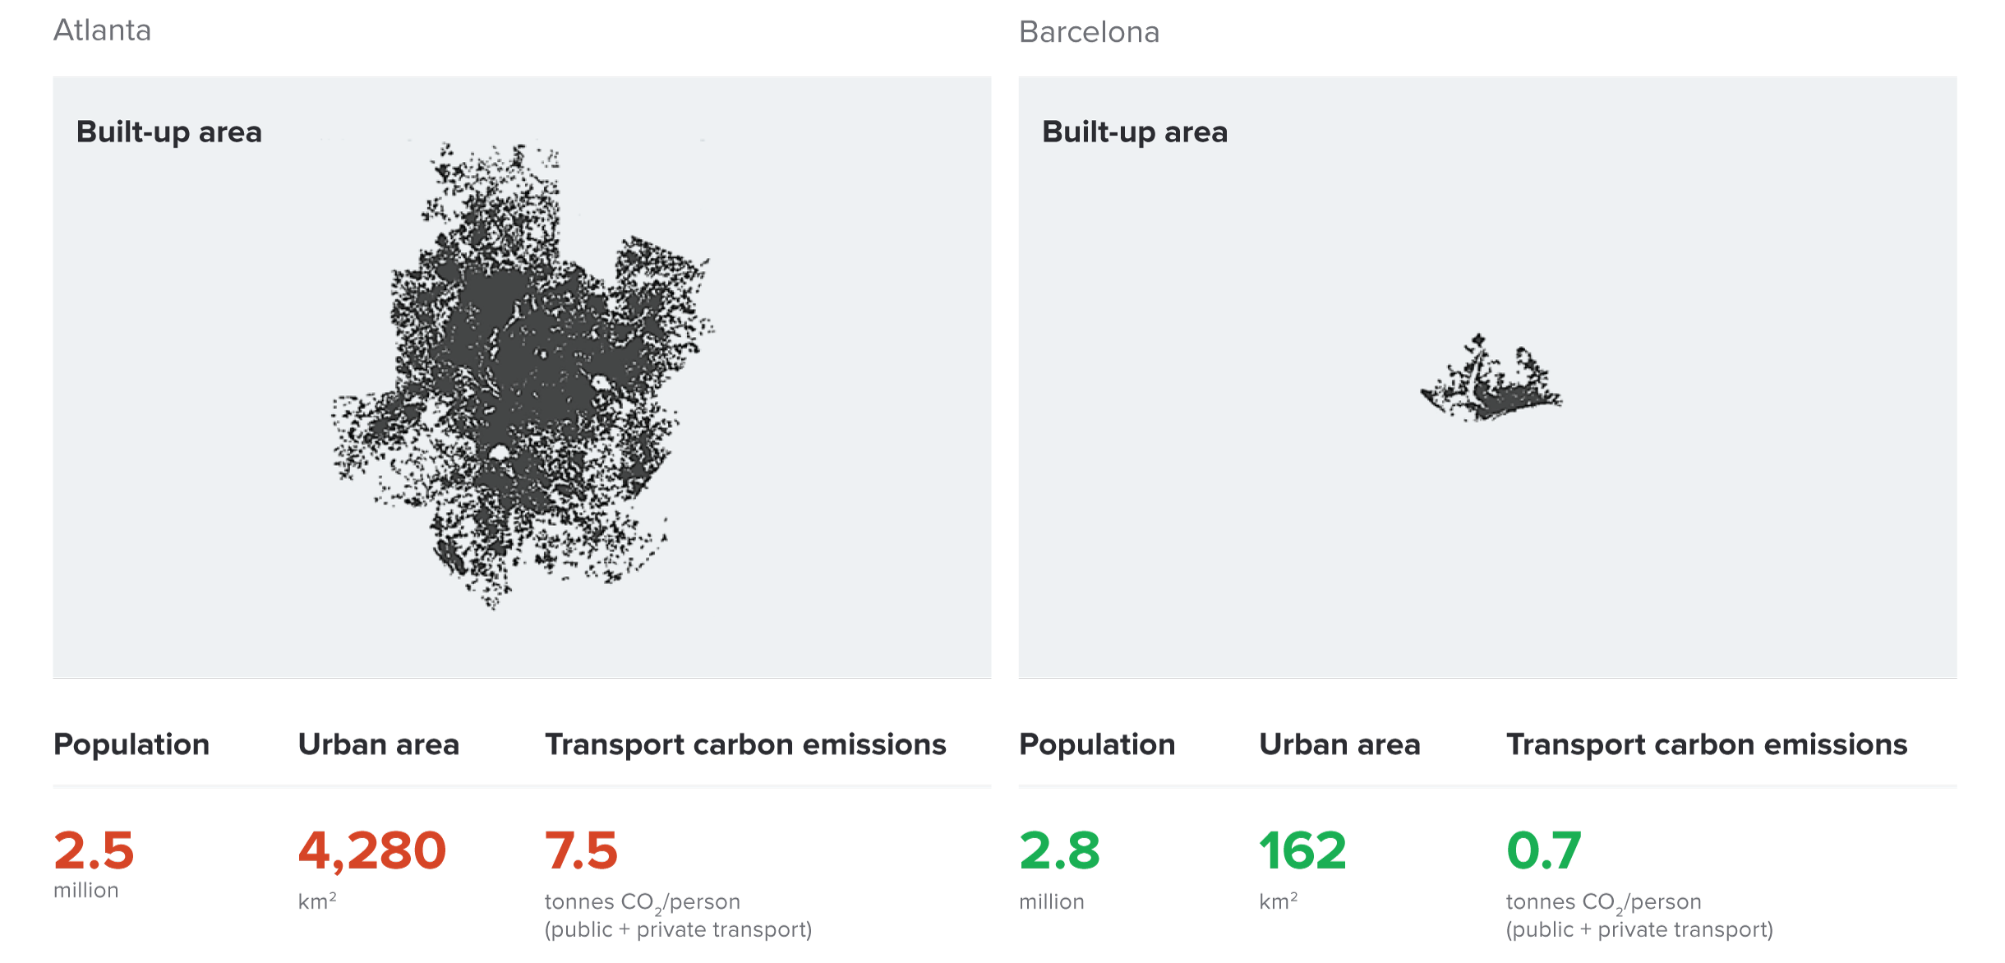
Atlanta and Barcelona Have Similar Populations but Very Different Carbon Productivity
Atlanta
Barcelona
Source: New Climate Economy Report, 2014
Notes:
Source: New Climate Economy Report

Slide 70
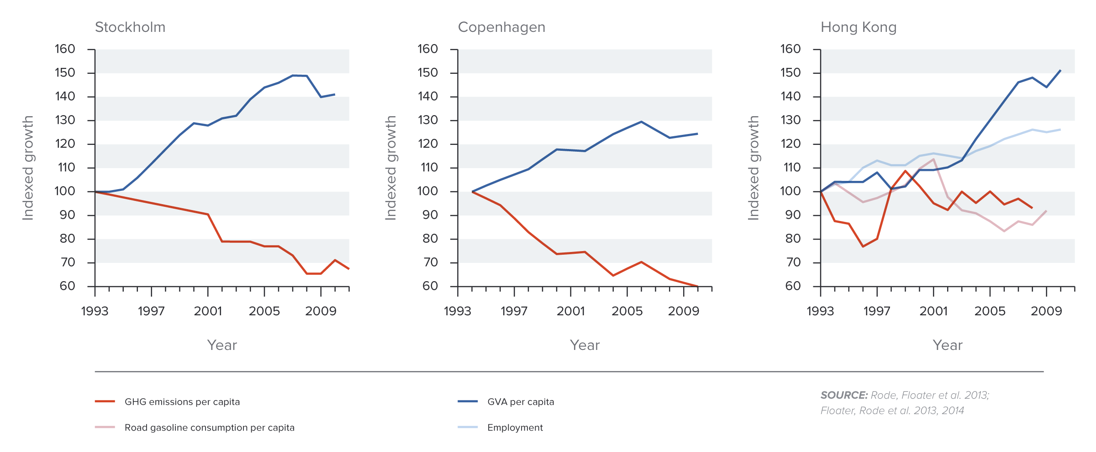
Compact and Connected Urban Pathways Can Go
Hand-in-hand with Economic Growth
Stockholm
Copenhagen
Hong Kong
Notes:
Source: New Climate Economy Report

Slide 71
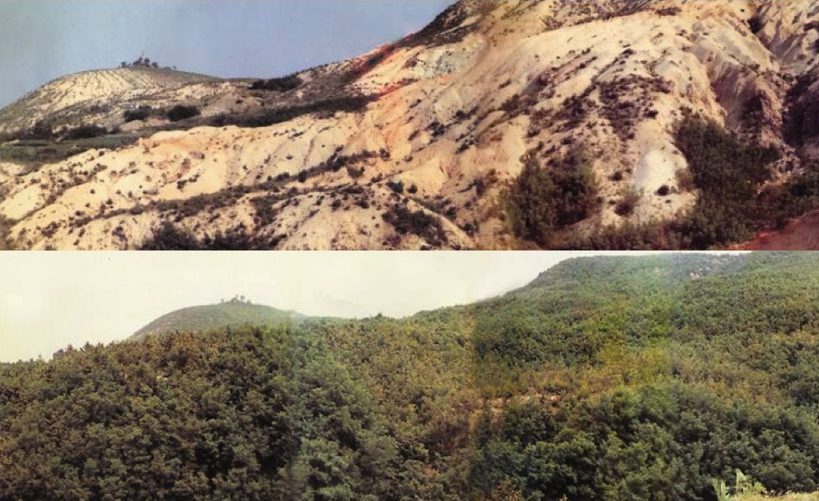
Land Use: Restoration Is Possible
1953
2000
South Korea restored its forest cover from 35% to 64% of the country’s total area
Notes:
Source: New Climate Economy Report

Slide 72
Climate Change Policy in Action

Slide 73
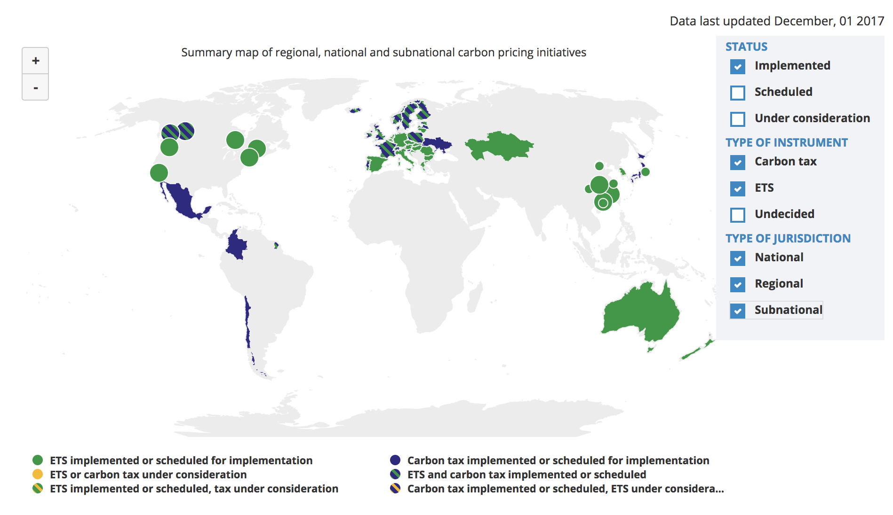
Carbon Policies Across the World
ETS = Emissions Trading System = Cap and Trade
Source: World Bank Carbon - Pricing Dashboard

Slide 74
Cap and Trade
Notes:
Does NEED want transition (section-starter) slides to maybe ALL look like this? If not, maybe these slides should be plain text like the rest of them?

Slide 75
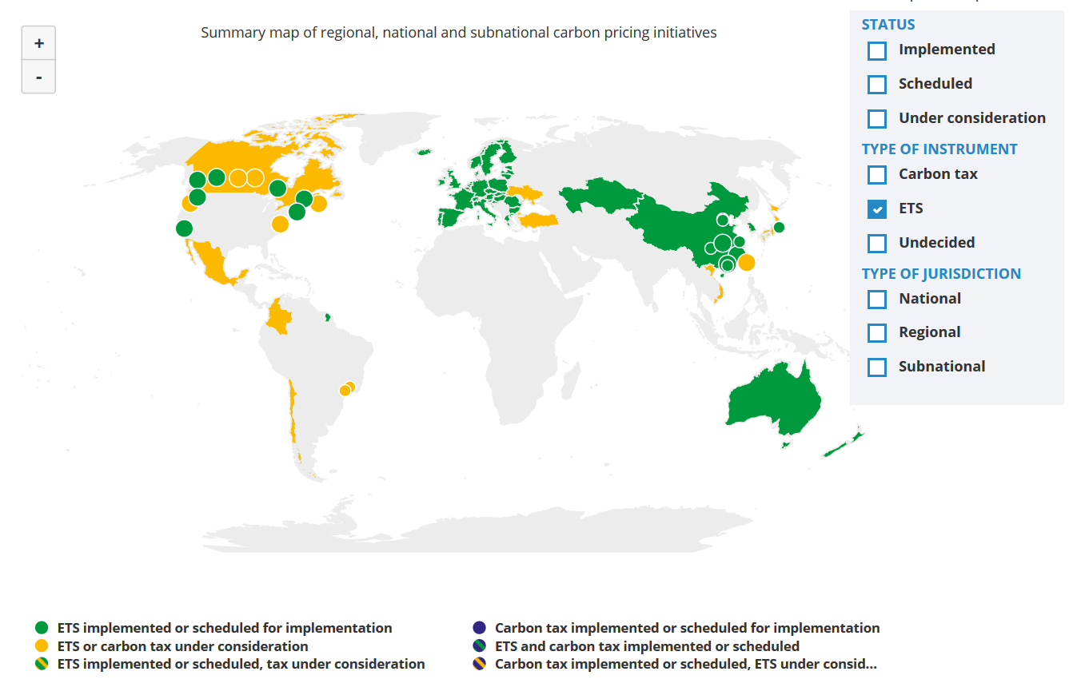
Cap and Trade Policies Around the World
ETS = Emissions Trading System = Cap and Trade
Source: World Bank - Carbon Pricing Dashboard

Slide 76

European Union’s Emissions Trading Scheme
4%
of global greenhouse gas emissions
Circa 2005

Slide 77
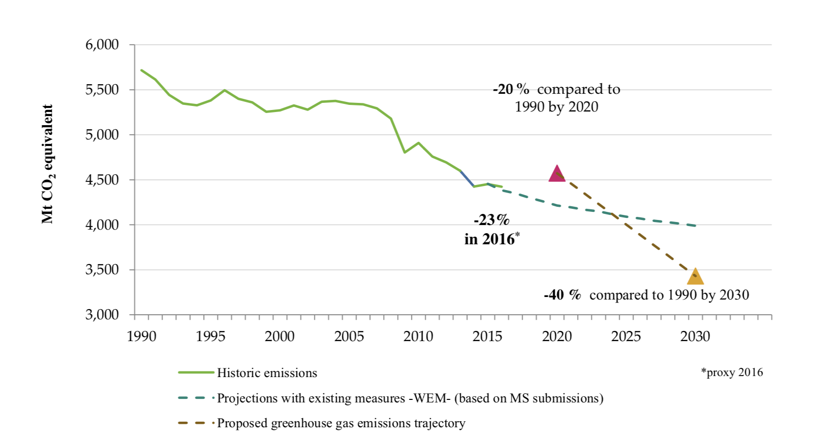
Progress Towards Meeting Europe 2020 And 2030 Targets (EU Total GHG Emissions)
Notes:
Source: “REPORT FROM THE COMMISSION TO THE EUROPEAN PARLIAMENT AND THE COUNCIL Implementing the Paris Agreement - Progress of the EU towards the at least -40% target” https://eur-lex.europa.eu/legal-content/EN/TXT/?uri=COM%3A2016%3A707%3AFIN

Slide 78
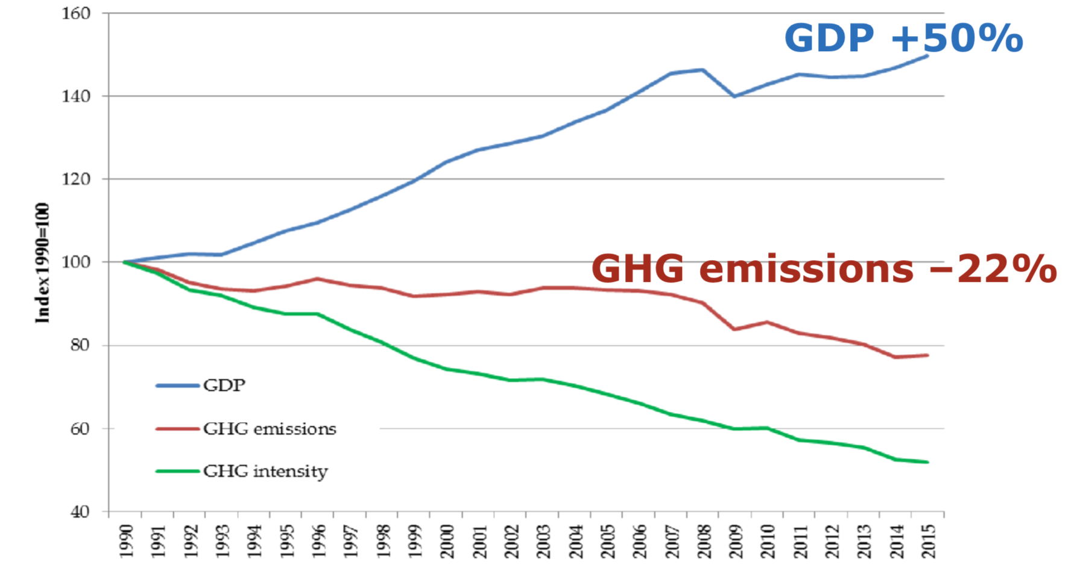
EU Has Decoupled Economic Growth from Greenhouse Gas Emissions
European Commission
Cap & Trade ->
Climate Action
Notes:
Source: “REPORT FROM THE COMMISSION TO THE EUROPEAN PARLIAMENT AND THE COUNCIL Implementing the Paris Agreement - Progress of the EU towards the at least -40% target” https://eur-lex.europa.eu/legal-content/EN/TXT/?uri=COM%3A2016%3A707%3AFIN

Slide 79

California’s Cap and Trade System: 2012+
0.7%
of global greenhouse gas emissions

Slide 80
California’s System Is Flexible
California’s goals:
  Reduce emissions to 1990 levels by 2020
  An 80% reduction in emissions from 1990 levels by 2030
California’s Tools:
  Cap and Trade
  Renewable Portfolio Standard
  Clean Cars Program
  Low Carbon Fuel Standard

Slide 81
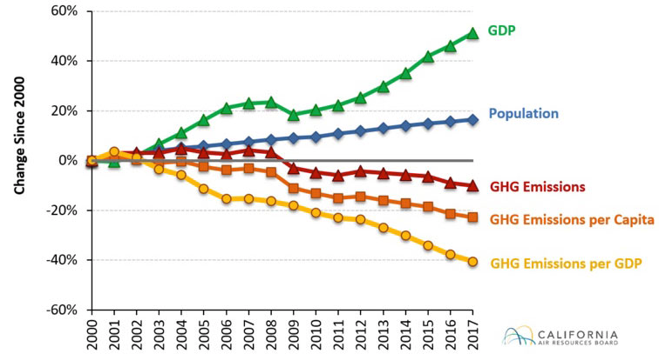
Change in California GDP, Population, and
GHG Emissions since 2000
Cap & Trade ->
Notes:
This would be nice animated.
Source: https://www.arb.ca.gov/newsrel/newsrelease.php?id=933

Slide 82
RGGI: the Regional Greenhouse Gas Initiative
Participants: Connecticut, Delaware, Maine, Maryland, Massachusetts, New Hampshire, New York, Rhode Island, and Vermont
  7% of US emissions
Covers power plants
First implemented in 2009
Caused emissions reduction of 24% below what they would have been

Slide 83
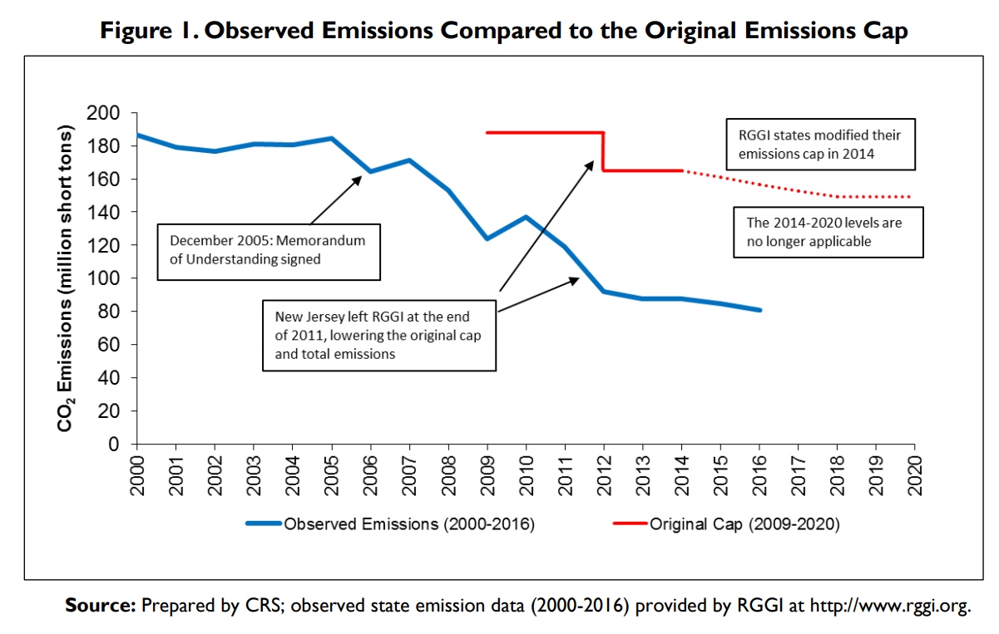
RGGI’s Effect on Emissions
Notes:
Source: Ramseur, 2015

Slide 84
Carbon Tax
Notes:
Does NEED want transition (section-starter) slides to maybe ALL look like this? If not, maybe these slides should be plain text like the rest of them?

Slide 85
Worldwide Carbon Taxes
28
carbon tax programs
25
national jurisdictions
covered
5.5%
of global greenhouse gas emissions

Slide 86

British Columbia’s Carbon Tax Policy
0.1%
of global greenhouse gas emissions

Slide 87

“
Tax the pollution we do not want, and return the money for what we do want — money in people’s pockets, jobs and investment.
- B.C. Government - Carbon Tax Brochure
“

Slide 88
British Columbia's Tax on Carbon
Notes:
Source for slide: https://www2.gov.bc.ca/gov/content/environment/climate-change/planning-and-action/carbon-tax

Slide 89
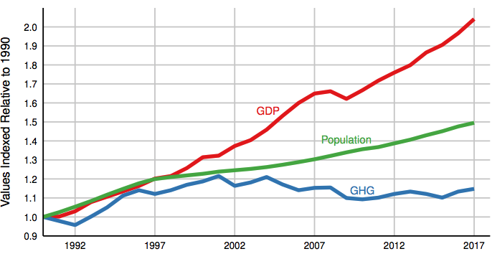
Relative Greenhouse Gas Emissions, GDP & Population Size: British Columbia
Carbon Tax ->
Notes:
http://www.env.gov.bc.ca/soe/indicators/sustainability/ghg-emissions.html

Slide 90

Sweden’s Carbon Tax Policy
Oldest Carbon Tax

Slide 91
Sweden’s Carbon Tax Policy
Started in 1991
Currently at $140/ton

Slide 92
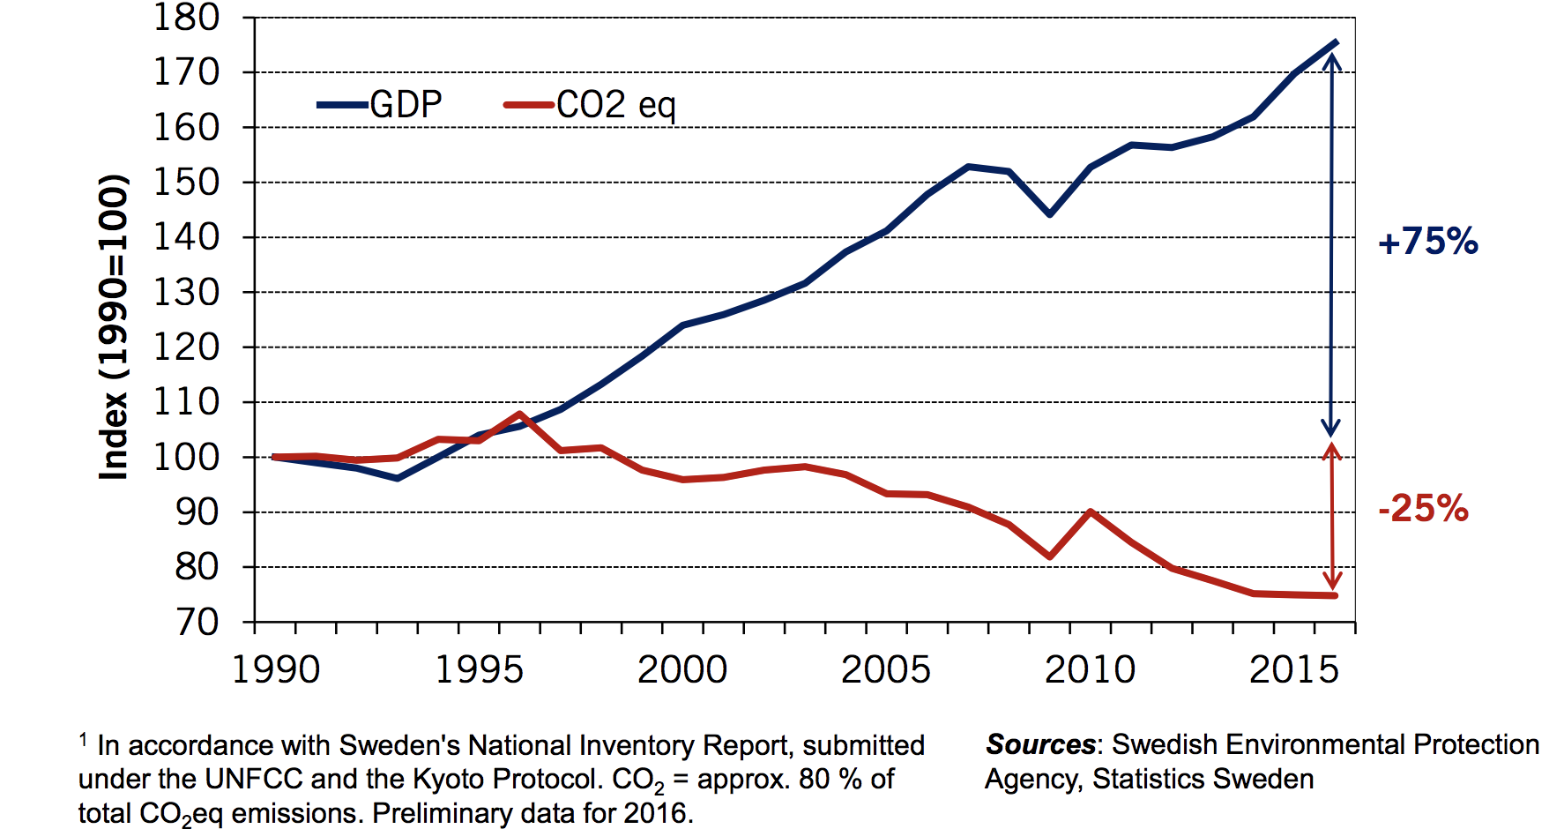
Real GDP and Domestic CO₂eq Emissions¹
In Sweden, 1990-2016
Notes:
Source: http://www.government.se/492fd9/contentassets/18ed243e60ca4b7fa05b36804ec64beb/170925-aakerfeldt-panel-debate-tuscon-gcet.pdf

Slide 93

U.S. Carbon Tax Plans
Climate Leadership Council
Citizens Climate Lobby
States and municipalities: Washington state, Oregon,
Washington, DC
CO₂

Slide 94

“
Economic policies will be central to accomplishing
the goals we choose.
- Harris and Roach (2007)
“

Slide 95
Summary
Climate change is real, is caused by human actions, and has impacts we’re already feeling.
We need to reduce emissions to balance the costs of action against the costs of inaction.
Scientists and the IPCC recommend that we work to keep warming below 1.5 degrees celcius.
  Economists believe that this goal is well worth the costs!

Slide 96
Summary – continued
There are many ways to reduce emissions.
Economics-inspired policies can help us do this at the lowest cost.
Taxes and cap and trade are proven effective tools to fight climate change!
Other tools may also be necessary.

Slide 97
Thank you!
Any Questions?
www.NEEDelegation.org
<presenter name>
<presenter email>
Contact NEED: Info@NEEDelegation.org
Submit a testimonial: www.NEEDelegation.org/testimonials.php

Slide 98
Available NEED Topics Include:
Coronavirus Economics
US Economy
Climate Change
Economic Inequality
Economic Mobility
US Social Policy
Autonomous Vehicles
Trade and Globalization
Trade Wars
Immigration Economics
Housing Policy
Federal Budgets
Federal Debt
2017 Tax Law

