Slide 1

Cryptocurrencies & The Future of Money
Lenox Club
10/12/2021
Geoffrey Woglom
Amherst College
Professor of Economics (emeritus)

Slide 2
National Economic Education Delegation
Vision
  One day, the public discussion of policy issues will be grounded in an accurate perception of the underlying economic principles and data.
Mission
  NEED unites the skills and knowledge of a vast network of professional economists to promote understanding of the economics of policy issues in the United States.
NEED Presentations
  Are nonpartisan and intended to reflect the consensus of the economics profession.

Slide 3
Who Are We?
Honorary Board: 54 members
  2 Fed Chairs: Janet Yellen, Ben Bernanke
  1 Secretary of the Treasury: Yellen (D)
  6 Chairs Council of Economic Advisers
    Furman (D), Rosen (R), Bernanke (R), Yellen (D), Tyson (D), Goolsbee (D)
  3 Nobel Prize Winners
    Akerlof, Smith, Maskin
Delegates: 590+ members
  At all levels of academia and some in government service
  All have a Ph.D. in economics
  Crowdsource slide decks
  Give presentations
Global Partners: 45 Ph.D. Economists
  Aid in slide deck development

Slide 4
Available NEED Topics Include:
US Economy
Climate Change
Economic Inequality
Economic Mobility
US Social Policy
Trade and Globalization
Trade Wars
Immigration Economics
Housing Policy
Federal Budgets
Federal Debt
2017 Tax Law
Autonomous Vehicles

Slide 5
Credits and Disclaimer
This slide deck was authored by:
  Geoffrey Woglom, Amherst College, Emeritus
Disclaimer
  NEED presentations are designed to be nonpartisan.
  It is, however, inevitable that the presenter will be asked for and will provide their own views.
  Such views are those of the presenter and not necessarily those of the National Economic Education Delegation (NEED).

Slide 6
Bitcoin Has Started a Revolution in Finance
The way we buy and sell things, our “payments system;” the way we save, borrow and invest; the role of banks and other financial firms are rapidly changing.
In my view, Bitcoin will NOT be an important player in these developments, but the technologies underlying Bitcoin will.
Regulation is needed to control the excesses of these new technologies, while allowing for beneficial innovations.
Should the Fed issue a “digital dollar?”

Slide 7
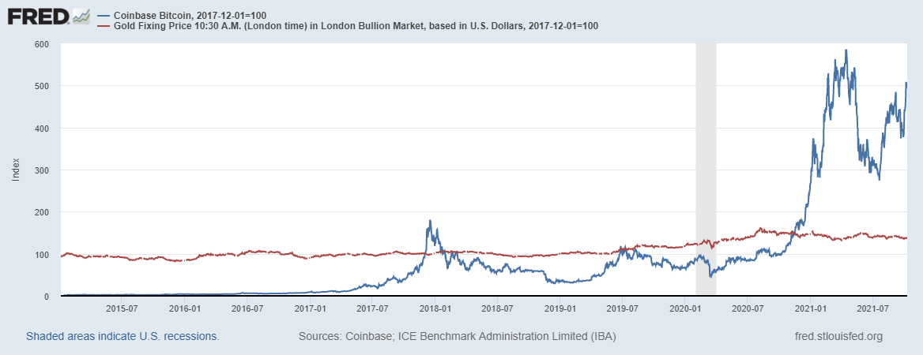
Bitcoins: What is the Excitement About?
Almost 500% increase in 6 months
Blue Line Price of Bitcoin
Red Line: Price of Gold
Notes:
Bitcoin today was trading at $56,850

Slide 8
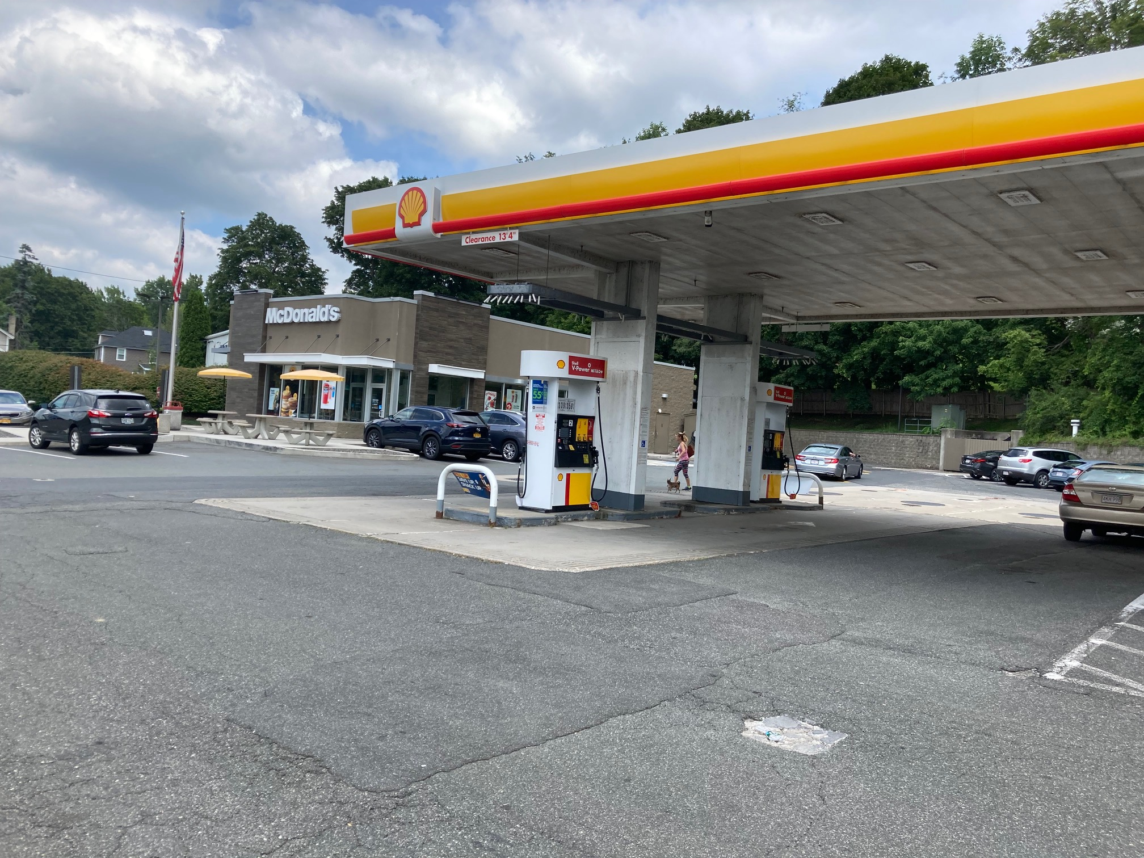
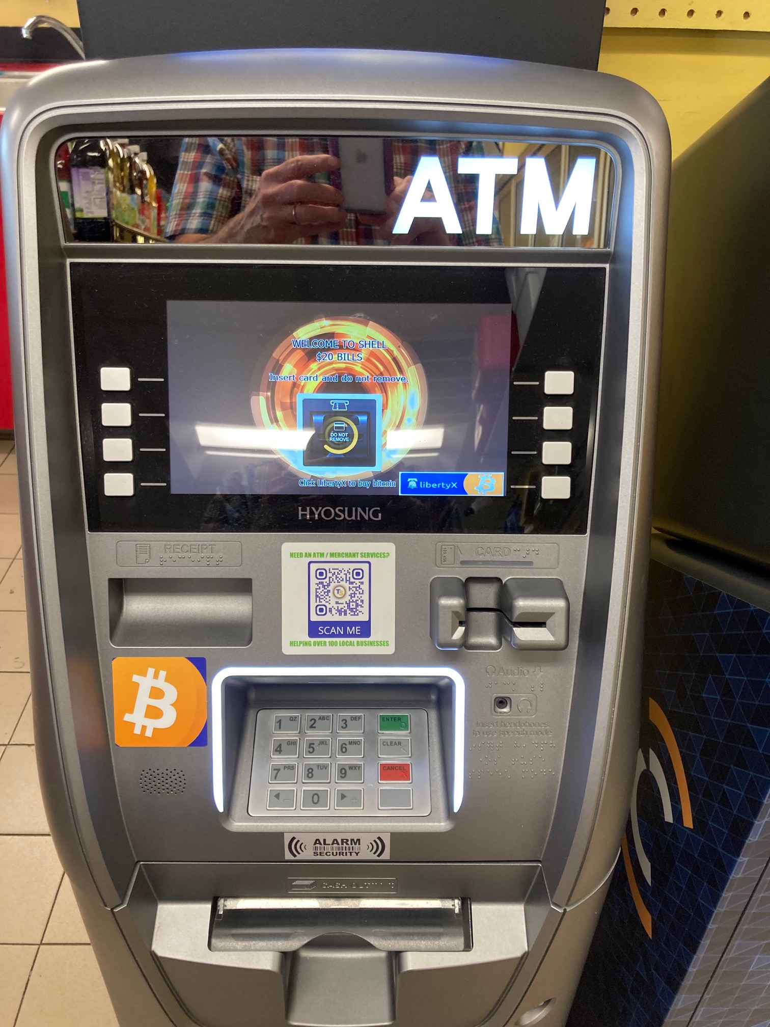
One of the Over 42,000 Bitcoin ATMs

Slide 9
And, an Origin Story Worthy of a Pulp Novel!
The Mysterious Satoshi Nakamoto:
  Lehman Brothers Bankruptcy, 9/2008
  Halloween 2008: a white paper is published on the Internet laying out the idea and design for Bitcoin. The author (or authors) used Satoshi Nakomoto as a pseudonym.
  January 2009: Satoshi releases the first version of the Bitcoin software.
  2009-2010: Satoshi releases new versions of the software and is actively involved in Internet Chatter about Bitcoin.
  April 2011: Satoshi ceases all known and/or verified communications.
To this date the identity or identities of Satoshi are unknown.

Slide 10
The Possible Economic Role for Bitcoin
“Improving money,” more prosaically
Facilitate payments at lower costs with speed and security.
Meet the needs of previously unbanked.
Notes:
Natoshi, Bitcoin is “A purely peer-to-peer version of electronic cash [that] would allow online payments to be sent directly from one party to another without going through a financial institution.”
So, Natoshi’s goal was to improve money, in a way that did not depend banks or governments!

Slide 11
Opportunities: Transaction Costs & Speed
Transactions Costs Example:
Online bill payments charge an extra fee if you use a credit card.
1.5%
Credit and Debit card payments are slow: typically takes 2 business days for the merchant to get paid..
Bank for International Settlements (BIS), Annual Report 2021, Chapter III
Notes:
More generally, merchants pay fees, which are passed on to consumers in higher prices. international transactions cost are particularly high.

Slide 12
Opportunities: Serve Unmet Need
World Bank, Global Findex Database, 2017
Notes:
Federal Reserve (2020)estimates that 5% of US adults are “unbanked,” and another 13% are underbanked, over 50 million

Slide 13
Reduce Cyber Risk
BIS, Annual Report 2021, Chapter III

Slide 14
Facts about Cryptocurrencies (as of 10/12)
Bitcoin was the first and is the largest in terms of market cap (total value of all bitcoins) of about $1 trillion.
Ethereum is in second place with a market cap of about $400 billion.
Presently, thousands of different varieties with a total market cap of about $2.4 trillion (https://www.coingecko.com/en)
NY stock exchange market cap is about $25 trillion

Slide 15
Underlying Technology of Bitcoin
Digital Token (exists only as data on a computer) whose ownership is cryptographically protected.
Distributed Ledger, Block Chain Technology.
Software protocol the provides a “consensus” mechanism on the validity of transactions without a “trusted third party.” (i.e, a bank or the Fed)
Notes:
Define distributed Ledger

Slide 16
So, how does it work?
Jack, the owner of a bitcoin is given a public number or key and a private encrypted key.
Jack can trade his bitcoin with Jill by using Jill’s public key and verifying the transaction with his private key.
The transaction is then posted on a website available to all.
The record of the transaction is then entered into database or ledger called a blockchain through a process know as bitcoin mining.

Slide 17
Mining for Bitcoin
Bitcoin Miners gather about 3000 new transactions into a “block.”
The miners compete for who gets to add the new block to the chain of previous blocks by generating long random numbers (“hashing”) until one of the numbers fits a precise set of attributes.
Miners must come to a consensus that the transactions in the block are legitimate; e.g., the owner of a bitcoin hasn’t tried to spend it twice.
The new block is then linked to the previous block and added to the chain. The total process takes about 10 minutes
The incentive for miners is that the winner of the competition gets compensated with new bitcoins and transaction fees.

Slide 18
Question #1: Is Bitcoin serving an economic role
Bitcoin is not and cannot be widely used to make transactions
Scalability?
Price Instability.
Transactions costs
Cash ATM vs. Bitcoin ATM
BIS, Annual Report 2018, Chapter V

Slide 19
Bitcoin Operates at a Substantial Cost
Presently, Bitcoin mining requires 80.7 terawatt-hours per year, a little less than Belgium’s energy consumption (although less than is used in gold mining). (Note there are other consensus mechanisms that do not use as much energy.)
Source: https://cbeci.org/
Notes:
China currently has 46 percent of the computer power devoted to mining with the US second with 16.8%
But the Chinese government vowed to put an end to bitcoin mining in July and banned all cryptocurrency transactions in September.

Slide 20
What Role Does Bitcoin Play?
For some it plays the same role as $100 bills: 32.8% of all bills in circulation (more than the number of $1 bills) and 80.2% of the value of all bills.
Illegal Activity:
This claim is disputed: https://www.newsweek.com/illegal-use-bitcoin-dropped-50-2020-citibank-reports-1573263
Notes:
Trading of banned goods; e.g, Silk Road
Ransomware Payments.
Money Laundering.
Tax Evasion

Slide 21
But What about as an Investment?
It is hard to argue with the fact that Bitcoin has provided outsized returns for many, albeit very volatile.
But what is its the “fundamental value” ?
To me it is a purely speculative investment.
Notes:
Promised future payments such as dividends for stocks or coupon payments for bonds.
For currencies, promise of future use in exchange with stable values.
Bitcoin only promises the possibility of capital gains, but not based on future payments.

Slide 22
Question #2: The Value of the New Technology?
The value cryptographically protected digital-tokens is nuanced:
Blockchain technologies have significant promise which is already being realized.
See: Mehta N,. Agashe A., P. Detroja Blockchain Bubble or Revolution, 2021
Notes:
Cryptographic protection is a tougher call and depends on your views of privacy rights, as well as what information is being kept private (e.g., medical records versus financial transactions) Supply Chains (Walmart IBM)
Smart Contracts (Xbox royalties)

Slide 23
DeFi and Smart Contracts
Broad Category of Decentralized Financial Services
  Crypto exchanges, online lending platforms, crypto derivatives, insurance, startup finance, etc.
  Explosion over time: $1b in 2019; $15b in 2020; $80b as of 5/2021 (“DeFi Beyond the Hype” Wharton School, 5/2021).
Smart Contracts are executed via Block Chain Technology, mostly on Ethereum. No brokers, financial intermediaries, traders, and little regulation.
New need for a digital means of payment that is low cost, secure, and fast to facilitate DeFi innovations.

Slide 24
What about Digital Payments More Generally?
Who pays for their lattes with cash? We already have digital payments, but what about the needs of the unbanked?
The US and the developed world are far behind Africa: Mobile as in cellphone money, the M-Pesa.
Grameen Foundation:
Making Cash Digital is the Key to Possibility
When Poor Women Control their own money, it no longer controls them.
Lesson: Economic Opportunities Don’t Remain Unmet for Long.
Notes:
Started in Kenya in 2007 and now available in 10 countries.
Buy M-Pesa credits from “agents” (local shop) which can be transferred to others with an M-Pesa account via cellphone.
96 percent of Kenyan households have a mobile account.
M-pesa is a digital currency, but not a crypto currency

Slide 25
Stablecoins: Cryptocurrency with a stable value of $1 (we hope)
2014 “Tether”: a cryptocurrency supposed to be backed by dollars so its price would always have a value of $1.
All sorts of operational and legal problems, including
Enter Facebook and Diem: Proposed blockchain enabled stablecoin
Janet Yellen and Gary Gensler into the Breach to provide good regulation?
https://www.washingtonpost.com/washington-post-live/2021/09/21/transcript-path-forward-cryptocurrency-with-gary-gensler/
Notes:
WSJ, Headline, 8/11/2021, “Poly Network Hackers Steal More Than $600 Million in Cryptocurrency” Bloomberg 7/27/2021: “Tether and the Facebook Inc.-backed Diem token were a main focus of a recent meeting of U.S. regulators held on the financial risks posed by stablecoins.

Slide 26
Do We Need More Than (Good) Regulation?
The Bank for International Settlement (BIS) and a number of central banks are exploring how the development of Central Bank Digital Currency (CBDC) “contribute to an open, safe and competitive monetary environment that supports innovation and serves the public interest.”
Source of quotes, BIS Annual Report 2021

Slide 27
CBDCs and Other Central Bank Liabilities
The Fed and most Central Banks presently already have digital money!
CBDCs would permit wider access to the Fed’s digital assets to other financial institutions and possibly to the public
In addition, CBDCs could be designed for rapid settlement, finality, privacy and security (perhaps using blockchain technology)
Notes:
The Fed and most Central Banks presently have two financial liabilities:
Currency.
Bank Reserves.
Bank Reserves are Balances that Commercial Banks hold at the Fed and that are used in check clearing. They are already di

Slide 28
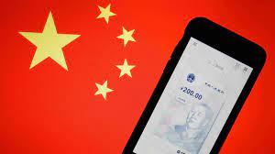
The Devil Is In the Details
Countries as Diverse as Sweden, Ecuador and China have begun experiments with CBDCs.
Where’s the Fed?
Source: E. Prasad, The Future of Money

Slide 29




Who should design our payment system?
Notes:
Vitalek Buterin

Slide 30
Questions?
Learn More
E Prasad, The Future of Money (https://youtu.be/o3NuHb7V1IA)
https://www.washingtonpost.com/washington-post-live/2021/09/21/path-forward-cryptocurrency-with-gary-gensler-us-securities-exchange-commission-chair/
N. Mehta, et.al. Blockchain Bubble or Revolution
www.NEEDelegation.org
Geoffrey Woglom
grwoglom@amherst.edu
Contact NEED: Info@NEEDelegation.org
Submit a testimonial: www.NEEDelegation.org/testimonials.php
Support NEED: www.NEEDelegation.org/donate.php

