Slide 1
U.S. Economic Update
Redwood High School
September 30 & October 1, 2021
Jon Haveman, Ph.D.
National Economic Education Delegation

Slide 2
Outline
State of the Pandemic
Evidence of Impact
Employment Growth
Inflation

Slide 3
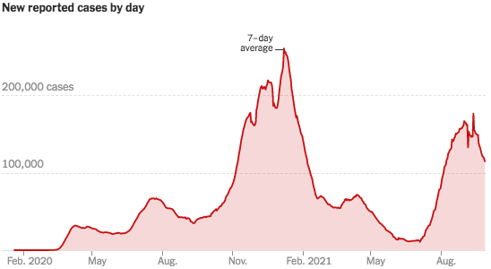
COVID Cases: Trend is Reversing Nationwide
Source: NYTimes

Slide 4
Evidence of Impact

Slide 5
GDP Trajectory: Pandemic Plunge!
GDP is:
$0.5 Trillion below 2019 forecast.
$0.2 Trillion ABOVE 2019-Q4 level.

Slide 6
Spending Patterns Since First US Case
Source: https://tracktherecovery.org/

Slide 7
Employment Gap
5.3 Million below February, 2020.
9.4 Million below where we should be.
Notes:
payroll_recent.png

Slide 8
Not All Jobs Are Recovering

Slide 9
Unemployment is Recovering

Slide 10
Labor Force is Shrinking

Slide 11
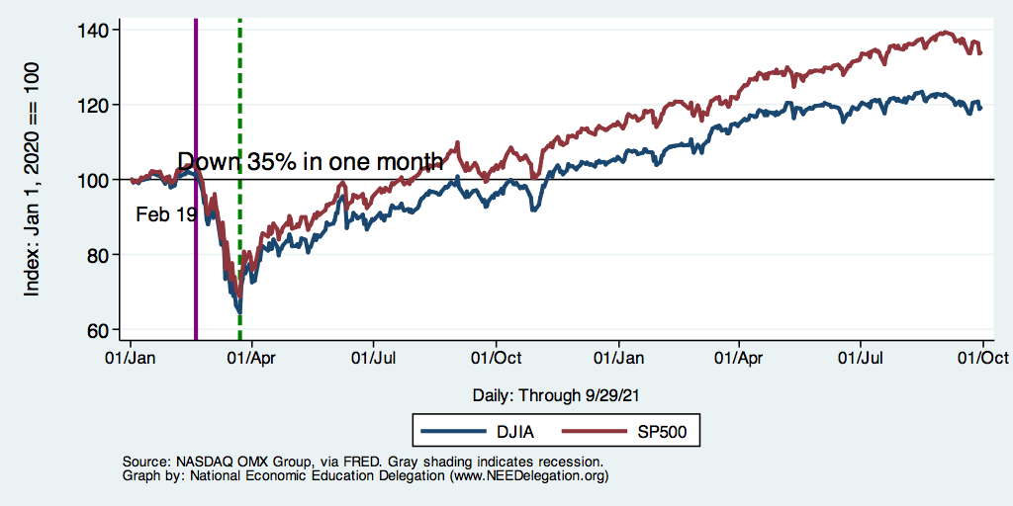
DJIA and S&P 500

Slide 12
Government Policy

Slide 13
Recovery Due to Immense Fiscal Stimulus and Control of COVID

Slide 14
What Have Been Policy Effects
Monetary Policy (Fed) acted quickly and effectively to prevent a financial market meltdown and to keep credit flowing. But the Fed lends and does not spend.
Fiscal policy (Congress) acted quickly, but inevitably made some mistakes.
Stimulus Checks, A ($268b)
Expanded Unemployment, B ($268b)
Paycheck Protection Program, C- ($525b)
COVID Spending: $5 Trillion
Same as spending during WWII, and ~25% of GDP.

Slide 15
Debt: A Problem Exacerbated….Not Created

Slide 16
Inflation

Slide 17
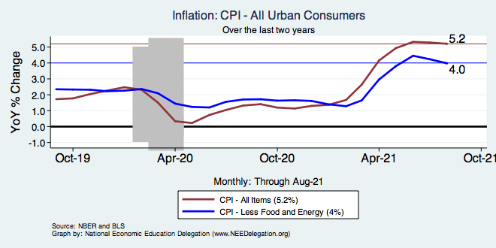
Inflation – Climbing! Should we worry?
Notes:
Cpi_recent.png

Slide 18
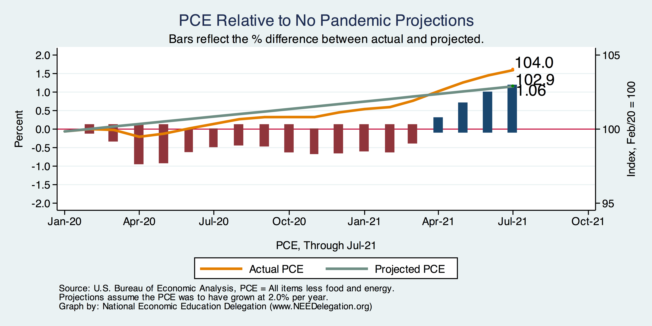
Inflation – PCE and Fed Suggest: No!
1.06
Notes:
Cpi_recent.png

Slide 19
Inflation: Concentrated

Slide 20
Why do we have inflation?
Inflation reflects the setting of prices in all markets
Aggregate DEMAND is in good shape.
Government support.
People are buying things.
Aggregate SUPPLY is in bad shape.
Many small businesses are still closed.
Some things are hard to get:
Microprocessors.
People are buying things they don’t usually buy.

Slide 21
Primary Topics Covered
GDP
Recovered the decline, but not where it should be.
Won’t recover previous forecast until early 2022.
Employment
Still down 9.3 million jobs relative to forecast. (5.3 million relative to Feb/20).
Labor force is 5.7 million smaller than at the beginning of the pandemic.
Inflation
Going to be high for a little while, but transitory.
Federal Debt
Has grown significantly, but economists are not worried…yet.

Slide 22
Thank you!
Any Questions?
www.NEEDelegation.org
Jon D. Haveman
Jon@NEEDelegation.org
Contact NEED: info@NEEDelegation.org
Submit a testimonial: www.NEEDelegation.org/testimonials.php
Become a Friend of NEED: www.NEEDelegation.org/friend.php

Slide 23
GDP: Quarterly Growth
Notes:
Graph: gdp_pot_grow.png
The Point: From 1990 – 2007, average annual US GDP growth pre-crisis is 2.94%. However, post-crisis US GDP growth is 2.19% (0.75 percentage points lower). Why is has the recovery been sluggish?
Note: At the recession’s height, the gap between quarterly GDP growth and potential growth was 2.5 percentage points.

Slide 24
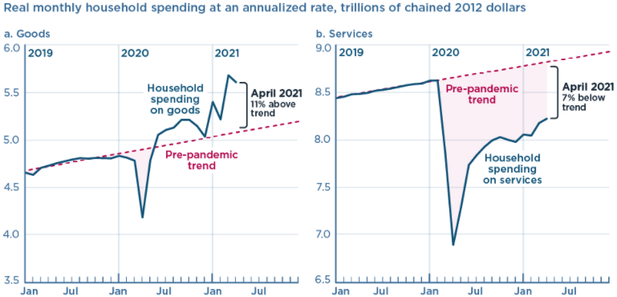
And We’re Buying Mostly … Stuff
Source: Jason Furman, PIIE

Slide 25
Monthly Changes in Nonfarm Employment
Notes:
PAYEMS.png

Slide 26
Labor Force is Shrinking

Slide 27
Employment in California

Slide 28
Small Businesses: They Didn’t Get Enough PPP

Slide 29
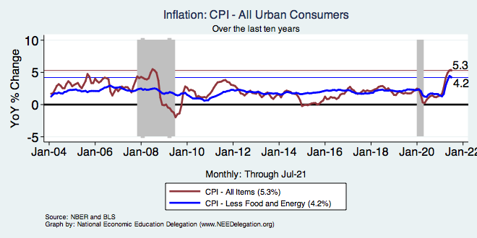
Inflation – Prepandemic Stability
Notes:
Cpi_recent.png

Slide 30
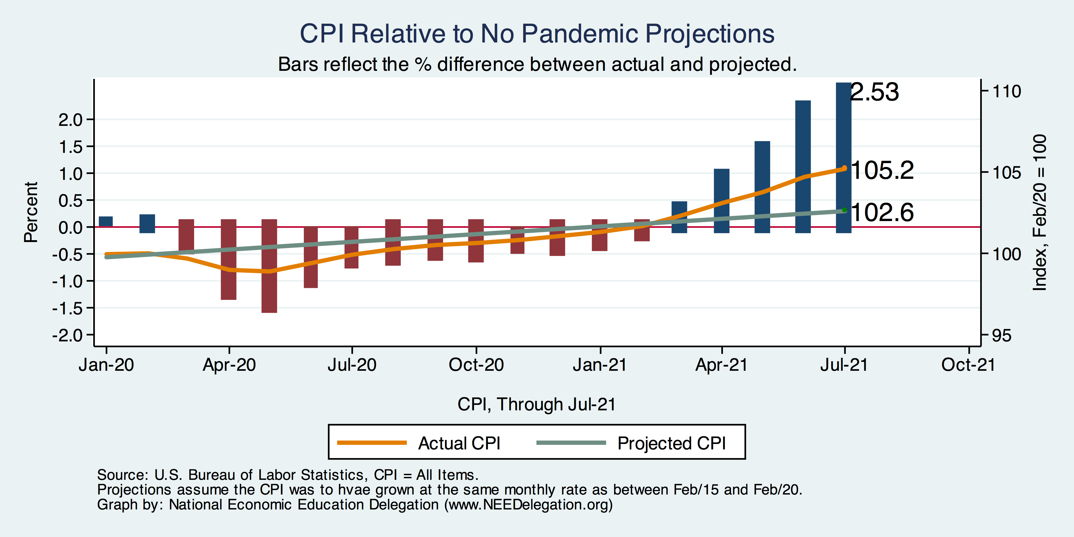
Inflation – CPI Suggests: Yes!
Notes:
Cpi_recent.png

Slide 31
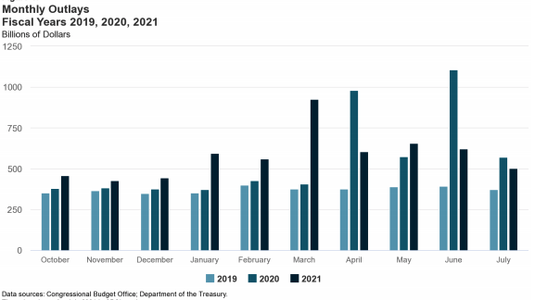
Trillions in Pandemic Spending

Slide 32
Why so Excited About Telecommunting?
Productivity at home appears to be really high during pandemic.
Nothing else to do.
Short term – corporate culture and new hires – visibility to the boss – camaraderie.
CEOs are salivating over reduced Comm RE costs.

Slide 33
Telecommuting – Will it Stick?
Working from home is ALWAYS less productive than working in the office.
But the gap has shrunk because of technology.
In the interest of workplace productivity, employers are likely to allow more working from home.
Increased in-office moral and hence productivity.
But not 100% or even 50%. How much?
Has important implications for real estate.

Slide 34
Population Change: San Francisco & CCC

Slide 35
www.NEEDelegation.org/LocalGraphs
For every state and county in the United States.
Detailed graphs on employment, housing, moves, and other statistics.

