Slide 1
COVID-19: Economic Implications and Policy Response
Rotary Club of Sausalito
June 10, 2021
Jon Haveman, Ph.D.
National Economic Education Delegation

Slide 2
National Economic Education Delegation
Vision
One day, the public discussion of policy issues will be grounded in an accurate perception of the underlying economic principles and data.
Mission
NEED unites the skills and knowledge of a vast network of professional economists to promote understanding of the economics of policy issues in the United States.
NEED Presentations
Are nonpartisan and intended to reflect the consensus of the economics profession.

Slide 3
Who Are We?
Honorary Board: 54 members
2 Fed Chairs: Janet Yellen, Ben Bernanke
6 Chairs Council of Economic Advisers
Furman (D), Rosen (R), Bernanke (R), Yellen (D), Tyson (D), Goolsbee (D)
3 Nobel Prize Winners
Akerlof, Smith, Maskin
Delegates: 590+ members
At all levels of academia and some in government service
All have a Ph.D. in economics
Crowdsource slide decks
Give presentations
Global Partners: 44 Ph.D. Economists
Aid in slide deck development

Slide 4
Available NEED Topics Include:
Coronavirus Economics
US Economy
Climate Change
Economic Inequality
Economic Mobility
Trade and Globalization
Minimum Wages
Immigration Economics
Housing Policy
Federal Budgets
Federal Debt
Black-White Wealth Gap
Autonomous Vehicles
US Social Policy

Slide 5
Credits and Disclaimer
This slide deck was authored by:
Jon D. Haveman, NEED
Scott Baier, Clemson University
Geoffrey Woglom, Amherst College (Emeritus)
Brian Dombeck, Lewis & Clark College
Doris Geide-Stevenson, Weber State
Disclaimer
NEED presentations are designed to be nonpartisan.
It is, however, inevitable that the presenter will be asked for and will provide their own views.
Such views are those of the presenter and not necessarily those of the National Economic Education Delegation (NEED).

Slide 6
Outline
State of the Pandemic
Evidence of Impact
Government Policy
What to expect going forward

Slide 7
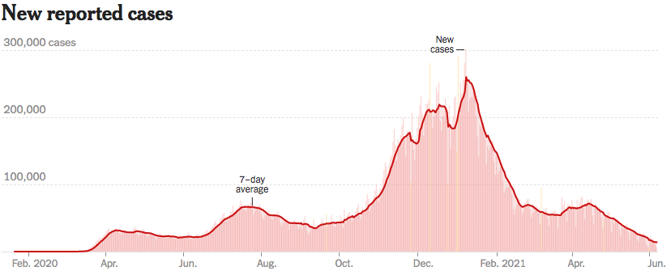
Making Real Progress
Source: NYTimes

Slide 8
California Cases Are Falling Nicely
Source: NYTimes

Slide 9
Evidence of Impact

Slide 10
Spending Patterns Since First US Case
Source: https://tracktherecovery.org/

Slide 11
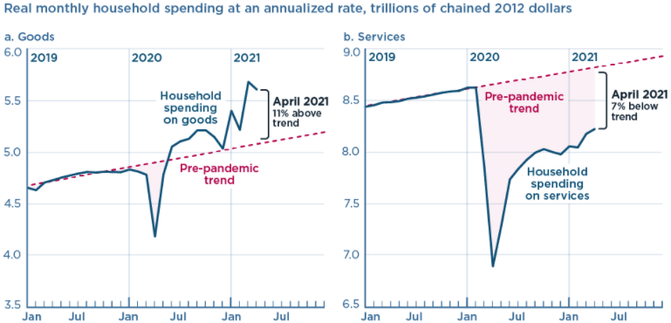
And We’re Buying Mostly … Stuff
Source: Jason Furman, PIIE

Slide 12
GDP Trajectory: Pandemic Plunge!
GDP is:
$0.8 Trillion below 2019 forecast.
$0.2 Trillion below 2019-Q4 level.

Slide 13
Monthly Changes in Nonfarm Employment
Notes:
PAYEMS.png

Slide 14
Employment Gap
Notes:
payroll_recent.png

Slide 15
Why Slow Employment Growth?
Economists had expected more than 1 million jobs in April.
Why didn’t we get them?
It is not: the generous unemployment checks.
Low wage sectors were the only ones to see solid employment growth.
Leisure and hospitality: +328k (April) +292k (May)
Professional services: -81k (April) +35k (May)
Lack of wage growth.
It might be:
Continued fear of the virus.
Microchip shortages.
Geographic mismatch and an unwillingness to relocate…yet.
Child care – lack of availability.
???

Slide 16
What Have Been Policy Effects
Monetary Policy (Fed) acted quickly and effectively to prevent a financial market meltdown and to keep credit flowing. But the Fed lends and does not spend.
Fiscal policy (Congress) acted quickly, but inevitably made some mistakes.
Stimulus Checks, A ($268b)
Expanded Unemployment, B ($268b)
Paycheck Protection Program, C- ($525b)
Last two packages: $2.8 Trillion
Why?

Slide 17
Is it a V or a K shaped recovery?
Aggregate data look good because the Cares Act (at least until the end of July) supported low income workers.
But, it doesn’t look good everywhere. Bottom part of K
Employment of Low-Income workers.
Small firms.
Hard-hit Sectors: Restaurants, entertainment and transportations.
State and Local Governments
Nike swoosh

Slide 18
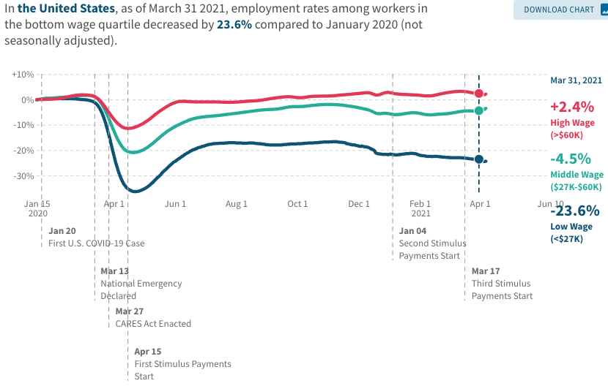
Low Wage Employment is Lagging

Slide 19
Balancing Act
Too Big (Larry Summers)
There already is about $1.5 trillion in personal saving waiting to be spent.
Needlessly adding to our debt and deficit problems.
Reignite inflation.
Less ”fiscal space” - room for needed public infrastructure investment.
Too Small (Paul Krugman)
Double Dip.
Your only get one bite at the apple.
Prolonged economic scarring.
People in true need are left out.

Slide 20
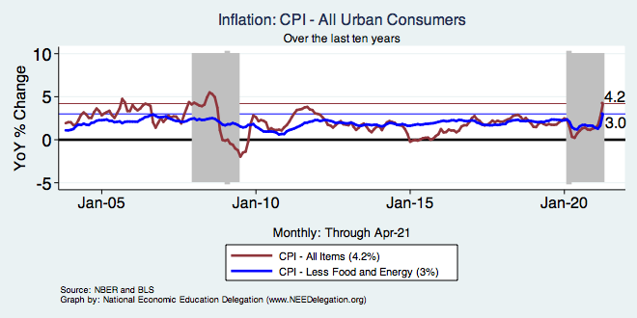
Inflation – Recent Stability
Notes:
Cpi_recent.png

Slide 21
Aggregate Data Looks Encouraging
Recovery has been unexpectedly rapid, albeit incomplete, but has started to pick up again.
Why so rapid: There were no short-run macro problems at the start of the crisis.
The only obstacle to a continued recovery:
Resurgence of the virus.
Economic damage due to prolonged job losses and business failures in specific sectors.
Adapting to structural changes.

Slide 22
Structural Changes?
Pandemic has been an accelerant.
Not a change agent.
Retail
Telecommuting
Telehealth
Business travel?
Wealth concentration
Industry concentration
Automation

Slide 23
Why so Excited About Telecommunting?
Productivity at home appears to be really high during pandemic.
Nothing else to do.
Short term – corporate culture and new hires – visibility to the boss – camaraderie.
CEOs are salivating over reduced Comm RE costs.

Slide 24
Telecommuting – Will it Stick?
Working from home is ALWAYS less productive than working in the office.
But the gap has shrunk because of technology.
In the interest of workplace productivity, employers are likely to allow more working from home.
Increased in-office moral and hence productivity.
But not 100% or even 50%. How much?
Has important implications for real estate.

Slide 25
RE Experiences Differ!

Slide 26
Population Change: San Francisco & San Mateo

Slide 27
www.NEEDelegation.org/LocalGraphs
For every state and county in the United States.
Detailed graphs on employment, housing, moves, and other statistics.

Slide 28
Primary Topics Covered
GDP
Recovered MOST of the decline.
Won’t recover previous forecast until late 2022.
Employment
Still down 11 million jobs relative to forecast. ($7.5 million relative to Feb/20).
Inflation
Going to be high for a little while, but transitory.
Telecommuting
Going to be high for a little while, but transitory.

Slide 29
Conclusion
COVID-19 is health crisis that has macroeconomic implications.
With enormous built-in inequities.
Significant structural changes – accelerant.
GDP will likely expand between 4.0 and 5.0 percent this year.
Policy gap created enormous hardship.
Hunger, evictions, foreclosures, additional deaths.
Loss of GDP: 4-5% Unemployment: up 4-5 pts.
Physical health determines economic health for the economy.
Well on our way to recovery, both health and economic.

Slide 30
Thank you!
Any Questions?
www.NEEDelegation.org
Jon D. Haveman
Jon@NEEDelegation.org
Contact NEED: info@NEEDelegation.org
Submit a testimonial: www.NEEDelegation.org/testimonials.php
Become a Friend of NEED: www.NEEDelegation.org/friend.php

