Slide 1
COVID-19: Economic Implications and Policy Response
SIRs 146, Walnut Creek
August 12, 2021
Jon Haveman, Ph.D.
National Economic Education Delegation

Slide 2
National Economic Education Delegation
Vision
One day, the public discussion of policy issues will be grounded in an accurate perception of the underlying economic principles and data.
Mission
NEED unites the skills and knowledge of a vast network of professional economists to promote understanding of the economics of policy issues in the United States.
NEED Presentations
Are nonpartisan and intended to reflect the consensus of the economics profession.

Slide 3
Who Are We?
Honorary Board: 54 members
2 Fed Chairs: Janet Yellen, Ben Bernanke
6 Chairs Council of Economic Advisers
Furman (D), Rosen (R), Bernanke (R), Yellen (D), Tyson (D), Goolsbee (D)
3 Nobel Prize Winners
Akerlof, Smith, Maskin
Delegates: 599 members
At all levels of academia and some in government service
All have a Ph.D. in economics
Crowdsource slide decks
Give presentations
Global Partners: 44 Ph.D. Economists
Aid in slide deck development

Slide 4
Available NEED Topics Include:
Coronavirus Economics
US Economy
Climate Change
Economic Inequality
Economic Mobility
Trade and Globalization
Minimum Wages
Immigration Economics
Housing Policy
Federal Budgets
Federal Debt
Black-White Wealth Gap
Autonomous Vehicles
US Social Policy

Slide 5
Credits and Disclaimer
This slide deck was authored by:
Jon D. Haveman, NEED
Scott Baier, Clemson University
Geoffrey Woglom, Amherst College (Emeritus)
Brian Dombeck, Lewis & Clark College
Doris Geide-Stevenson, Weber State
Disclaimer
NEED presentations are designed to be nonpartisan.
It is, however, inevitable that the presenter will be asked for and will provide their own views.
Such views are those of the presenter and not necessarily those of the National Economic Education Delegation (NEED).

Slide 6
Outline
State of the Pandemic
Evidence of Impact
Employment Growth
Inflation
The Debt

Slide 7
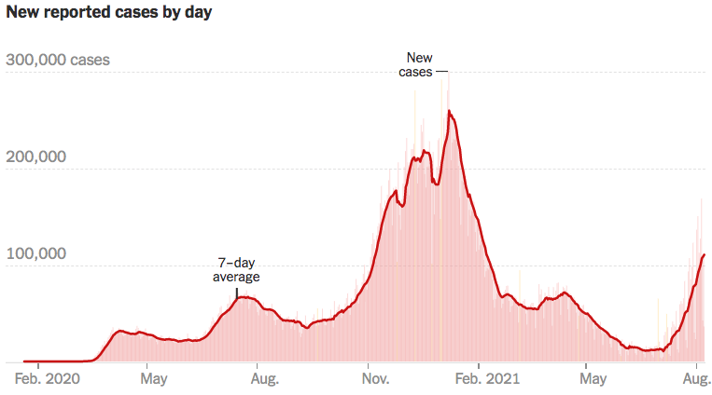
COVID Cases: Back in the Soup…
Source: NYTimes

Slide 8
California Cases Were Falling Nicely
Source: NYTimes

Slide 9
Evidence of Impact

Slide 10
Spending Patterns Since First US Case
Source: https://tracktherecovery.org/

Slide 11
GDP Trajectory: Pandemic Plunge!
GDP is:
$0.5 Trillion below 2019 forecast.
$0.2 Trillion ABOVE 2019-Q4 level.

Slide 12
Employment Gap
5.7 Million below February, 2020.
9.6 Million below where we should be.
Notes:
payroll_recent.png

Slide 13
Why Slow Employment Growth?
Is employment growth slow?
It is not because of the generous unemployment checks.
Low wage sectors are seeing solid employment growth.
Leisure and hospitality: +328k (July)
Professional services: +60k (July)
Lack of wage growth.
Low wage employment is growing faster in states WITH supplement than in states w/o.

Slide 14
Why Slow Employment Growth?
It might be:
Continued fear of the virus.
Microchip shortages.
Geographic mismatch and an unwillingness to relocate…yet.
Childcare – lack of availability.
People wanting to do better.
Facilitated by additional UI payments.
People dropping out of the labor force.

Slide 15
Labor Force is Shrinking

Slide 16
Employment in Contra Costa County

Slide 17
Government Policy

Slide 18
What Have Been Policy Effects
Monetary Policy (Fed) acted quickly and effectively to prevent a financial market meltdown and to keep credit flowing. But the Fed lends and does not spend.
Fiscal policy (Congress) acted quickly, but inevitably made some mistakes.
Stimulus Checks, A ($268b)
Expanded Unemployment, B ($268b)
Paycheck Protection Program, C- ($525b)
Last two packages: $2.8 Trillion
Why?

Slide 19
Is it a V or a K shaped recovery?
Aggregate data look good because the government support for low income workers.
But, it doesn’t look good everywhere. Bottom part of K
Employment of Low-Income workers.
Small firms.
Hard-hit Sectors: Restaurants, entertainment and transportations.
State and Local Governments
Nike swoosh

Slide 20
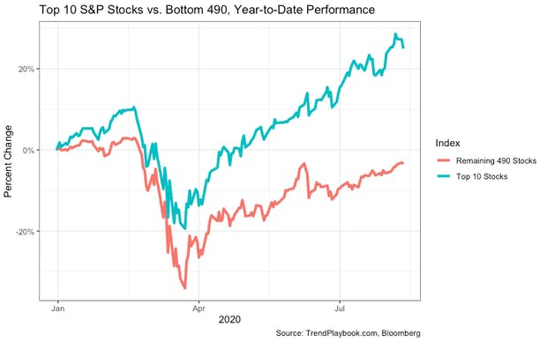
Recovery/Recession for Whom?
Top 10 S&P Stocks:
Apple
Microsoft
Amazon
Facebook
Alphabet Class A shares
Alphabet Class C shares
Berkshire Hathaway
Johnson & Johnson
Visa
Procter & Gamble

Slide 21
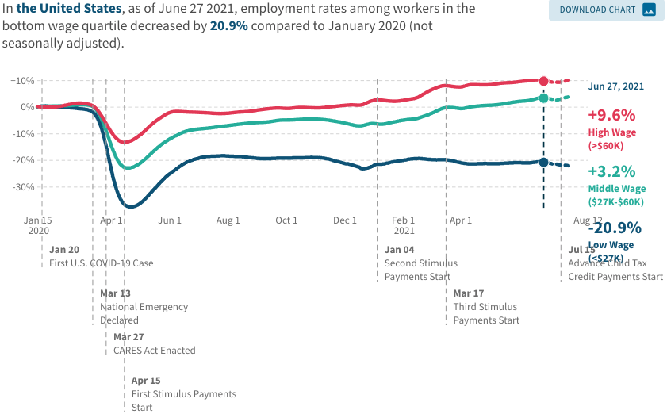
Low Wage Employment is Lagging

Slide 22
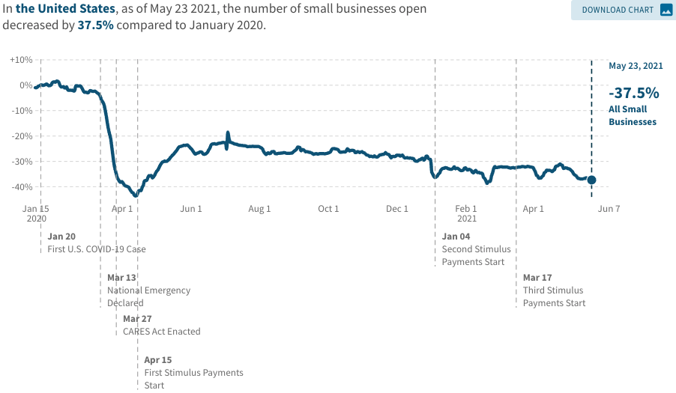
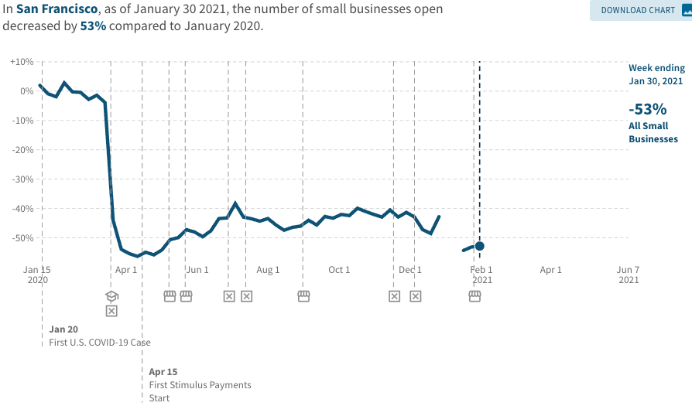
Another Hard-Hit Sector: Small Business
Small Biz Closures in the United States
Small Biz Closures in San Francisco

Slide 23
Debt: A Problem Exacerbated….Not Created

Slide 24
Balancing Act
Too Big (Larry Summers)
There already is about $1.5 trillion in personal saving waiting to be spent.
Needlessly adding to our debt and deficit problems.
Reignite inflation.
Less ”fiscal space” - room for needed public infrastructure investment.
Too Small (Paul Krugman)
Double Dip.
Your only get one bite at the apple.
Prolonged economic scarring.
People in true need are left out.

Slide 25
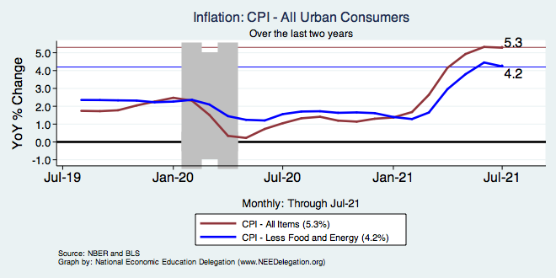
Inflation – Climbing! Should we worry?
Notes:
Cpi_recent.png

Slide 26
What Index to Follow: CPI or PCE?
CPI is the headline statistic, followed by most newspapers.
Allows more granularity – ability to look at specific products.
PCE is the one followed by the Fed.
Why?
Accounts for short term fluctuations in consumer purchases.
Based on more reliable data.
Fed generally pays attention to the core inflation #s.
Excluding food and energy.

Slide 27
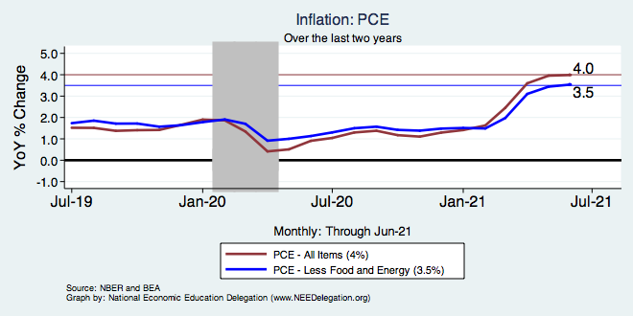
Inflation – Climbing! Should we worry?
Notes:
Cpi_recent.png

Slide 28
Inflation – PCE and Fed Suggest: No!
Notes:
Cpi_recent.png

Slide 29
Inflation – Summary
Headline inflation story is troublesome.
The Fed suggests that is not.
Inflation has been high, but has just recently caused the price level to be higher than it would have been.
Powell: current high inflation is “transitory”.
That does not mean that price levels will come down.
It means that inflation is likely to return to its prior trajectory once the economy has worked out the pandemic kinks.
Notes:
Cpi_recent.png

Slide 30
Aggregate Data Looks Encouraging
Recovery has been unexpectedly rapid, albeit incomplete, but has started to pick up again.
Why so rapid: There were no short-run macro problems at the start of the crisis.
Obstacles to continued recovery:
Resurgence of the virus.
Economic damage due to prolonged job losses and business failures in specific sectors.
Adapting to structural changes.

Slide 31
Structural Changes?
Pandemic has been an accelerant.
Not a change agent.
Retail
Telecommuting
Telehealth
Business travel?
Wealth concentration
Industry concentration
Automation

Slide 32
RE Experiences Differ!

Slide 33
Primary Topics Covered
GDP
Recovered the decline, but not where it should be.
Won’t recover previous forecast until late 2022.
Employment
Still down 9.6 million jobs relative to forecast. (5.7 million relative to Feb/20).
Inflation
Going to be high for a little while, but transitory.
Federal Debt
Has grown significantly, but economists are not worried…yet.

Slide 34
Conclusion
COVID-19 is health crisis that has macroeconomic implications.
With enormous built-in inequities.
Significant structural changes – accelerant.
GDP will likely expand between 5.0 and 6.0 percent this year.
Physical health determines economic health for the economy.
Well on our way to recovery, both health and economic.
Variants may well slow our progress, however.

Slide 35
Thank you!
Any Questions?
www.NEEDelegation.org
Jon D. Haveman
Jon@NEEDelegation.org
Contact NEED: info@NEEDelegation.org
Submit a testimonial: www.NEEDelegation.org/testimonials.php
Become a Friend of NEED: www.NEEDelegation.org/friend.php

Slide 36
GDP: Quarterly Growth
Notes:
Graph: gdp_pot_grow.png
The Point: From 1990 – 2007, average annual US GDP growth pre-crisis is 2.94%. However, post-crisis US GDP growth is 2.19% (0.75 percentage points lower). Why is has the recovery been sluggish?
Note: At the recession’s height, the gap between quarterly GDP growth and potential growth was 2.5 percentage points.

Slide 37
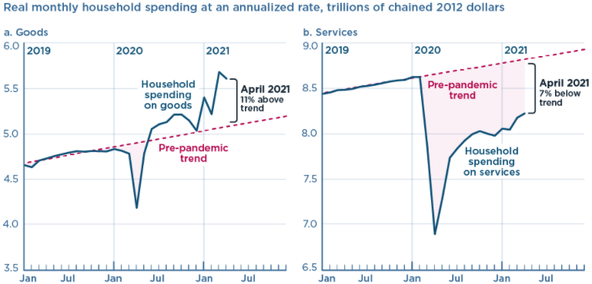
And We’re Buying Mostly … Stuff
Source: Jason Furman, PIIE

Slide 38
Monthly Changes in Nonfarm Employment
Notes:
PAYEMS.png

Slide 39
Labor Force is Shrinking

Slide 40
Employment in California

Slide 41
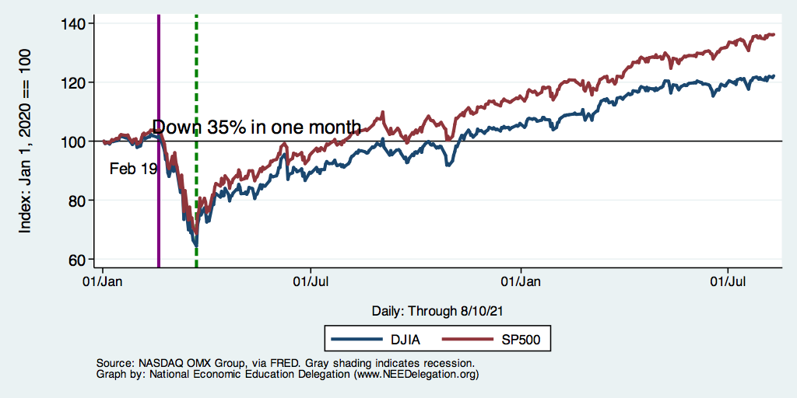
DJIA and S&P 500

Slide 42
Small Businesses: They Didn’t Get Enough PPP

Slide 43
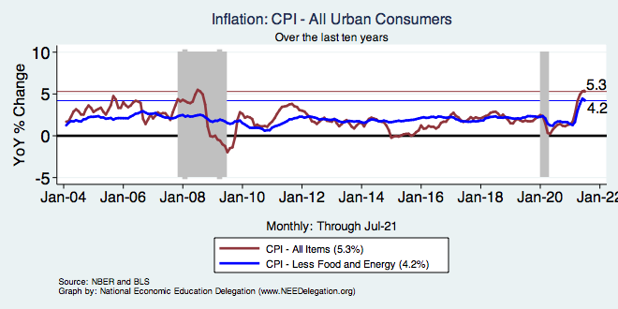
Inflation – Prepandemic Stability
Notes:
Cpi_recent.png

Slide 44
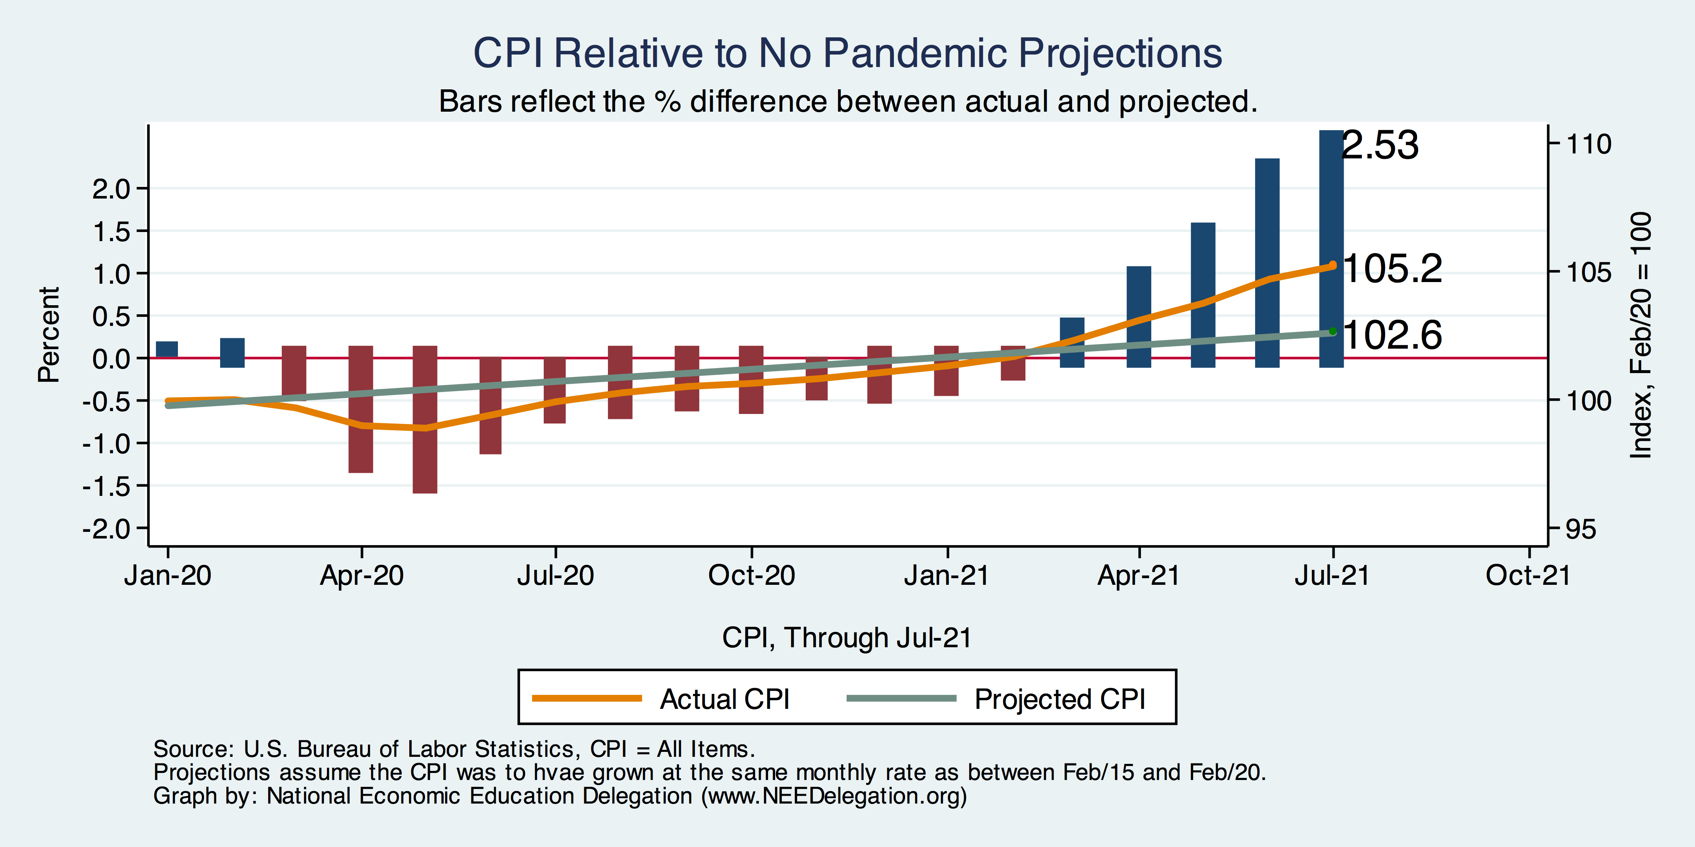
Inflation – CPI Suggests: Yes!
Notes:
Cpi_recent.png

Slide 45
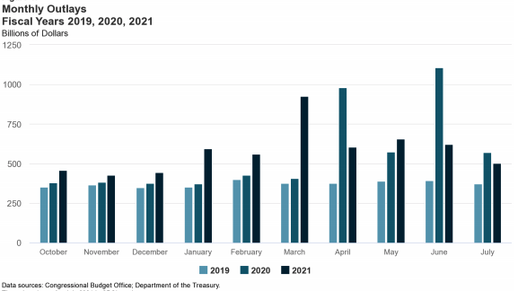
Trillions in Pandemic Spending

Slide 46
Why so Excited About Telecommunting?
Productivity at home appears to be really high during pandemic.
Nothing else to do.
Short term – corporate culture and new hires – visibility to the boss – camaraderie.
CEOs are salivating over reduced Comm RE costs.

Slide 47
Telecommuting – Will it Stick?
Working from home is ALWAYS less productive than working in the office.
But the gap has shrunk because of technology.
In the interest of workplace productivity, employers are likely to allow more working from home.
Increased in-office moral and hence productivity.
But not 100% or even 50%. How much?
Has important implications for real estate.

Slide 48
Population Change: San Francisco & CCC

Slide 49
www.NEEDelegation.org/LocalGraphs
For every state and county in the United States.
Detailed graphs on employment, housing, moves, and other statistics.

