Slide 1
Osher Lifelong Learning Institute, Summer 2021
Contemporary Economic Policy
Summer, 2021, San Francisco State University
Jon Haveman, Ph.D.
National Economic Education Delegation

Slide 2
National Economic Education Delegation
Vision
One day, the public discussion of policy issues will be grounded in an accurate perception of the underlying economic principles and data.
Mission
NEED unites the skills and knowledge of a vast network of professional economists to promote understanding of the economics of policy issues in the United States.
NEED Presentations
Are nonpartisan and intended to reflect the consensus of the economics profession.

Slide 3
Who Are We?
Honorary Board: 54 members
2 Fed Chairs: Janet Yellen, Ben Bernanke
6 Chairs Council of Economic Advisers
Furman (D), Rosen (R), Bernanke (R), Yellen (D), Tyson (D), Goolsbee (D)
3 Nobel Prize Winners
Akerlof, Smith, Maskin
Delegates: 590+ members
At all levels of academia and some in government service
All have a Ph.D. in economics
Crowdsource slide decks
Give presentations
Global Partners: 44 Ph.D. Economists
Aid in slide deck development

Slide 4
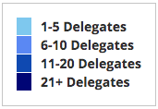
Where Are We?

Slide 5
Available NEED Topics Include:
Coronavirus Economics
US Economy
Climate Change
Economic Inequality
Economic Mobility
Trade and Globalization
Minimum Wages
Immigration Economics
Housing Policy
Federal Budgets
Federal Debt
Black-White Wealth Gap
Autonomous Vehicles
US Social Policy

Slide 6
Course Outline
Contemporary Economic Policy
Week 1 (6/8): US Economy & Coronavirus Economics
Week 2 (6/15): Climate Change Economics (Jennifer Alix-Garcia, Oregon St.)
Week 3 (6/22): Health Economics (Veronika Dolar, SUNY)
Week 4 (6/29): Economic Inequality
Week 5 (7/6): The Black-White Wealth Gap
Week 6 (7/20): Autonomous Vehicles

Slide 7
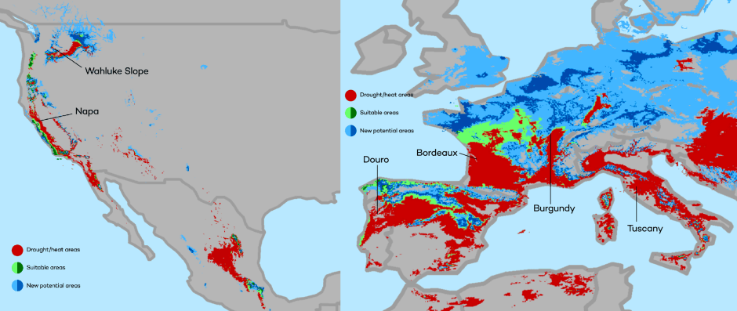
Climate Change Economics
The changing map of the world’s wine-growing regions.

Slide 8
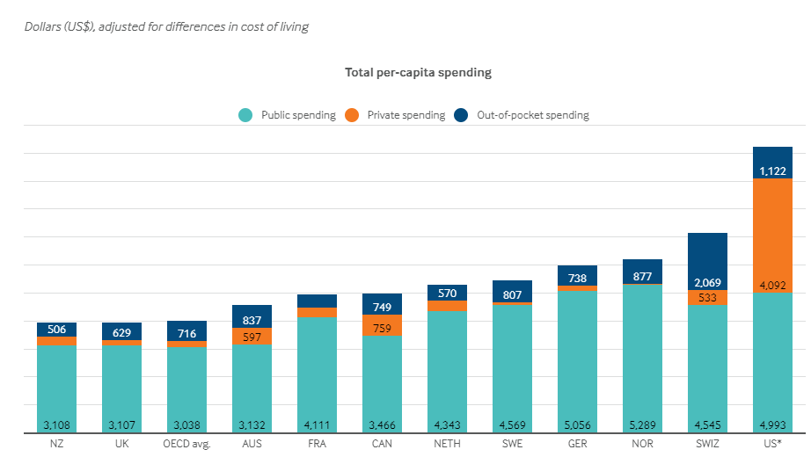
International Comparison: Health Spending
Notes:
Some good resources:
https://www.commonwealthfund.org/publications/issue-briefs/2020/jan/us-health-care-global-perspective-2019
A bit older report: https://www.commonwealthfund.org/publications/issue-briefs/2015/oct/us-health-care-global-perspective
https://www.healthsystemtracker.org/chart-collection/quality-u-s-healthcare-system-compare-countries/#item-overall-age-specific-potential-years-of-life-lost-per-100000-population-1990-2017
https://axenehp.com/international-healthcare-systems-us-versus-world/

Slide 9
National Income Inequality: Share of Top 10%
Stock Market Crash
Dot-com Bubble
WWII
Housing Bubble

Slide 10
Evidence of the Black-White Wealth Gap
Mean is
7x Greater
Median is 8x Greater

Slide 11
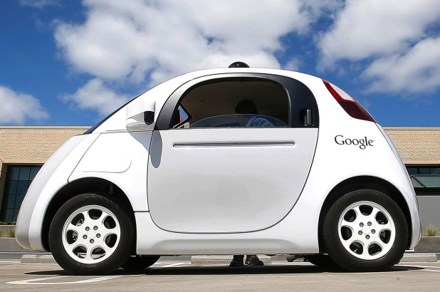
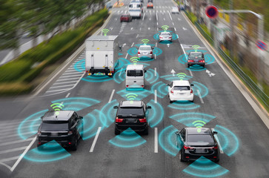
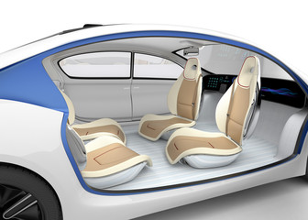
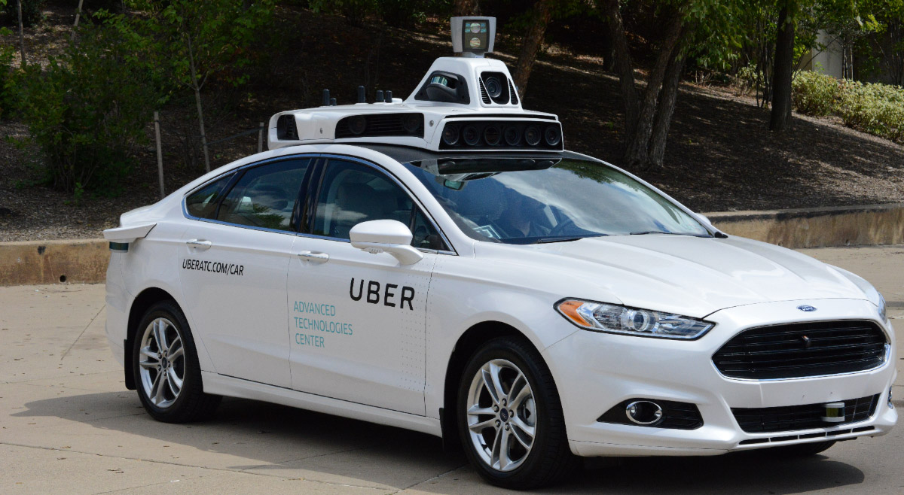
Autonomous Vehicles

Slide 12
COVID-19: Economic Implications and Policy Response

Slide 13
Credits and Disclaimer
This slide deck was authored by:
Jon D. Haveman, NEED
Scott Baier, Clemson University
Geoffrey Woglom, Amherst College (Emeritus)
Brian Dombeck, Lewis & Clark College
Doris Geide-Stevenson, Weber State
Disclaimer
NEED presentations are designed to be nonpartisan.
It is, however, inevitable that the presenter will be asked for and will provide their own views.
Such views are those of the presenter and not necessarily those of the National Economic Education Delegation (NEED).

Slide 14
Outline
The U.S. Economy
What is this?
Evidence of Impact
Government Policy
What to expect going forward

Slide 15
Some Basic Statistics
Statistic: | Value
Population | 331.1 Million
Labor Force | 160.9 Million
Employment | 144.9 Million
Gross Domestic Product (GDP) | 22.1 Trillion
Ave. Hourly Earnings | $30.33

Slide 16
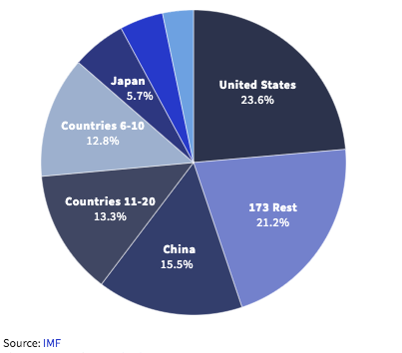
U.S. Economy in Global Perspective
U.S. Real GDP:
$19.3 trillion in 2019-Q4
$19.1 trillion in 2021-Q1
$17.3 trillion in 2020-Q2
Notes:
https://www.investopedia.com/insights/worlds-top-economies/#countries-by-gdp

Slide 17
Composition of the U.S. Economy: GDP

Slide 18
Composition of the U.S. Economy: Employment
Manufacturing
GDP Share = 10.9%
Health GDP Share = 7.4%

Slide 19
COVID

Slide 20
What is this?
A natural disaster – with important twists:
Global
Duration is unpredictable
Economic toll is enormous and potentially durable
A health crisis that spilled over onto the economy.
A perfect storm of economic difficulty
Supply side
Demand side
Financial
Without a culprit

Slide 21
Process for Dealing with a Natural Disaster
Mitigation of effects
Social Policy
Tend to the vulnerable
Fiscal Policy
Shore up structures
Fiscal and Monetary
Rebuild
Stimulus
There are corollaries in this crisis.

Slide 22
Evidence of Impact

Slide 23
Spending Patterns Since First US Case
Source: https://tracktherecovery.org/

Slide 24
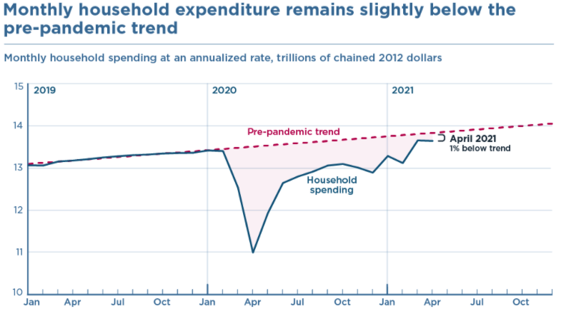
Spending: As High as it Should Be?
Source: Jason Furman, PIIE

Slide 25
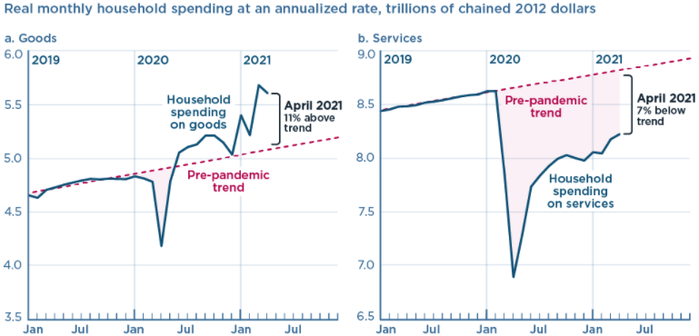
And We’re Buying Mostly … Stuff
Source: Jason Furman, PIIE

Slide 26
Spending Patterns – Hardest Hit Sectors
Source: https://tracktherecovery.org/

Slide 27
Spending Patterns Since First US Case: CA
Total Spending: +11.1%
Source: https://tracktherecovery.org/

Slide 28
Why does spending matter?
Notes:
Components sum to GDP
Average % of GDP for each component from 1960-Present: C = 64%, I=15%, G=24%, NX = 2% (X = 7%, M=9%)
Net Exports as a % of GDP has increased over the sample period, but it’s contribution to GDP is relatively small

Slide 29
GDP Trajectory: Pandemic Plunge!
GDP is:
$0.8 Trillion below 2019 forecast.
$0.2 Trillion below 2019-Q4 level.

Slide 30
GDP: Quarterly Growth
Notes:
Graph: gdp_pot_grow.png
The Point: From 1990 – 2007, average annual US GDP growth pre-crisis is 2.94%. However, post-crisis US GDP growth is 2.19% (0.75 percentage points lower). Why is has the recovery been sluggish?
Note: At the recession’s height, the gap between quarterly GDP growth and potential growth was 2.5 percentage points.

Slide 31
Consumption: Quarterly Growth
Notes:
Graph: gdp_pot_grow.png
The Point: From 1990 – 2007, average annual US GDP growth pre-crisis is 2.94%. However, post-crisis US GDP growth is 2.19% (0.75 percentage points lower). Why is has the recovery been sluggish?
Note: At the recession’s height, the gap between quarterly GDP growth and potential growth was 2.5 percentage points.

Slide 32
Monthly Changes in Nonfarm Employment
Dec. 2020: -140,000
May 2021: +559,000
Notes:
PAYEMS.png

Slide 33
Monthly Changes in Nonfarm Employment
Notes:
PAYEMS.png

Slide 34
Annual Changes in Nonfarm Employment

Slide 35
Employment Gap
Notes:
payroll_recent.png

Slide 36
Employment Gap
Notes:
payroll_recent.png

Slide 37
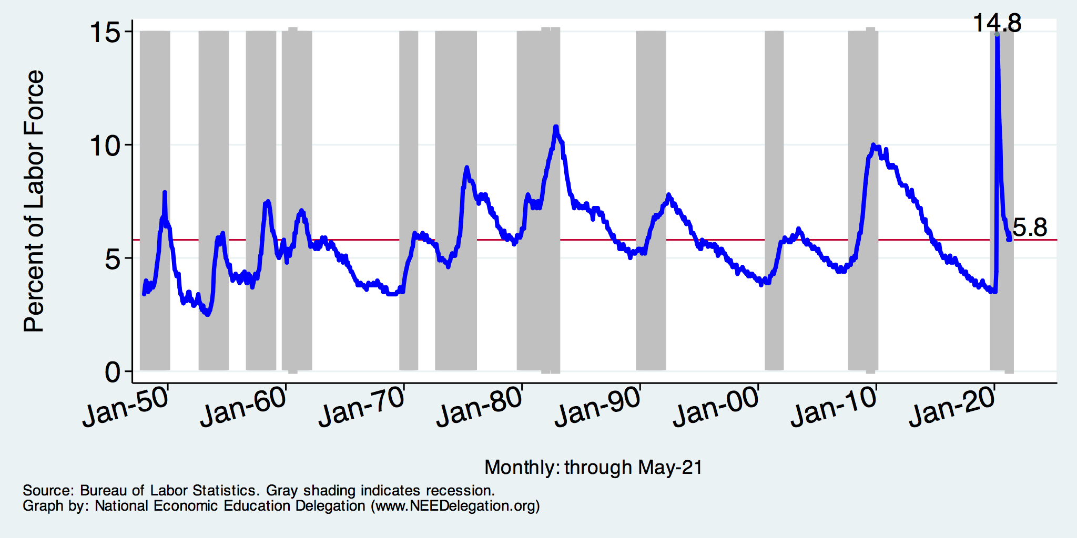
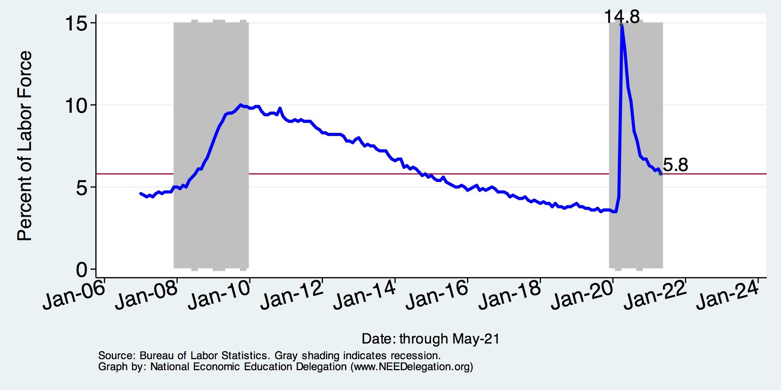
Unemployment Rate
Notes:
Unemployment rises during recessions and falls during economic expansions.
Unemployment peaked at the end of the 2009 recession.
The Fed worked to reduce the effects of the recession. Near the end of 2008, the FOMC reduced the federal funds rate to nearly zero and worked to reduce longer-term interest rates via large-scale asset purchase programs (late 2008 – 10/2014).
Unemployment is currently below the natural rate of unemployment. This is traditionally accompanied by economic growth and rising price levels. It’s also a major reason for FOMC’s decision to increase the federal funds rate.

Slide 38
Reduced Spending: Unemployment
Peak: 22.9% (April)

Slide 39
Labor Force is Shrinking – Drives Down UR

Slide 40
Affected Women More Than Men

Slide 41
Affected Women More Than Men
Men
Women
Long term implications for women?

Slide 42
Why Women More Than Men?
Women are disproportionately represented in low-wage and face-to-face jobs.
Our childcare and school systems don’t meet the needs of working mothers.
COVID-19 has upended the labor market, with disastrous consequences for working women and their families.
Many women continued working in high risk jobs.
The difference in impact is waning.

Slide 43
Affecting Black Workers More than White
White
Black

Slide 44
Continuing Unemployment Claims

Slide 45
Continuing Unemployment Claims

Slide 46
Why Slow Employment Growth?
Economists had expected more than 1 million jobs in April.
Why didn’t we get them?
It is not: the generous unemployment checks.
Low wage sectors were the only ones to see solid employment growth.
Leisure and hospitality: +328k (April) +292 (May)
Professional services: -81k (April) +35 (May)
Lack of wage growth.
It might be:
Continued fear of the virus.
Microchip shortages.
Geographic mismatch and an unwillingness to relocate…yet.
Child care – lack of availability.
???

Slide 47
Employment in California

Slide 48
Employment in San Francisco

Slide 49
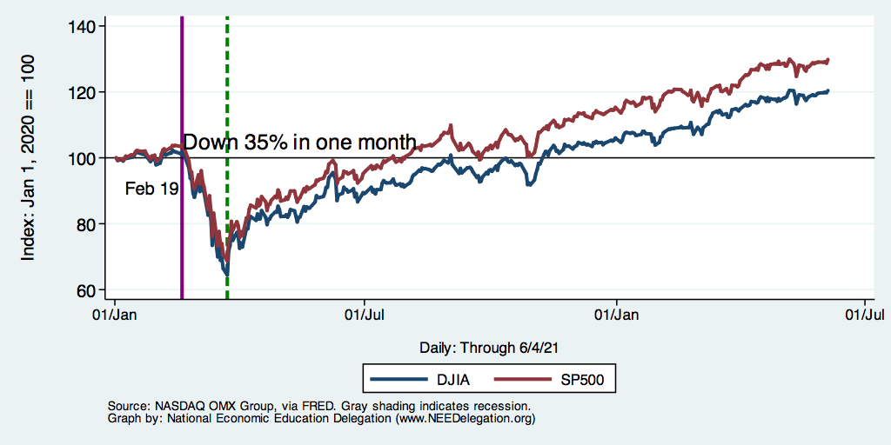
DJIA and S&P 500

Slide 50
State of the Pandemic

Slide 51
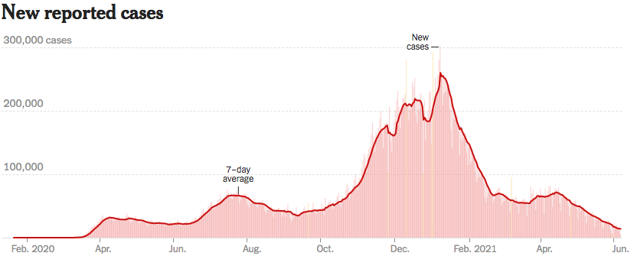
Making Real Progress
Source: NYTimes

Slide 52
California Cases Are Falling Nicely
Source: NYTimes

Slide 53
A Tale of Three Policies Efforts
Social policy: Social Distancing
Fiscal Policy
Monetary Policy

Slide 54
Flattening the Curve and Lengthening the Recession
Without
Protective
Measures
Number or Cases
GOAL for Health Care Capacity
With Protective
Measures
Current Health Care Capacity
Time
GDP (Recession)

Slide 55
Cost Benefit Analysis: Tradeoffs
No containment policies
Reduced economic activity
More coronavirus deaths
Non-coronavirus deaths
Stringent containment policies
Dramatically reduced economic activity
Fewer coronavirus deaths
Non-coronavirus deaths(?)
???
Analysis of Containment Policies
Reduced economic activity < value of additional deaths
Complicated equation – both numerically and philosophically

Slide 56
BOTE Cost Benefit Analysis
BOTE: Back Of The Envelope
BENEFITS of social distancing:
$7 million/life and 600,000 lives saved ($4.2 trillion)
Long term health issues avoided: 2 million at $500,000 ($1 trillion)
Total Benefit of Social Distancing: $5.2 Trillion
COSTS of “Shelter in Place” or “Lockdown”
There are about 70+ workdays in a quarter (plus March).
The cost of a “lockdown” is roughly $1.3 Trillion
Benefit: $5.2 trillion > Cost: $1.3 trillion
https://twitter.com/BetseyStevenson/status/1242180499566669828

Slide 57
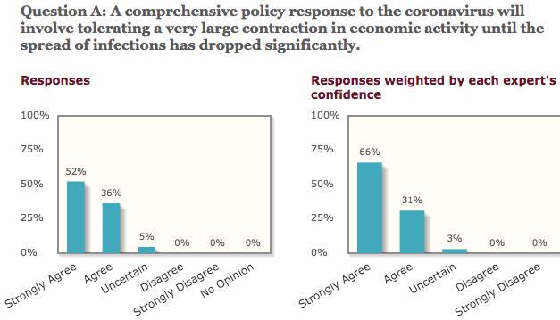
University of Chicago – Experts Poll

Slide 58
Flattening the Curve – Again and Again….is Problematic
Without
Protective
Measures
Number or Cases
GOAL for Health Care Capacity
With Protective
Measures
Current Health Care Capacity
Time
GDP (Recession)

Slide 59
Reopening, It’s Not This Simple

Slide 60
What Have Been Policy Effects
Monetary Policy (Fed) acted quickly and effectively to prevent a financial market meltdown and to keep credit flowing. But the Fed lends and does not spend.
Fiscal policy (Congress) acted quickly, but inevitably made some mistakes.
Stimulus Checks, A ($268b)
Expanded Unemployment, B ($268b)
Paycheck Protection Program, C- ($525b)
Last two packages: $2.8 Trillion
Why?

Slide 61
Is it a V or a K shaped recovery?
Aggregate data look good because the Cares Act (at least until the end of July) supported low income workers.
But, it doesn’t look good everywhere. Bottom part of K
Employment of Low-Income workers.
Small firms.
Hard-hit Sectors: Restaurants, entertainment and transportations.
State and Local Governments
Nike swoosh

Slide 62
A “K-shaped” recovery?
Executive Summary
Those with financial wealth/residential real estate have seen its value grow in excess of inflation.
High income earners (>60k/yr) have largely kept their jobs;
middle and low income earners have depressed employment rates
Women are disproportionately exiting labor force.
Food insecurity is very high.

Slide 63
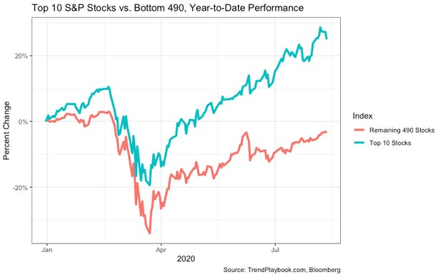
Recovery/Recession for Whom?
Top 10 S&P Stocks:
Apple
Microsoft
Amazon
Facebook
Alphabet Class A shares
Alphabet Class C shares
Berkshire Hathaway
Johnson & Johnson
Visa
Procter & Gamble

Slide 64
Coronavirus and Inequality
Resources to weather the storm.
Racial inequities.
Educational inequities
Telecommuting
Low wage jobs are at risk.

Slide 65
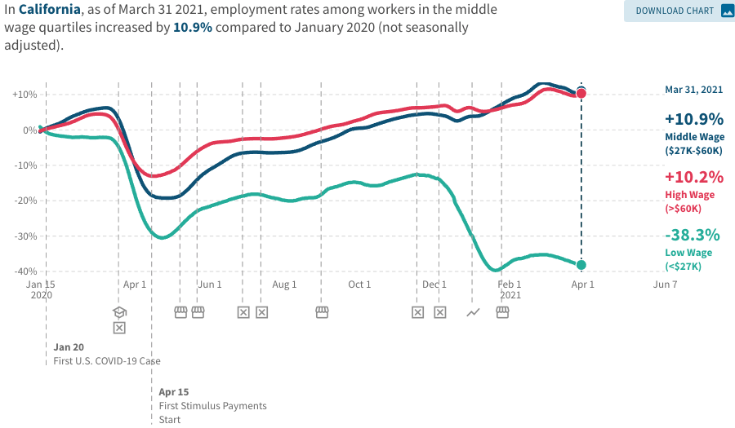
Low Wage Employment is Lagging

Slide 66
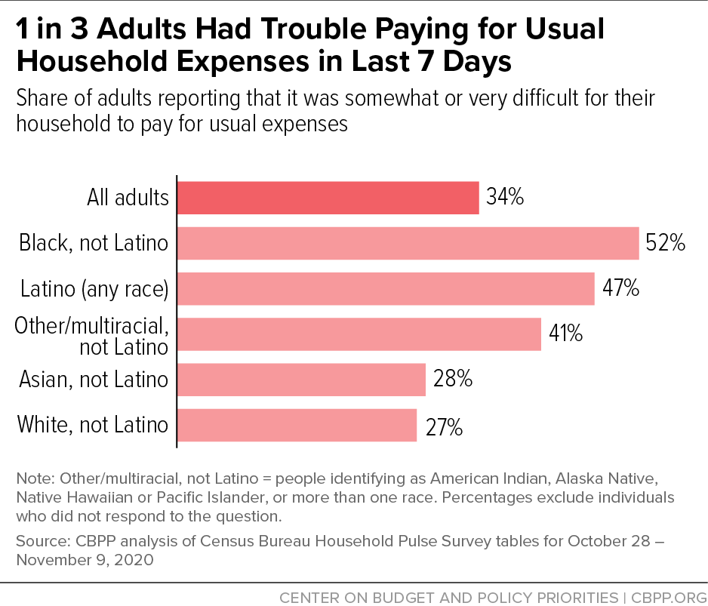
Low Income Troubles

Slide 67
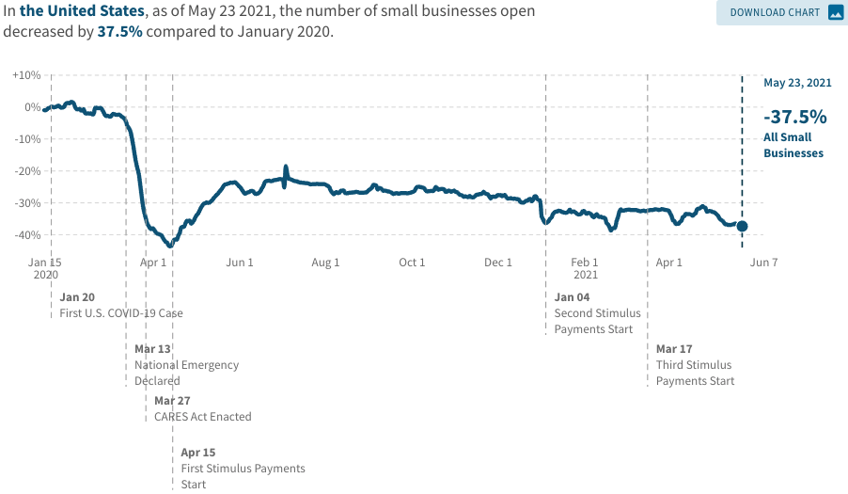
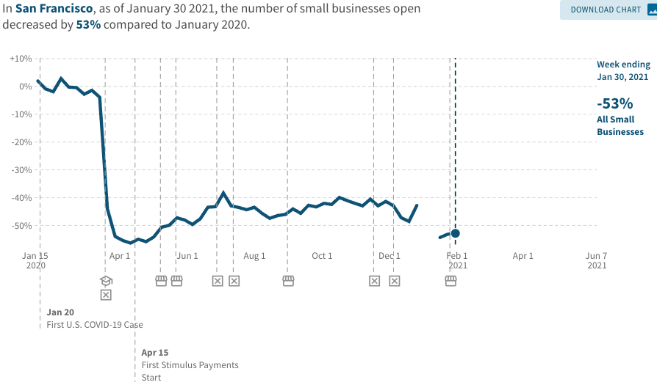
Another Hard-Hit Sector: Small Business
Small Biz Closures in the United States
Small Biz Closures in San Francisco

Slide 68
Small Businesses: They Didn’t Get Enough PPP

Slide 69
2020 State Tax Receipts Relative to 2019
CA
+3.5%
https://markets.jpmorgan.com/research/email/9oirrqoa/jA-9jthJ33avL4Z96Lz3vA/GPS-3630418-0

Slide 70
Employment Losses Don’t Match Revenue
CA
-8.64%

Slide 71
State and Local Employment
Hopefully general federal aid will help.

Slide 72
# of Law Enforcement Officers: 2004-2018

Slide 73
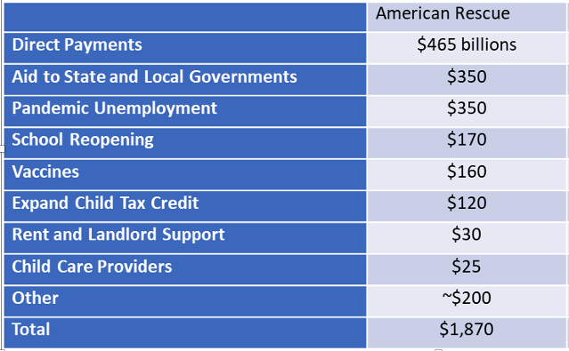
So, The President Went Big!

Slide 74
$1.9 Trillion Plan – Includes Other Initiatives
Child Poverty in the United States, by Race
Child poverty alleviation
Pension fund support
Benefits for veterans
Gender-based violence protections
SNAP and TANF increases
Other…

Slide 75
Balancing Act
Too Big (Larry Summers)
There already is about $1.5 trillion in personal saving waiting to be spent.
Needlessly adding to our debt and deficit problems.
Reignite inflation.
Because of 1 & 2 less room for needed public infrastructure investment.
Too Small (Paul Krugman)
Double Dip.
Your only get one bite at the apple: take care of yourself Senator Leahy!
Prolonged economic scarring.
People in true need are left out.

Slide 76
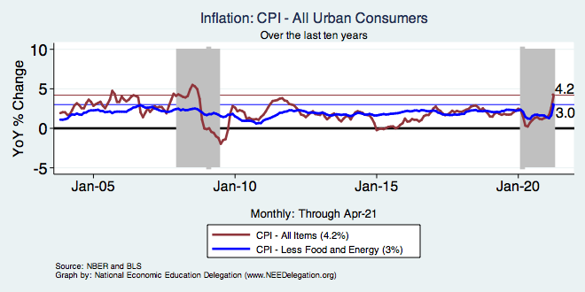
Inflation – Recent Stability
Notes:
Cpi_recent.png

Slide 77
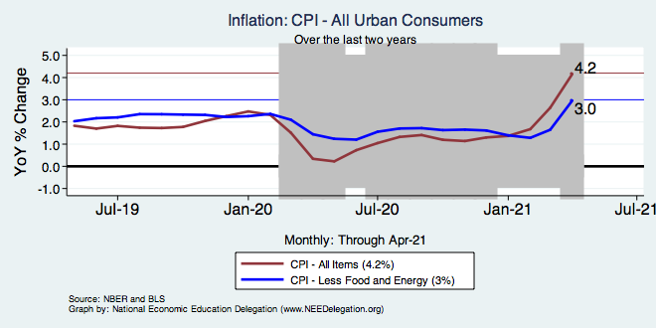
Inflation – Trending Upward?
Notes:
Cpi_recent.png

Slide 78
Prices Overall Had Fallen…Catching Up!

Slide 79
Source of Optimism About Recovery?

Slide 80
A Problem Exacerbated….Not Created

Slide 81
Aggregate Data Looks Encouraging
Recovery has been unexpectedly rapid, albeit incomplete, but has started to pick up again.
Why so rapid: There were no short-run macro problems at the start of the crisis.
The only obstacle to a continued recovery:
Resurgence of the virus.
Economic damage due to prolonged job losses and business failures in specific sectors.
Adapting to structural changes.

Slide 82
Causes for Concern
Economic inequality is worsening
Elevated/persistent unemployment + rising asset prices.
Does not show up in aggregate data (problem of “averages”).
State/local governments face deep budget shortfalls
Often the largest employers within a state.
Eviction/foreclosure moratoria are expiring.
Structural Changes.

Slide 83
Structural Changes?
Pandemic has been an accelerant.
Not a change agent.
Retail
Telecommuting
Telehealth
Business travel?
Wealth concentration
Industry concentration
Automation
NFL Scoring

Slide 84
Population Change: California

Slide 85
Which Way Did They Go?

Slide 86
Population Change: San Francisco & San Mateo

Slide 87
Why so Kean on Telecommunting?
Productivity at home appears to be really high during pandemic.
Nothing else to do.
Short term – corporate culture and new hires – visibility to the boss – camaraderie.
CEOs are salivating over reduced Comm RE costs.

Slide 88
Which Way Did They Go? SF & CC

Slide 89
Telecommuting – Will it Stick?
Working from home is ALWAYS less productive than working in the office.
But the gap has shrunk because of technology.
In the interest of workplace productivity, employers are likely to allow more working from home.
Increasesd in-office moral and hence productivity.
But not 100%. How much?
Has important implications for real estate.

Slide 90
RE Experiences Differ!

Slide 91
Summary

Slide 92
Primary Topics Covered
GDP
Recovered MOST of the decline.
Won’t recover previous forecast until late 2022.
Employment
Still down 11 million jobs relative to forecast. ($7.5 million relative to Feb/20).
Inflation
Going to be high for a little while, but transitory.
Telecommuting
Going to be high for a little while, but transitory.

Slide 93
My Advice for Joe – Had He Asked
First, priority should be to control the pandemic.
Second priority is to protect the vulnerable.
Target spending to rescue:
Poor Households.
State and Local governments (maybe not $350b).
Small Firms (e.g., restaurants).
Third priority is stimulus.
Pursue needed infrastructure investment.
Fourth priority is long term stability.
Develop a politically feasible plan to raise revenues and lower spending over the longer term.
Listen to Janet Yellen.

Slide 94
Conclusion
COVID-19 is health crisis that has macroeconomic implications.
With enormous built-in inequities.
Significant structural changes – accelerant.
GDP will likely expand between 4.0 and 5.0 percent this year.
Policy gap created enormous hardship.
Hunger, evictions, foreclosures, additional deaths.
Loss of GDP: 4-5% Unemployment: up 4-5 pts.
Physical health determines economic health for the economy.
Well on our way to recovery, both health and economic.

Slide 95
Thank you!
Any Questions?
www.NEEDelegation.org
Jon D. Haveman
Jon@NEEDelegation.org
Contact NEED: info@NEEDelegation.org
Submit a testimonial: www.NEEDelegation.org/testimonials.php
Become a Friend of NEED: www.NEEDelegation.org/friend.php

