Slide 1
COVID-19: Economic Implications and Policy Response
Marin County Dept of Education
Property Tax Forum
May 6, 2021
Jon Haveman, Ph.D.
Executive Director, NEED

Slide 2
National Economic Education Delegation
Vision
One day, the public discussion of policy issues will be grounded in an accurate perception of the underlying economic principles and data.
Mission
NEED unites the skills and knowledge of a vast network of professional economists to promote understanding of the economics of policy issues in the United States.
NEED Presentations
Are nonpartisan and intended to reflect the consensus of the economics profession.

Slide 3
Who Are We?
Honorary Board: 54 members
2 Fed Chairs: Janet Yellen, Ben Bernanke
6 Chairs Council of Economic Advisers
Furman (D), Rosen (R), Bernanke (R), Yellen (D), Tyson (D), Goolsbee (D)
3 Nobel Prize Winners
Akerlof, Smith, Maskin
Delegates: 585+ members
At all levels of academia and some in government service
All have a Ph.D. in economics
Crowdsource slide decks
Give presentations
Global Partners: 44 Ph.D. Economists
Aid in slide deck development

Slide 4
Available NEED Topics Include:
Coronavirus Economics
US Economy
Climate Change
Economic Inequality
Economic Mobility
Trade and Globalization
Minimum Wages
Immigration Economics
Housing Policy
Federal Budgets
Federal Debt
Black-White Wealth Gap
Autonomous Vehicles
US Social Policy

Slide 5
Credits and Disclaimer
This slide deck was authored by:
Jon D. Haveman, NEED
Scott Baier, Clemson University
Geoffrey Woglom, Amherst College (Emeritus)
Brian Dombeck, Lewis & Clark College
Doris Geide-Stevenson, Weber State
Disclaimer
NEED presentations are designed to be nonpartisan.
It is, however, inevitable that the presenter will be asked for and will provide their own views.
Such views are those of the presenter and not necessarily those of the National Economic Education Delegation (NEED).

Slide 6
Outline
State of the pandemic
Where is the recovery now?
How has policy affected the recovery?
The most recent COVID package
California and Marin

Slide 7
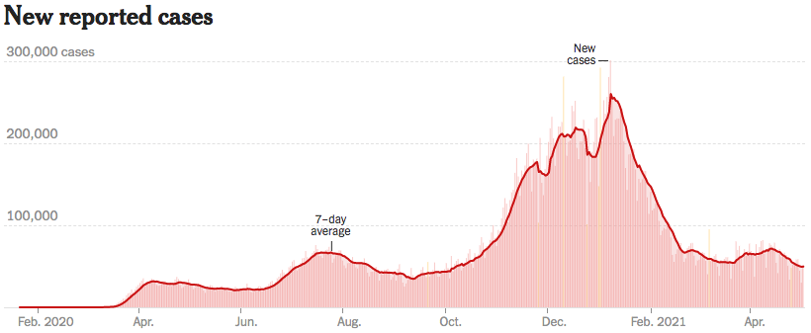
Trajectory Looks Promising
Source: NYTimes

Slide 8
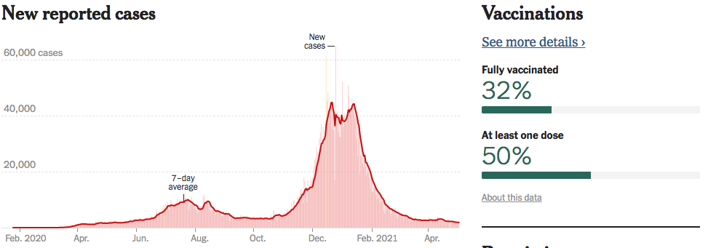
California is Looking Good!
Source: NYTimes

Slide 9
GDP Trajectory: Pandemic Plunge!
GDP is $800 Billion
Below 2019 forecast.

Slide 10
GDP – Quarterly Growth
Notes:
Graph: gdp_pot_grow.png
The Point: From 1990 – 2007, average annual US GDP growth pre-crisis is 2.94%. However, post-crisis US GDP growth is 2.19% (0.75 percentage points lower). Why is has the recovery been sluggish?
Note: At the recession’s height, the gap between quarterly GDP growth and potential growth was 2.5 percentage points.

Slide 11
Philadelphia Federal Reserve
 | Real GDP (%) |  | Unemployment Rate (%)
 | Previous | New | Previous | New
Quarterly
2021:Q1 | 3.2 | 3.2 | 6.7 | 6.3
2021:Q2 | 3.5 | 5.0 | 6.5 | 6.1
2021:Q3 | 3.5 | 5.3 | 6.1 | 5.7
2021:Q4 | 3.3 | 4.0 | 5.8 | 5.4
2022:Q1 | N.A. | 3.7 | N.A. | 5.1
Annual data (projections based on annual averages):
2021 | 4.0 | 4.5 | 6.3 | 5.9
2022 | 3.0 | 3.7 | 5.2 | 4.8
2023 | 2.1 | 3.1 | 4.6 | 4.2
2024 | N.A. | 2.5 | N.A. | 4.0
Survey of Professional Forecasters Q1 2021
IMF: GDP Growth after inflation
+5.1% in 2021
+2.5% in 2022
CBO: GDP Growth after inflation
+4.6% in 2021
+2.9% in 2022
+2.3% in 2023
Source: Federal Reserve

Slide 12
Spending Patterns Since First US Case
Source: https://tracktherecovery.org/

Slide 13
Spending Patterns – Hardest Hit Sectors
Source: https://tracktherecovery.org/

Slide 14
Employment Gap
Notes:
payroll_recent.png

Slide 15
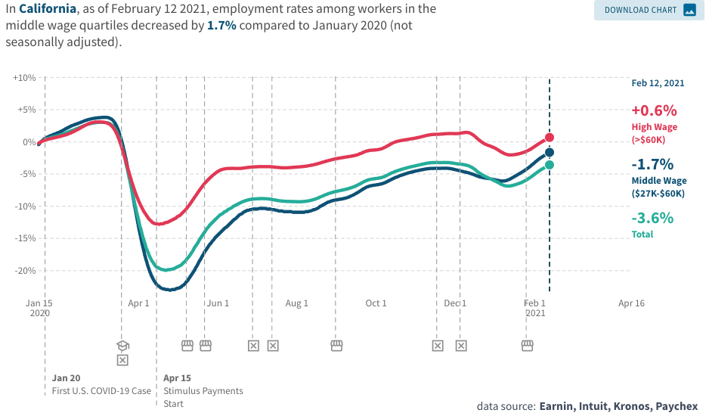
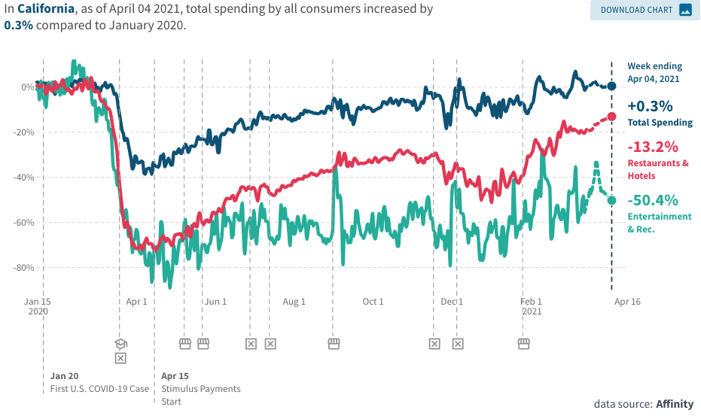
Conditions Closer to Home
Employment in California
Consumer Spending in California

Slide 16
Employment Situation: California

Slide 17
What Have Been Policy Effects
Monetary Policy (Fed) acted quickly and effectively to prevent a financial market meltdown and to keep credit flowing. But the Fed lends and does not spend.
Fiscal policy (Congress) acted quickly, but inevitably made some mistakes.
Stimulus Checks, A ($268b)
Expanded Unemployment, B ($268b)
Paycheck Protection Program, C- ($525b)
Last couple of months: $2.8 Trillion
Why?

Slide 18
K-Shaped Recovery

Slide 19
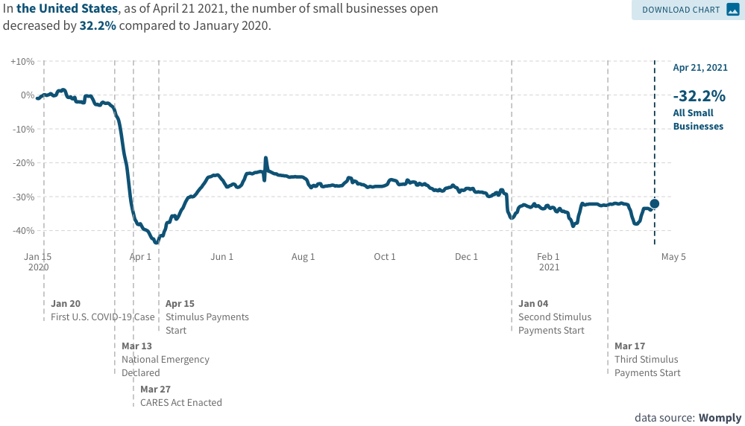
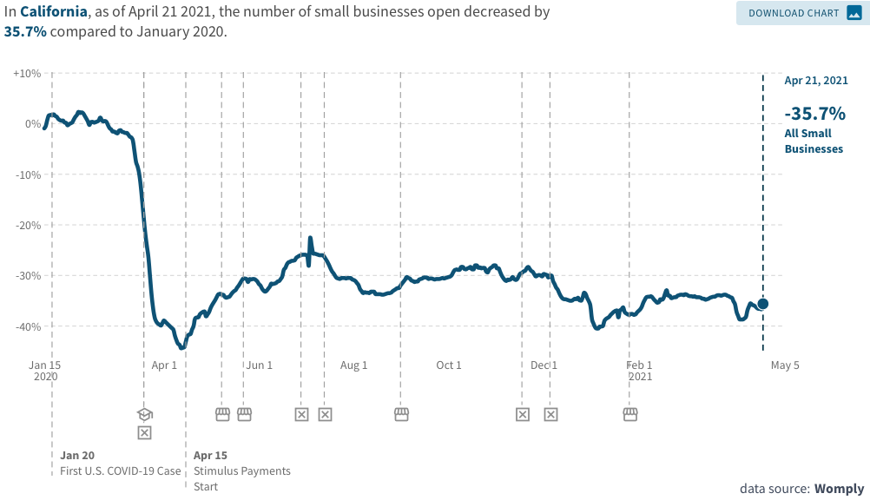
Another Hard-Hit Sector: Small Business
Small Biz Closures in the United States
Small Biz Closures in California

Slide 20
2020 State Tax Receipts Relative to 2019
CA
+3.5%
https://markets.jpmorgan.com/research/email/9oirrqoa/jA-9jthJ33avL4Z96Lz3vA/GPS-3630418-0

Slide 21
Employment Losses Don’t Match Revenue
CA
-8.64%

Slide 22
State and Local Employment
Since February 2020, a net loss of 1.3m jobs (from a low base).

Slide 23
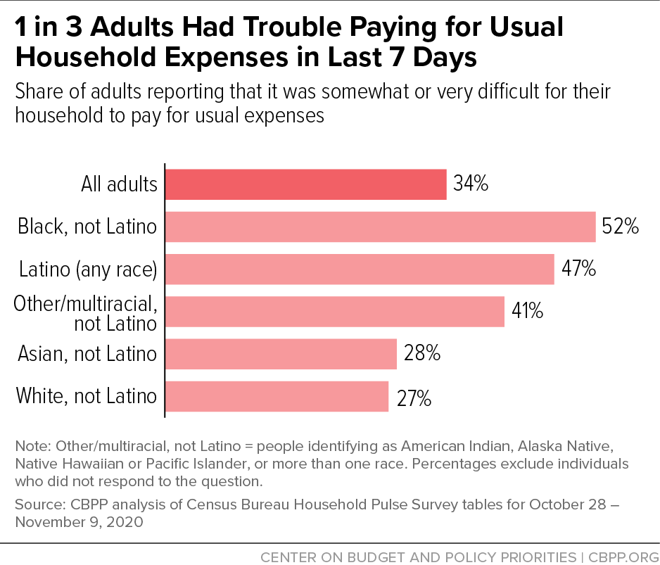
And,People are Really Hurting

Slide 24
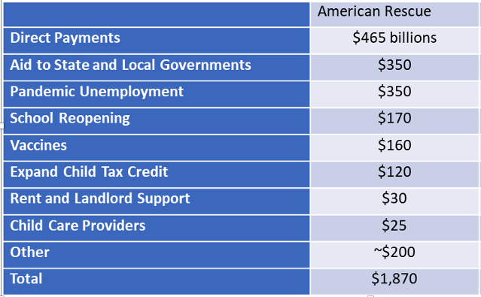
So, The President Went Big!

Slide 25
Balancing Act
Too Big (Larry Summers)
There already is about $1.5 trillion in personal saving waiting to be spent.
Needlessly adding to our debt and deficit problems.
Reignite inflation.
Because of 1 & 2 less room for needed public infrastructure investment.
Too Small (Paul Krugman)
Double Dip.
Your only get one bite at the apple: take care of yourself Senator Leahy!
Prolonged economic scarring.
People in true need are left out.

Slide 26
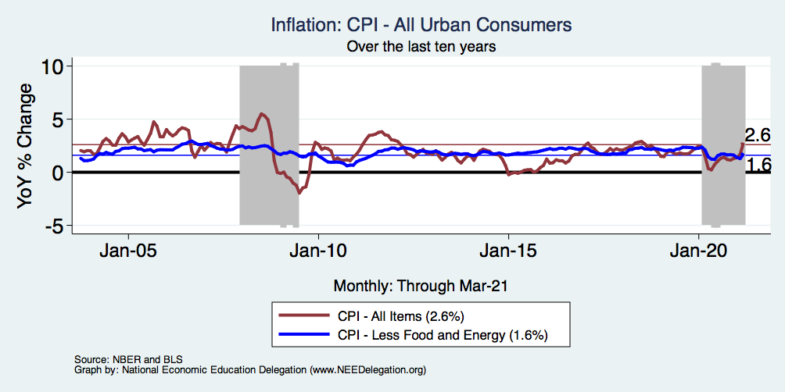
Inflation – Recent Stability
Notes:
Cpi_recent.png

Slide 27
A Problem Exacerbated….Not Created

Slide 28
Aggregate Data Looks Encouraging
Recovery has been unexpectedly rapid, albeit incomplete, but has started to pick up again.
Why so rapid: There were no short-run macro problems at the start of the crisis.
The only obstacle to a continued recovery:
Resurgence of the virus.
Economic damage due to prolonged job losses and business failures in specific sectors.
Adapting to structural changes.

Slide 29
Structural Changes?
Pandemic has been an accelerant.
Not a change agent.
Retail
Telecommuting
Telehealth
Business travel?
Wealth concentration
Industry concentration
Automation

Slide 30
My Advice for Joe, Had He Asked
First, priority should be to control the pandemic.
Second priority is to protect the vulnerable.
Target spending to rescue:
Poor Households.
State and Local governments (maybe not $350b).
Small Firms (e.g., restaurants).
Third priority is stimulus.
Pursue needed infrastructure investment.
Fourth priority is long term stability.
Develop a politically feasible plan to raise revenues and lower spending over the longer term.
Listen to Janet Yellen.

Slide 31
California & Marin

Slide 32
Population Change: California

Slide 33
Which Way Did They Go?

Slide 34
Population Change: San Francisco & Marin

Slide 35
Which Way Did They Go? SF & Marin

Slide 36
Real Estate Prices

Slide 37
RE Experiences Differ!

Slide 38
Marin’s Home Price Position

Slide 39
Home Price Appreciation w/in Marin

Slide 40
Employment Situation: Marin County

Slide 41
Employment Situation: Marin County

Slide 42
For More Graphs on Marin’s Economy
https://needelegation.org/LocalGraphs/

Slide 43
Summary
U.S. economy poised for a solid recovery.
Small businesses may struggle for a while yet.
GDP likely to recover fully end of 2021, early 2022.
Employment may take a little longer.
California is lagging behind the rest of the United States.
Tourism is going to be slow in recovering…until it isn’t!
Marin workers are doing well, but employment is not.
Small business services sector drives employment in Marin.
Home prices locally are doing well.
Marin is benefitting from the San Francisco exodus.

Slide 44
Thank you!
Any Questions?
www.NEEDelegation.org
Jon Haveman
Jon@NEEDelegation.org
Contact NEED: info@needelegation.org
Submit a testimonial: www.NEEDelegation.org/testimonials.php
Become a Friend of NEED: www.NEEDelegation.org/friend.php

