Slide 1
The State of the Recovery and the Challenges Ahead
July 13, 2021
Maplewood Rotary Club
Geoffrey Woglom
Professor of Economics (emeritus)
Amherst College

Slide 2
National Economic Education Delegation
Vision
One day, the public discussion of policy issues will be grounded in an accurate perception of the underlying economic principles and data.
Mission
NEED unites the skills and knowledge of a vast network of professional economists to promote understanding of the economics of policy issues in the United States.
NEED Presentations
Are nonpartisan and intended to reflect the consensus of the economics profession.

Slide 3
Who Are We?
Honorary Board: 54 members
2 Fed Chairs: Janet Yellen, Ben Bernanke
6 Chairs Council of Economic Advisers
Furman (D), Rosen (R), Bernanke (R), Yellen (D), Tyson (D), Goolsbee (D)
3 Nobel Prize Winners
Akerlof, Smith, Maskin
Delegates: 590+ members
At all levels of academia and some in government service
All have a Ph.D. in economics
Crowdsource slide decks
Give presentations
Global Partners: 44 Ph.D. Economists
Aid in slide deck development

Slide 4
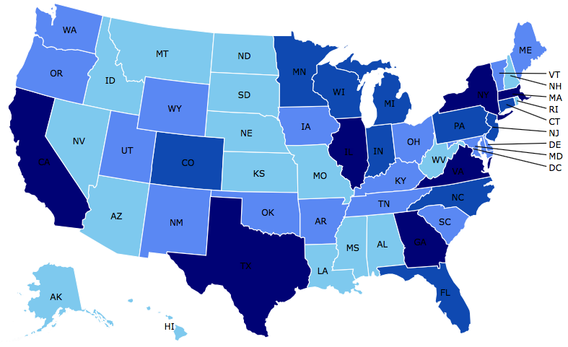
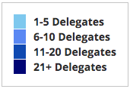
Where Are We?

Slide 5
Available NEED Topics Include:
US Economy
Climate Change
Economic Inequality
Economic Mobility
US Social Policy
Trade and Globalization
Minimum Wages
Immigration Economics
Housing Policy
Federal Budgets
Federal Debt
Black-White Wealth Gap
Autonomous Vehicles

Slide 6
Credits and Disclaimer
This slide deck was authored by:
Geoffrey Woglom, Amherst College, emeritus
This slide deck was reviewed by:
Jon Haveman
Disclaimer
NEED presentations are designed to be nonpartisan.
It is, however, inevitable that the presenter will be asked for and will provide their own views.
Such views are those of the presenter and not necessarily those of the National Economic Education Delegation (NEED).

Slide 7
Real GDP and Potential during the Recovery
The “output gap” is about $500b
-2.6%
-10.5%
Source: Bureau of Economic Activity https://www.bea.gov/ & CBO

Slide 8
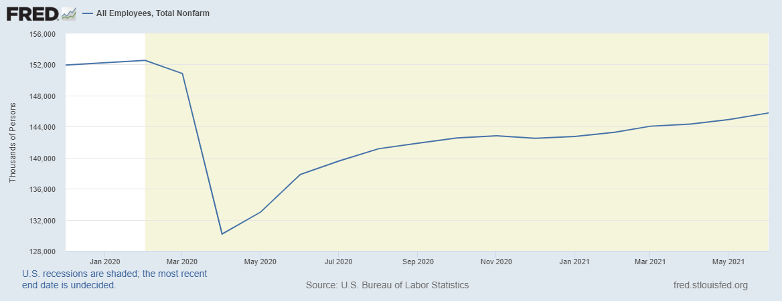
How about the Labor Market?
-7m

Slide 9
Recovery Due to Immense Fiscal Stimulus and Control of COVID

Slide 10
Stimulus allowed Spending to Recover
But Note that Saving also went way up
Saving
Abnormally high Saving is over $2trillion

Slide 11
Production and Employment on Tap for a Full Recovery
Fiscal Stimulus is Not Done.
Emergency Unemployment will continue until September 4th.
Expanded Child Tax Credit Payments start this month and continue to the end of the year.
Infrastructure on the Horizon?
Monetary Policy is committed to maintaining near zero interest rates:
The Committee decided to keep [short-term intertest rates near zero] until labor market conditions have reached levels consistent with the Committee’s assessments of maximum employment… (Policy Statement 6/16)
Proviso: We keep the Pandemic under Control

Slide 12
Ah, But What about Inflation?
Ugliness is Also in the Eye of the Beholder: It depends on the starting point for measuring price increases:
Annualized Percentage Changes in the CPI (excl food and energy)
May to Jun, 11.1%
Jun 2020 to Jun 2021, 4.5% (highest since 10/91!)
Feb 2020 (since the start of the recession), to Jun 2021 3.1%
A Picture Might Help!

Slide 13
Inflation during the Recovery

Slide 14
Recent Inflation Has Been More than 2.5%
But why?
Price increases are “catching up” for declines in early 2020.
Supply disruptions due to the virus –e.g., used car prices have risen by 45 percent.
Labor shortages due to
Too generous unemployment benefits.
Covid Fears and Family responsibilities.
Mismatch of available workers and jobs.
Total spending is growing too fast.
Notice, that except for 4., the other reasons are temporary,

Slide 15
Democratic Economists Can Disagree
Treasury Secretary Jane Yellen, 3/14:
To get a sustained high inflation like we had in the 1970s, I absolutely don’t expect that. We have had very well anchored inflationary expectations, and a Federal Reserve that’s learned how to manage inflation.
Former Treasury Secretary Larry Summers, 3/26:
It may be that a way will be found to bring it under control. But as I look at $3 trillion of stimulus, $2 trillion of savings overhang, …,rates expected by the Federal Reserve to be at zero for three years even in a booming economy, …, and much new fiscal stimulus to come — I'm worried.

Slide 16
How Does the Fed “Manage” Inflation?
The Fed has a “dual mandate”
Price stability (2% inflation, which corresponds to 2.5% in CPI)
Maximum employment consistent with price stability.
When the Fed fears a rise in inflation, they raise interest rates to lower total spending.
When the Fed fears rising unemployment, they cut interest rates to increase total spending.
These tools are far more effective when inflationary expectations are stable, or as in Yellen’s jargon, well anchored at 2%.
At the moment, the Fed appears to be more concerned about its employment objective than in the past. Could this change lead to inflationary expectations becoming “unmoored?”

Slide 17
So, What’s the Problem?
If the Fed sees an uptick in inflation, can’t they raise interest rates?
Economic Problems
Total Spending has tremendous inertia, it could take months for a rise in interest rates to slow spending;
Significant danger of “overshooting.” What would a substantial rise in interest rates do to stock prices, financial stability, Federal deficit?
Political Economic Problem
Would the Fed raise rates with the 2022 elections pending?
A substantial rise in rates would make our deficit and debt problems much, much worse.

Slide 18
Financial Press Is Confused (as am I)

Slide 19
So, Too the Bond Market
NYTimes, 7/8, “The Bond Market Is Telling Us to Worry About Growth, Not Inflation”

Slide 20
Thank you!
What Do You Think?
www.NEEDelegation.org
Geof Woglom
grwoglom@amherst.edu
Contact NEED: info@needelegation.org
Submit a testimonial: www.NEEDelegation.org/testimonials.php
Become a Friend of NEED: www.NEEDelegation.org/friend.php

Slide 21
