Slide 1
COVID-19: Economic Implications and Policy Response
680 Exchange
May 19, 2021
Jon Haveman, Ph.D.
Executive Director, NEED

Slide 2
National Economic Education Delegation
Vision
One day, the public discussion of policy issues will be grounded in an accurate perception of the underlying economic principles and data.
Mission
NEED unites the skills and knowledge of a vast network of professional economists to promote understanding of the economics of policy issues in the United States.
NEED Presentations
Are nonpartisan and intended to reflect the consensus of the economics profession.

Slide 3
Who Are We?
Honorary Board: 54 members
2 Fed Chairs: Janet Yellen, Ben Bernanke
6 Chairs Council of Economic Advisers
Furman (D), Rosen (R), Bernanke (R), Yellen (D), Tyson (D), Goolsbee (D)
3 Nobel Prize Winners
Akerlof, Smith, Maskin
Delegates: 590+ members
At all levels of academia and some in government service
All have a Ph.D. in economics
Crowdsource slide decks
Give presentations
Global Partners: 44 Ph.D. Economists
Aid in slide deck development

Slide 4
Available NEED Topics Include:
Coronavirus Economics
US Economy
Climate Change
Economic Inequality
Economic Mobility
Trade and Globalization
Minimum Wages
Immigration Economics
Housing Policy
Federal Budgets
Federal Debt
Black-White Wealth Gap
Autonomous Vehicles
US Social Policy

Slide 5
Credits and Disclaimer
This slide deck was authored by:
Jon D. Haveman, NEED
Scott Baier, Clemson University
Geoffrey Woglom, Amherst College (Emeritus)
Brian Dombeck, Lewis & Clark College
Doris Geide-Stevenson, Weber State
Disclaimer
NEED presentations are designed to be nonpartisan.
It is, however, inevitable that the presenter will be asked for and will provide their own views.
Such views are those of the presenter and not necessarily those of the National Economic Education Delegation (NEED).

Slide 6
Outline
State of the pandemic
Where is the recovery now?
How has policy affected the recovery?
The most recent COVID package
Inflation and the debt
Local mobility and RE data
Summary

Slide 7
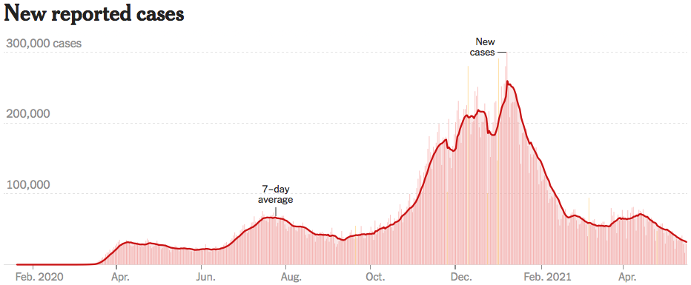
Trajectory Looks Promising
Source: NYTimes

Slide 8
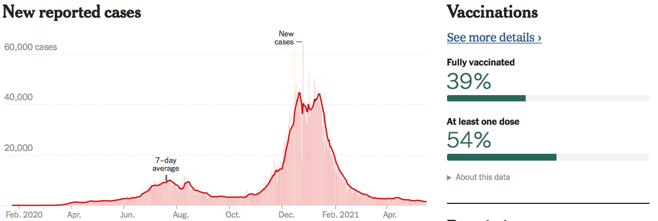
California is Looking Good!
Source: NYTimes

Slide 9
GDP Trajectory: Pandemic Plunge!
GDP is $800 Billion
Below 2019 forecast.
$170 billion below 2019-Q4

Slide 10
GDP – Quarterly Growth
Notes:
Graph: gdp_pot_grow.png
The Point: From 1990 – 2007, average annual US GDP growth pre-crisis is 2.94%. However, post-crisis US GDP growth is 2.19% (0.75 percentage points lower). Why is has the recovery been sluggish?
Note: At the recession’s height, the gap between quarterly GDP growth and potential growth was 2.5 percentage points.

Slide 11
Spending Patterns Since First US Case
Source: https://tracktherecovery.org/

Slide 12
Spending Patterns – Hardest Hit Sectors
Source: https://tracktherecovery.org/

Slide 13
Slow April Employment Growth
266k was
very disappointing

Slide 14
Why Slow Employment Growth?
Nobody yet knows…could be an anomaly. Just one month.
It is not: the generous unemployment checks.
Low wage sectors were the only ones to see solid employment growth.
Leisure and hospitality: +331k
Professional services: -111k
It might be:
Continued fear of the virus
Microchip shortages
Geographic mismatch and an unwillingness to relocate…yet.
Child care – lack of availability.
???

Slide 15
Employment Gap
Notes:
payroll_recent.png

Slide 16
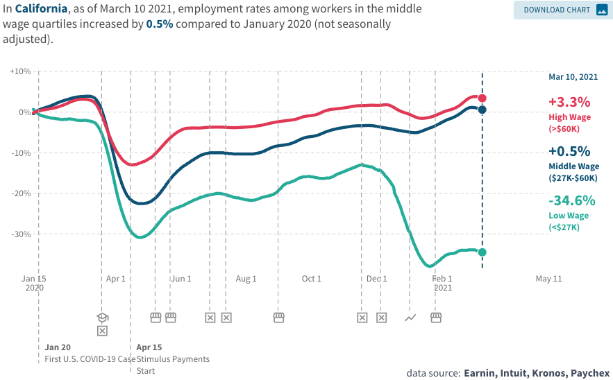
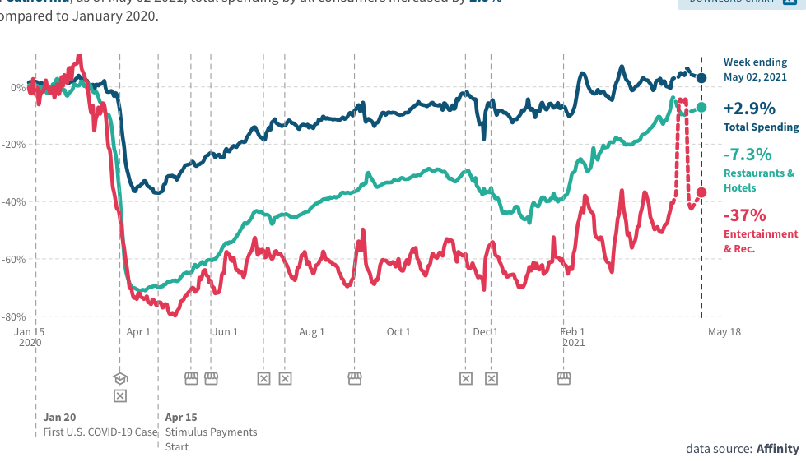
Conditions Closer to Home
Employment in California
Consumer Spending in California
Total: -0.1%

Slide 17
Employment Situation: California

Slide 18
Employment Situation: Contra Costa County

Slide 19
What Have Been Policy Effects
Monetary Policy (Fed) acted quickly and effectively to prevent a financial market meltdown and to keep credit flowing. But the Fed lends and does not spend.
Fiscal policy (Congress) acted quickly, but inevitably made some mistakes.
Stimulus Checks, A ($268b)
Expanded Unemployment, B ($268b)
Paycheck Protection Program, C- ($525b)
Last 6 of months: $2.8 Trillion
Why?

Slide 20
K-Shaped Recovery

Slide 21
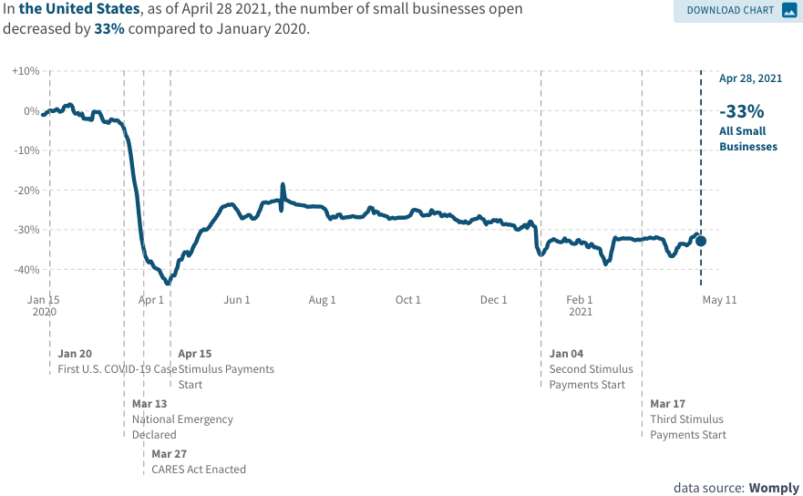
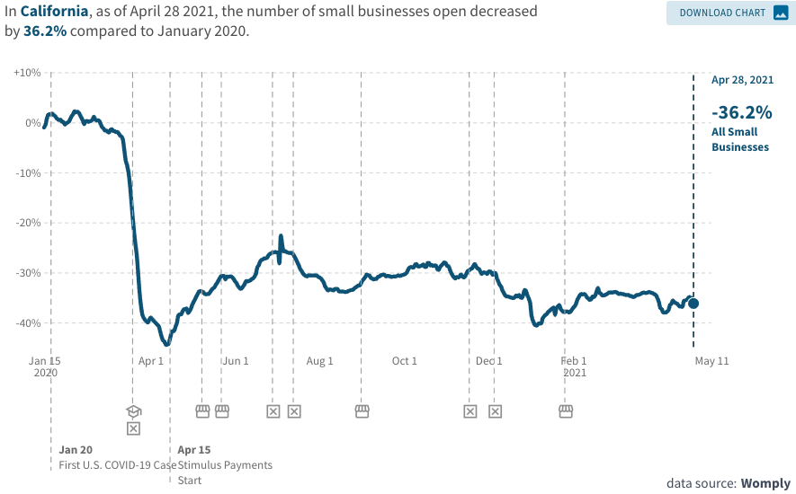
Another Hard-Hit Sector: Small Business
Small Biz Closures in the United States
Small Biz Closures in California

Slide 22
State and Local Employment
Since February 2020, a net loss of 1.3m jobs (from a low base).

Slide 23
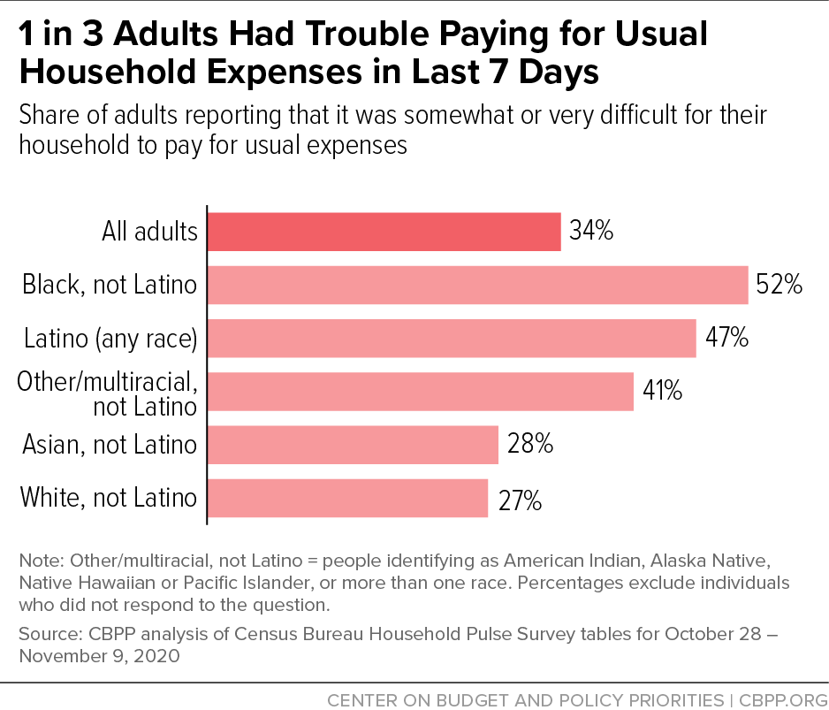
And,People are Really Hurting

Slide 24
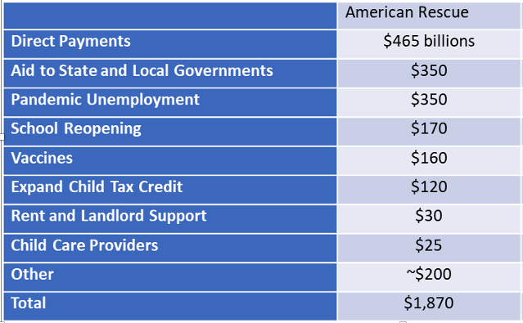
So, The President Went Big!

Slide 25
Balancing Act
Too Big (Larry Summers)
There already is about $1.5 trillion in personal saving waiting to be spent.
Needlessly adding to our debt and deficit problems.
Reignite inflation.
Because of 1 & 2 less room for needed public infrastructure investment.
Too Small (Paul Krugman)
Your only get one bite at the apple.
Prolonged economic scarring.
People in true need are left out.

Slide 26
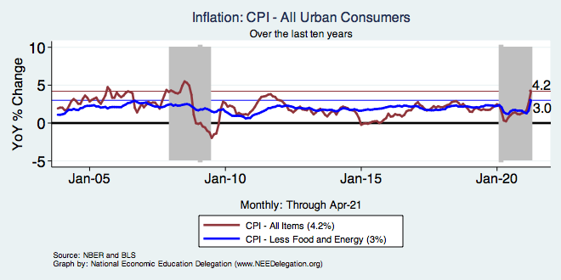
Inflation – Recent Stability
Used cars and trucks =
One-third of the all items increase.
Notes:
Cpi_recent.png

Slide 27
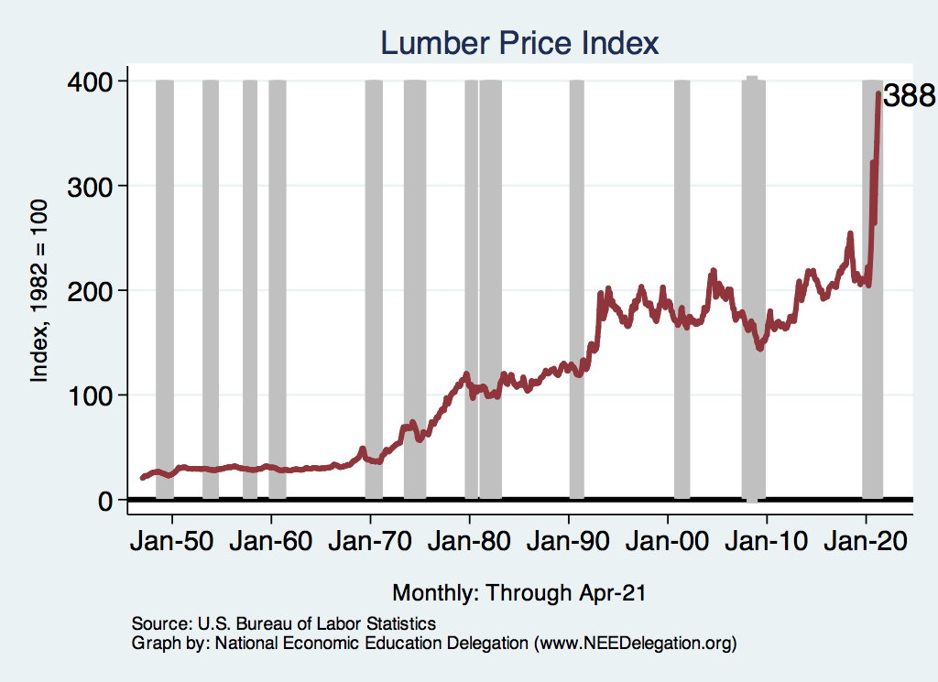
Used Cars & Wood

Slide 28
A Problem Exacerbated….Not Created

Slide 29
Aggregate Data Looks Encouraging
Recovery has been unexpectedly rapid, albeit incomplete and perhaps slowing.
Why so rapid: There were no short-run macro problems at the start of the crisis.
Obstacles to a continued recovery:
Fear of the virus or a resurgence.
Economic damage due to prolonged job losses and business failures in specific sectors.
Adapting to structural changes.

Slide 30
Structural Changes?
Pandemic has been an accelerant.
Not a change agent.
Retail
Telecommuting
Telehealth
Business travel?
Wealth concentration
Industry concentration
Automation

Slide 31
Population Change: California

Slide 32
Which Way Did They Go?

Slide 33
Population Change: San Francisco & Contra Costa

Slide 34
Which Way Did They Go? SF & CC

Slide 35
RE Experiences Differ!

Slide 36
Summary
U.S. economy poised for a solid recovery.
Small businesses may struggle for a while yet.
GDP likely to recover fully end of 2021, early 2022.
Employment may take a little longer.
California is lagging behind the rest of the United States.
Tourism is going to be slow in recovering…until it isn’t!
Debt and inflation are the primary concerns at this point.
Sec. Yellen is not concerned about inflation.
Economists are not (yet) concerned about the debt.

Slide 37
Thank you!
Any Questions?
www.NEEDelegation.org
Jon Haveman
Jon@NEEDelegation.org
Contact NEED: info@needelegation.org
Submit a testimonial: www.NEEDelegation.org/testimonials.php
Become a Friend of NEED: www.NEEDelegation.org/friend.php

Slide 38
2020 State Tax Receipts Relative to 2019
CA
+3.5%
https://markets.jpmorgan.com/research/email/9oirrqoa/jA-9jthJ33avL4Z96Lz3vA/GPS-3630418-0

Slide 39
Employment Losses Don’t Match Revenue
CA
-8.64%

