Slide 1
COVID-19: Economic Implications and Policy Response
July 7, 2021 Rotary Club, Albuquerque, NM
Doris Geide-Stevenson, Ph.D.
Professor of Economics
Weber State University, Ogden, UT

Slide 2
Who Are We?
Honorary Board: 47 members
2 Fed Chairs: Janet Yellen, Ben Bernanke
6 Chairs Council of Economic Advisers
Furman (D), Rosen (R), Bernanke (R), Yellen (D), Tyson (D), Goolsbee (D)
3 Nobel Prize Winners
Akerlof, Smith, Maskin
Delegates: 500+ members
At all levels of academia and some in government service
All have a Ph.D. in economics
Crowdsource slide decks
Give presentations
Global Partners: 45 Ph.D. Economists
Aid in slide deck development

Slide 3
Credits and Disclaimer
This slide deck was authored by:
Scott L. Baier, Clemson University
Jon D. Haveman, NEED
Geoffrey Woglom, Amherst College
Doris Geide-Stevenson, Weber State University
Disclaimer
NEED presentations are designed to be nonpartisan.
It is, however, inevitable that the presenter will be asked for and will provide their own views.
Such views are those of the presenter and not necessarily those of the National Economic Education Delegation (NEED).

Slide 4
Resources
Schedules of Major Economic Releases
Economic Calendars at
Marketwatch (marketwatch.com/economy-politics/calendar)
FRBNY (newyorkfed.org/research/calendars/nationalecon_cal)
DIY Real Time Data:
Track the Recovery: (tracktherecovery.org)
Federal Reserve Economic Database (FRED): (fred.stlouisfed.org)

Slide 5
Guiding Questions
What is the current state of “the economy”?
What have been the effects of policy?
What kind of a recovery are we looking at?
What about inflation?
What about the labor market?
Is progress equitable?

Slide 6
Spending Collapsed in March 2020
https://tracktherecovery.org/
Notes:
Why did spending collapse – severely reduced time spent outside the home – lockdowns mandatory

Slide 7
Implications of Reduced Spending

Slide 8
Where are We ?
Real GDP = Total value of production = Consumption + Investment + Government Purchases + Net Exports
Still a negative Output Gap compared to the start of the pandemic, but a quick recovery.
Notes:
US real GDP fell by 2.5% between 2020Q4 and 2019Q4, but is forecast to grow between 5.9 – 7ds% in 2021 (IMF).

Slide 9
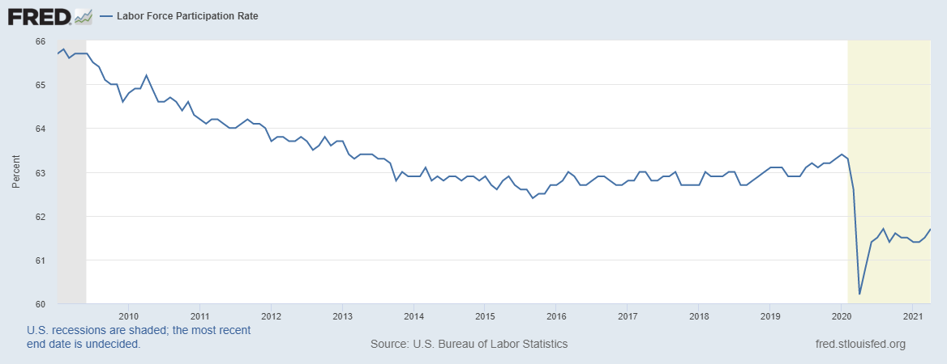
What is going on with the labor market?
Notes:
May 2021 5.8 % unemployment rate. Missouri 4.1%

Slide 10
Employment Rates by Income
Notes:
US: total employment down by 6.5% and 23.6% for low wage workers.

Slide 11
Where are we now? - Summary
Household spending on goods and many services has recovered (+), with ‘whiplash’ in some sectors that contribute to shortages.
Repeated cash injections from government have increased household personal income and savings (+)
Interest rates are at historic lows, but expected to trend up earlier (+)
About 1/3 of small businesses have stopped operations (-), but many new business formations (+)
Unemployment rolls remain elevated and employment is below pre-pandemic levels (7 million fewer employed) (-)
Many Americans – both men and women - have left the labor force (as of May 2021: All: 3.5 million, 1.7 million men and 1.95 million women) (-)

Slide 12
A Tale of Three Policy Efforts
Health Policy – Addressing the Pandemic
Monetary Policy
Fiscal Policy

Slide 13
Health Policy – Pandemic
Moved from various types of ‘social distancing’ and ‘lock-downs’ to living with Covid-19.
Unlikely to reach full herd immunity in the US – continued threat from new variants for vaccinated and unvaccinated persons.
Uneven global approach to vaccinations.

Slide 14
Federal Funds Rate and Balance Sheet
Monetary Policy acted quickly and effectively to prevent a financial market meltdown and keep credit flowing. But the Fed lends and does not spend; so there is a limited impact on spending.
Notes:
Primary objective: Stabilize the economy and maintain the functioning of the financial system by providing liquidity to all kinds of institutions.

Slide 15
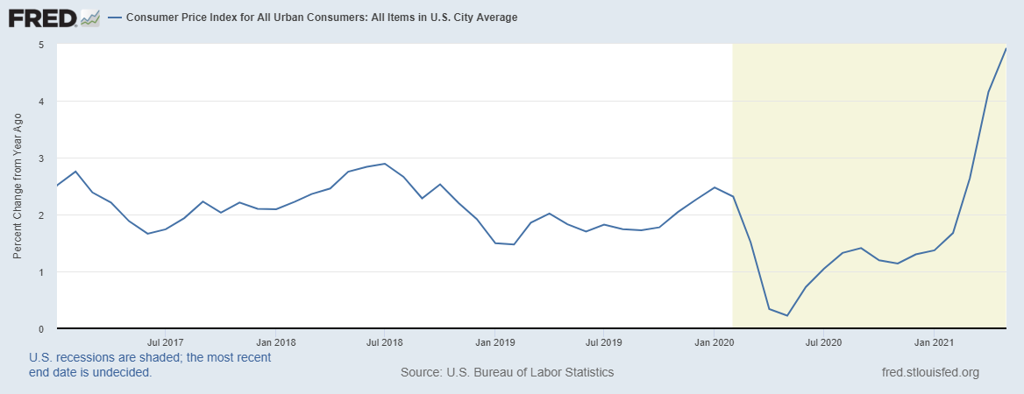
Inflation I
Higher temporary inflation because of: 1. Base effect, 2. Pent-up demand for services, 3. Supply-chain disruptions.
Current market measures of inflation expectations are 2.3 – 2.4% annually (close to Fed goal). Fed measure of inflation
Is below CPI measures – closer to 3% currently.

Slide 16
TLocal Housing Market – Asset Market 1

Slide 17
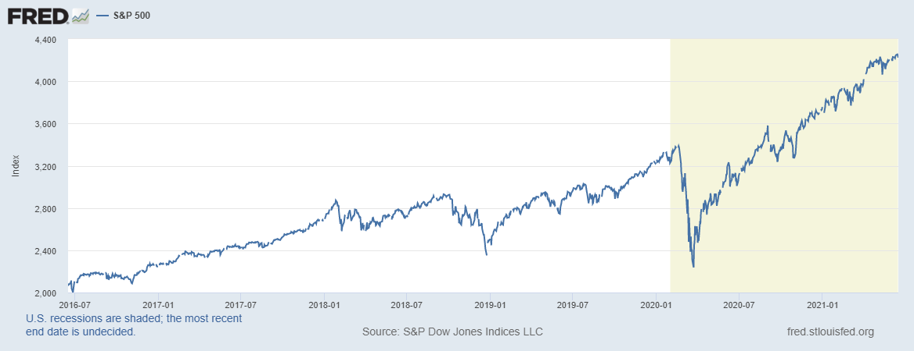
Stock Market Impact – Asset Market 2

Slide 18
Fiscal Policy Timeline – First Round
Phase I: H.R. 6074
3/6
Phase II: Family First
3/14
Phase IIIa: CARES
3/18
Phase III b
4/24
$8 Billion
R&D
Public Health
Medical Supplies
Other
$100 Billion
Paid Sick Leave
Family Medical Leave
Covid-19 Testing
Unemployment Expansion
$2.2 Trillion
HHLD Payments
Support for Small Firms
Support for Medium Sized Firms
Unemployment Insurance
Aid to States
$484 Billion
(More) Support for Small Firms
COVID-19 Testing
Hospitals
Notes:
CARES Act Coronavirus Aid, Relief, and Economic Security Act

Slide 19
Who is spending in the US?
Low Income Households were able to increase spending in response to the stimulus programs. High income households chose not to spend as much as before the lockdown.

Slide 20
Who is spending in New Mexico?

Slide 21
Hard Hit Sectors – uneven recovery among industries

Slide 22
Fiscal Policy Timeline – Second and Third Round
Phase IV: H.R. 133
12/27
Phase V
03/11/21
$900 Billion
Direct Payments ($600)
Small Business Support Extension of UI Benefits
Other
$1.9 Trillion
Direct Payments ($1400)
Aid to State and Local Government
Pandemic Unemployment School Reopening
Vaccines
Notes:
CARES Act Coronavirus Aid, Relief, and Economic Security Act

Slide 24
Expected impact of the stimulus bill
Updated expectations for U.S. economic growth: 5.95% - 7% Q42020 through Q42021 (WSJ survey/Oxford Economics/Fed)
Updated expectations for global economic growth: +1% because of vaccination roll-out and US fiscal stimulus (OECD forecast)
Increase in national debt/GDP ratio to WWII levels (additional debt financed at negative real interest rates).
Substantial (temporary) reduction of child poverty as most benefits from the current bill go to households with incomes below $90,000.

Slide 25
Questions about the stimulus bill
Is the bill too big and will it cause inflation?
Maybe, but unlikely since income subsidies (about $1tn) are temporary, consumers are likely to spend only about 50% and save 50%. This will not be enough to close the existing negative output gap. Uptick in the CPI (5% in May 2021 likely transitory).
Does the bill contain ‘pork’ that is not directly targeting Covid relief?
Yes, but about 85% of the total spending is pandemic-related (if state and school aid is included).
Should the bill have prioritized other types of programs?
Instead of direct payments to persons unaffected by the pandemic more infrastructure spending would have created more future economic growth.
https://www.usatoday.com/story/news/factcheck/2021/03/02/fact-check-breaking-down-spending-covid-19-relief-bill/6887487002 Zhao, Chen, Inflation risk from Biden’s stimulus plan is exaggerated, Financial Times, March 9, 2021 Wolf, Martin, Joe Biden’s $1.9tn package is a risky experiment, Financial Times, Feb. 23, 2021

Slide 26
Is there a worker shortage?
Unemployment benefits and economic impact payments have created a financial cushion for many households.
Ongoing concerns with pandemic affect child care and other caregiving.
Some early retirements (about 1 million).
Early recovery reconnected workers with their old jobs – in this phase new matches have to be made.
Real average hourly earnings are still lower in May 2021 than they were a year ago.
There is room for more workers to enter the labor force – and for wages to increase.

Slide 27
K- Shaped Recovery

Slide 28
Conclusion
COVID-19 is public health crisis that has macroeconomic implications.
With enormous built-in inequities.
Strong policy responses in the US have led to a strong recovery of the US economy.
Positive growth will return in 2021. Forecast: 6 – 7% for 2021.
Significant structural changes.
Telecommuting, telehealth, retail decline, other business failures. Increased concentration of market power – but also many new business formations.
Ongoing economic reallocations will create uncertainty.
Long-term effects: Educational opportunities, labor force participation changes, reallocations that require retraining, possibly increasing inequality, long-term health challenges.
Wide agreement that the ‘American Rescue Plan’ was needed, but debate over the size of additional fiscal stimulus to ‘building back better’.
Households are in a stronger financial position, but government debt has increased substantially.

Slide 29
Thank you!
Any Questions?
www.NEEDelegation.org
Doris Geide-Stevenson dgsteven@weber.edu
Contact NEED: info@needelegation.org
Submit a testimonial: www.NEEDelegation.org/testimonials.php
Become a Friend of NEED: www.NEEDelegation.org/friend.php

