Slide 1
COVID-19: Economic Implications and Policy Response
June 17, 2021 Rotary Club 13, Kansas City, MO
Doris Geide-Stevenson, Ph.D.
Professor of Economics
Weber State University, Ogden, UT

Slide 2
Who Are We?
Honorary Board: 47 members
2 Fed Chairs: Janet Yellen, Ben Bernanke
6 Chairs Council of Economic Advisers
Furman (D), Rosen (R), Bernanke (R), Yellen (D), Tyson (D), Goolsbee (D)
3 Nobel Prize Winners
Akerlof, Smith, Maskin
Delegates: 500+ members
At all levels of academia and some in government service
All have a Ph.D. in economics
Crowdsource slide decks
Give presentations
Global Partners: 45 Ph.D. Economists
Aid in slide deck development

Slide 3
Credits and Disclaimer
This slide deck was authored by:
Scott L. Baier, Clemson University
Jon D. Haveman, NEED
Geoffrey Woglom, Amherst College
Doris Geide-Stevenson, Weber State University
Disclaimer
NEED presentations are designed to be nonpartisan.
It is, however, inevitable that the presenter will be asked for and will provide their own views.
Such views are those of the presenter and not necessarily those of the National Economic Education Delegation (NEED).

Slide 4
Resources
Schedules of Major Economic Releases
Economic Calendars at
Marketwatch (marketwatch.com/economy-politics/calendar)
FRBNY (newyorkfed.org/research/calendars/nationalecon_cal)
DIY Real Time Data:
Track the Recovery: (tracktherecovery.org)
Federal Reserve Economic Database (FRED): (fred.stlouisfed.org)

Slide 5
Guiding Questions
What is the current state of “the economy”?
What have been the effects of policy?
What kind of a recovery are we looking at?
What about inflation?
Is progress equitable?

Slide 6
Spending Collapsed in March 2020
https://tracktherecovery.org/
Notes:
Why did spending collapse – severely reduced time spent outside the home – lockdowns mandatory

Slide 7
Implications of Reduced Spending

Slide 8
Where are We ?
Real GDP = Total value of production = Consumption + Investment + Government Purchases + Net Exports
Still a negative Output Gap compared to the start of the pandemic, but a quick recovery.
Notes:
US real GDP fell by 2.5% between 2020Q4 and 2019Q4, but is forecast to grow between 5.9 – 7ds% in 2021 (IMF).

Slide 9
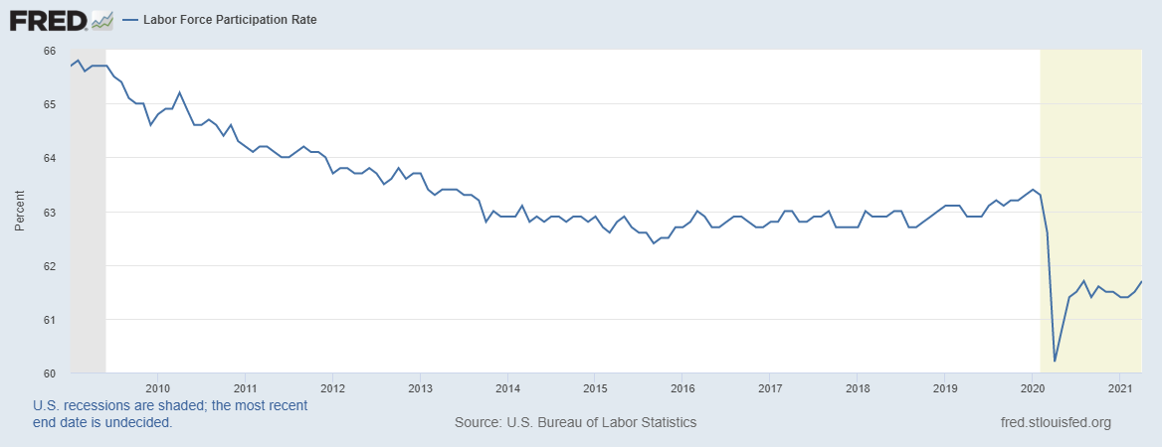
What is going on with the labor market?
Notes:
May 2021 5.8 % unemployment rate. Missouri 4.1%

Slide 10
Employment Rates by Income
Notes:
US: total employment down by 6.5% and 23.6% for low wage workers.

Slide 11
Where are we now? - Summary
Household spending on goods and many services has recovered (+), but Entertainment and Recreation still slightly below pre-pandemic levels.
Repeated cash injections from government have increased household personal income and savings (+)
Interest rates are at historic lows, but trending up since Feb. (+/-)
About 1/3 of small businesses have stopped operations (-)
Unemployment rolls remain elevated and employment is below pre-pandemic levels (7 million fewer employed) (-)
Many Americans – both men and women - have left the labor force (as of May 2021: All: 3.5 million, 1.7 million men and 1.95 million women) (-)

Slide 12
A Tale of Three Policy Efforts
Social policy: Social Distancing
Monetary Policy
Fiscal Policy

Slide 13
How impactful is government? – Social Policy
Notes:
Note TX versus CA also.

Slide 14
Federal Funds Rate and Balance Sheet
Monetary Policy acted quickly and effectively to prevent a financial market meltdown and keep credit flowing. But the Fed lends and does not spend; so there is a limited impact on spending.
Notes:
Primary objective: Stabilize the economy and maintain the functioning of the financial system by providing liquidity to all kinds of institutions.

Slide 15
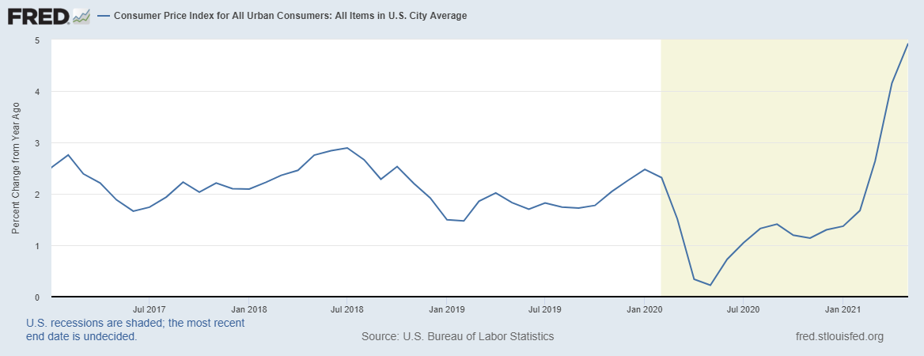
Inflation I
Higher temporary inflation because of: 1. Base effect, 2. Pent-up demand for services, 3. Supply-chain disruptions.
Current market measures of inflation expectations are 2.3 – 2.4% annually (close to Fed goal). Fed measure of inflation
Is below CPI measures – closer to 3% currently.

Slide 16
Interest Rate Outlook
But longer term interest rates (10-yr Treasury bond rate) are already trending upward since Feb. 2021.
Notes:
In updated projections, Fed officials 13/18 indicate they expect to lift short-term rates by the end of 2023, up from 7 in March.

Slide 17
TLocal Housing Market – Asset Market 1

Slide 18
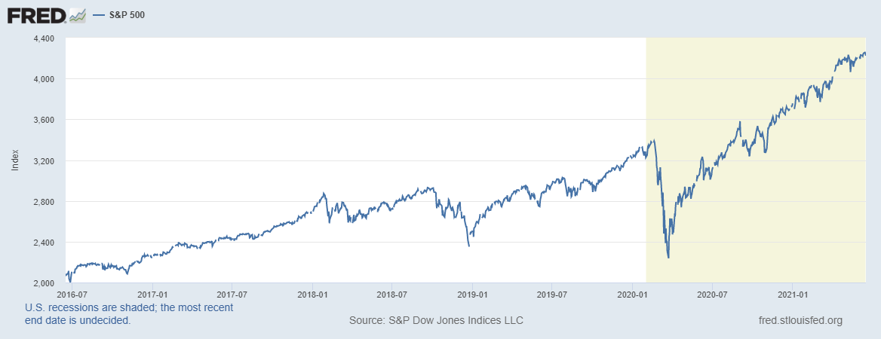
Stock Market Impact – Asset Market 2

Slide 19
Fiscal Policy Timeline – First Round
Phase I: H.R. 6074
3/6
Phase II: Family First
3/14
Phase IIIa: CARES
3/18
Phase III b
4/24
$8 Billion
R&D
Public Health
Medical Supplies
Other
$100 Billion
Paid Sick Leave
Family Medical Leave
Covid-19 Testing
Unemployment Expansion
$2.2 Trillion
HHLD Payments
Support for Small Firms
Support for Medium Sized Firms
Unemployment Insurance
Aid to States
$484 Billion
(More) Support for Small Firms
COVID-19 Testing
Hospitals
Notes:
CARES Act Coronavirus Aid, Relief, and Economic Security Act

Slide 20
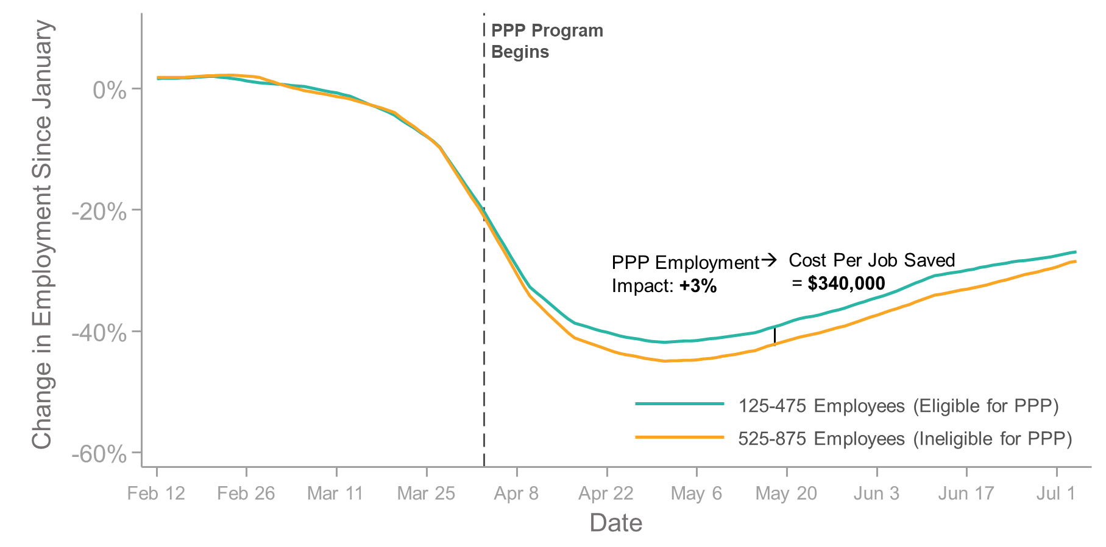
Did PPP Mitigate Job Losses?
Key Takeaway:
PPP had a relatively small impact on small business payroll (but it did help!)

Slide 21
Who is spending in Missouri?
Low Income Households were able to increase spending in response to the stimulus programs. High income households chose not to spend as much as before the lockdown.

Slide 22
Hard Hit Sectors – uneven recovery among industries

Slide 23
Fiscal Policy Timeline – Second and Third Round
Phase IV: H.R. 133
12/27
Phase V
03/11/21
$900 Billion
Direct Payments ($600)
Small Business Support Extension of UI Benefits
Other
$1.9 Trillion
Direct Payments ($1400)
Aid to State and Local Government
Pandemic Unemployment School Reopening
Vaccines
Notes:
CARES Act Coronavirus Aid, Relief, and Economic Security Act

Slide 25
Expected impact of the stimulus bill
Updated expectations for U.S. economic growth: 5.95% - 7% Q42020 through Q42021 (WSJ survey/Oxford Economics/Fed)
Updated expectations for global economic growth: +1% because of vaccination roll-out and US fiscal stimulus (OECD forecast)
Increase in national debt/GDP ratio to WWII levels (additional debt financed at negative real interest rates).
Substantial (temporary) reduction of child poverty as most benefits from the current bill go to households with incomes below $90,000.

Slide 26
Questions about the stimulus bill
Is the bill too big and will it cause inflation?
Maybe, but unlikely since income subsidies (about $1tn) are temporary, consumers are likely to spend only about 50% and save 50%. This will not be enough to close the existing negative output gap. Uptick in the CPI (5% in May 2021 likely transitory).
Does the bill contain ‘pork’ that is not directly targeting Covid relief?
Yes, but about 85% of the total spending is pandemic-related (if state and school aid is included).
Should the bill have prioritized other types of programs?
Instead of direct payments to persons unaffected by the pandemic more infrastructure spending would have created more future economic growth.
https://www.usatoday.com/story/news/factcheck/2021/03/02/fact-check-breaking-down-spending-covid-19-relief-bill/6887487002 Zhao, Chen, Inflation risk from Biden’s stimulus plan is exaggerated, Financial Times, March 9, 2021 Wolf, Martin, Joe Biden’s $1.9tn package is a risky experiment, Financial Times, Feb. 23, 2021

Slide 27
A “K-shaped” recovery?
Executive Summary
Those with financial wealth/residential real estate have seen its value grow in excess of inflation
High and middle income earners (>60k/yr) have largely kept their jobs; low income earners have depressed employment rates
Women (with young kids) are disproportionately exiting labor force
Specific industries (vaccine reliant) are hit particularly hard
Little evidence that UI benefits are a major disincentive for employment
Notes:
UI: careful studies look at variation in UI benefits across states – no evidence that more generous states lack in employment gains. Major reallocations with the labor market are likely (workers not going back to previous jobs). Still health concerns (long Covid, ineffective vaccine for immunocompromised people). Stimulative impact – increased aggregate demand outweigh the disincentive effect.

Slide 28
K- Shaped Recovery

Slide 29
Conclusion
COVID-19 is public health crisis that has macroeconomic implications.
With enormous built-in inequities.
GDP contracted 2.5% in 2020, much less than anticipated.
Positive growth will return in 2021. Forecast: 6 – 7% for 2021.
Significant structural changes.
Telecommuting, telehealth, retail decline, other business failures. Increased concentration of market power.
Policy gap and economic reallocations have created hardship.
Hunger, evictions, foreclosures, additional deaths.
Long-term effects: Educational opportunities, labor force participation changes, reallocations that require retraining, increasing inequality, long-term health challenges.
Wide agreement that the ‘American Rescue Plan’ was needed, but debate over the size of additional fiscal stimulus to ‘building back better’.

Slide 30
Thank you!
Any Questions?
www.NEEDelegation.org
Doris Geide-Stevenson dgsteven@weber.edu
Contact NEED: info@needelegation.org
Submit a testimonial: www.NEEDelegation.org/testimonials.php
Become a Friend of NEED: www.NEEDelegation.org/friend.php

Slide 31
What are the risks to recovery?
Continuation of the virus with mutations and insufficient vaccine roll-out (like 1918)
Lack of additional and appropriately targeted fiscal support to prevent debt default, evictions, and business failures (like 1929)
Damage to State and Local Budgets leading to cuts in jobs and discretionary spending (like 2009)
Key Risk #1: Temporary economic downturn becoming permanent Key Risk #2: An inequitable recovery
Both risks are directly addressed with the American Rescue Plan.

Slide 32
2020 State Tax Receipts Relative to 2019
https://markets.jpmorgan.com/research/email/9oirrqoa/jA9jthJ33avL4Z96Lz3vA/GPS-3630418-0

Slide 34
Monetary Policy – Federal Reserve – 2020
Primary objectives:
Stabilize the economy
Maintain liquidity of the system
March 15
March 17/18
March 23
April 9
March 3
Primary Market Corporate Credit Facility
(PMCCF)
Secondary Market Corporate Credit Facility
(CMCCF)
Term Asset-Backed Securities Loan Facility
(TALF)
Paycheck Protection Program Liquidity Facility (PPPLF)
Main Street Business Lending Program
Municipal Liquidity Facility
Federal Funds Rate
Discount Window Lending
Quantitative Easing
Forward Guidance
Primary Dealer Credit Facility
(PDCF)
Commercial Paper Funding Funding Facility (CPFF)
Money Market Mutual Fund Facility (MMLF)
Federal Funds Rate

Slide 35
President Biden’s Infrastructure Plan
Source: New York Times, Mar. 31, 2021

Slide 36
Personal Savings Rate – impact of Fiscal Policy

Slide 37
Causes for Optimism
There were no short-run macro problems at the start of the crisis
The only obstacle to a quick recovery is damage that is being done while the pandemic continues (and the pandemic itself)
Main concern: temporary disruptions turning into permanent ones
Things are not as bad as they could be
Federal Reserve prevented collapse in financial markets
Congress + White House prevented complete collapse in labor/productive markets; second and third rounds of stimulus will help
Aggregate household balance sheets in good position
Vaccine rollout should alleviate pressure on service industry

Slide 38
Causes for Concern
Economic inequality is worsening
Elevated/persistent unemployment + rising asset prices
Does not show up in aggregate data (problem of “averages”)
State/local governments may face deep budget shortfalls (13% of employment)
https://www.brookings.edu/events/the-covid-19-pandemic-and-state-local-budgets-past-present-and-future/
Often the largest employers within a state
Eviction/foreclosure moratoria are shifting burdens to future as well as a drop in bankruptcies during the current recession

Slide 39
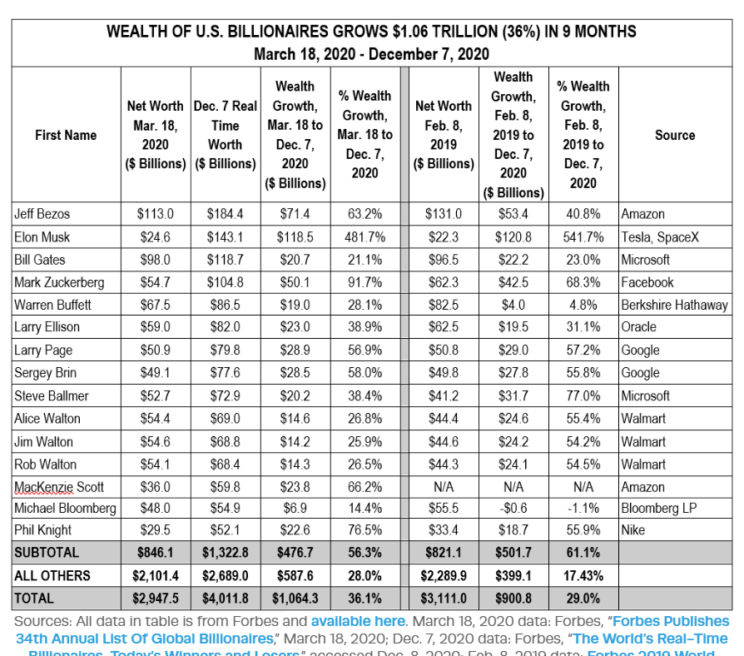
Gains by American Billionaires

Slide 40
Public Health versus the Economy? Lives versus Livelihood?

Slide 41
PPPLoans Didn’t Go to the Right Firms
In addition, first round loans went disproportionately to predominantly white Congressional Districts
Bloomberg, 7/30
Improvements to the program in the second stimulus bill

Slide 42
Paid Leave by Income Category
Paid
Sick
Leave

Slide 43
Monetary Policy – Current State and Impact
Fed Funds Rate at 0% → newly issued debt very cheap
Good for borrowers
Balance Sheet grew from $4T to $7T
Large volume of liquidity + few high yield, high quality savings vehicles → risky asset price bubbles
Forward Guidance: Keep FFR at ZLB until PCE inflation “at least 2%”
High inflation + low nominal rates → negative real returns
Difficult period for fixed-income households
Monetary Policy acted quickly and effectively to prevent a financial market meltdown and keep credit flowing. But the Fed lends and does not spend; so there is a limited impact on spending.

Slide 44
Employment at Small Firms (40% of total jobs)
Between February and April 2020, net loss of 10.4m losses, by Dec. 2020 ‘only’ 4.4m jobs lost.
Notes:
Possible 1 in 6 small businesses will declare bankruptcy.

Slide 45
Three Measures of Unemployment?
None is a perfect measure:
Insured Unemployment
Most accurate number because it is a numerical count.
Administrative delays in processing claims and not all unemployed are eligible to collect
Household Survey: 60,000 households
Disruptions to survey
Ambiguity of some of the classifications
Survey are done mid-month
Establishment Survey: 145,000 businesses about 700,000 employees
Response rate fluctuated recently
Survey done mid-month

Slide 46
Making Sense of Unemployment Numbers
Two Data Reports:
Depart of Labor Unemployment Insurance Weekly Claims
Weekly, Thursdays at 8:30
Initial Claims
Continuing Claims or Insured Unemployment
Bureau of Labor Statistics (BLS), Employment Situation
Monthly, First Fridays at 8:30. Surveys done midmonth
Household Survey: Unemployment Rate
Establishment Survey: New Jobs Created
For Perspective on Numbers, as of 2/2020:
Labor Force, 165m; Employed; 159m; Unemployed, 6m, or 3.5%
Total New Jobs added per month: round 225 thousand

Slide 47
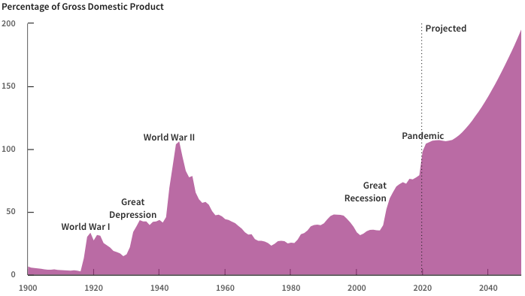
Record Levels of Debt are Forecast
Source: Congressional Budget Office, The Budget and Economic Outlook: 2020 to 2030

