Slide 1
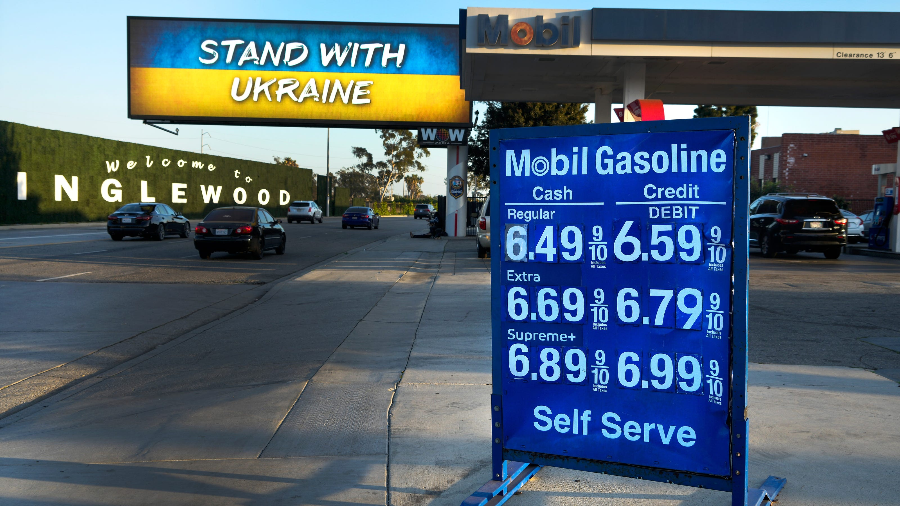
Coronavirus Economics
Redwood High School
Jon Haveman, Ph.D.
NEED
September 30, 2022

Slide 2
Outline
The State of the US Economy
Global Comparisons
Inflation
On the policy response:
To the pandemic
To inflation

Slide 3
State of the US Economy

Slide 4
GDP Trajectory: Pandemic Plunge!
Recession?
GDP is:
$0.6 Trillion below 2019 forecast.
$0.6 Trillion ABOVE 2019-Q4 level.

Slide 5
GDP: Quarterly Growth
Notes:
Graph: gdp_pot_grow.png
The Point: From 1990 – 2007, average annual US GDP growth pre-crisis is 2.94%. However, post-crisis US GDP growth is 2.19% (0.75 percentage points lower). Why is has the recovery been sluggish?
Note: At the recession’s height, the gap between quarterly GDP growth and potential growth was 2.5 percentage points.

Slide 6
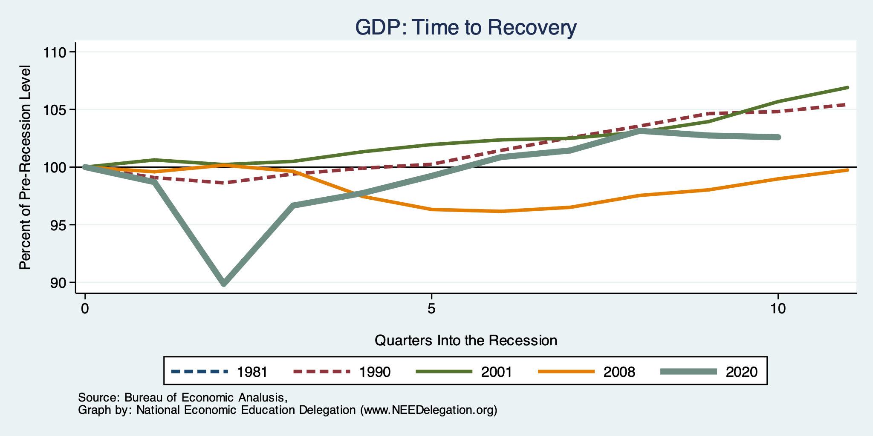
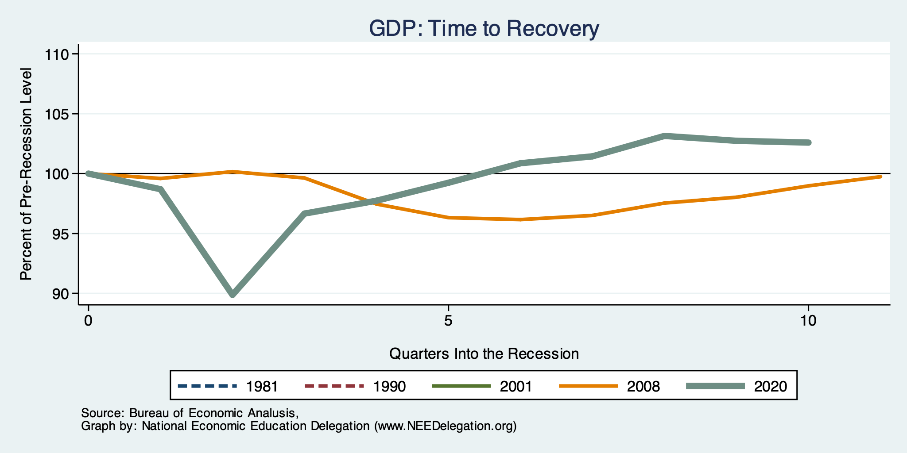
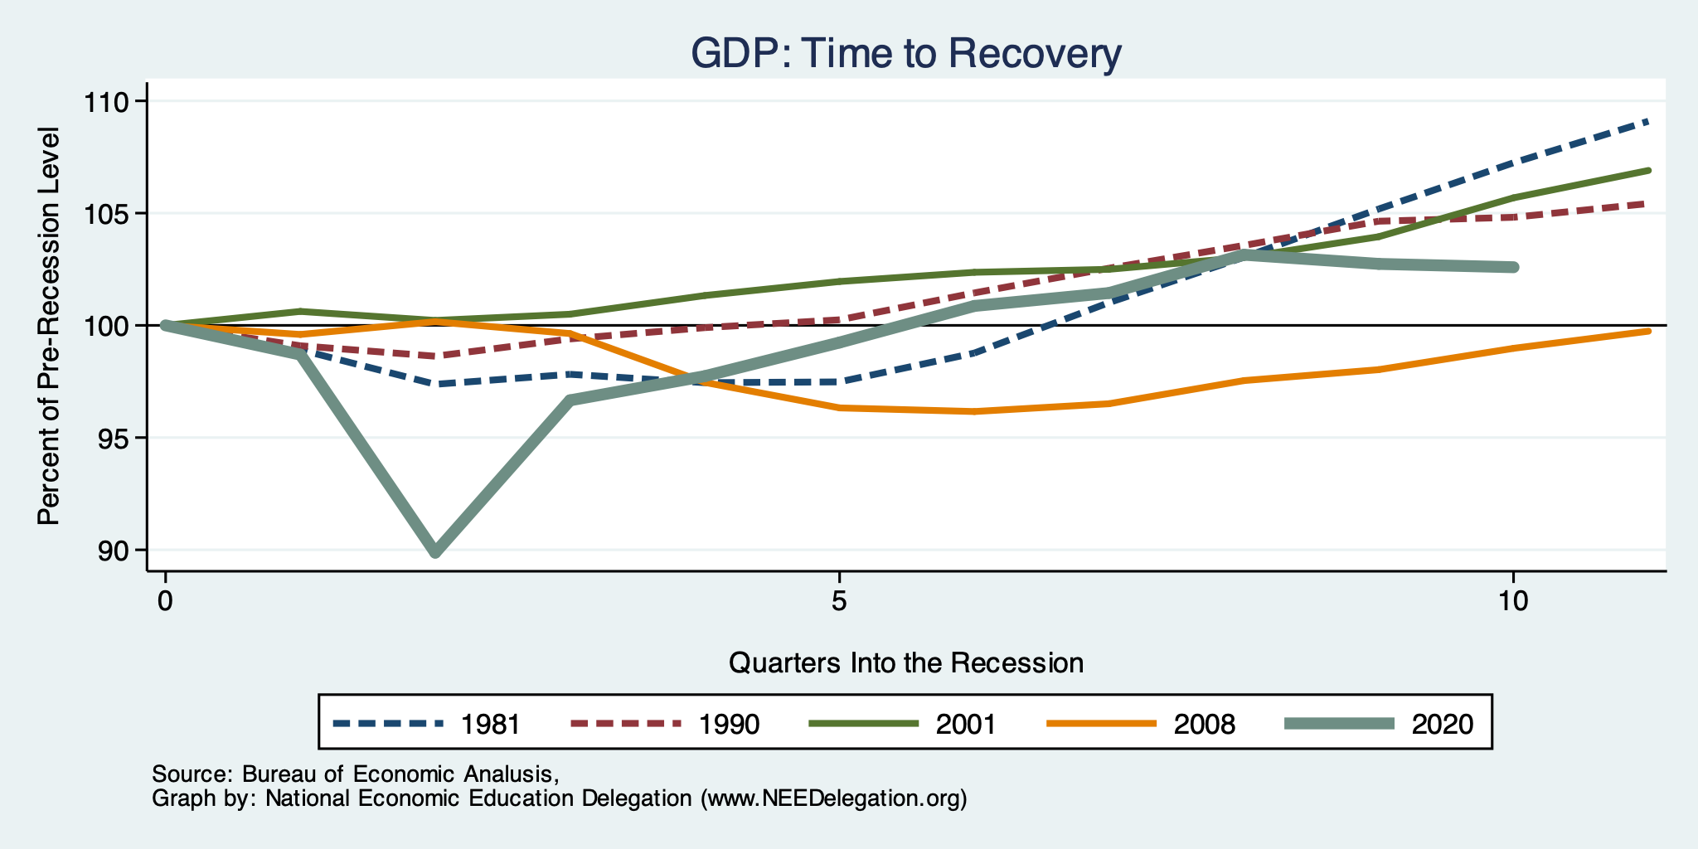
Recessions and Recovery: GDP

Slide 7
What Is “Accounting” for the Decline?
Expenditures drive GDP growth.
GDP is the sum of four categories of spending:
Consumption
Investment – housing/business/inventories
Government spending
Net Exports: Exports – Imports
Notes:
Recall: GDP is measures production of an economy; we often measure GDP as the sum of spending on final goods/services produced within an economy. The first three categories (C,I,G) contain spending on both domestically and foreign produced goods. To accurately measure domestic production, we subtract domestic consumption of foreign goods (imports).
The Point: Analysis of components of GDP as well as the production side of the economy should provide a comprehensive picture of the US economic landscape

Slide 8
Recession? Two Quarters….
Depends on what is driving the drop.
Inventories
Housing
Government spending
Consumer spending is still ok.
Employment growth is solid.
Other indicators are still ok.

Slide 9
Contribution to GDP Growth: Inventories
Notes:
Average GDP growth from 1990-2007 is 2.99% and from 2010+ is 2.19%
Average Consumption contribution from 1990-2007 is 2.16 percentage points and from 2010+ is 1.67 percentage points

Slide 10
Monthly Changes in Nonfarm Employment
August: 315,000
Notes:
PAYEMS.png

Slide 11
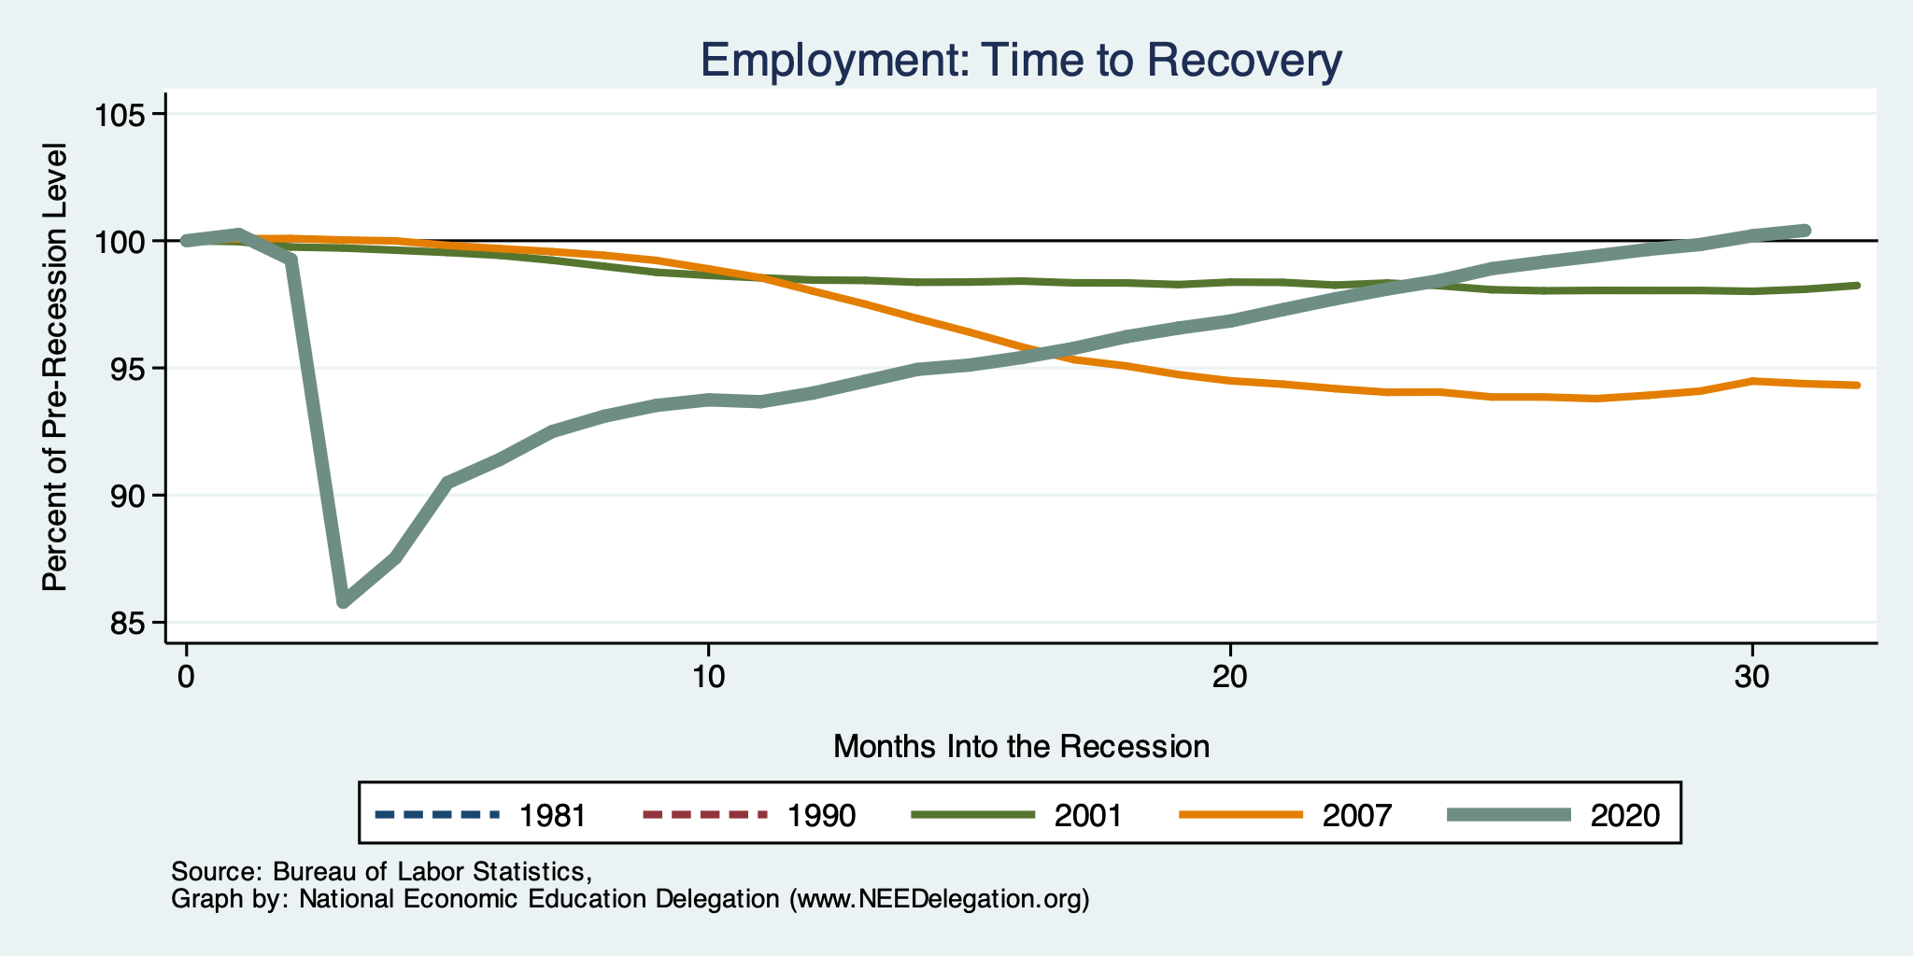
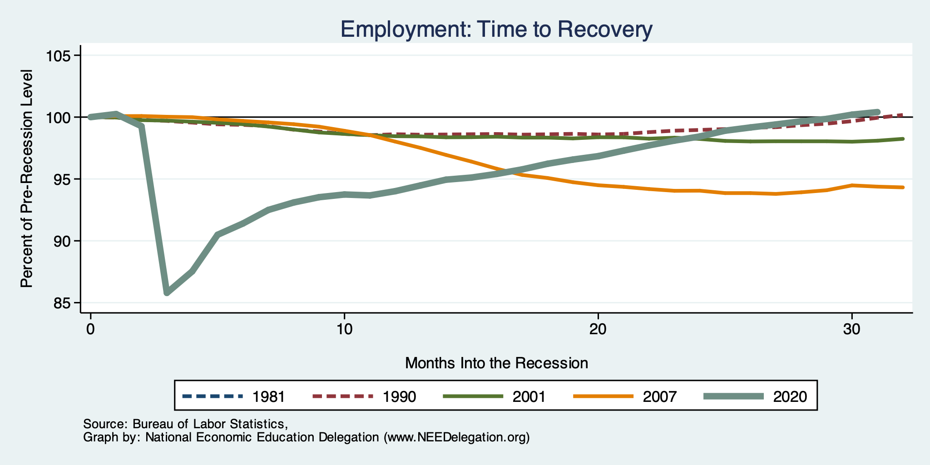
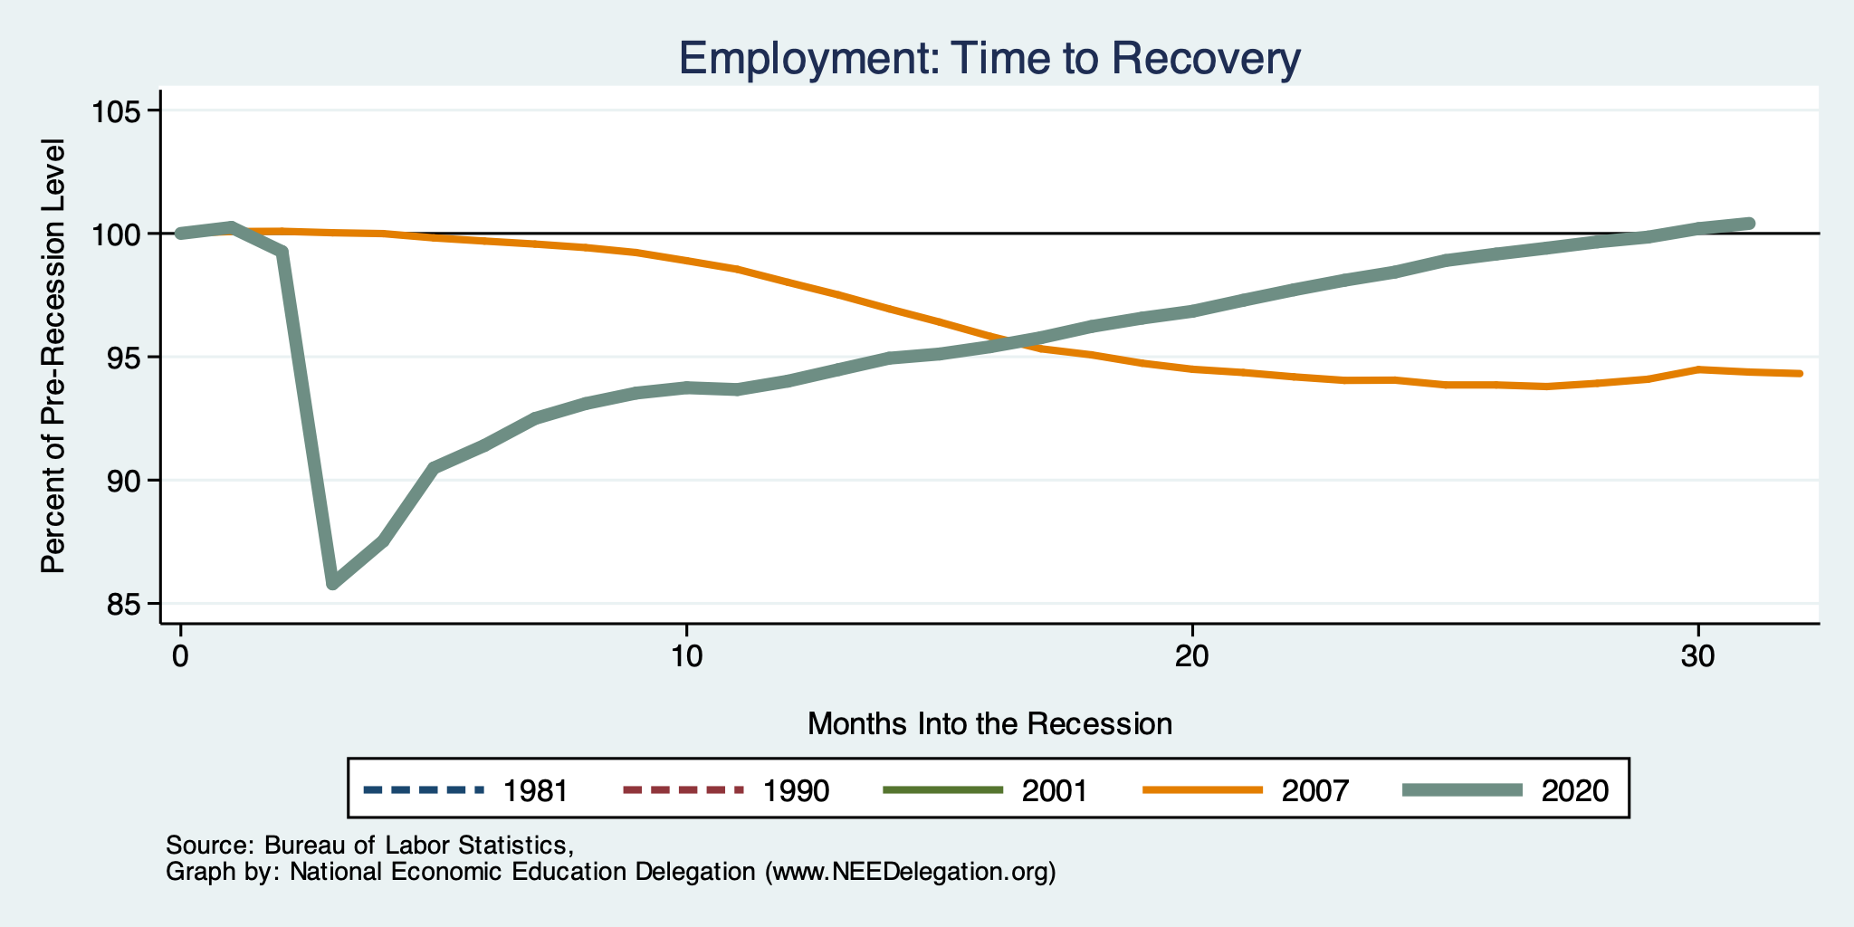
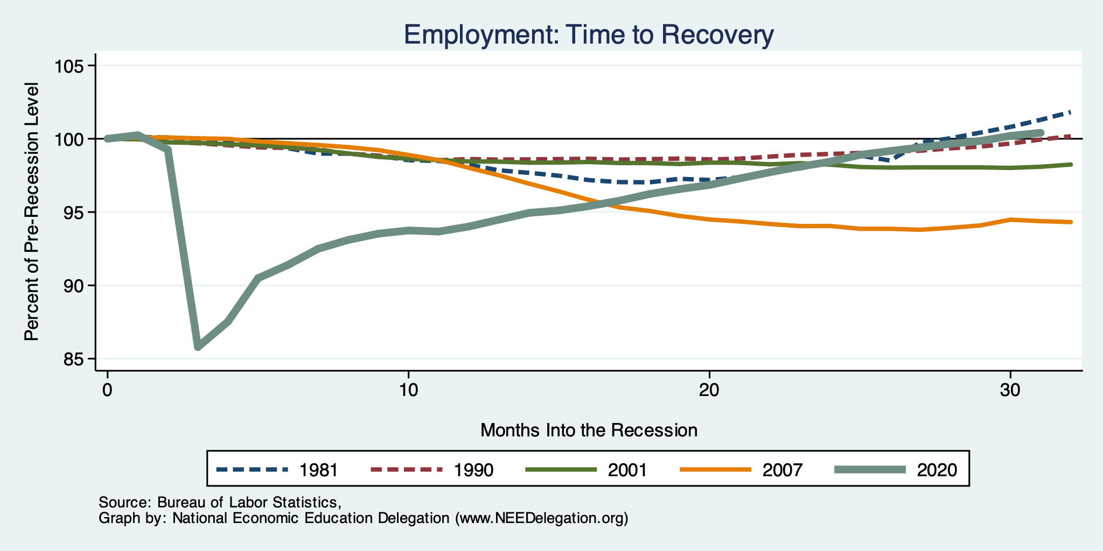
Recessions and Recovery: Employment

Slide 12
Employment Gap
240 thousand ABOVE February, 2020.
6.3 Million below where we should be.
Notes:
payroll_recent.png

Slide 13
Where Have All the Workers Gone?
3.7 million below where we should be

Slide 14
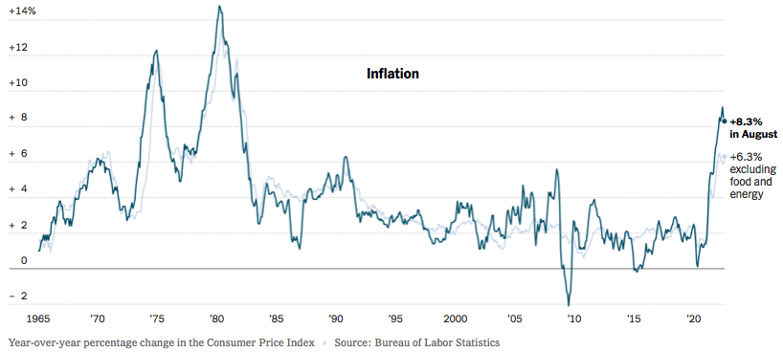
Inflation: Latest Figures
Source: NYTimes.com

Slide 15
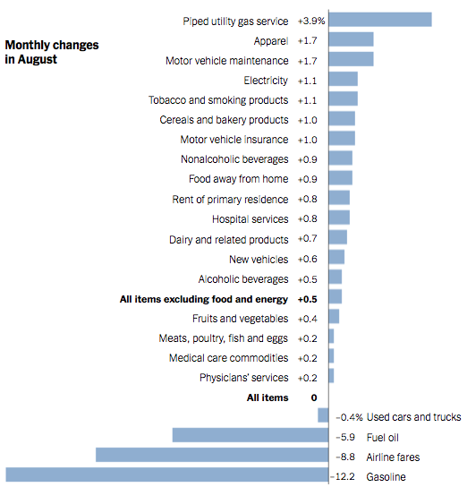
Which Prices?
Food

Slide 16
Global Evidence

Slide 17
Inflation: Not just a US Problem
United States: 8.5
Netherlands: 12.0
Spain: 10.4
United Kingdom: 10.1
Denmark: 8.9
Sweden: 8.5
Germany: 7.9
Norway: 6.5
France: 5.8
Source: TradingEconomics.com, 9/12/22

Slide 18
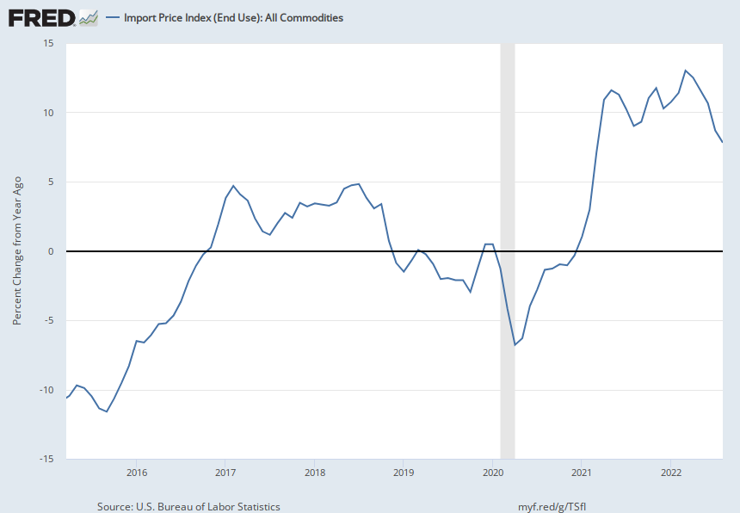
Import Prices Are Elevated
Inflation – Imported Products: 9-10%

Slide 19
GDP: U.S. Stands Out, But Not Alone
United States: -0.6
Netherlands: 2.6
Spain: 1.1
United Kingdom: -0.1
Denmark: 0.9
Sweden: 0.9
Germany: 0.1
Norway: 0.7
France: 0.5
Source: TradingEconomics.com, 9/12/22

Slide 20
Inflation

Slide 21
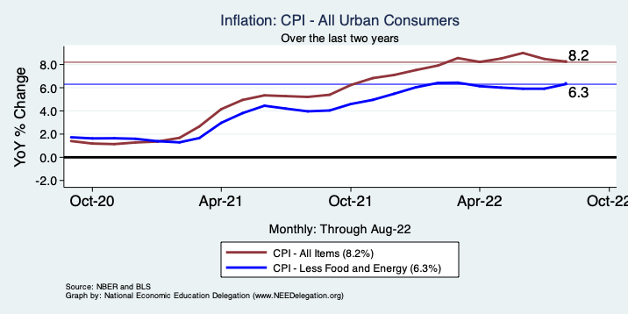
Inflation – Climbing! Or Turning Around?
Notes:
Cpi_recent.png

Slide 22
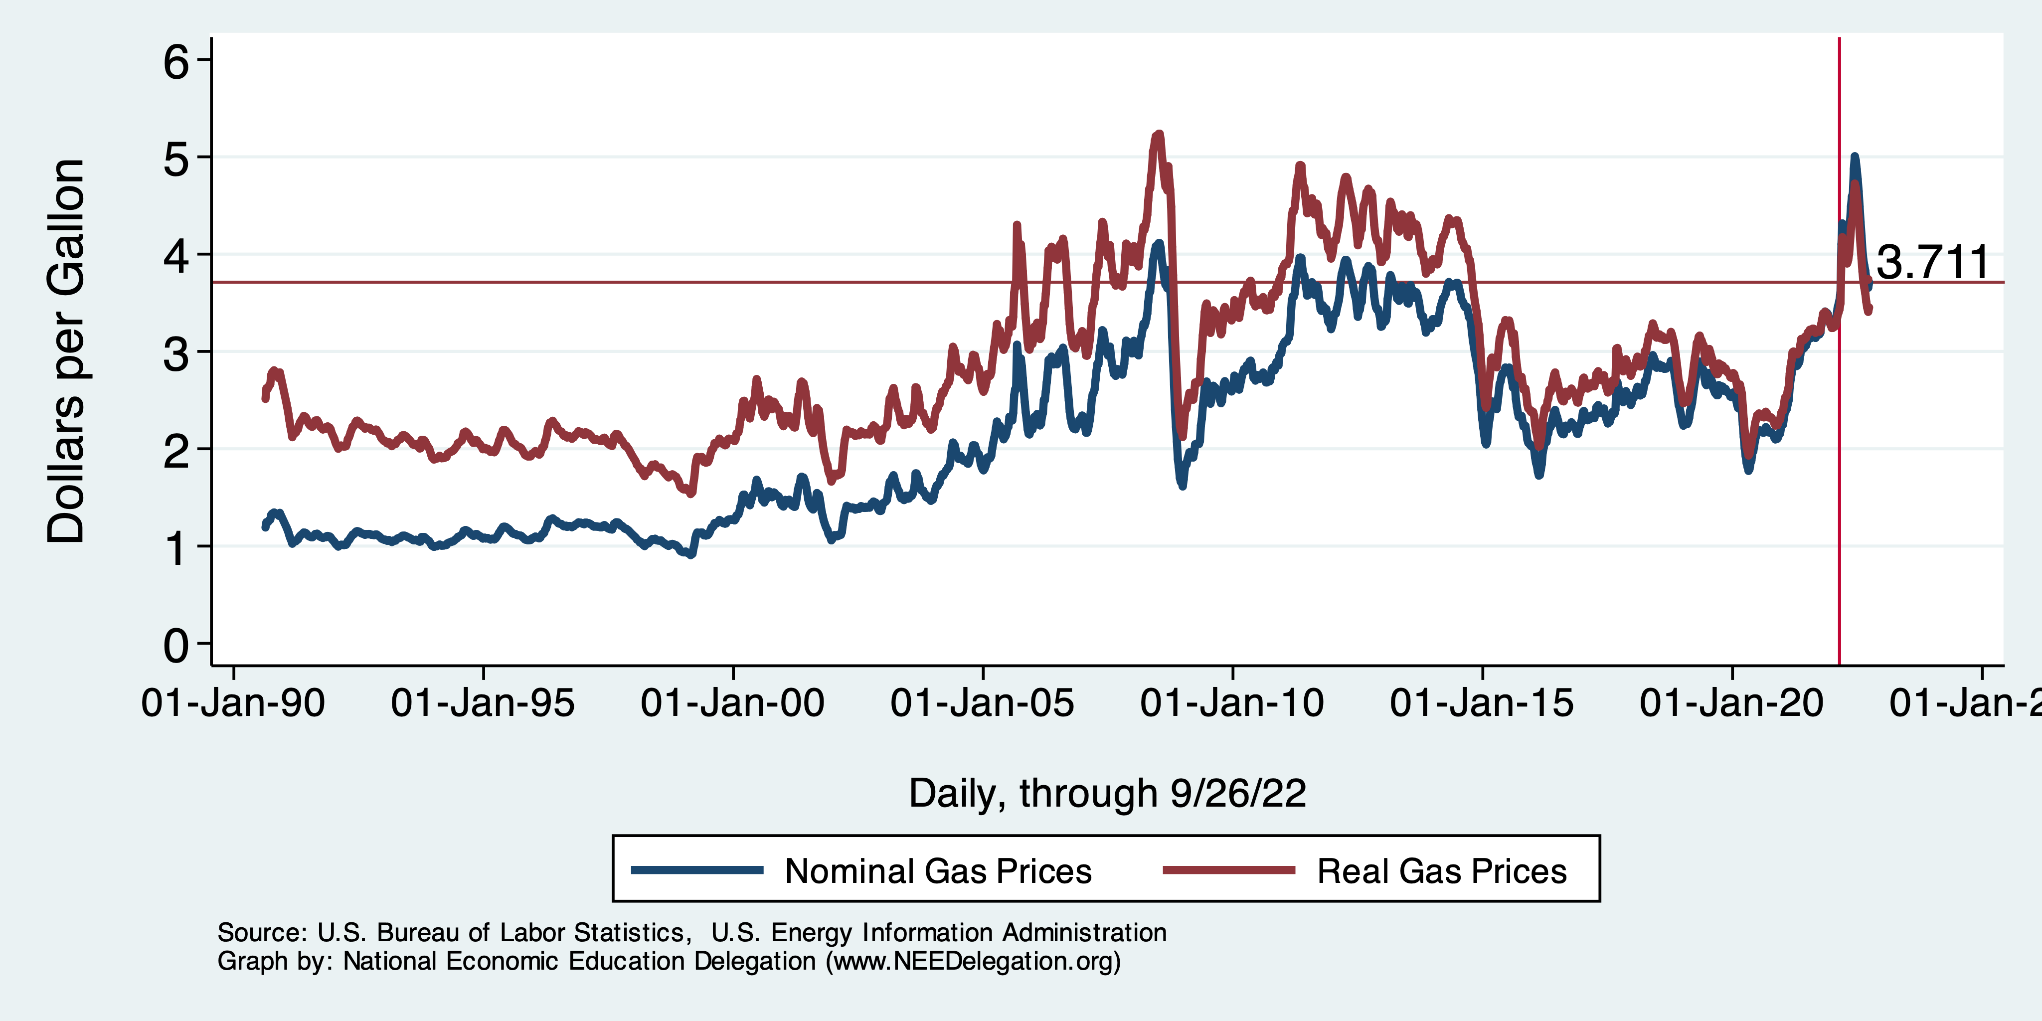
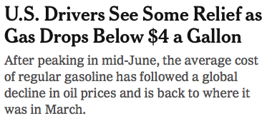
Gas Prices: National Average at the Pump

Slide 23
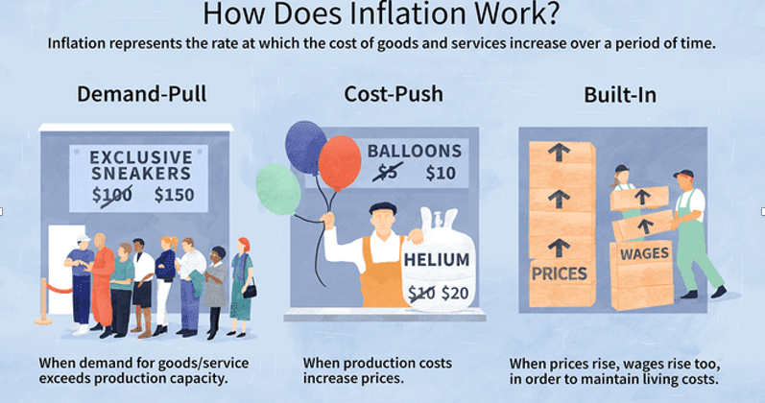
Source: Investopedia

Slide 24
Spending Patterns Changed - More Goods!
Demand-Pull
Goods spending up 14.3%
- And coming down.
Services spending up 0.7%
- And going up.

Slide 25
Supply Chains
Cost-Push

Slide 26
Fed’s Preferred Measure of Inflation

Slide 27
My Diagnosis for the Uptick in Inflation
Spending patterns have changed dramatically.
Yes, there were supply chain issues that affected some areas in particular (e.g., computer chips).
But there was also too much total spending.
Fiscal stimulus led households to increase saving over 2021 by more than $2 trillion. Strong retail sales numbers suggest they are prepared to spend it.
Whose to Blame: ARP probably too big, but the Fed could have acted sooner.

Slide 28
What’s the Fed Doing About It?

Slide 29
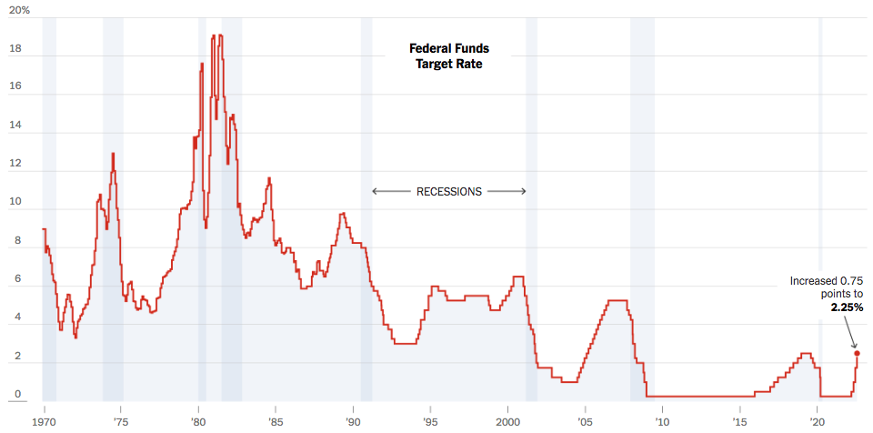
Federal Funds Rate
Just raised to: 3%
Notes:
The fed funds rate is the interest rate on overnight loans between banks. Think of it as the baseline interest rate on which banks base all other interest rates (e.g. mortgage rates)
FOMC lowers the fed funds rate during recessions and raises the fed funds rate during expansions
Fed funds rate peaked in the 1980s as then Chairman Paul Volcker sought to reign in “run away” inflation of the 1970s; doing so resulted in a recession in the early 1980s.
Since the 2008-09 recession, the fed funds rate has been kept near zero.
During the 2008-09 recession, Federal Reserve turned to unconventional tools to influence longer term interest rates to further stimulate the economy - QE
FedFunds.png

Slide 30
Implications for Demand
Investment borrowing
Home loans – tied to 10-year Treasury
Car loans
Credit cards
Savings accounts – positive
And more….

Slide 31
Takeaways
Is a recession on the horizon?
While the chances of slipping into a recession have increased, I think on many dimensions the economy is doing quite well.
Consumer’s have been driving the recovery, and consumer’s account for two-thirds of GDP.
Job creation remains robust – 315k in August.
What about GDP?
2022:Q1 was -1.6%, 2022:Q2 was -0.6.
Much of this lower growth was driven by lower inventory.
Inventories led GDP growth in 2021:Q4, didn’t sell, so production in Q1&Q2 fell.
Housing markets – very tightly linked to interest rates – softened … A LOT.
Government spending is falling.
Still just the pandemic messing with the ecomomy.

