Slide 1
Health(care) Economics
Bio2Device Group
August 3, 2021
Veronika Dolar, Ph.D.
State University of New York
SUNY Old Westbury

Slide 2
National Economic Education Delegation
Vision
One day, the public discussion of policy issues will be grounded in an accurate perception of the underlying economic principles and data.
Mission
NEED unites the skills and knowledge of a vast network of professional economists to promote understanding of the economics of policy issues in the United States.
NEED Presentations
Are nonpartisan and intended to reflect the consensus of the economics profession.

Slide 3
Who Are We?
Honorary Board: 49 members
2 Fed Chairs: Janet Yellen, Ben Bernanke
6 Chairs Council of Economic Advisers
Furman (D), Rosen (R), Bernanke (R), Yellen (D), Tyson (D), Goolsbee (D)
3 Nobel Prize Winners
Akerlof, Smith, Maskin
Delegates: 500+ members
At all levels of academia and some in government service
All have a Ph.D. in economics
Crowdsource slide decks
Give presentations
Global Partners: 45 Ph.D. Economists
Aid in slide deck development

Slide 4
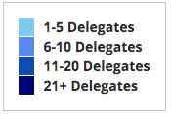
Where Are We?

Slide 5
Credits and Disclaimer
This slide deck was authored by:
Veronika Dolar, SUNY Old Westbury
dolarv@oldwestbury.edu
Disclaimer
NEED presentations are designed to be nonpartisan.
It is, however, inevitable that the presenter will be asked for and will provide their own views.
Such views are those of the presenter and not necessarily those of the National Economic Education Delegation (NEED).

Slide 6
Outline
What is Health(care) Economics?
Taking the Pulse of the Health Economy
Health Care Systems and Institutions
Health Insurance and Reform
Pharmaceuticals – Big Pharma

Slide 7
What is Health(care) Economics?
Health Economics is a special field of (applied) microeconomics that focuses on the health care industry.
Examples of other subfields of microeconomics are labor economics, industrial organization, economics of education, public economics, and urban economics.
Notes:
Microeconomics (from Greek prefix micro- meaning "small" + "economics") is a branch of economics that studies the behavior of how the individual modern household and firms make decisions to allocate limited resources.
Macroeconomics (from Greek prefix macro- meaning “large" + "economics") is the study of economy-wide phenomena, including inflation, unemployment, and economic growth.
These two branches of economics are closely intertwined, yet distinct—they address different questions.
Microeconomics studies individual markets or sectors or industries (hence health care industry is classified under microeconomics) while macroeconomics studies national economies and country/state-wide, general equilibrium questions.
Many times people think that since micro means small and macro large, that microeconomics is somehow inferior or studies smaller issues than what is studied in macroeconomics. But it should be noted, that many firms today have revenues that are substantially larger than most national incomes on nations. Obviously, this is comparing apples to oranges – but at least it gives a general idea of the size of some of these firms and markets.
https://medium.com/@denislesak/companies-with-revenues-greater-than-gdp-of-countries-58c46af4a1a9
https://oxfamblogs.org/fp2p/of-the-worlds-top-100-economic-entities-29-are-states-71-are-corporates/
See the next slide to compare US health care.

Slide 8
Health Economics is part of Microeconomics
Although health economics is part of “micro-” economics, it is actually very big:
In 2019, U.S. national health expenditure was 17.8% of GDP, which is equivalent to around $3,427 billions.
For comparison, the entire GDP of Germany in 2019 was $3,845 billions (4th largest economy), GDP of UK was $2,827 billions (6th largest economy), and $2,715 billions in France (7th largest economy).
Notes:
Hopefully the comparison of the US health care industry to the entire economy of Germany, UK, and France will make students also appreciate how difficult any type of a reform is – when the sector being reformed is of this size and complexity.
The list of top 10 largest economies based on the total size of GDP: 1) US, 2) China, 3) Japan, 4) Germany, 5) India, 6) UK, 7) France, 8) Italy, 9) Brazil, 10) Canada

Slide 9
What is Health Economics?
Health economics studies health care resources markets and health insurance.
Healthcare is the biggest industry and the largest employer in the US.
Notes:
Here the big emphasis is on the distinction between other health care markets and health insurance – this difference it typically hard to grasp for most people.

Slide 10
What is a Market?
A market is a group of buyers and sellers of a particular product in the area or region under consideration. The area may be the earth, or countries, regions, states, or cities.
The concept of a market is any structure that allows buyers and sellers to exchange any type of goods, services and information.
Markets can be physical and non-physical.
There are many different types of markets and depending on the type a different rules should be set up for eliciting the best results for the society.

Slide 11
Markets studied in health economics
Markets for:
Physicians
Nurses
Hospital facilities
Nursing homes
Pharmaceuticals
Medical supplies (such as diagnostic and therapeutic equipment)
Health Insurance
Notes:
Many times people confuse Health Economics with Health Insurance. The topics discuss in health economics included health insurance, but also a number of other markets related to health care resources.
This is an important distinction – because it also relates to the Health Care reform. Health care reform in the US is mostly dealing with the reform of the Health Insurance, rather than other health care markets.
The debate about many of these issues has to do with the market structure – and the issue of when does a market work well – without a lot of government intervention (free markets) and when is it necessary for a government to play a much larger role.

Slide 12
Market Economies
In market economies, prices adjust to balance supply and demand.
These equilibrium prices are the signals that guide economic decisions and thereby allocate scarce resources.
The invisible hand works through the price system:
The interaction of buyers and sellers determines prices.
Each price reflects the good’s value to buyers and the cost of producing the good.
Prices guide self-interested households and firms to make decisions that, in many cases, maximize society’s economic well-being.

Slide 13
When does “free market does it better” hold?
Two very important assumptions need for this to hold are:
Perfectly Competitive Market
No Market Failure
What is a Perfectly Competitive Market?
Many (numerous) buyers – price takers
Many (numerous) sellers – price takers
Identical (homogeneous) product
Free entry and exit
Both buyers and sellers have perfect information about the price, utility, quality, and production methods of products.
What is Market Failure?
Market Failure is a situation in which the allocation of goods and services by a free market is not efficient, often it leads to a net social welfare loss.
Examples of Market Failure:
Externalities
Public Goods
Asymmetric Information

Slide 14
What types of markets are there?
More Competition
Less Competition
Perfect Competition
Monopolistic Competition
Monopoly
Oligopoly
Duopoly
Monopsony
Less Concentration
More Concentration

Slide 15
Hospital Monopolization
Market consolidation among and between health systems, hospitals, medical groups, and health insurers has surged over the last decade.
Over an 18-month period between July 2016 and January 2018, hospitals acquired 8,000 more medical practices, and 14,000 more physicians left independent practice to become hospital employees, according to an analysis.

Slide 16
Hospital Monopolization: California
A large Northern California hospital system used its size and influence to achieve a "domination of the market”.
Sutter Health grew into a behemoth hospital system and then, like a classic monopoly, used its dominance in Northern California to raise hospital prices.
Sutter used its windfall from excessive pricing to acquire more entities and grew into a conglomerate of 24 hospitals, 12,000 doctors and several cancer, cardiac and other specialty centers.
In some counties, Sutter was the sole hospital for a thousand square miles.

Slide 17
Hospital Monopolization Across the Nation
Most of the top 100 most expensive hospitals are located in states in the west and south.
Florida had the highest number, with 40 hospitals.
Other top states included Texas with 14 hospitals, Alabama with eight, Nevada with seven, and California with six.
Hospitals Charge Patients More Than Four Times the Cost of Care
The most expensive hospitals cost of care range from 1,808 % at the high end to 1,129 % at the low end.

Slide 18
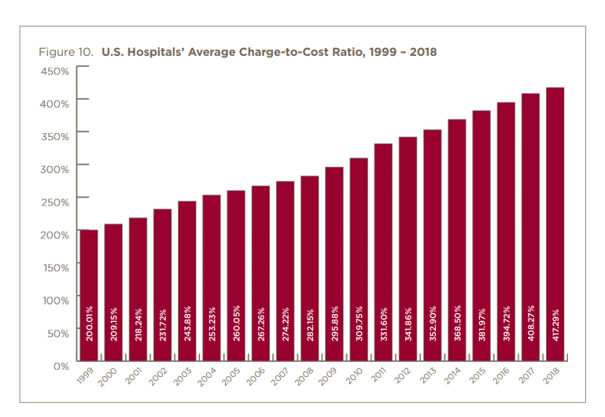

Slide 19
Hospital Monopolization: Florida
South Florida hospitals recorded combined profits of nearly $1.3 billion in 2018 and have posted combined profits above $1 billion for four of the past five years.
HCA hospitals were the most profitable, with a net income of $363.6 million, according to the report.
Baptist Health, a nonprofit and the largest system in the Miami area, had a net income of $142.8 million and Memorial Healthcare System in Broward County, a nonprofit hospital network, had a net income of $158.6 million.

Slide 20
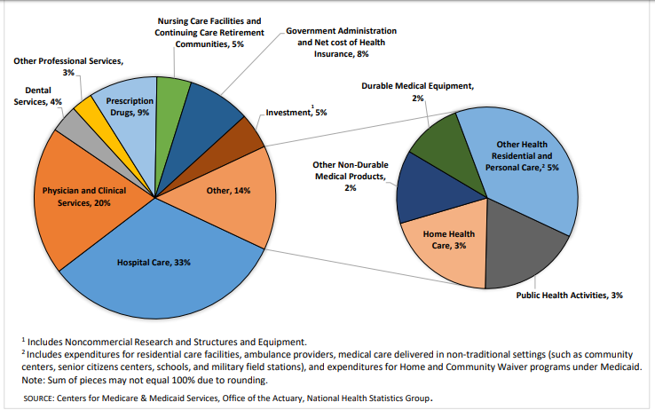
Where the money goes?

Slide 21
Health Care Markets are Different
Sponsor
Premiums
Insurer or
third-party payers
Premiums (individual policies)
Money (fixed or variable payments)
Taxes or Lower Wages
Claims
Insurance Coverage
Services
Consumers
Producers
Price
Health Care Providers (hospitals, physicians)
Patients
Out-of-pocket fees

Slide 22
Is there something special about Health Care Markets?
Market Structure
Type of products and services
Principal-Agent Problem
Asymmetric Information
Moral Hazard

Slide 23
Pulse of the Health Economy
Health economy involves activities related to population health:
Production and consumption of goods and services
Distribution of those goods to consumers
Performance indicators of medical care
Costs
Quality
Access

Slide 24
Tradeoffs
Tradeoffs take place among the three legs:
By increasing quality health care this leads to higher health care costs, which means that some individuals might not be able to afford it and the access may be more limited.
By increasing access, the costs and/or quality may suffer.
By decreasing costs, access and/or quality may suffer.

Slide 25
Costs

Slide 26
National Health Expenditure as Percent of GDP
Notes:
https://www.cms.gov/

Slide 27
National Healthcare Expenditure Per Capita
Notes:
https://www.cms.gov/

Slide 28
International Per Capita Healthcare Spending
Source: Roosa Tikkanen and Melinda K. Abrams, U.S. Health Care from a Global Perspective, 2019: Higher Spending, Worse Outcomes (Commonwealth Fund, Jan. 2020).
Notes:
Some good resources:
https://www.commonwealthfund.org/publications/issue-briefs/2020/jan/us-health-care-global-perspective-2019
A bit older report: https://www.commonwealthfund.org/publications/issue-briefs/2015/oct/us-health-care-global-perspective
https://www.healthsystemtracker.org/chart-collection/quality-u-s-healthcare-system-compare-countries/#item-overall-age-specific-potential-years-of-life-lost-per-100000-population-1990-2017
https://axenehp.com/international-healthcare-systems-us-versus-world/

Slide 29
Health Care Spending as % of GDP, 1980–2018
Source: Roosa Tikkanen and Melinda K. Abrams, U.S. Health Care from a Global Perspective, 2019: Higher Spending, Worse Outcomes (Commonwealth Fund, Jan. 2020).

Slide 30
GDP per capita and health consumption spending per capita, 2017

Slide 31
Out-of-Pocket Costs
Percent of women ages 18–64 with out-of-pocket costs of $2,000 or more
*
*
*
*
*
*
*
*
*
Source: Munira Z. Gunja et al., What Is the Status of Women’s Health and Health Care in the U.S. Compared to Ten Other Countries? (Commonwealth Fund, Dec. 2018).
Notes:
https://www.commonwealthfund.org/publications/issue-briefs/2018/dec/womens-health-us-compared-ten-other-countries
Notes: ^ Percent of respondents who reported that their annual (past year) family out-of-pocket spending for medical treatments or services, that were not covered by public or private insurance, was $2,000 or more. Does not include adults who reported “don’t know”/refused to respond. * Statistically significant difference compared to the United States (p<.05).
Data: The Commonwealth Fund International Health Policy Survey, 2016.
Source: Munira Z. Gunja et al., What Is the Status of Women’s Health and Health Care in the U.S. Compared to Ten Other Countries? (Commonwealth Fund, Dec. 2018). https://doi.org/10.26099/wy8a-7w13

Slide 32
Medical Bill Problems
Percent of women ages 18–64 with at least one medical bill problem
*
*
*
*
*
*
*
*
*
*
Source: Munira Z. Gunja et al., What Is the Status of Women’s Health and Health Care in the U.S. Compared to Ten Other Countries? (Commonwealth Fund, Dec. 2018).
Notes:
Notes: ^ Medical bill problems include any of the following in the past year: 1) serious problems paying or were unable to pay medical bills; 2) spent a lot of time on paperwork or disputes related to medical bills; or 3) insurance denied payment or paid less than expected. * Statistically significant difference compared to the United States (p<.05).
Data: The Commonwealth Fund International Health Policy Survey, 2016.
Source: Munira Z. Gunja et al., What Is the Status of Women’s Health and Health Care in the U.S. Compared to Ten Other Countries? (Commonwealth Fund, Dec. 2018). https://doi.org/10.26099/wy8a-7w13

Slide 33
Skipped Care Because of Cost
Percent of women ages 18–64 with at least one cost-related access problem
*
*
*
*
*
*
*
*
*
*
Source: Munira Z. Gunja et al., What Is the Status of Women’s Health and Health Care in the U.S. Compared to Ten Other Countries? (Commonwealth Fund, Dec. 2018).
Notes:
Notes: ^ Cost-related access problems include any of the following in the past year: 1) having a medical problem but did not visit a doctor; 2) skipped a medical test, treatment, or follow-up recommended by a doctor; or 3) did not fill or collect a prescription for medicine, or skipped doses of medicine, because of the cost in the past 12 months. * Statistically significant difference compared to the United States (p<.05).
Data: The Commonwealth Fund International Health Policy Survey, 2016.
Source: Munira Z. Gunja et al., What Is the Status of Women’s Health and Health Care in the U.S. Compared to Ten Other Countries? (Commonwealth Fund, Dec. 2018). https://doi.org/10.26099/wy8a-7w13

Slide 34
Health vs Social Care Spending
Source: E. H. Bradley and L. A. Taylor, The American Health Care Paradox: Why Spending More Is Getting Us Less, Public Affairs, 2013.

Slide 35
Health vs Social Care Spending
A 2013 study by Bradley and Taylor found that the U.S. spent the least on social services—such as retirement and disability benefits, employment programs, and supportive housing—among the countries studied in this report, at just 9 percent of GDP.
From 2000 to 2011, for every dollar the US spent on health care, the country spent another $1.00 on social services, whereas across the OECD, for every dollar spent on health care, countries spend an additional $2.50 on social services
Notes:
Redo this! See the source: the book and NYT article
The U.S. invests the smallest share of its economy on social services.
A 2013 study by Bradley and Taylor found that the U.S. spent the least on social services—such as retirement and disability benefits, employment programs, and supportive housing—among the countries studied in this report, at just 9 percent of GDP.¹² Canada, Australia and New Zealand had similarly low rates of spending, while France, Sweden, Switzerland, and Germany devoted roughly twice as large a share of their economy to social services as did the U.S.
The U.S. was also the only country studied where health care spending accounted for a greater share of GDP than social services spending. In aggregate, U.S. health and social services spending rank near the middle of the pack.

Slide 36
Why this increase in healthcare spending?
The share of the economy spent on health care has been steadily increasing for all countries because
health spending growth has outpaced economic growth.
Also because of
advances in medical technologies
increased demand for services
rising prices in the health sector – why?

Slide 37
Quality

Slide 38
Summary
The U.S. has the highest chronic disease burden and an obesity rate that is two times higher than the OECD average.
Americans had fewer physician visits than peers in most countries, which may be related to a low supply of physicians in the U.S.
Americans use some expensive technologies, such as MRIs, and specialized procedures, such as hip replacements, more often than our peers.
The U.S. outperforms its peers in terms of preventive measures — it has the one of the highest rates of breast cancer screening among women ages 50 to 69 and the second-highest rate (after the U.K.) of flu vaccinations among people age 65 and older.
Compared to peer nations, the U.S. has among the highest number of hospitalizations from preventable causes and the highest rate of avoidable deaths.

Slide 39
Life Expectancy
Source: Roosa Tikkanen and Melinda K. Abrams, U.S. Health Care from a Global Perspective, 2019: Higher Spending, Worse Outcomes (Commonwealth Fund, Jan. 2020).

Slide 40
Life Expectancy
Despite the highest spending, Americans experience worse health outcomes than their international peers.
Life expectancy at birth in the U.S. was 78.6 years in 2017 — more than two years lower than the OECD average and five years lower than Switzerland, which has the longest lifespan.
Notes:
Compare it also to Japan.

Slide 41
Life Expectancy
In the U.S., life expectancy masks racial and ethnic disparities. Average life expectancy among non-Hispanic black Americans (75.3 years) is 3.5 years lower than for non-Hispanic whites (78.8 years).
Life expectancy for Hispanic Americans (81.8 years) is higher than for whites, and similar to that in Netherlands, New Zealand and Canada.
Notes:
Include data on life expectancy difference based on race!

Slide 42
Life Expectancy by Race
All Races | 78.6
White | 78.8
Black | 75.3
Hispanic | 81.8
Non-Hispanic white | 78.5
Non-Hispanic black | 74.9
Life expectancy at birth 2017
Notes:
CDC

Slide 43
Infant Mortality International Comparison
Deaths per 1,000 live births
Source: NEED from OECD Data

Slide 44
Infant Mortality International by Race, 2016
Deaths per 1,000 live births
Source: NEED from CDC.gov

Slide 45
Maternal Mortality Rate
Maternal deaths per 100,000 live births
Source: Munira Z. Gunja et al., What Is the Status of Women’s Health and Health Care in the U.S. Compared to Ten Other Countries? (Commonwealth Fund, Dec. 2018).

Slide 46
Maternal Mortality Rate
American Indian/Alaska Native and Black women are 2 to 3 times as likely to die from a pregnancy-related cause than white women.

Slide 47
Avoidable Deaths
Deaths per 100,000 population
Source: Roosa Tikkanen and Melinda K. Abrams, U.S. Health Care from a Global Perspective, 2019: Higher Spending, Worse Outcomes (Commonwealth Fund, Jan. 2020).

Slide 48
Percent of adults who have experienced medical, medication, or lab errors or delays
Source: 2016 Commonwealth Fund International Health Policy Survey.

Slide 49
Prevention and Screening
The U.S. Excels in Prevention Measures, Including Flu Vaccinations and Breast Cancer Screenings
The U.S. Has the Highest Average Five-Year Survival Rate for Breast Cancer, but the Lowest for Cervical Cancer

Slide 50
Flu immunization
Source: Roosa Tikkanen and Melinda K. Abrams, U.S. Health Care from a Global Perspective, 2019: Higher Spending, Worse Outcomes (Commonwealth Fund, Jan. 2020).

Slide 51
Breast cancer screening
Percent of females ages 50–69 screened (%)
Source: Roosa Tikkanen and Melinda K. Abrams, U.S. Health Care from a Global Perspective, 2019: Higher Spending, Worse Outcomes (Commonwealth Fund, Jan. 2020).

Slide 52
Suicides, 2016
Deaths per 100,000 population
OECD average: 11.5
Source: Roosa Tikkanen and Melinda K. Abrams, U.S. Health Care from a Global Perspective, 2019: Higher Spending, Worse Outcomes (Commonwealth Fund, Jan. 2020).

Slide 53
Obesity Rate, 2017
Percent (%)
Source: Roosa Tikkanen and Melinda K. Abrams, U.S. Health Care from a Global Perspective, 2019: Higher Spending, Worse Outcomes (Commonwealth Fund, Jan. 2020).

Slide 54
Adults with Multiple Chronic Conditions, 2016
Source: Roosa Tikkanen and Melinda K. Abrams, U.S. Health Care from a Global Perspective, 2019: Higher Spending, Worse Outcomes (Commonwealth Fund, Jan. 2020).

Slide 55
The World Health Report 2000, Health Systems: Improving Performance
 | Overall Ranking
30. | Canada
31. | Finland
32. | Australia
33. | Chile
34. | Denmark
35. | Dominica
36. | Costa Rica
37. | United States
38. | Slovenia
39. | Cuba
 | Overall Ranking
1. | France
2. | Italy
3. | San Marino
4. | Andorra
5. | Malta
6. | Singapore
7. | Spain
8. | Oman
9. | Austria
10. | Japan

Slide 56
Perception of quality of medical
Source: Munira Z. Gunja et al., What Is the Status of Women’s Health and Health Care in the U.S. Compared to Ten Other Countries? (Commonwealth Fund, Dec. 2018).

Slide 57
Access

Slide 58
Physician Visits and Physician Supply, 2018
Source: Roosa Tikkanen and Melinda K. Abrams, U.S. Health Care from a Global Perspective, 2019: Higher Spending, Worse Outcomes (Commonwealth Fund, Jan. 2020).

Slide 59
Hospital Acute Care Average Length of Stay
Average length of stay for acute care (days)

Slide 60
Acute care hospital beds per 1,000 population
Source: OECD Health Data 2015.

Slide 61
Percent of women ages 18–64 who reported having a regular doctor/regular place of care
Source: Munira Z. Gunja et al., What Is the Status of Women’s Health and Health Care in the U.S. Compared to Ten Other Countries? (Commonwealth Fund, Dec. 2018).

Slide 62
Percent of women ages 18–64 who reported going to the emergency department in the past two years
Source: Munira Z. Gunja et al., What Is the Status of Women’s Health and Health Care in the U.S. Compared to Ten Other Countries? (Commonwealth Fund, Dec. 2018).

Slide 63
Waited Less Than a Month to See Specialist
Source: 2011 Commonwealth Fund International Health Policy Survey of Sicker Adults in Eleven Countries.

Slide 64
Health Care Systems and Institutions

Slide 65
Health System Classification
Developed countries of the world have each taken a different approach for their health care delivery systems
5 basic models:
National health insurance (Canada)
Bismarck (France, Germany, Japan, Switzerland)
Beveridge – socialized medicine (United Kingdom)
Out of pocket model – you pay yourself
Mixed (United States)

Slide 66
US Health Care System
Medicare – National Health Insurance
Military Veteran Care – Beveridge model (socialized medicine)
Employer-sponsored insurance – Bismarck model
Individual market health plans - Bismarck model
Uninsured - Out of pocket model

Slide 67
Health Insurance and Reform

Slide 68
Definitions
Universal coverage refers to health care systems in which all individuals have insurance coverage.
Generally, this coverage includes access to all needed services and benefits while protecting individuals from excessive financial hardships.

Slide 69
Single Payer
Single-payer refers to financing a health care system by making one entity solely and exclusively responsible for paying for medical goods and services.
It is only the financing component that is necessarily socialized.
The money for the payment can be either collected by
Taxes collected by the government
Premiums collected by National or Public Health Insurance

Slide 70
Socialize Medicine
Socialized medicine: this model actually takes the single-payer system one step further.
In a socialized medicine system, the government not only pays for health care but operates the hospitals and employs the medical staff.
This has NOT been proposed by any presidential hopeful and is not part of the current debate in the US.

Slide 71
Third-Party Payer
A third-party payer is an entity that pays medical claims on behalf of the insured. Examples of third-party payers include government agencies, insurance companies, health maintenance organizations (HMOs), and employers.
Employer-sponsored health plans
Individual market health plans
National health insurance

Slide 72
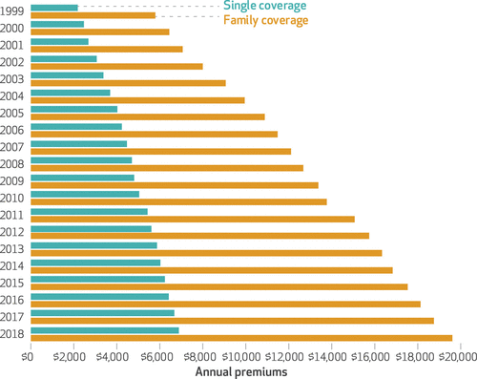
Average annual premiums for single and family coverage, 1999–2018

Slide 73
Spending on Deductibles

Slide 74
Reason for Higher Health Insurance Rates
Advances in medical technologies
Rising prices in the health sector (Why?)
Increased demand for services
Concentration of insurance companies!

Slide 75
Monopolization of Health Insurance Market
As of 2011, there were close to 100 insurers in Switzerland competing for consumer health care dollars, forcing firms to compete by setting prices to just cover costs.
In the United States, markets are state specific and consumers may choose from plans available in the state in which they reside.
In 2014, of the 50 states and the District of Columbia, 11 had only 1 or 2 insurers, 21 had 3 or 4, and only 19 states had 5 or more.
As of July 2019, the number of states with only 1 or 2 insurers had increased from 11 to 20, indicating a growing divide between ACA exchanges and competitive markets.
Notes:
6 Roy, Avik. “Why Switzerland Has the World’s Best Health Care System.” Forbes, April 29, 2011; https://www.forbes.com/sites/theapothecary/2011/04/29/why-switzerland-has-the-worlds-best-health-care-system/#2416d9a67d74.
7 Henry J. Kaiser Family Foundation. “Number of Issuers Participating in the Individual Health Insurance Marketplaces.” State Health Facts; https://www.kff.org/other/state-indicator/number-of-issuers-participating-in-the-individual-health-insurance-marketplace, accessed July 2019.

Slide 76
Big Pharma

Slide 77
Drug Prices for 30 Most Commonly Prescribed Brand-Name and Generic Drugs, 2006–07 US is set at 1.00
 | AUS | CAN | FR | GER | NETH | NZ | SWITZ | UK | US
Brand-name drugs | 0.40 | 0.64 | 0.32 | 0.43 | 0.39 | 0.33 | 0.51 | 0.46 | 1.00
Generic drugs | 2.57 | 1.78 | 2.85 | 3.99 | 1.96 | 0.90 | 3.11 | 1.75 | 1.00
THE
COMMONWEALTH
FUND
Source: IMS Health; analysis by Gerard Anderson, Johns Hopkins University.

Slide 78
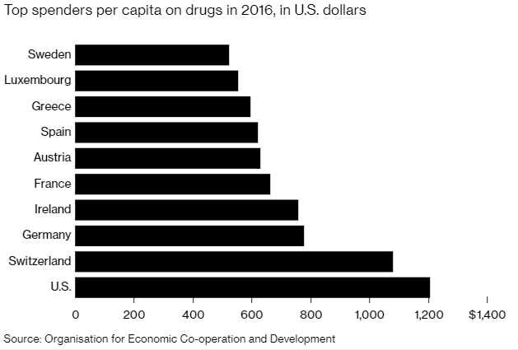
Drug Prices
Notes:
https://www.bloomberg.com/quicktake/drug-prices
https://en.wikipedia.org/wiki/Prescription_drug_prices_in_the_United_States
https://www.ft.com/content/e92dbf94-d9a2-11e9-8f9b-77216ebe1f17

Slide 79
Drug Prices

Slide 80
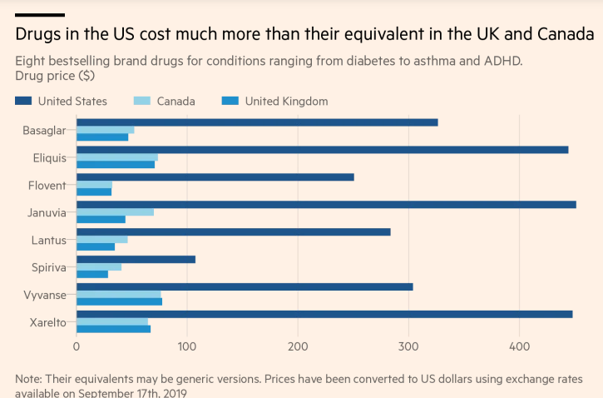

Slide 81
Price Hikes
Turing Pharmaceuticals’ 5,555% price increase of Daraprim® in 2015 and Mylan’s 500% increase of EpiPen®…
More than 3,400 drugs have boosted their prices in the first six months of 2019, an increase of 17% in the number of drug hikes from a year earlier.
The average price hike is 10.5%, or 5 times the rate of inflation.
About 41 drugs have boosted their prices by more than 100% in 2019.
Over the course of a decade, the net cost of prescription drugs in the United States rose more than three times faster than the rate of inflation.

Slide 82
Reasons for higher drug prices
The Medicare Prescription Drug, Improvement, and Modernization Act, also called the Medicare Modernization Act or MMA, is a federal law of the United States, enacted in 2003.
Concentration of pharmaceutical companies and increase in prices.

Slide 83
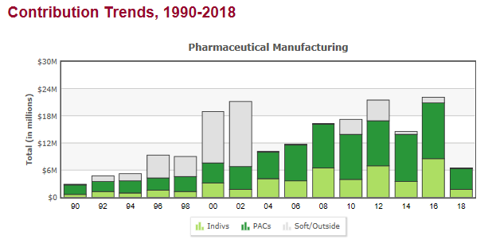
Medicare Prescription Drug Costs

Slide 85
Impact of Medicare Modernization Act
Medicare Part D, by law, cannot negotiate drug prices like other governments do.
The study found that in 2017, Medicare spent nearly $8 billion on insulin. The researchers said that if Medicare were allowed to negotiate drug prices like the U.S. Department of Veterans Affairs (VA) can, Medicare could save about $4.4 billion just on insulin.

Slide 86
Concentration in Pharmaceutical Companies
The number of mergers and acquisitions involving one of the top 25 firms more than doubled from 29 in 2006 to 61 in 2015, in part due to lax merger review.
Between 1995 and 2015, 60 pharmaceutical companies merged into 10.
In 2010, R&D returned 10.1%. In nearly every year since, that figure has dropped. In 2017, the return was 3.7%, and in 2018, 1.9%.

Slide 87
Summary
US HealthCare system is not preforming well (very expensive and low quality and access)
One of the main reasons for very high costs is the monopolization of healthcare markets (hospitals, health insurance, big pharma, etc.)
In addition, the Medicare Modernization Act of 2003 by law prevents government to negotiate drug prices.
Few simple solutions could drastically decrease the costs:
Enforcement of antitrust laws in this sector
Introduction of a public option in health insurance market
Ability for the US government to negotiate drug prices like most every other nation
Universal health insurance would increase the access and potentially also reduce the costs

Slide 88
Thank you!
Any Questions?
www.NEEDelegation.org
Veronika Dolar
dolarv@oldwestbury.edu
Contact NEED: info@needelegation.org
Submit a testimonial: www.NEEDelegation.org/testimonials.php
Become a Friend of NEED: www.NEEDelegation.org/friend.php

Slide 89
Available NEED Topics Include:
Coronavirus Economics
US Economy
Climate Change
Economic Inequality
Economic Mobility
Trade and Globalization
Trade Wars
Immigration Economics
Housing Policy
Federal Budgets
Federal Debt
Black-White Wealth Gap
Autonomous Vehicles
US Social Policy

