Slide 1
Osher Lifelong Learning Institute, Winter 2022
Contemporary Economic Policy
Florida Atlantic University/Johns Hopkins University
Fall, 2022
Jon Haveman, Ph.D.
National Economic Education Delegation

Slide 2
National Economic Education Delegation
Vision
  One day, the public discussion of policy issues will be grounded in an accurate perception of the underlying economic principles and data.
Mission
  NEED unites the skills and knowledge of a vast network of professional economists to promote understanding of the economics of policy issues in the United States.
NEED Presentations
  Are nonpartisan and are intended to reflect the consensus of the economics profession.

Slide 3
Who Are We?
Honorary Board: 54 members
  2 Fed Chairs: Janet Yellen, Ben Bernanke
  6 Chairs Council of Economic Advisers
    Furman (D), Rosen (R), Bernanke (R), Yellen (D), Tyson (D), Goolsbee (D)
  3 Nobel Prize Winners
    Akerlof, Smith, Maskin
Delegates: 652+ members
  At all levels of academia and some in government service
  All have a Ph.D. in economics
  Crowdsource slide decks
  Give presentations
Global Partners: 49 Ph.D. Economists
  Aid in slide deck development

Slide 4


Where Are We?

Slide 5
Available NEED Topics Include:
US Economy
Healthcare Economics
Climate Change
Economic Inequality
Economic Mobility
Trade and Globalization
Minimum Wages
Immigration Economics
Housing Policy
Federal Budgets
Federal Debt
Black-White Wealth Gap
Autonomous Vehicles
Healthcare Economics

Slide 6
Course Outline: Florida Atlantic University
Contemporary Economic Policy
  Week 1 (10/6): U.S. Economic Update (Jon Haveman, NEED)
  Week 2 (10/13): Trade and Globalization (Alan Deardorff, University of Michigan)
  Week 3 (10/20): Autonomous Vehicles (Jon Haveman, NEED)
  Week 4 (10/27): Economic Inequality (Chris Herrington, VCU)
  Week 5 (11/3): The Black-White Wealth Gap (Jon Haveman, NEED)
  Week 6 (11/10): Trade Deficits and Exchange Rates (Alan Deardorff, UM)

Slide 7
Course Outline: Johns Hopkins University
Contemporary Economic Policy
  Week 1 (11/3): The Black-White Wealth Gap (Jon Haveman, NEED)
  Week 2 (11/10): Economic Inequality (Adina Ardelean, Santa Clara Univ.)
  Week 3 (11/17): Economics of Immigration (Jennifer Alix-Garcia, Oregon State Univ.)
  Week 4 (12/1): U.S. Economic Update (Jon Haveman, NEED)
  Week 5 (12/8): Trade and Globalization (Adina Ardelean, Santa Clara Univ.)
  Week 6 (12/15): Climate Change Economics (Sarah Jacobson, Williams College)

Slide 8
Submitting Questions
Please submit questions of clarification in the chat.
  I will try to handle them as they come up.
We will do a verbal Q&A once the material has been presented.
Slides will be available from the NEED website tomorrow (https://needelegation.org/delivered_presentations.php)

Slide 9


The Black-White Wealth Gap
November 3, 2022
Jon Haveman, Ph.D.
National Economic Education Delegation

Slide 10
Credits and Disclaimer
This slide deck was authored by:
  Darrick Hamilton, Ph.D., The New School
  Jon Haveman, Ph.D., NEED
This slide deck was reviewed by:
  Patrick Mason, Florida State University
  Steven Craig, University of Houston
Disclaimer
  NEED presentations are designed to be nonpartisan.
  It is, however, inevitable that the presenter will be asked for and will provide their own views.
  Such views are those of the presenter and not necessarily those of the National Economic Education Delegation (NEED).

Slide 11
Outline
Evidence of disparities
Why wealth is important
Sources of disparities
Implications of disparities
Policy solutions

Slide 12
What is Wealth?
Income vs Wealth
  Income is the flow of funds into a households each year.
  Wealth is a household’s NET asset holdings.
    The value of all assets minus the value of all debts.
    Assets can be financial and physical.
Assets include:
  Owned homes, cars, stocks, businesses, savings and checking accounts, pensions, life insurance…
Debts include:
  Home mortgages, car loans, credit cards, and any other significant financial obligations (excl regular bills)…

Slide 13
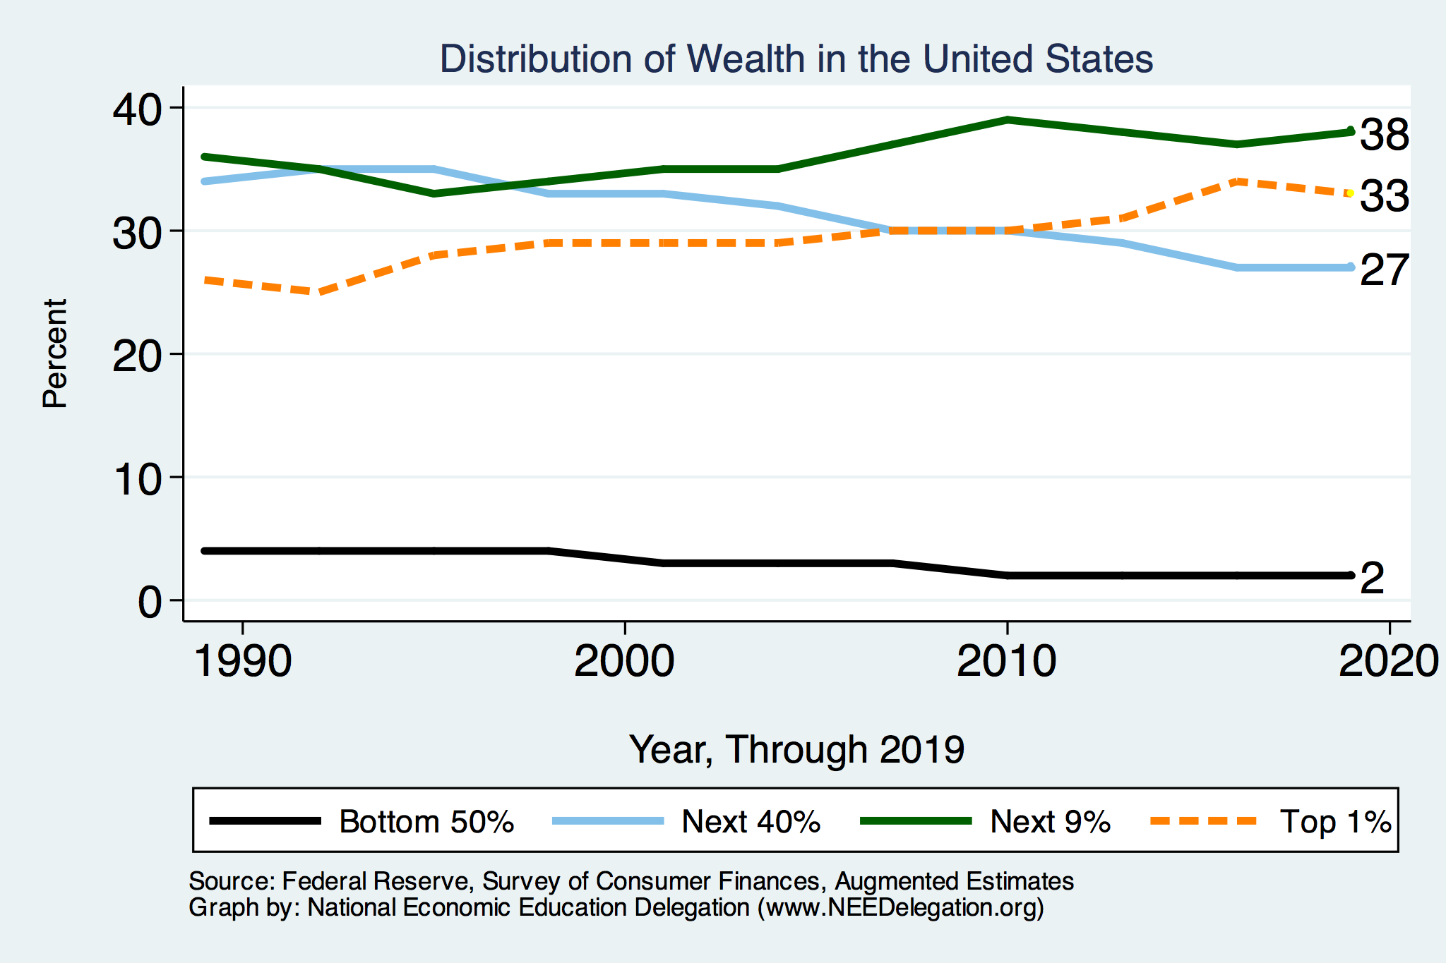
Overall Wealth Distribution
2019 Overall Median: $121,700

Slide 14
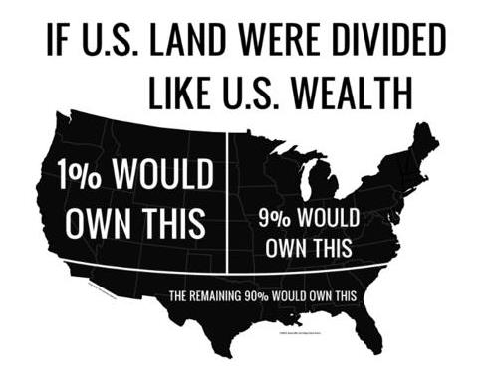
Wealth inequality in America

Slide 15

Wealth is More and More Concentrated
99th Percentile
2016 = 7x 1963
Source: Urban Institute

Slide 16
Evidence

Slide 17

Evidence of the Gap
Mean is
7x Greater
Median is 8x Greater

Slide 18
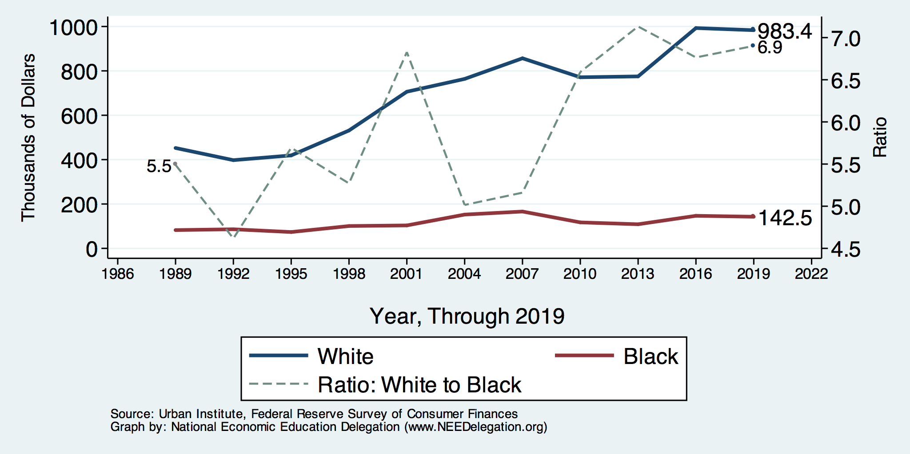
Wealth Gap Over Time: Mean

Slide 19
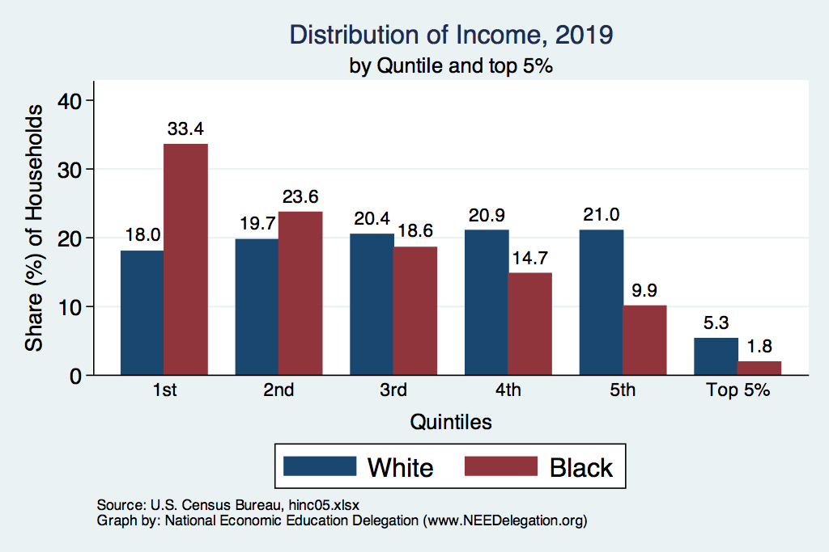
Black Household Incomes Relative to White
Source: pewsocialtrends.org

Slide 20
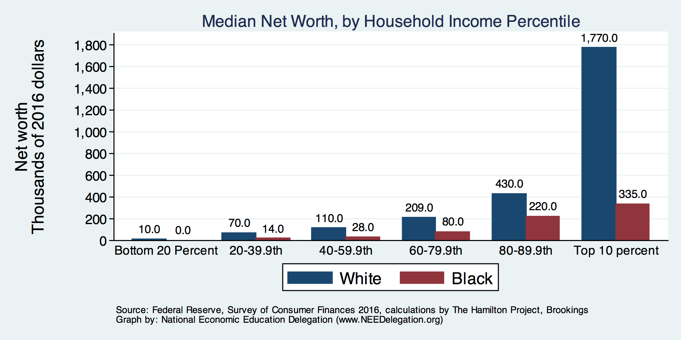
By Household Income

Slide 21
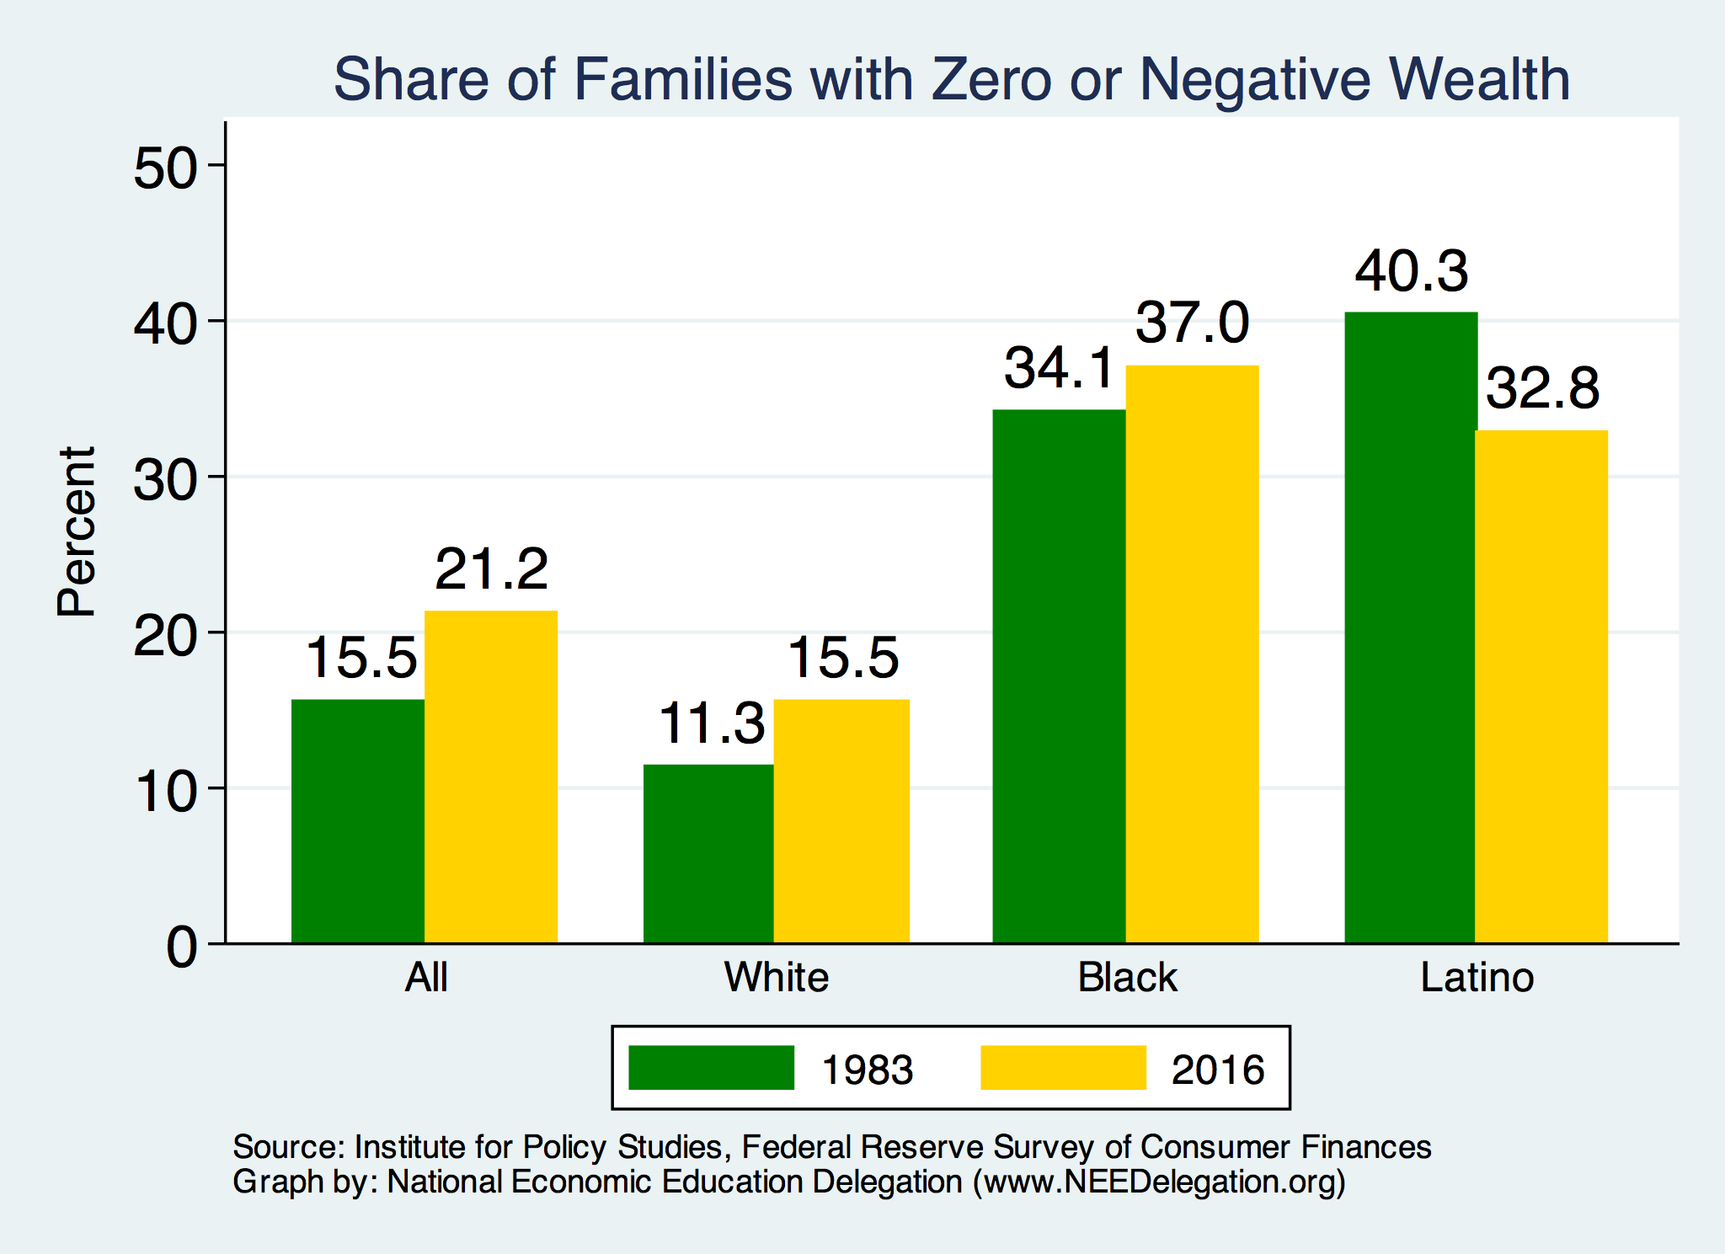
Evidence of Disparities: Zero Wealth

Slide 22
Why Wealth is Important

Slide 23
Widespread Household Wealth Pays Dividends
To individuals in the household
  Choices/Agency
  Wealth is iterative
And to broader society
  Human capital development
  Entrepreneurship and innovation

Slide 24
Household Level Benefits
Choices/Life Agency
  Finance high quality education
  Living in good neighborhoods
  Saving for retirement
  Capital to start a business
  Withstand financial hardship
  Better legal counsel
  Exert political influence
  Finance costly medical procedure
  Bequests
Wealth is iterative
  Wealth begets more wealth.
    Access to higher return investments.
  Wealth transfers across generations.
    Wealth is sticky.

Slide 25
Parental Wealth is Important
Important pre-estate transfer effects on kids:
  Influences human capital accumulation.
  Influences the returns to education.
  Adult incomes of offspring.
There are clearly enormous differences in wealth held by parents of Black and White children.
And it’s clear that nurture plays a big role.

Slide 26
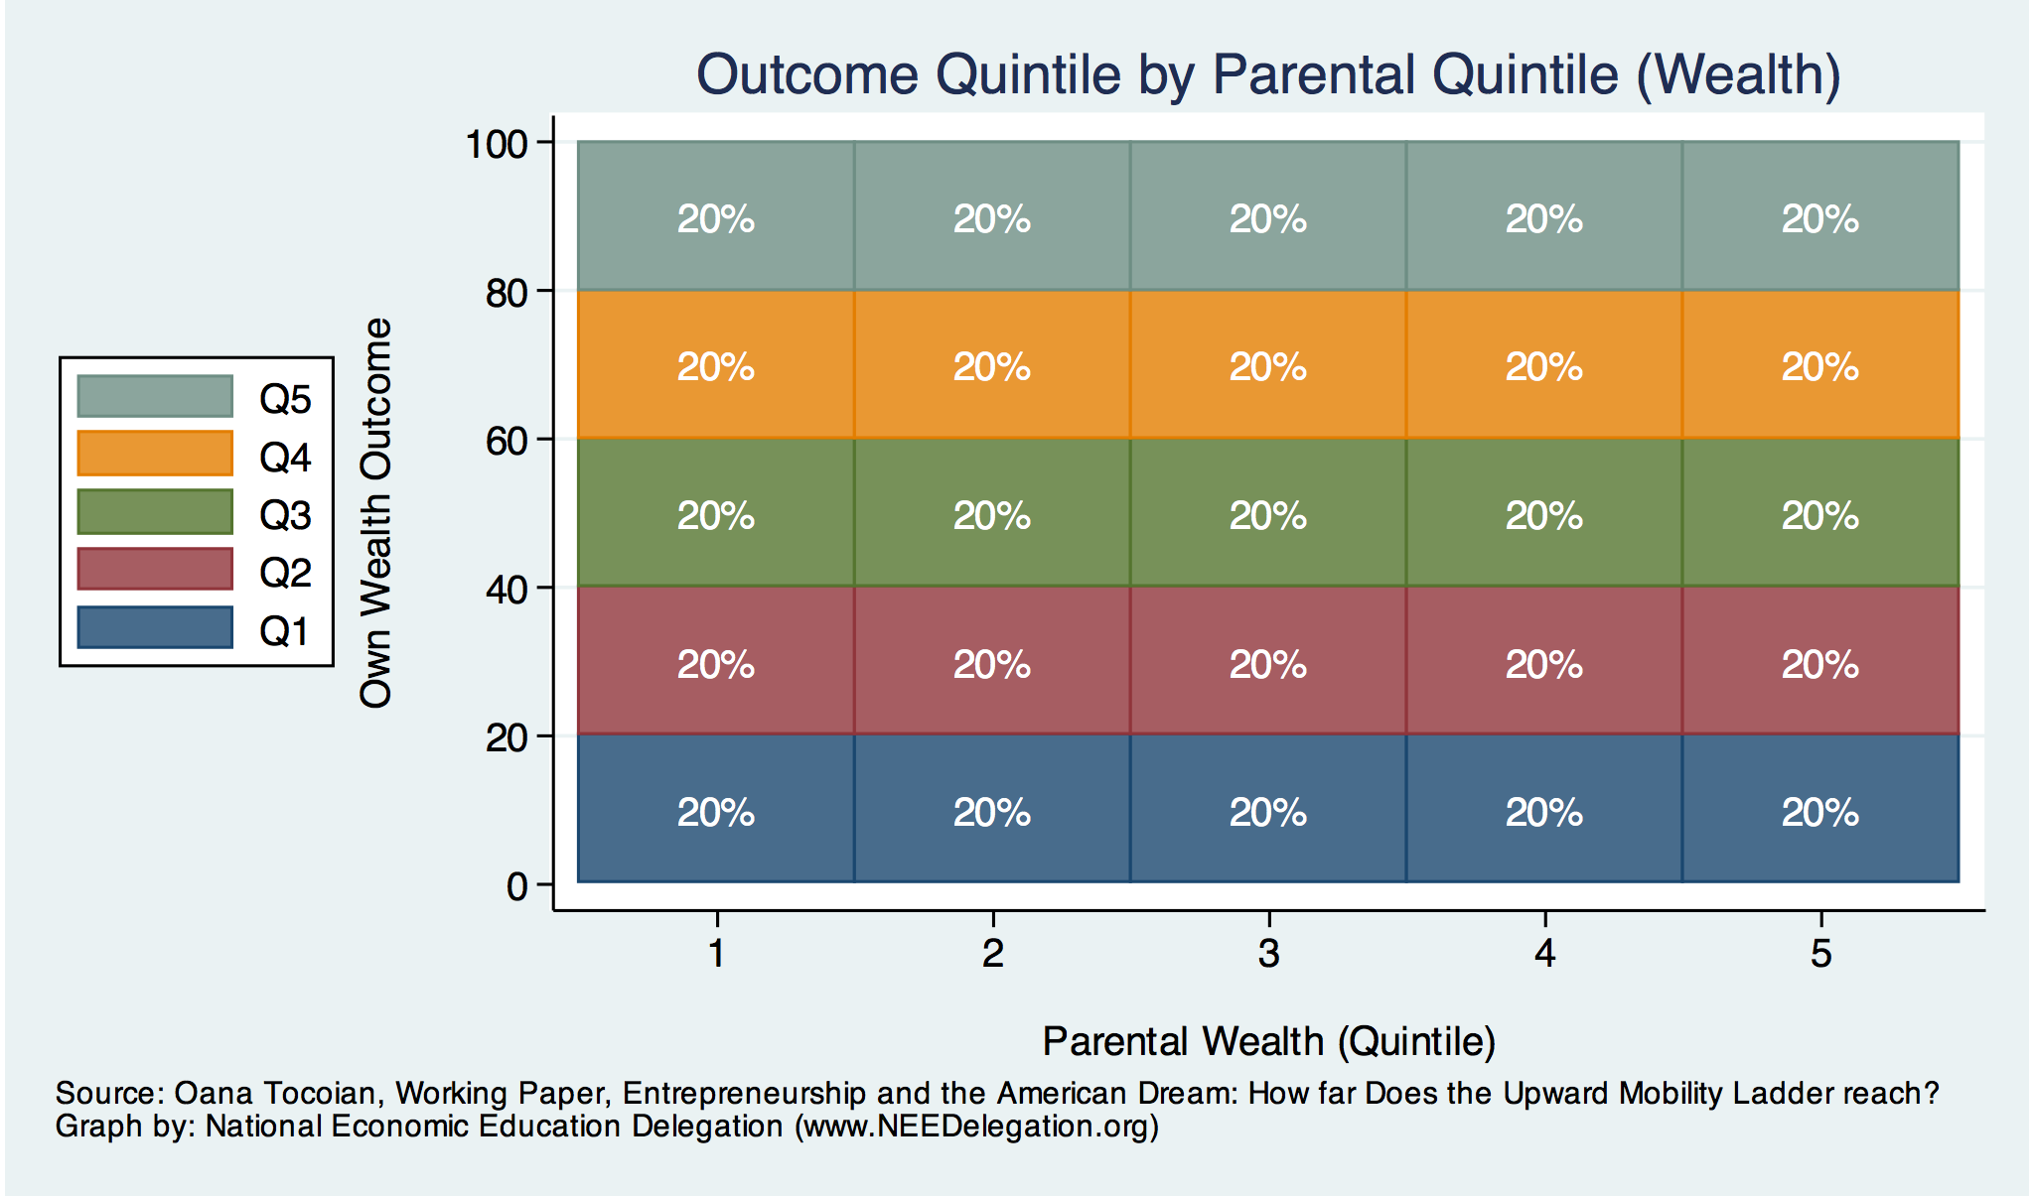
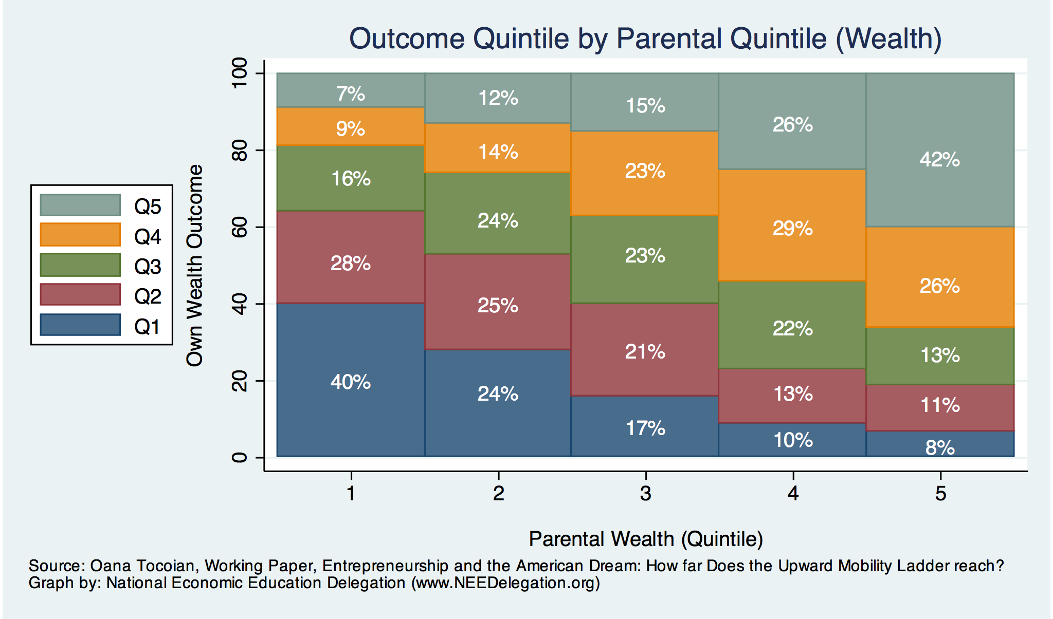
Wealth Mobility

Slide 27
Tangible Benefits for the Broader Economy
More human capital development
Increased entrepreneurship
Healthier labor force
Less social unrest
Less reliance on social programs
Smaller stock of student loans

Slide 28
Sources of Disparities

Slide 29
Events/Policies with Direct Wealth Implications
Slave trade
  The first deprivation
Slavery
40 acres (and a mule)
  The second deprivation
  Discriminatory distribution of land.
Freedmen’s Bank
  Lax oversite and dissolution.
Jim Crow Laws & Economic Policy
  Convict leasing, debt peonage, chain-gang, sharecropping, and lynching.
Homestead Act
  Discriminatory distribution of land.
Land theft and destruction
  E.g., Black Wall Street – Tulsa, 1921
GI Bill
  Discriminatory access – Levittown
Federal Housing Authority
  Redlining
And many more.

Slide 30
Results for Black Families
Much lower accumulation of wealth than among White families.
Implications:
  Less financial contribution from parents to children.
    More difficult access to higher education.
    Less access to capital for business formation.
  More likely to live in disadvantaged neighborhoods
    Fewer role models.
    Less access to quality education.
  Disparities in the capacity – availability of resources - to build wealth.

Slide 31
Potential Explanations: Differences in…
Educational attainment
Home ownership
Increased savings
Financial literacy
Soft skills & personal responsibility
Entrepreneurship
Wages
Incarceration rates
Family structure
Initial endowment

Slide 32
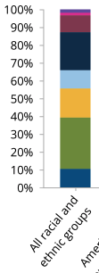


Differences in Educational Attainment, 2017
Source: American Council on Education

Slide 33
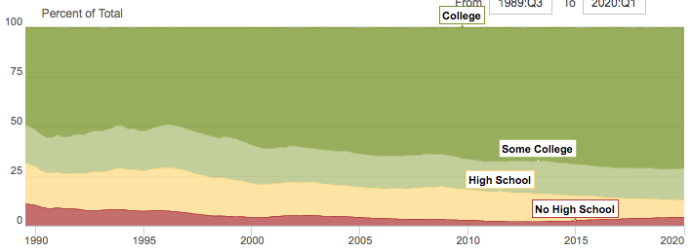
Wealth by Educational Attainment
Educational Attainment | Net Worth Median | Net Worth Mean
No High School | $22,800 | $157,200
High School | $67,100 | $249,600
Some College | $66,100 | $340,600
College | $292,100 | $1,511,100
71.0%
16.1%
8.6%
4.3%
Source: Federal Reserve Board, Table data are 2016.

Slide 34
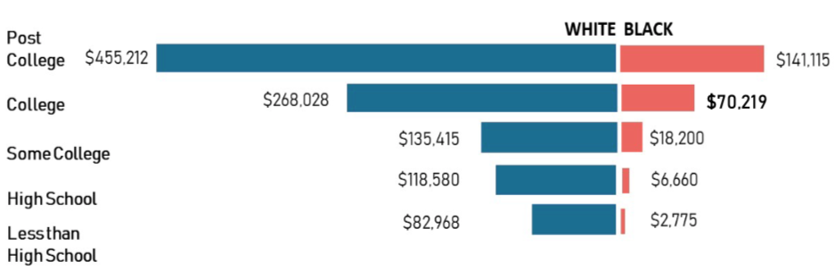
Educational Attainment
Median Household Net Worth by Race and Education
Source: Darity, et al., “What We Get Wrong About Closing the Racial Wealth Gap”

Slide 35
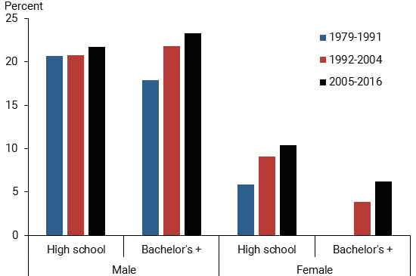
Black-White Earnings Gap by Education
Source: https://www.frbsf.org/economic-research/publications/economic-letter/2017/september/disappointing-facts-about-black-white-wage-gap/

Slide 36
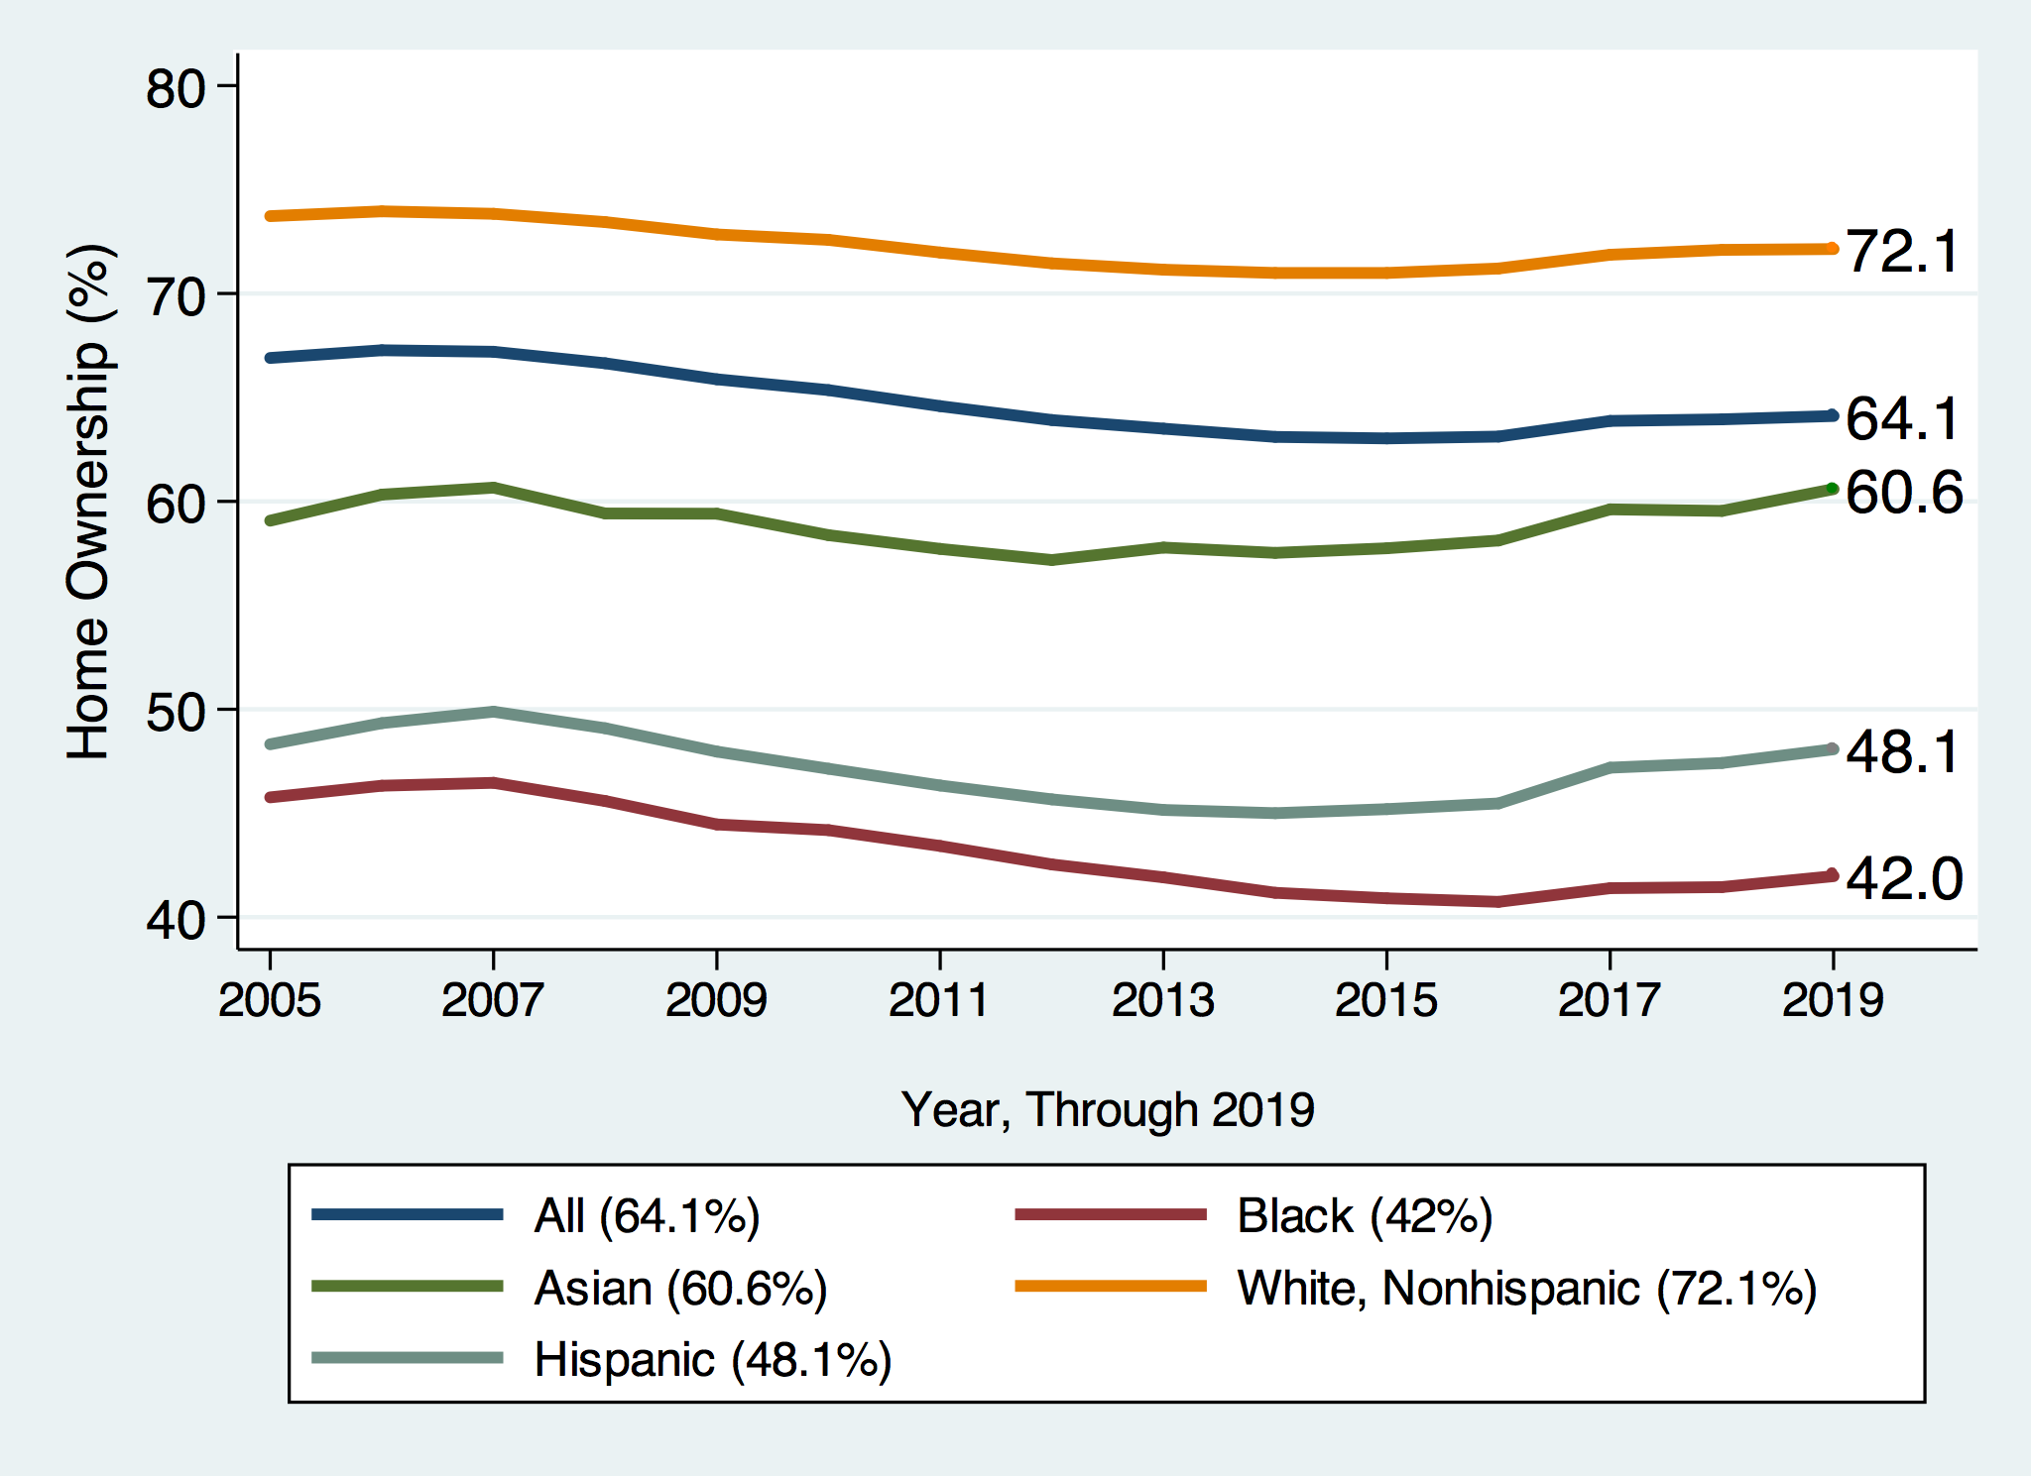
Home Ownership

Slide 37

Home Ownership
Housing Status | Net Worth Median | Net Worth Mean
Renters | $5,200 | $91,100
Owner | $231,400 | $1,034,200

Slide 38
Wealth Equality Through Home Ownership?
Well-documented evidence of historical and ongoing housing and lending discrimination.
What about home prices in minority neighborhoods? Even if they buy, they won’t get the appreciation of White neighborhoods.
  Home values are 50% lower in majority Black neighborhoods.
    23% after adjusting for quality and amenities.
Source: Brookings, Home ownership while black

Slide 39
What Determines Differences in Home Ownership?
Wealth of parents
Ability to borrow – lending discrimination
  At all
  On equivalent terms to white borrowers
Local ordinances – housing discrimination
Lower appreciation rates of homes in majority Black communities

Slide 40
Increased Savings
Historical evidence generated by economists ranging from Milton Friedman (1957) to Marjorie Galenson (1972) to Marcus Alexis (1971) to Gittelman and Wolff (2004)…..
  All find that after accounting for household income, Blacks have a slightly higher savings rate than Whites.
Risk and reward are higher for White investors
  Controlling for income, this is not clear.
  Access to and tolerance for higher risk investments is clearly correlated with income.

Slide 41
Financial Literacy
Financial literacy doesn’t matter that much when you don’t have any finances to manage.
Controlling for household income, there is no difference in rates of asset appreciation between Black and White households.

Slide 42
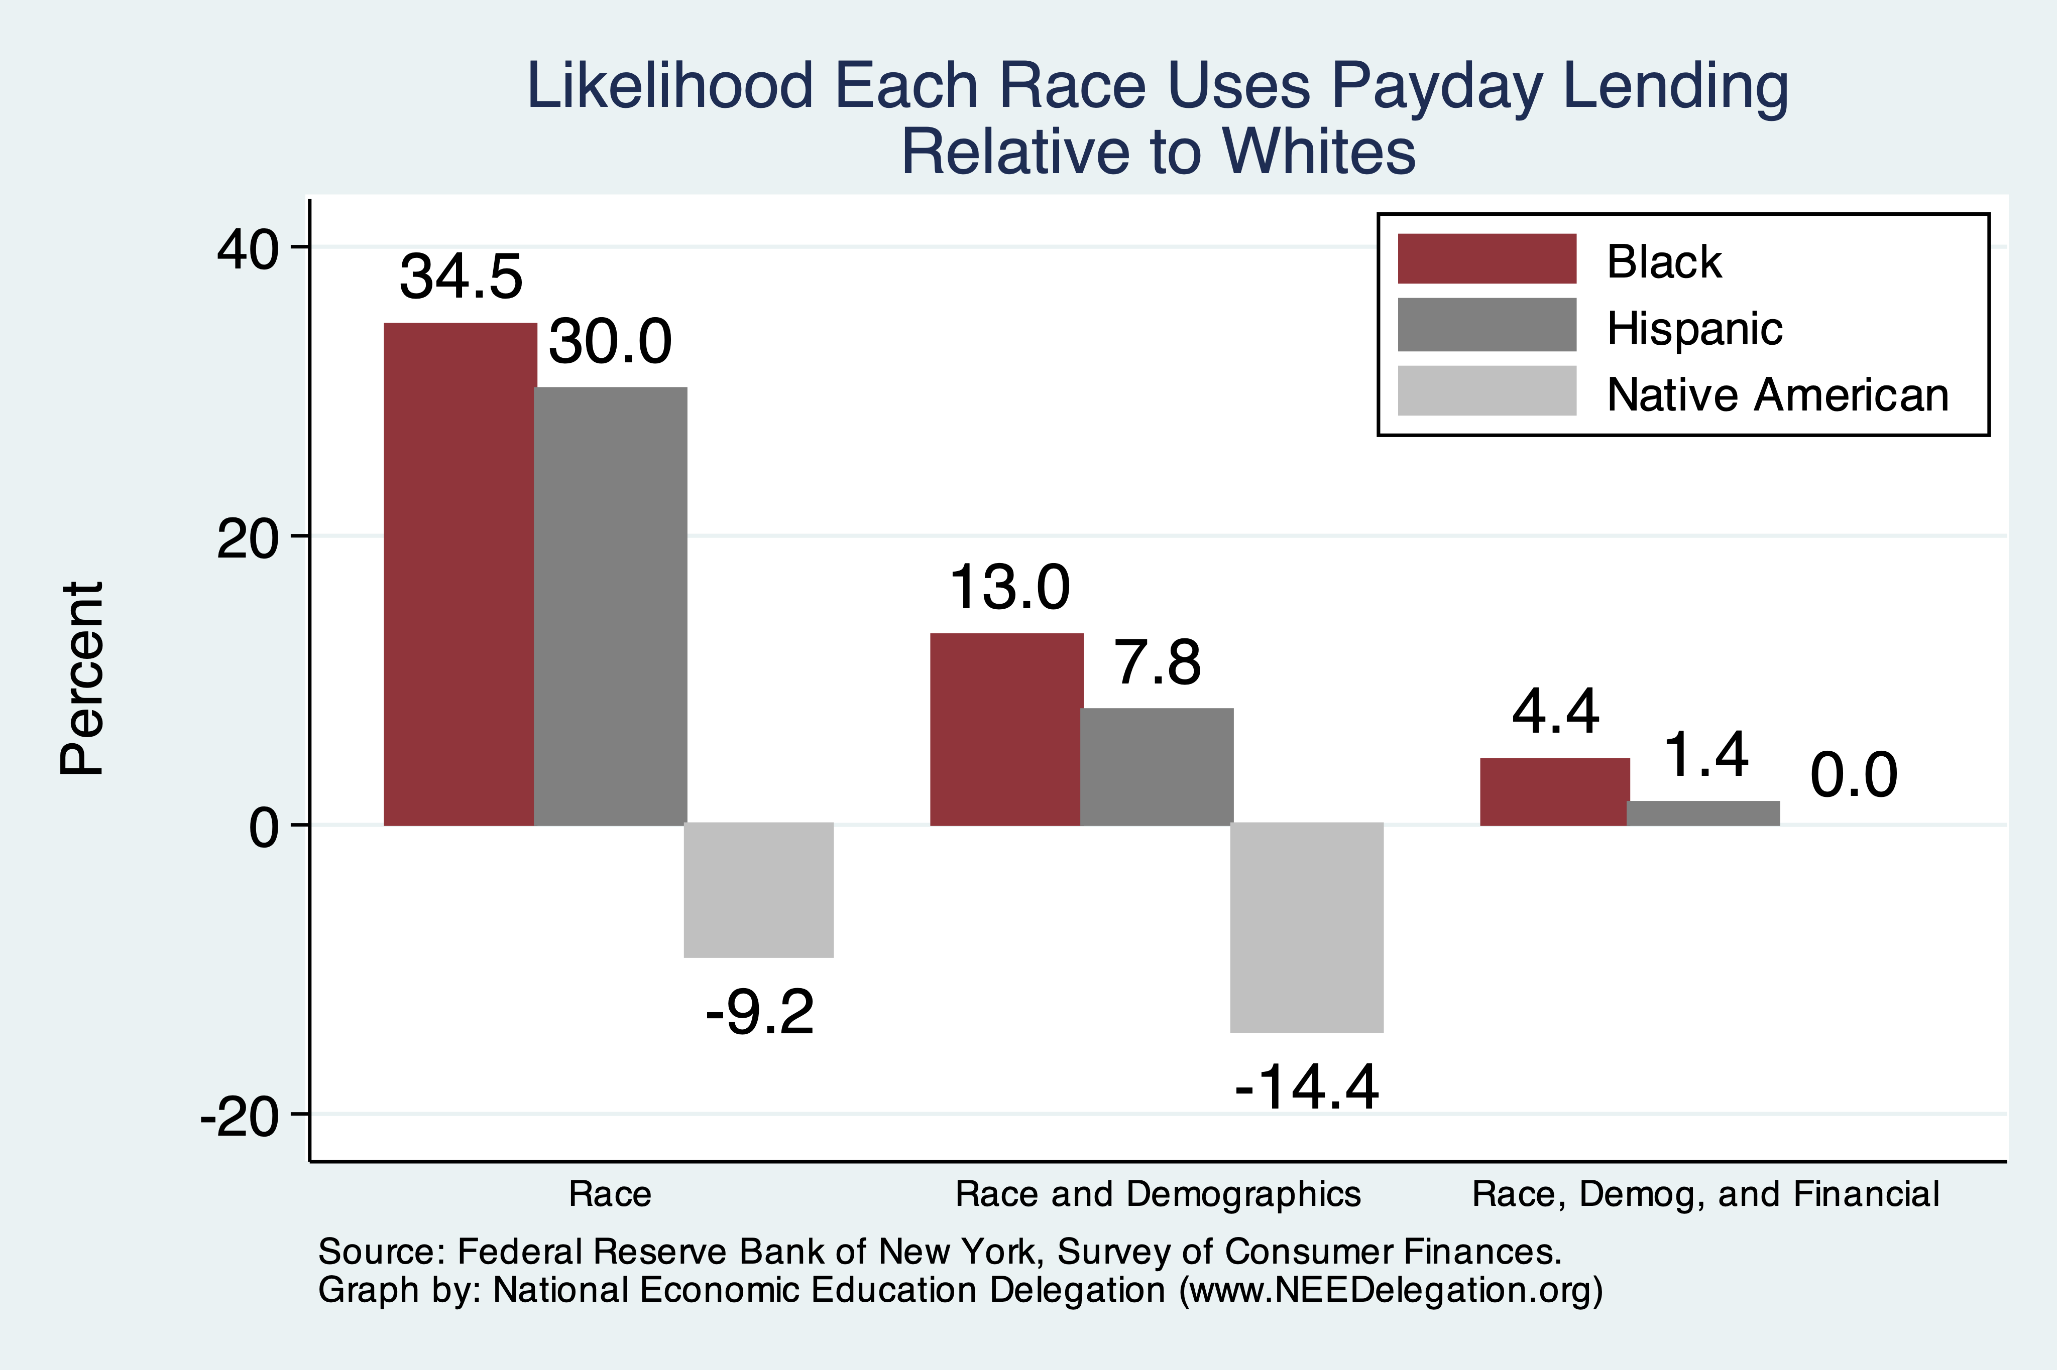
Use of Payday Lenders
Source: Federal Reserve Bank of New York; Survey of Consumer Finances

Slide 43
Soft Skills and Personal Responsibility
Employability
  Show up on time
  Eye contact with customers
  Dress well
  Collaborative skills
Reality
  Black workers are crowded into service sector jobs.
  Well represented in service, sales and office, and production, transportation, and material moving
  Relatively less well represented in construction, extraction, and maintenance.

Slide 44
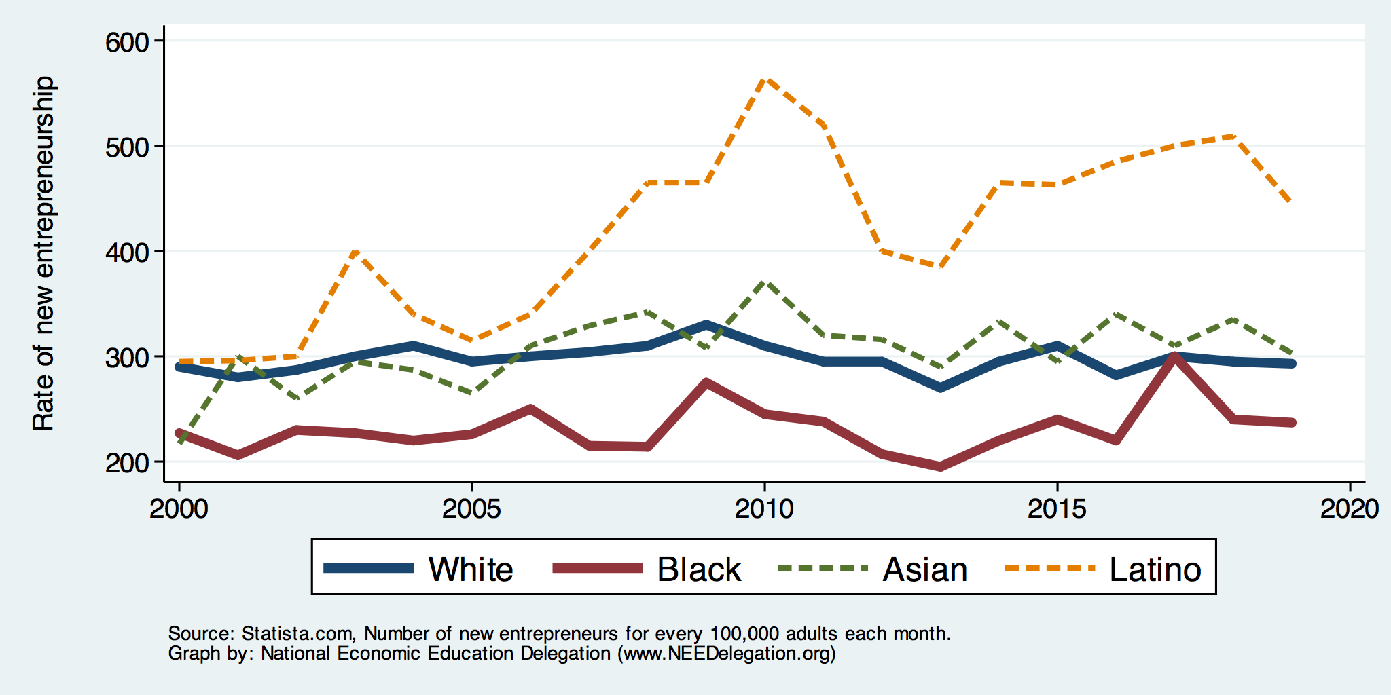
Entrepreneurship: Rate of New Entrepreneurs
Source: Statistica

Slide 45
Explaining Differences in Entrepreneurship
Disparities in access to capital:
  Wealth disparities
    Specifically, differences in home equity.
    Differences in wealth levels of friends and family.
  Less likely to rely on banks and more likely to rely on credit cards.
  Loans have higher int rates and more likely to be declined.
  Less access to venture funds.
Generally lower levels of education.
Previous business ownership by family.

Slide 46
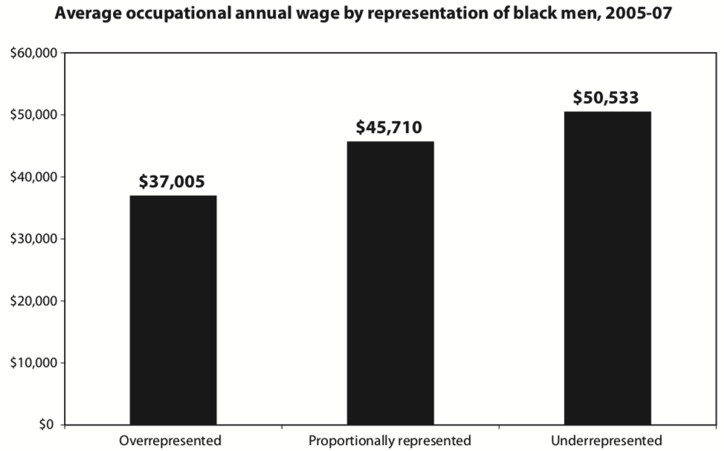
Overrepresented Where Wages are Low
Source: Hamilton Darrick, Algernon Austin, and William Darity, Jr. Whiter Jobs, Higher Wages :Occupational Segregation and the Lower Wages of Black Men Economic Policy Institute, Briefing Paper #288 2011.

Slide 47
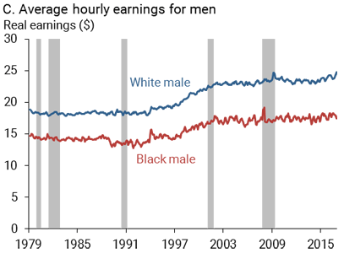
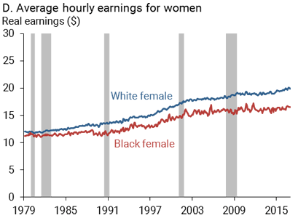
Wage Gap: Controlling for education, age, job type.
Source: https://www.frbsf.org/economic-research/publications/economic-letter/2017/september/disappointing-facts-about-black-white-wage-gap/

Slide 48
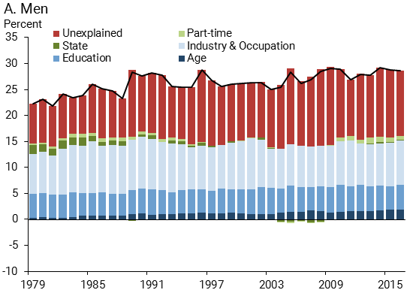
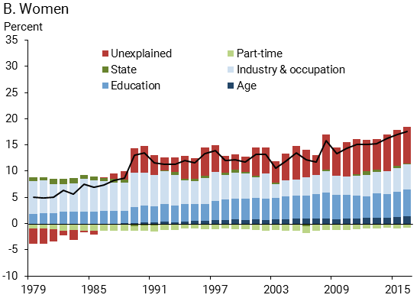
Wage Gap Broken Down
Source: https://www.frbsf.org/economic-research/publications/economic-letter/2017/september/disappointing-facts-about-black-white-wage-gap/

Slide 49
Black-White Earnings Gap by Education
Source: https://www.frbsf.org/economic-research/publications/economic-letter/2017/september/disappointing-facts-about-black-white-wage-gap/

Slide 50
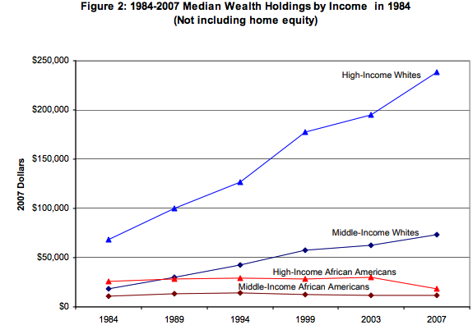
Equality of Income = Equality of Wealth
/
Source: http://hartfordinfo.org/issues/wsd/FamiliesandChildren/Racial-Wealth-Gap-Brief.pdf

Slide 51
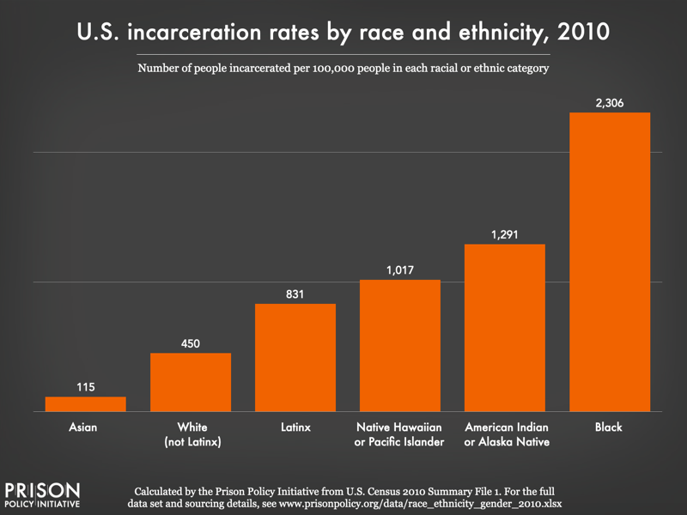
Incarceration Likely Plays A Role

Slide 52
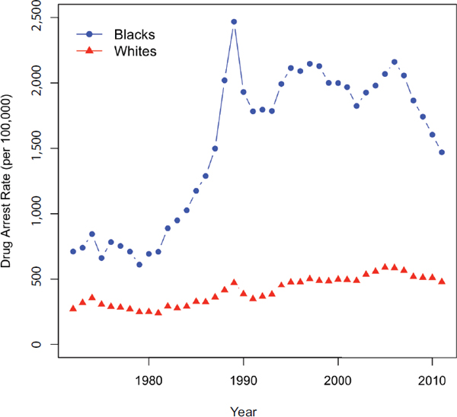
US Drug Arrest Rates per 100,000 by Race
War on Drugs

Slide 53
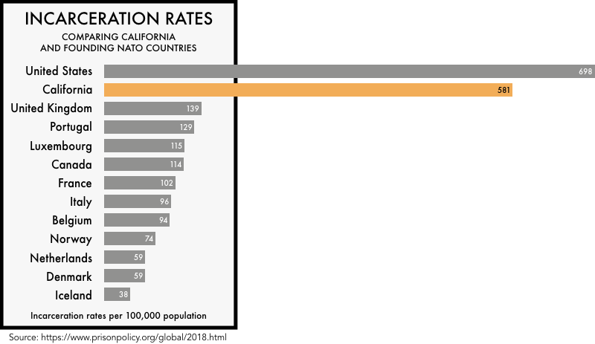

Slide 54
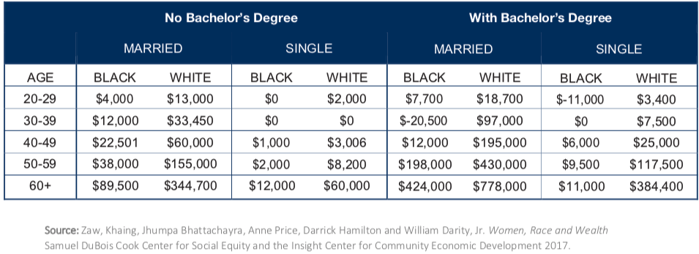
Family Structure

Slide 55
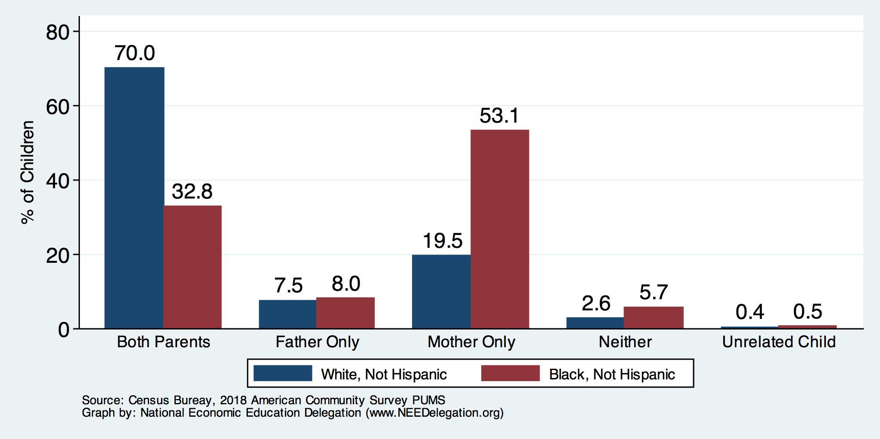
Kids – Household Types

Slide 56
Initial Endowment

Slide 57
What is Fundamentally Responsible?
Individual behaviors?
Structural characteristics of the economy?
History – policy and otherwise?

Slide 58
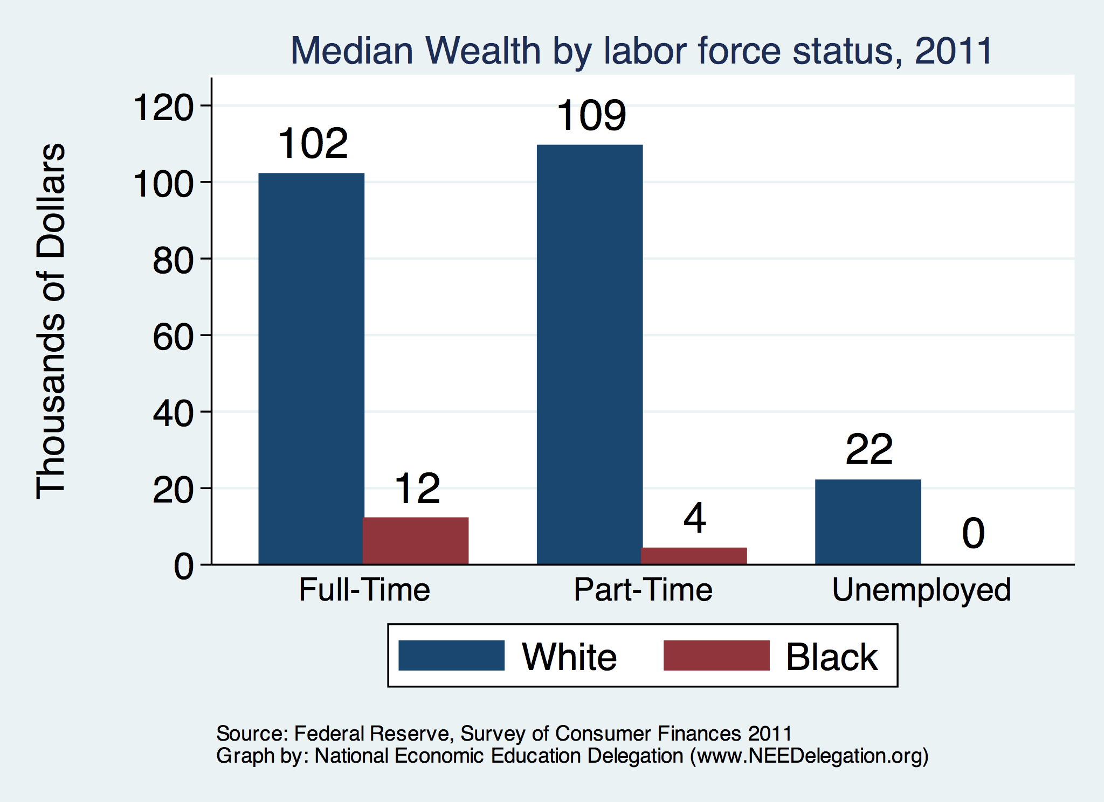

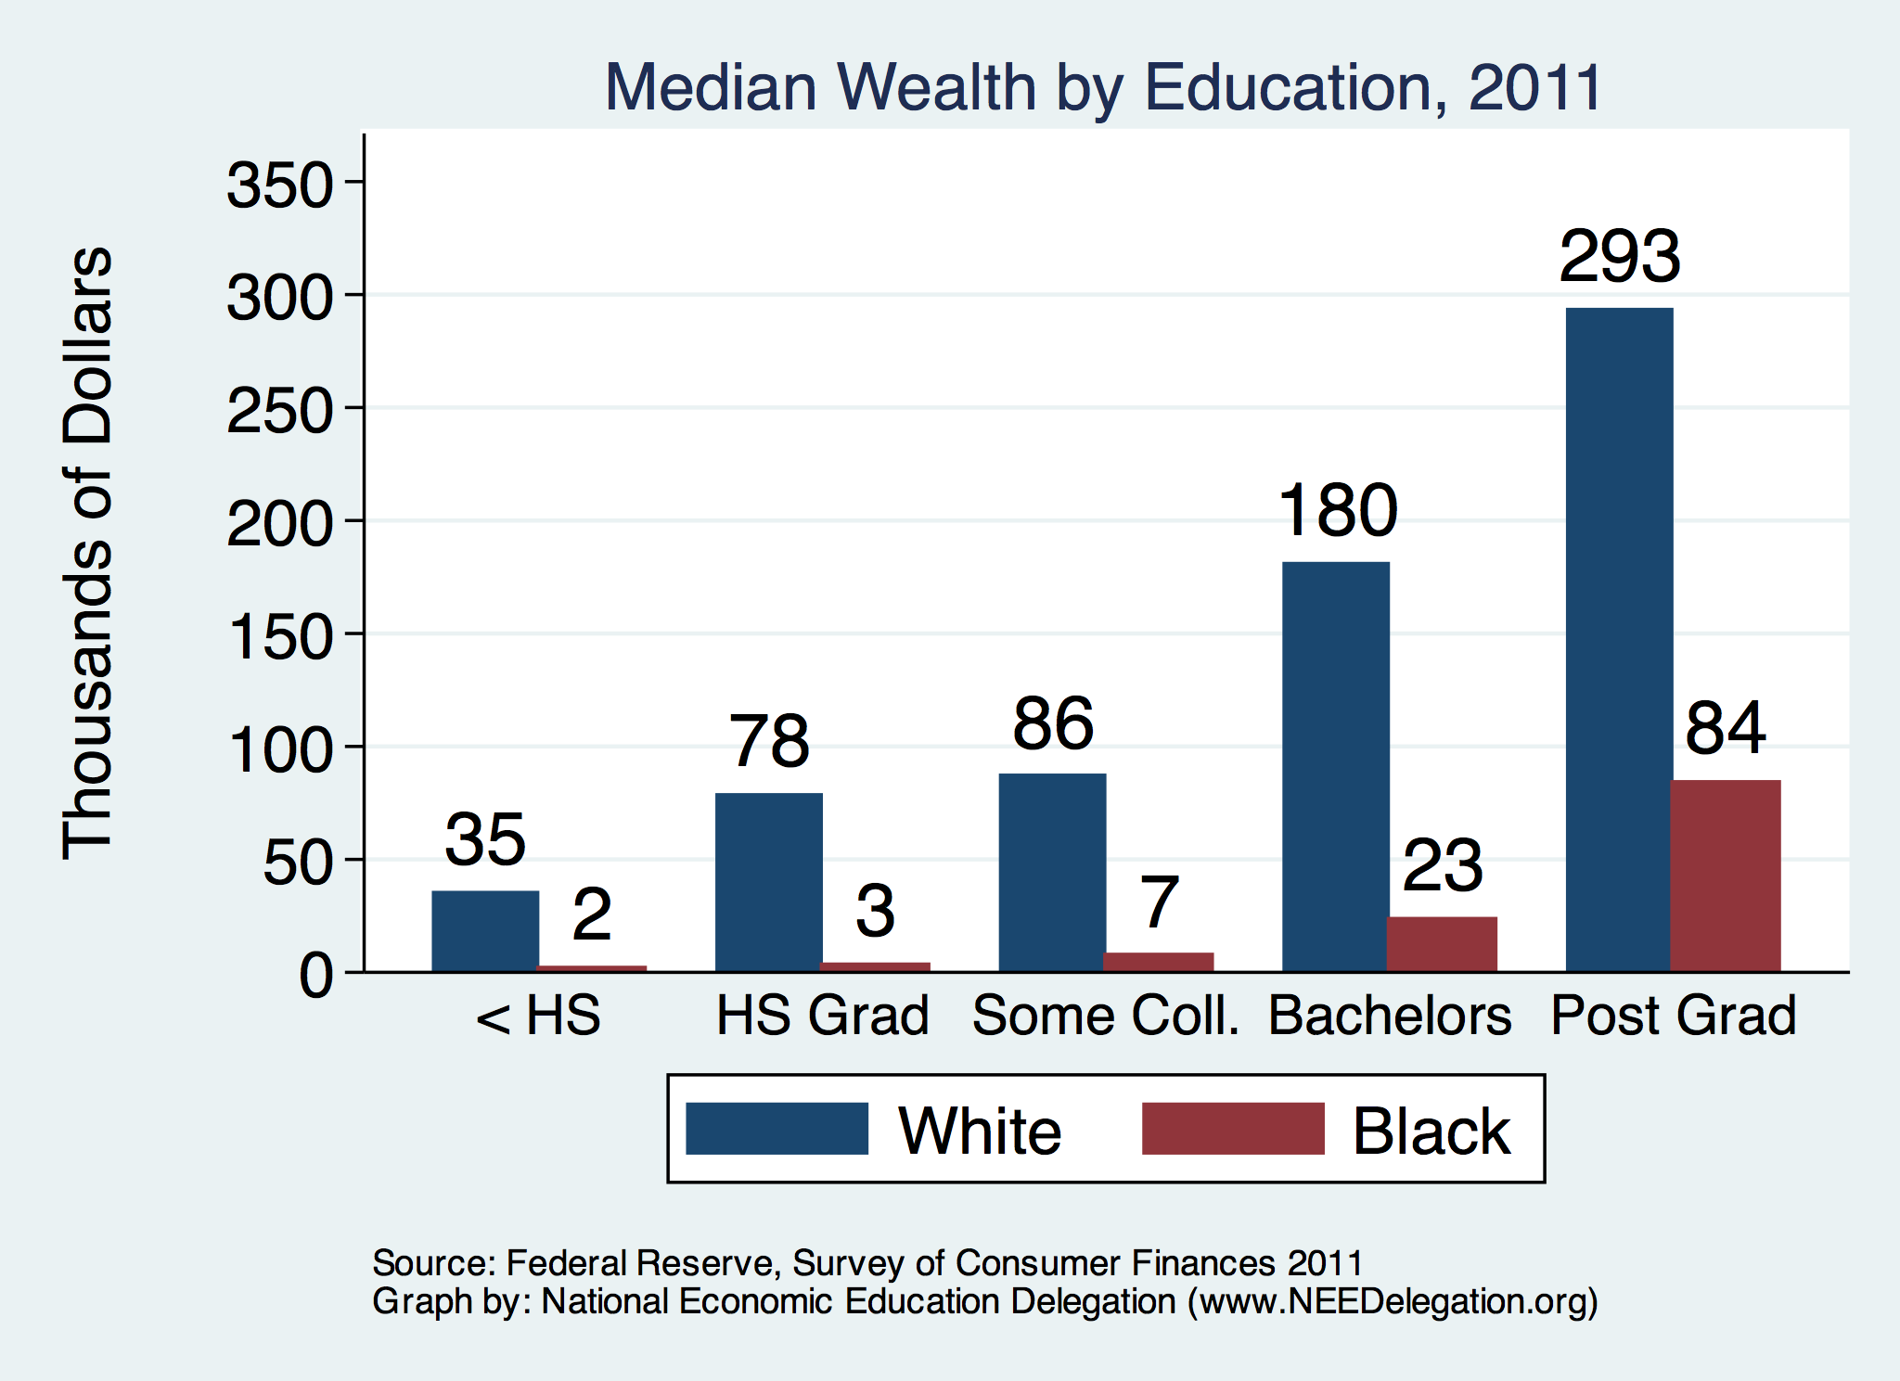
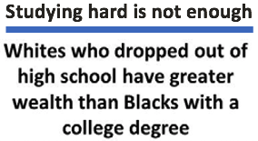
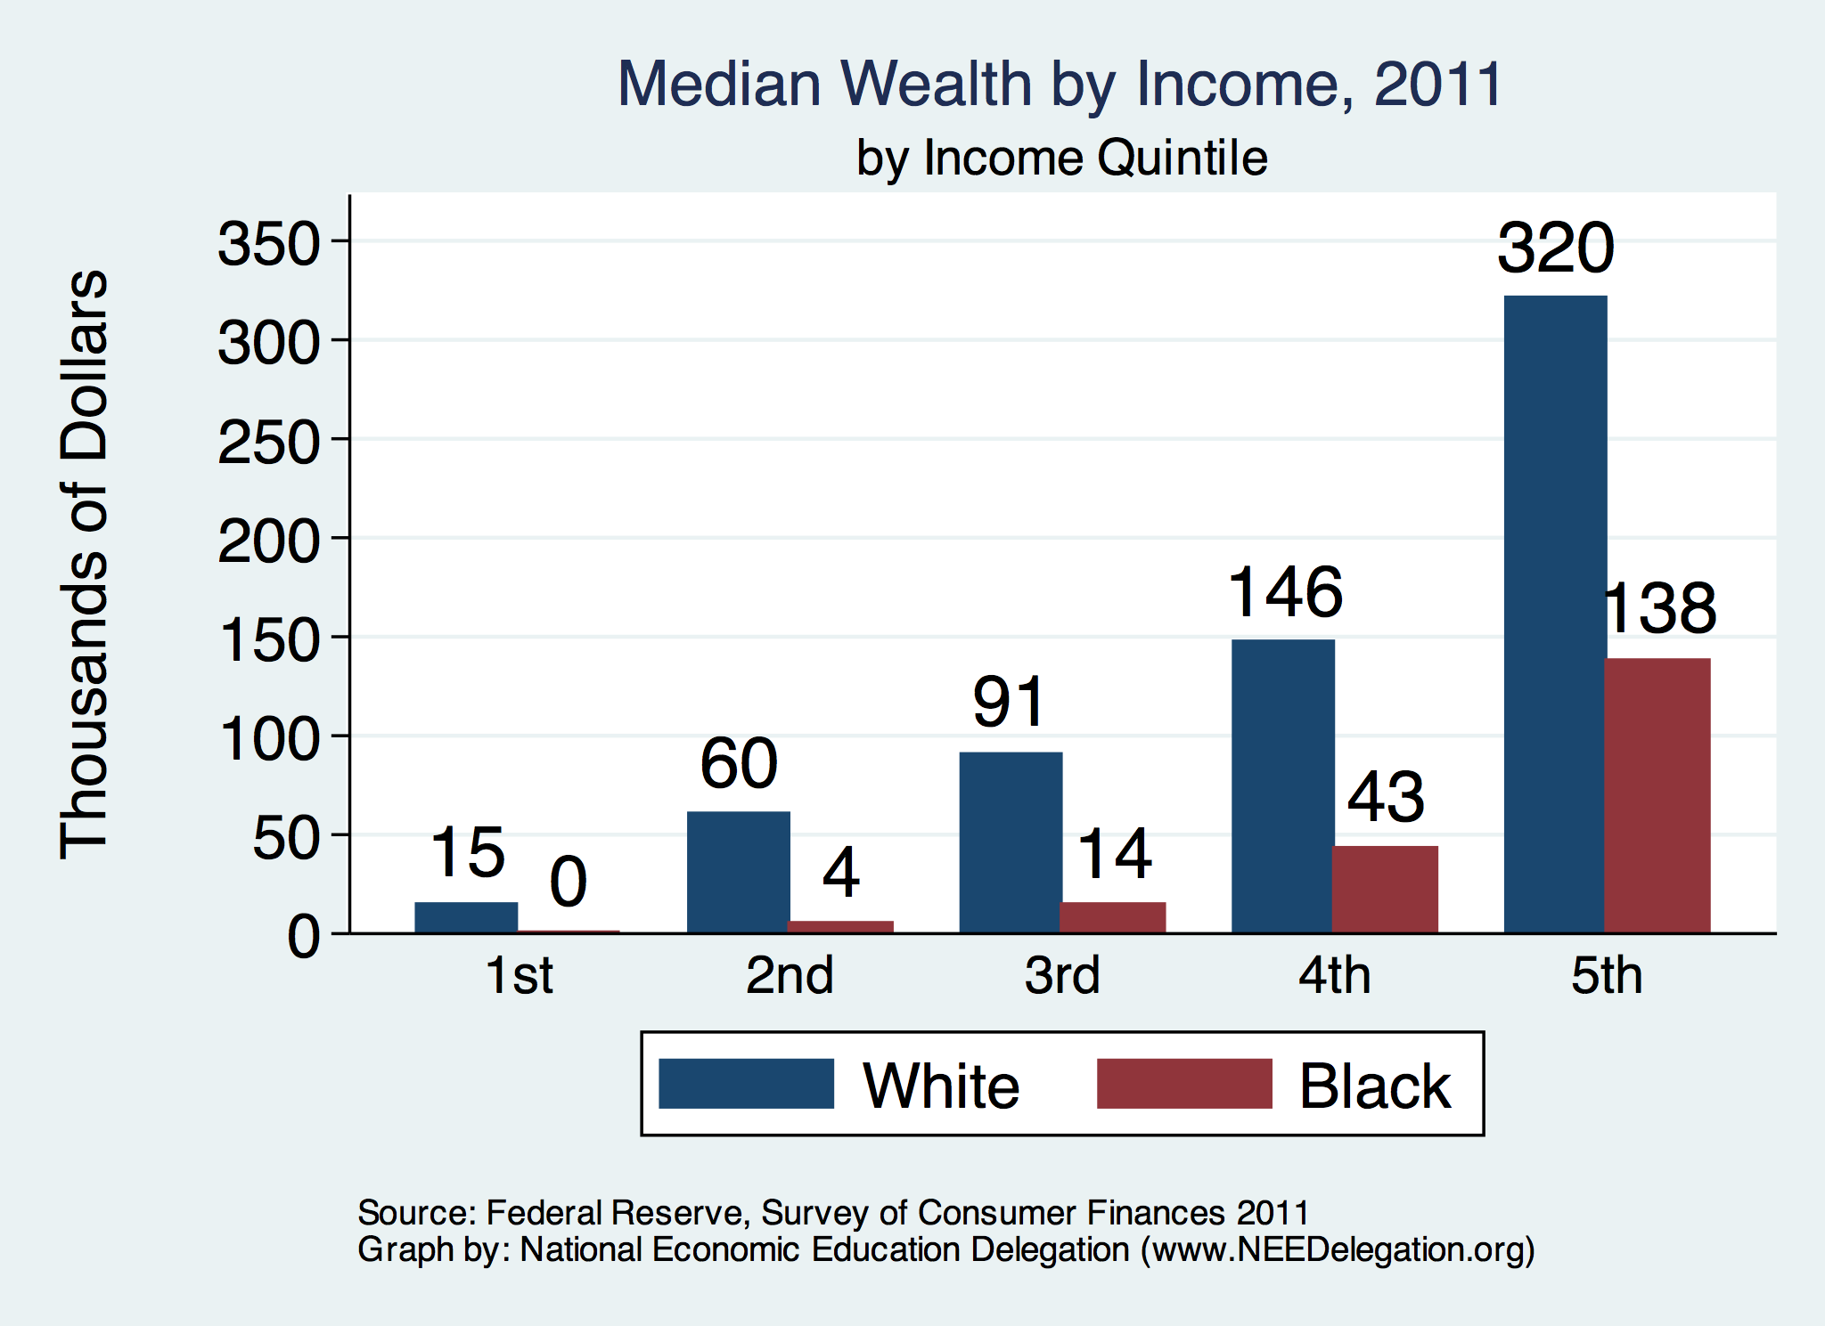


Slide 59
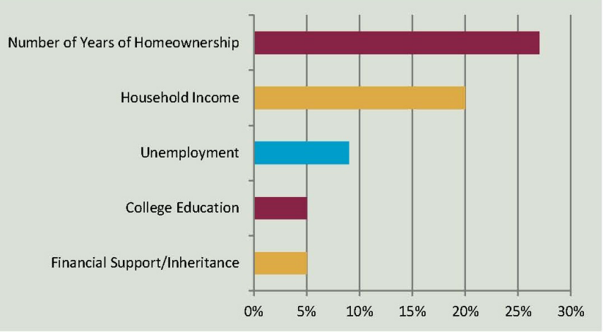
Accounting for the Wealth Gap
30%+ Left
Unaccounted for
Source: https://heller.brandeis.edu/iasp/pdfs/racial-wealth-equity/racial-wealth-gap/roots-widening-racial-wealth-gap.pdf

Slide 60
Policy Options

Slide 61
Categories of Policy Areas
Housing
  FHA and redlining
Health Care
Incarceration
  Black incarceration rates are very high.
Education
Workforce
Income support and stability
Asset accumulation

Slide 62
Specific Policy Options
Global solutions that affect all source areas
  Child Trust Accounts - ”Baby Bonds”
  Guaranteed minimum income
Addressing racial disparities directly
  Reparations
    Aggressive affirmative action.
    A new Homestead Act.
    Heavily investing in Black communities.
  Labor and other laws that address discrimination
    Enforce more aggressively and make adjustments where necessary to increase efficacy.
  Fundamental reorientation of asset building agenda.

Slide 63
Reform Criminal Justice System
Legal restrictions on the rights of people who have had contact with the criminal justice system, particularly contact resulting in conviction.
Usually placed in civil and regulatory codes, collateral consequences may limit a person’s:
  ability to vote
  live in public housing
  own a firearm
  qualify for an occupational license
  serve in the military
  receive public benefits (Food Stamps, housing vouchers)
  sit on a jury
  borrow money for college
Legal restrictions on the rights of people who have had contact with the criminal justice system, particularly contact resulting in conviction.
Usually placed in civil and regulatory codes, collateral consequences may limit a person’s:
  ability to vote
  live in public housing
  own a firearm
  qualify for an occupational license
  serve in the military
  receive public benefits (Food Stamps, housing vouchers)
  sit on a jury
  borrow money for college
Legal restrictions on the rights of people who have had contact with the criminal justice system, particularly contact resulting in conviction.
Usually placed in civil and regulatory codes, collateral consequences may limit a person’s:
  ability to vote
  live in public housing
  qualify for an occupational license
  serve in the military
  receive public benefits (Food Stamps, housing vouchers)
  sit on a jury
  borrow money for college

Slide 64
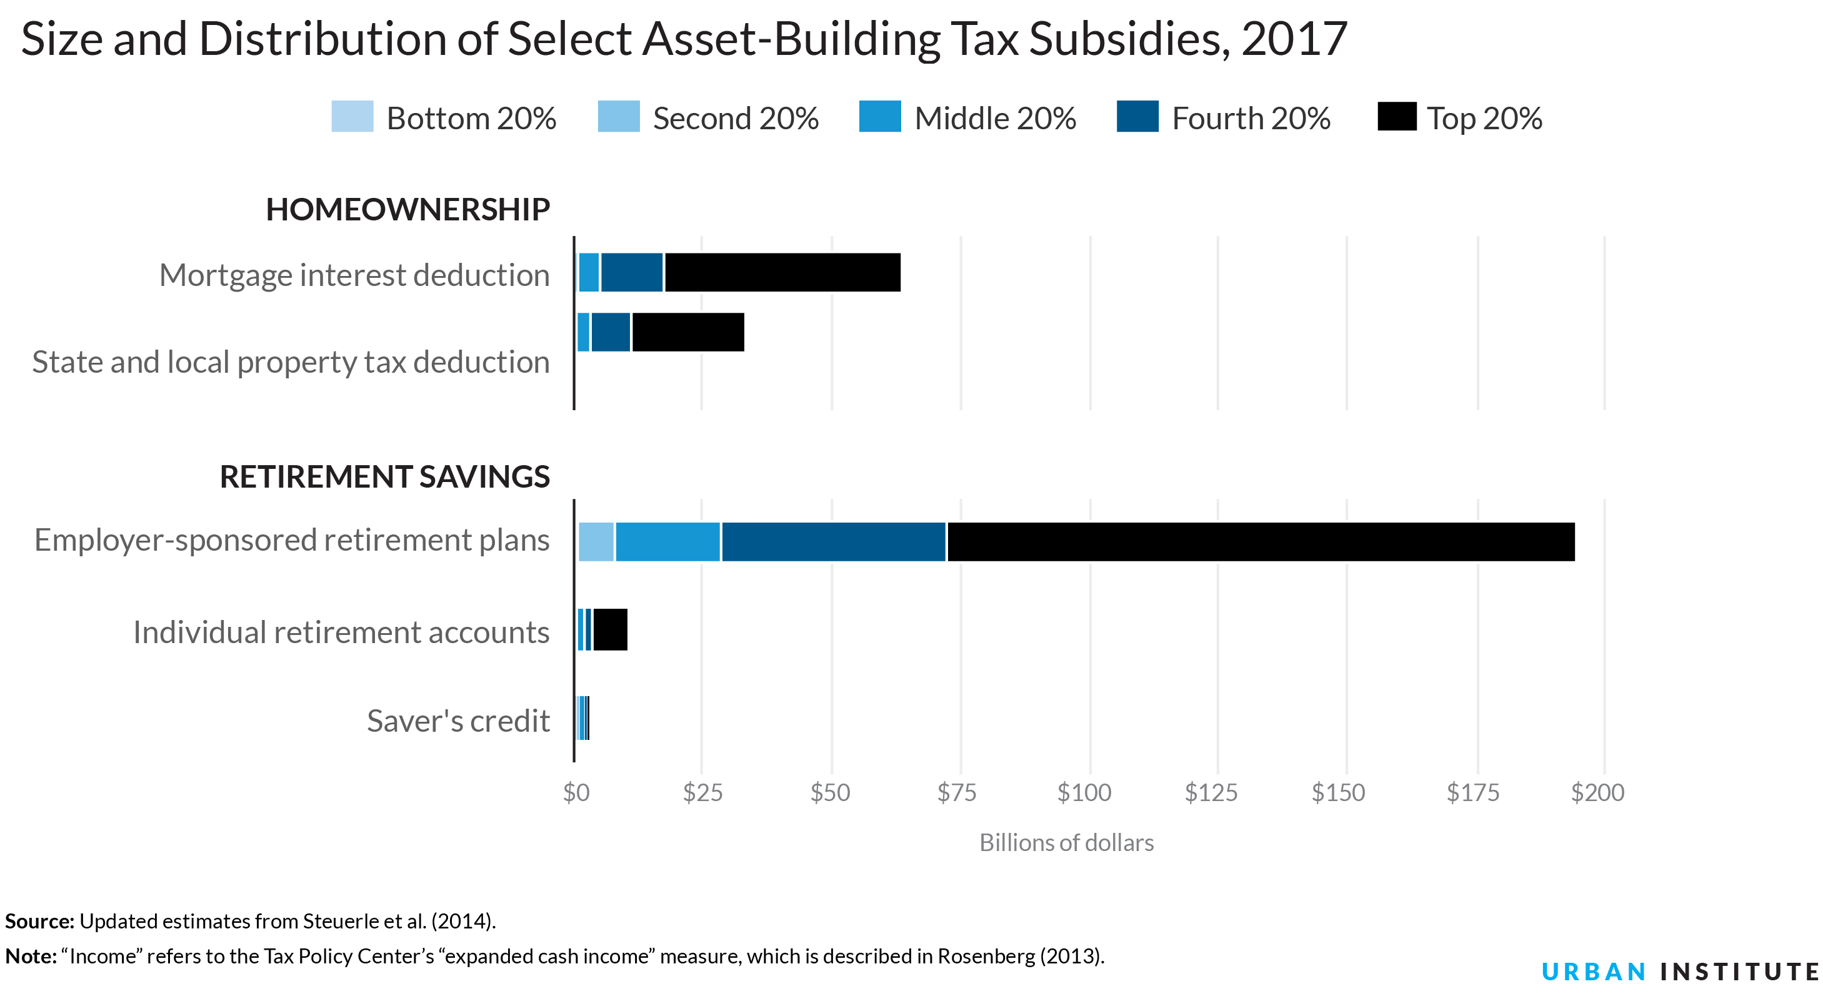
Gov’t Asset Building Policies

Slide 65
Other Concrete Policy Options
Limit the mortgage interest tax deduction and use the revenues to provide a credit for first-time homebuyers.
Establish automatic savings and retirement plans.
Reduce reliance on student loans while supporting success in postsecondary education.
Offer universal children's savings accounts.
Reform safety net program asset tests, which can act as barriers to saving among low-income families.
Provide subsidies to promote emergency savings, such as those linked to tax time.
Source: Urban Institute

Slide 66
Suggestions, Not Really Policies

Slide 67
Buying and Banking Black
Common Assertion: Marshalling the enormous purchasing power of the Black community will drive progress.
  More than $1.3 trillion in buying power.*
Common Assertion: Banking is a source of wealth creation.
  Combining the wealth of Black Americans in Black banks could be a source of wealth creation.
* Source: https://www.newswise.com/articles/minority-markets-have-3-9-trillion-buying-power

Slide 68
Intro to Fractional Reserve Banking
Money is deposited in an account in a bank.
Most of that money is lent out.
  The rest is the “reserve”.
Suppose lent to purchase a house.
  That money is then deposited in a bank.
    Most of that money is lent out.
      The rest is the “reserve”.
    Suppose lent to purchase a house.
      That money is then deposited…..
This is how wealth is created in the banking system.
  Many banks are charging interest on essentially the same deposit.

Slide 69
Why This Doesn’t Work for Black Banks
Money is deposited in an account in a Black bank.
Most is lent for the purchase of a house by a Black buyer.
If the seller is White, those funds then get deposited in a White bank.
  All of the remaining fractional reserve benefits now go to White banks.
Because the money is not allowed to circulate ONLY within the Black community, Black banking will likely have limited capacity to generate wealth.
  Capacity of banks. Capacity of depositors (3% of all U.S. wealth).

Slide 70
Why the Short Circuiting of Black Banking?
Category | White | Black
Home Ownership (%) | 73.7 | 45.0
Other Residential Property Ownership (%) | 15.1 | 8.2
Residential Ownership (%) | 75.8 | 12.5
Mean Asset Value (Thousands $)
- Own Home | 354.8 | 199.3
- Other Residential | 430.6 | 173.6
Share of Res. Value (%) | 80.0 | 5.7
Numbers of banks & credit unions
  Total: 10,655
  Black owned: 43 (0.4%)
They are very small
  All Black owned: $5.8 Billion
  JP Morgan Chase: $2.8 TRILLION

Slide 71
The Multiplier Economy – Spanner in the Works
Banking – money goes where money is.
Buying – money goes to buy intermediate inputs, into the White community.
  There is a similar multiplier for consumer spending.
  Money is spent – goes to a Black business
    That Black business then keeps some of the money, but some leaves the Black community through the purchases of intermediate inputs.
      The Black economy may simply not be big enough to prevent this leakage.

Slide 72
Can It Be Made To Work?
Both approaches to closing the wealth gap are severely limited unless the Black banking sector and economies are walled off from the rest of the country.
Walling off isn’t enough. Also need to:
  Capitalize the Black banking sector and economy.
  Offer fair protections from predatory market forces.
    Larger White banks start off with more economic power.

Slide 73
Summary
The Black White wealth gap is enormous (2019)
  Mean: White wealth is 6.9x Black wealth.
  Median: White wealth is 7.8x Black wealth.
There are many explanations in the common narrative.
  Many do not stand up to scrutiny.
Government policies have contributed enormously this gap.
  Racial dehumanizing permitted these policies.
Wealth endowments (parental wealth) are enormously important for determining own wealth in adulthood.
  Policies that address this relationship are most likely to be effective.
Some form of policy intervention is likely necessary if the gap is to be closed.

Slide 74
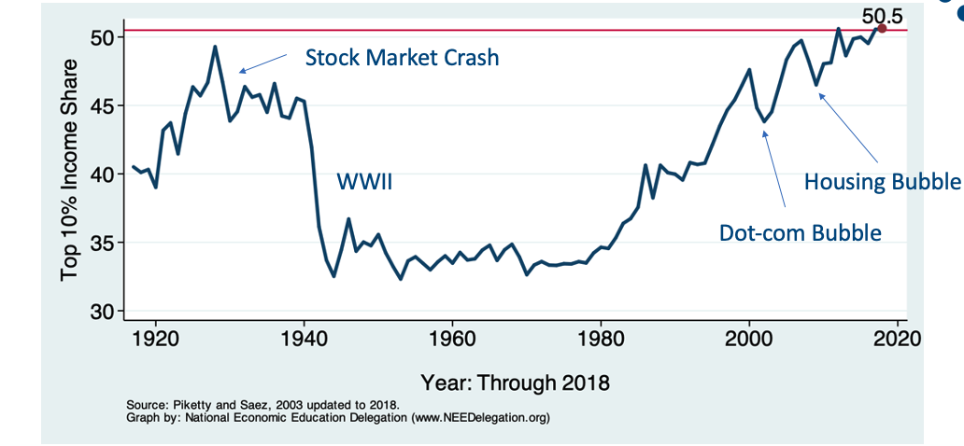
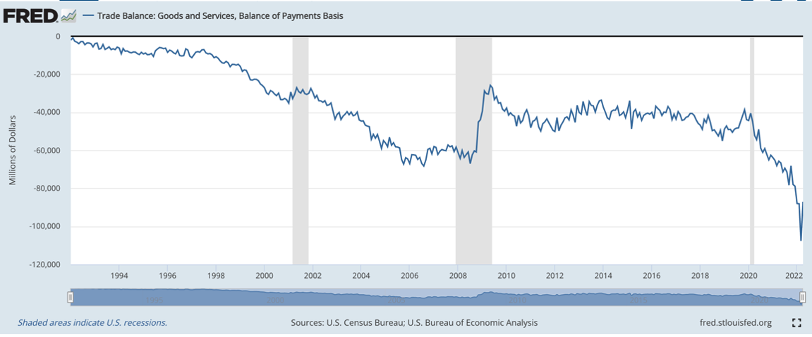
Next week:
FAU: Trade Balances and Exchange Rates – Alan Deardorff
JHU: Economic Inequality – Adina Ardelean

Slide 75
Thank you!
Any Questions?
www.NEEDelegation.org
Jon Haveman, Ph.D.
Jon@NEEDelegation.org
Contact NEED: info@needelegation.org
Submit a testimonial: www.NEEDelegation.org/testimonials.php

