Slide 1
Osher Lifelong Learning Institute, Spring 2023
Contemporary Economic Policy Issues
Duke University
May-June 2023
Host: Jon Haveman, Ph.D.
National Economic Education Delegation

Slide 2
Available NEED Topics Include:
US Economy
Healthcare Economics
Climate Change
Economic Inequality
Economic Mobility
Trade and Globalization
Minimum Wages
Immigration Economics
Housing Policy
Federal Budgets
Federal Debt
Black-White Wealth Gap
Autonomous Vehicles
Healthcare Economics

Slide 3
Course Outline
Contemporary Economic Policy
Week 1 (5/2): US Economic Update (Geoffrey Woglom, Amherst College)
Week 2 (5/9): Monetary Policy (Geoffrey Woglom)
Week 3 (5/16): Healthcare Economics (Kelley Cullen, E. Washington University)
Week 4 (5/23): Climate Change Economics (Sarah Jacobson, Williams College)
Week 5 (5/30): The Black-White Wealth Gap (Mike Shor, Univ. of Connecticut)
Week 6 (6/6): Federal Debt (Jon Haveman, NEED)

Slide 4
The Black-White Wealth Gap
Mike Shor, Ph.D.
Duke University
May 30, 2023

Slide 5
Outline
Evidence of disparities
Why wealth is important
Sources of disparities
Implications of disparities
Policy solutions

Slide 6
What is Wealth?
Income vs Wealth
Income is the flow of funds into a households each year.
Wealth is a household’s NET asset holdings.
The value of all assets minus the value of all debts.
Assets can be financial and physical.
Assets include:
Owned homes, cars, stocks, businesses, savings and checking accounts, pensions, life insurance…
Debts include:
Home mortgages, car loans, credit cards, and any other significant financial obligations (excl regular bills)…

Slide 7
Evidence

Slide 8
Wealth inequality in America

Slide 9
Overall Wealth Distribution
2019 Overall Median: $121,700

Slide 10
Evidence of the Gap
Mean is
7x Greater
Median is 8x Greater

Slide 11
Wealth Disparities, 2019
Race/Ethnicity | Mean Wealth | Share of Families | Share of Wealth | Ratio of Shares (Share of Wealth/Share of Families
White, non-Hispanic | $983,400 | 64.9 | 85.3 | 1.3
Black, non-Hispanic | $142,500 | 14.2 | 2.7 | 0.2
Source: Federal Reserve, Survey of Consumer Finances

Slide 12
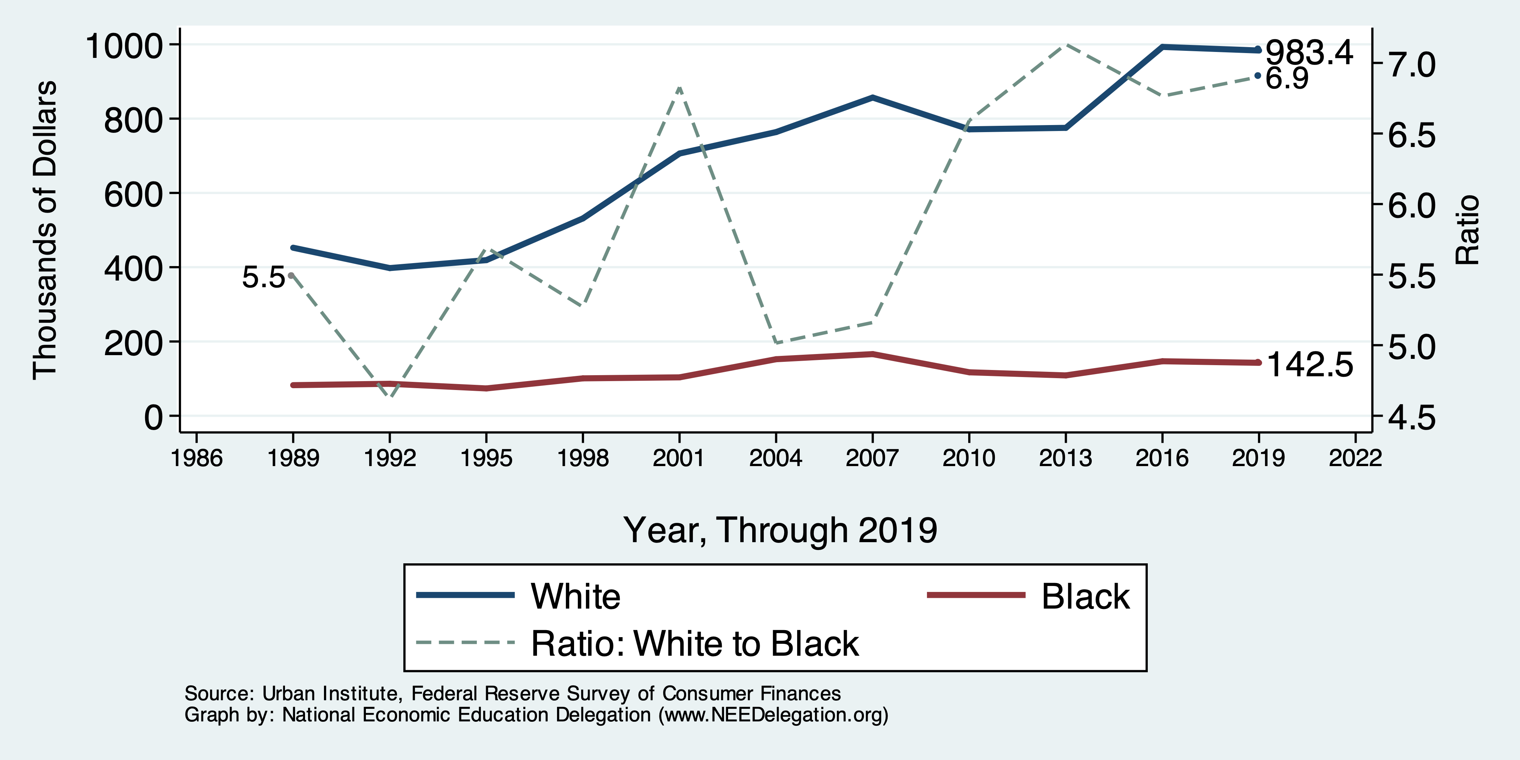
Wealth Gap Over Time: Mean

Slide 13
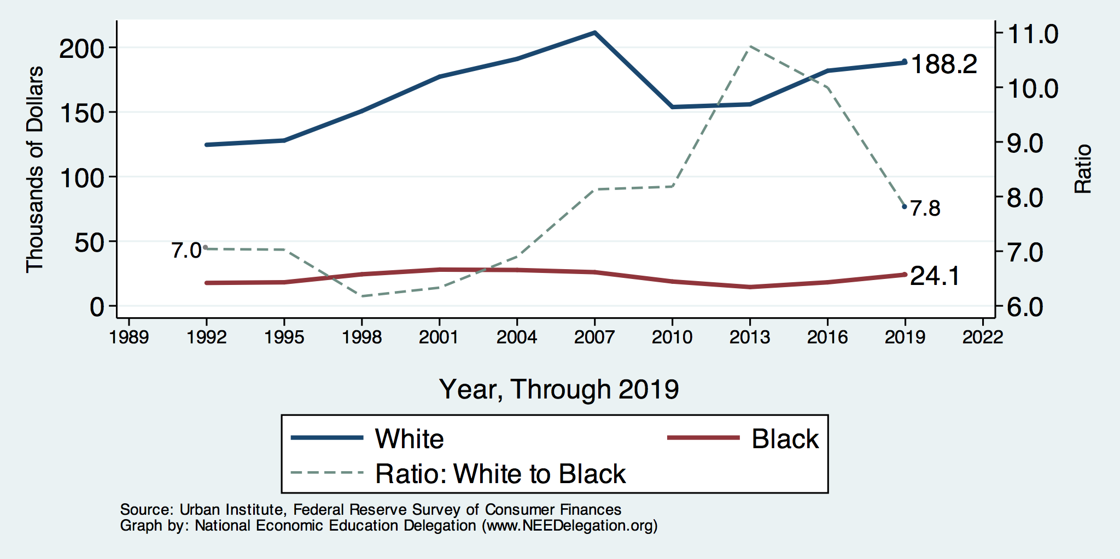
Wealth Gap Over Time: Median

Slide 14
Net Worth by Age and Race
Source: https://www.brookings.edu/blog/up-front/2020/02/27/examining-the-black-white-wealth-gap/

Slide 15
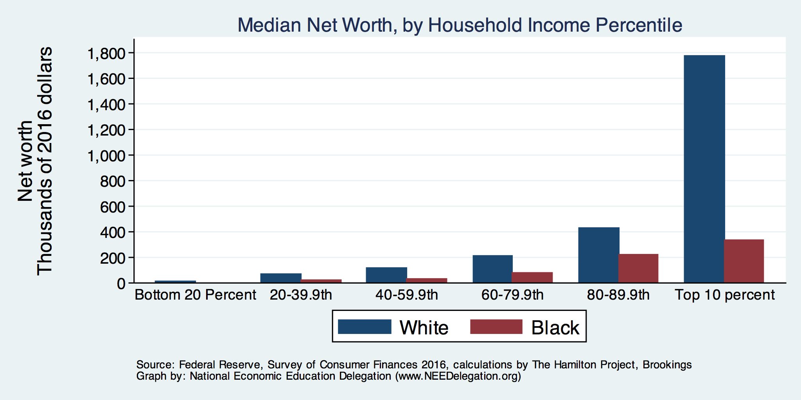
Net Worth by Household Income

Slide 16
Evidence of Disparities: Zero Wealth

Slide 17
Why Wealth is Important

Slide 18
Widespread Household Wealth Pays Dividends
To individuals in the household
Choices/Agency
Wealth is iterative
And to broader society
Human capital development
Entrepreneurship and innovation

Slide 19
Household Level Benefits
Choices/Life Agency
Finance higher education
Living in good neighborhoods
Saving for retirement
Capital to start a business
w/stand financial hardship
Better legal counsel
Exert political influence
Finance costly medical procedure
Bequests
Wealth is iterative
Wealth begets more wealth.
Access to higher return investments.
Wealth transfers across generations.
Wealth is sticky.

Slide 20
Parental Wealth is Important
Important pre-estate transfer effects on kids:
Influences human capital accumulation.
Influences the returns to education.
Adult incomes of offspring.
There are clearly enormous differences in wealth held by parents of Black and White children.

Slide 21
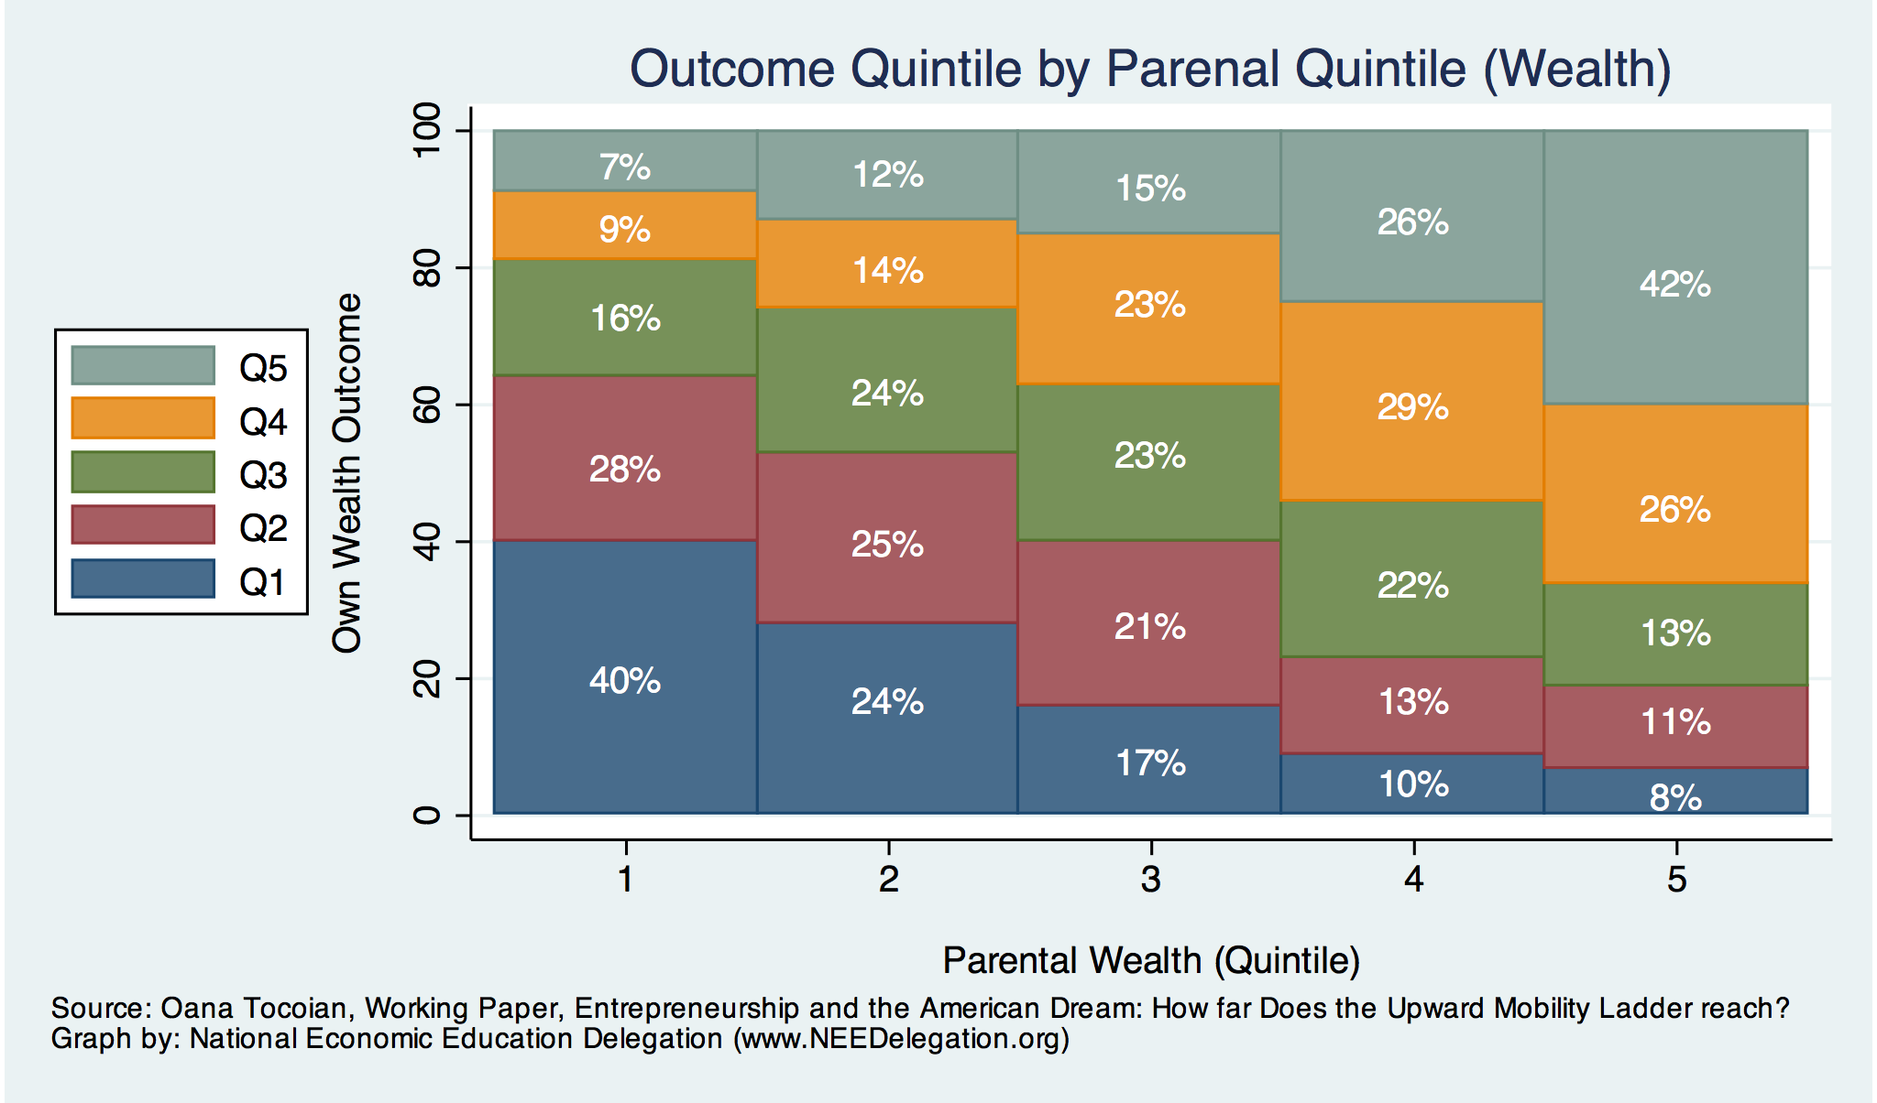
Wealth Mobility

Slide 22
Tangible Benefits for the Broader Economy
More human capital development
Increased entrepreneurship
Greater labor force participation
Healthier labor force
Less social unrest
Less reliance on social programs
Smaller stock of student loans

Slide 23
Sources of Disparities

Slide 24
Events/Policies with Direct Wealth Implications
Slave trade
The first deprivation.
Slavery
40 acres (and a mule)
The second deprivation.
Discriminatory distribution of land.
Freedmen’s Bank
Lax oversite and dissolution.
Jim Crow Laws & Economic Policy
Convict leasing, debt peonage, chain-gang, sharecropping, and lynching.
Homestead Act
Discriminatory distribution of land.
Land theft and destruction
E.g., Black Wall Street – Tulsa, 1921.
GI Bill
Discriminatory access – Levittown
Federal Housing Authority
Redlining
And many more.

Slide 25
Results for Black Families
Much lower accumulation of wealth than among White families.
Implications:
Less financial contribution from parents to children.
More difficult access to higher education.
Less access to capital for business formation.
More likely to live in disadvantaged neighborhoods.
Fewer role models.
Less access to quality education.
Disparities in the capacity – availability of resources - to build wealth.

Slide 26
Potential Explanations: Differences in…
Educational attainment
Home ownership
Increased savings
Financial literacy
Entrepreneurship
Soft skills and personal responsibility
Wages
Labor force participation
Family structure
Initial endowment

Slide 27
Wealth by Educational Attainment
Educational Attainment | Net Worth Median | Net Worth Mean
No High School | $22,800 | $157,200
High School | $67,100 | $249,600
Some College | $66,100 | $340,600
College | $292,100 | $1,511,100
Source: Federal Reserve Board, Table data are 2016.

Slide 28
Educational Attainment
Median Household Net Worth by Race and Education
Source: Darity, et al., “What We Get Wrong About Closing the Racial Wealth Gap.”

Slide 29
Home Ownership: Households

Slide 30
Home Ownership
Housing Status | Net Worth Median | Net Worth Mean
Renters | $5,200 | $91,100
Owner | $231,400 | $1,034,200

Slide 31
Wealth Equality Through Home Ownership?
Well-documented evidence of historical and ongoing housing and lending discrimination.
Appraisals, buyers, lenders, local laws, covenants…
What about home prices in minority neighborhoods? Even if they buy, they won’t get the appreciation of White neighborhoods.
Home values are 50% lower in majority Black neighborhoods.
Source: Brookings, Home ownership while black

Slide 32
What Determines Differences in Home Ownership?
Wealth of parents
Ability to borrow – lending discrimination
At all
On equivalent terms to white borrowers
Local ordinances – housing discrimination
Lower appreciation rates of homes in majority Black communities
This makes it a less attractive investment.

Slide 33
Increased Savings
Historical evidence generated by economists ranging from Milton Friedman (1957) to Marjorie Galenson (1972) to Marcus Alexis (1971) to Gittelman and Wolff (2004)…..
All find that after accounting for household income, Blacks have a slightly higher savings rate than Whites.

Slide 34
Financial Literacy
Financial literacy helps explain individual wealth differences within racial groups, but none of the wealth differences between racial groups.
The insufficient financial literacy argument is often leveled specifically at Black households.
The argument holds equally with regard to all households of comparable incomes.
Controlling for household income, there is no difference in rates of asset appreciation between Black and White households.

Slide 35
Use of Payday Lenders
Source: Federal Reserve Bank of New York; Survey of Consumer Finances

Slide 36
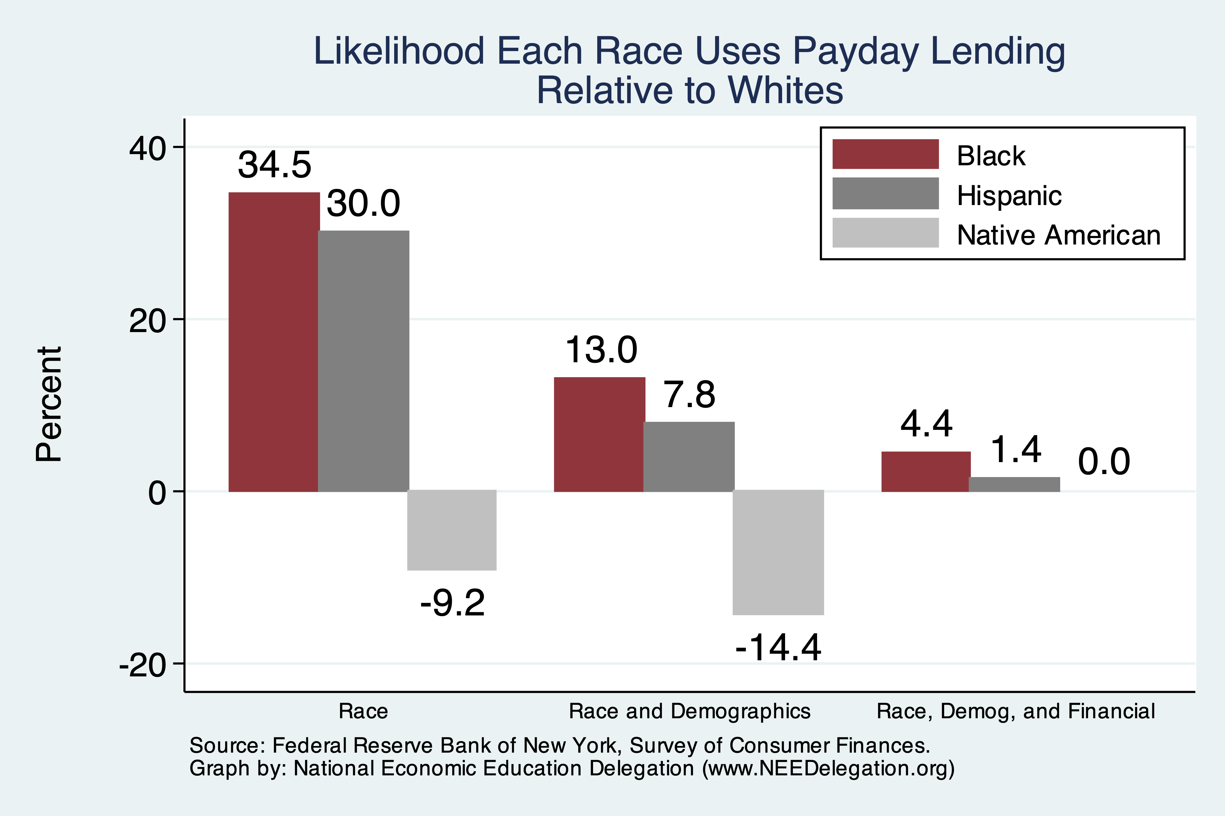
Use of Payday Lenders
Source: Federal Reserve Bank of New York; Survey of Consumer Finances

Slide 37
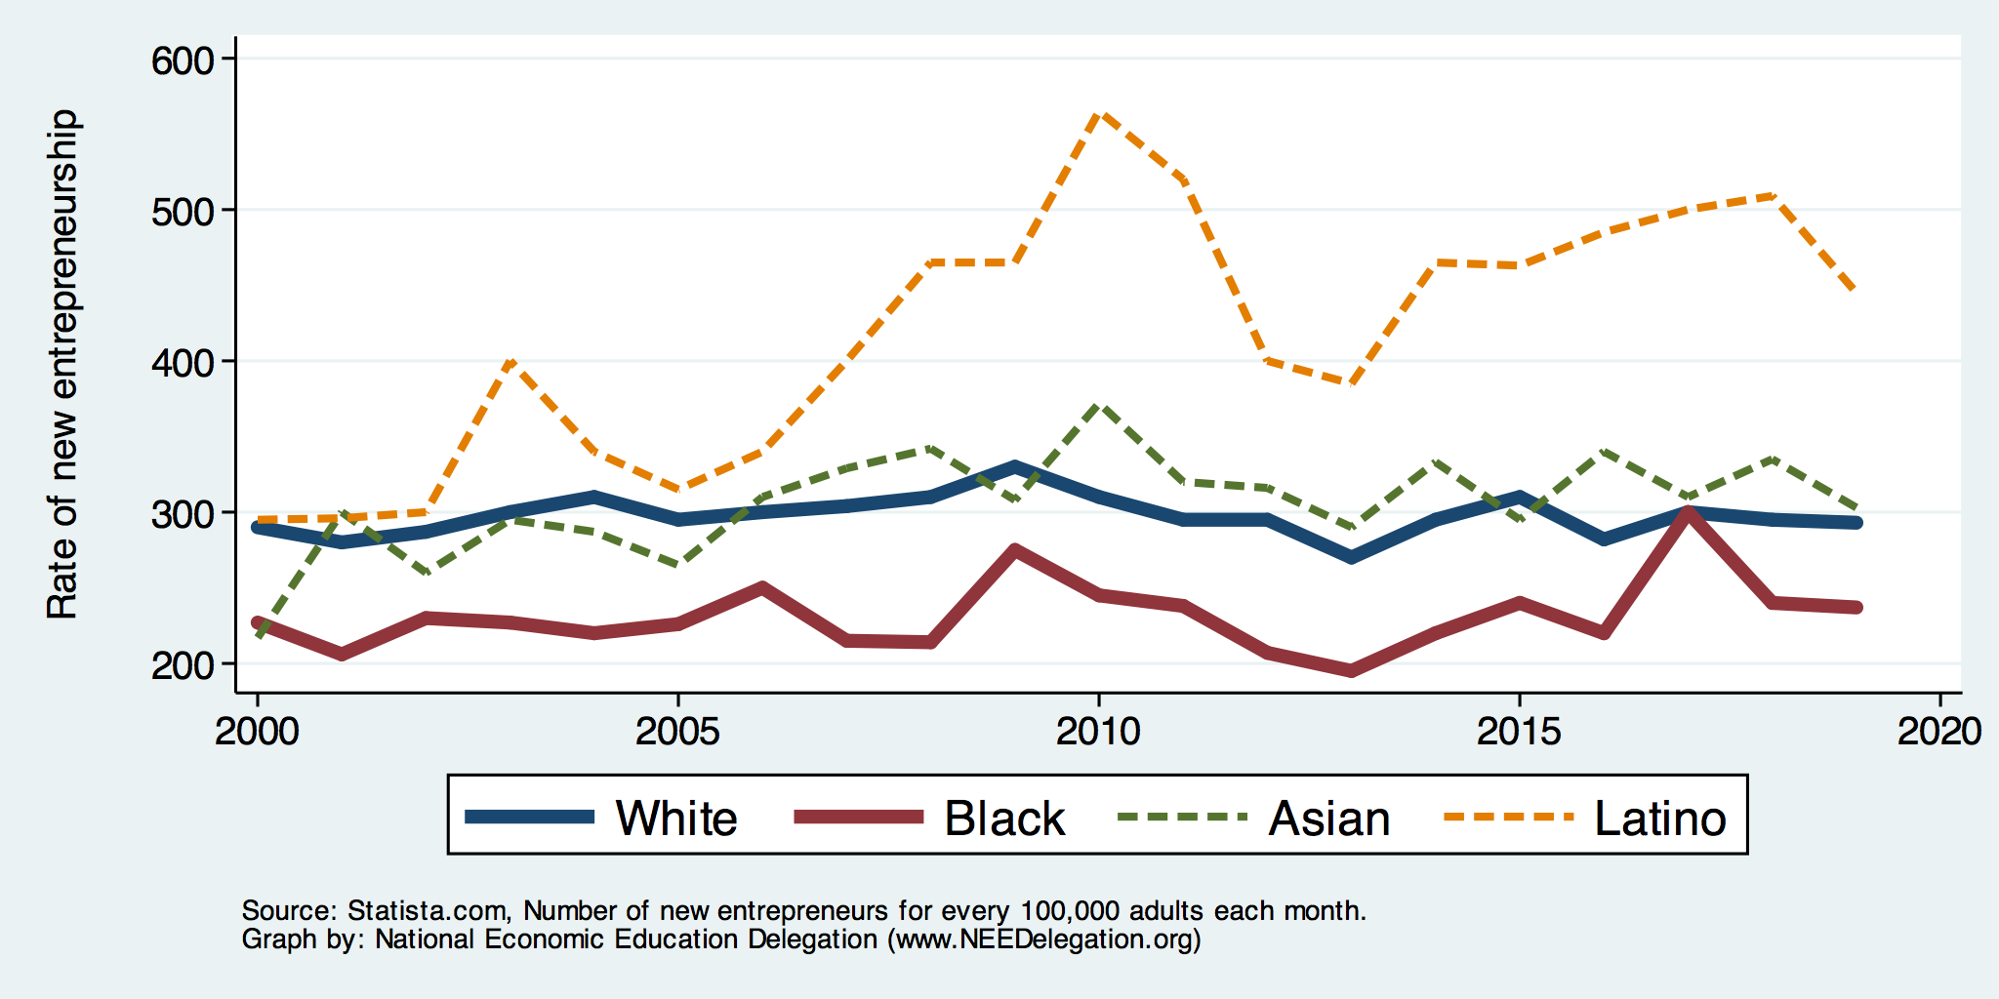
Entrepreneurship: Rate of New Entrepreneurs
Source: Statistica

Slide 38
Explaining Differences in Entrepreneurship
Disparities in access to capital:
Wealth disparities
Specifically, differences in home equity.
Differences in wealth levels of friends and family.
Less likely to rely on banks and more likely to rely on credit cards.
Loans have higher int rates and more likely to be declined.
Less access to venture funds.
Generally lower levels of education.
Previous business ownership by family.

Slide 39
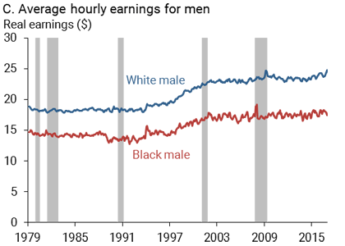
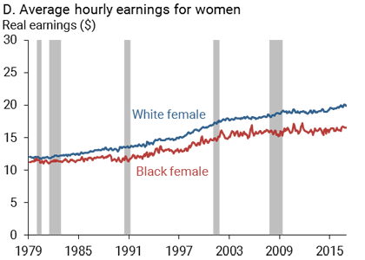
Wage Gap: Controlling for education, age, job type.
Source: https://www.frbsf.org/economic-research/publications/economic-letter/2017/september/disappointing-facts-about-black-white-wage-gap/

Slide 40
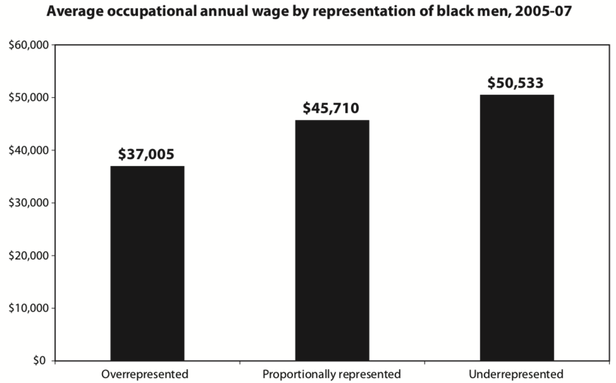
Overrepresented Where Wages are Low
Source: Hamilton Darrick, Algernon Austin, and William Darity, Jr. Whiter Jobs, Higher Wages :Occupational Segregation and the Lower Wages of Black Men Economic Policy Institute, Briefing Paper #288 2011.

Slide 41
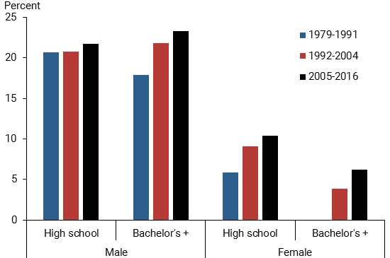
Black-White Earnings Gap by Education
Source: https://www.frbsf.org/economic-research/publications/economic-letter/2017/september/disappointing-facts-about-black-white-wage-gap/

Slide 42
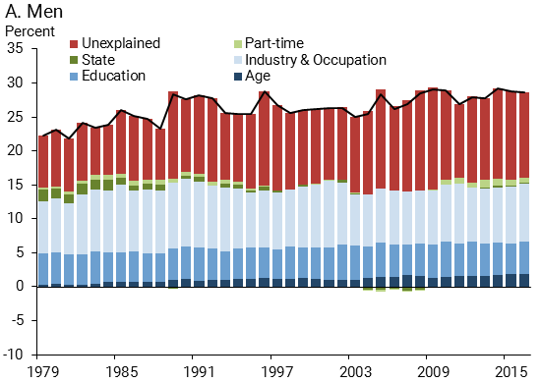
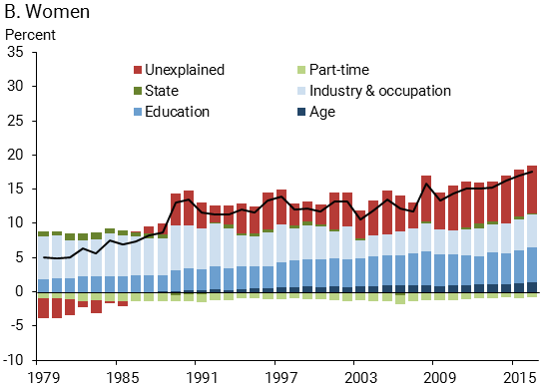
Wage Gap Broken Down
Source: https://www.frbsf.org/economic-research/publications/economic-letter/2017/september/disappointing-facts-about-black-white-wage-gap/

Slide 43
Equality of Income = Equality of Wealth
/
Source: http://hartfordinfo.org/issues/wsd/FamiliesandChildren/Racial-Wealth-Gap-Brief.pdf

Slide 44
Labor Force Participation

Slide 45
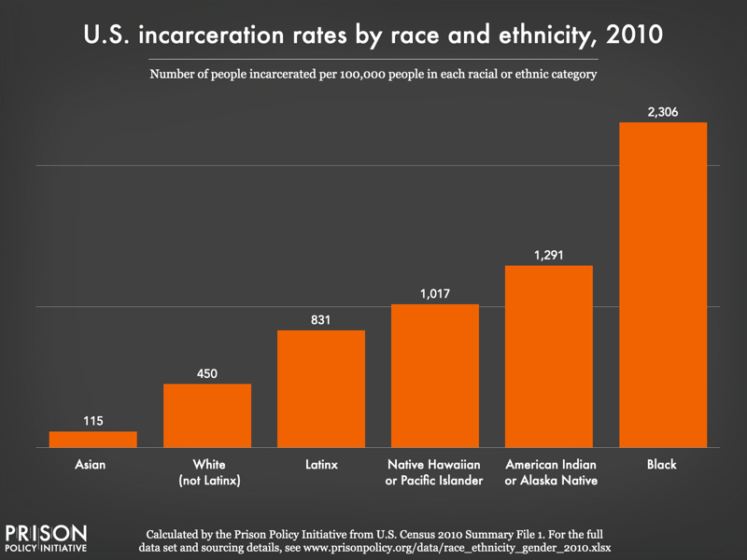
Incarceration Likely Plays A Role

Slide 46
US Drug Arrest Rates per 100,000 by Race

Slide 47
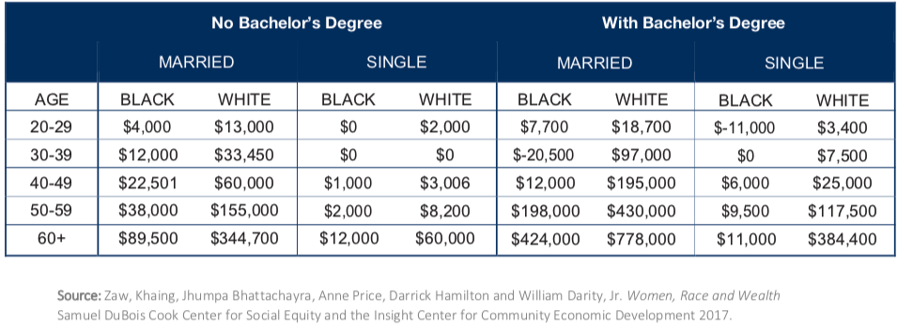
Family Structure

Slide 48
Kids – Household Types

Slide 49
Initial Endowment

Slide 50
What is Fundamentally Responsible?
Individual behaviors?
Structural characteristics of the economy?
History – policy and otherwise?

Slide 51
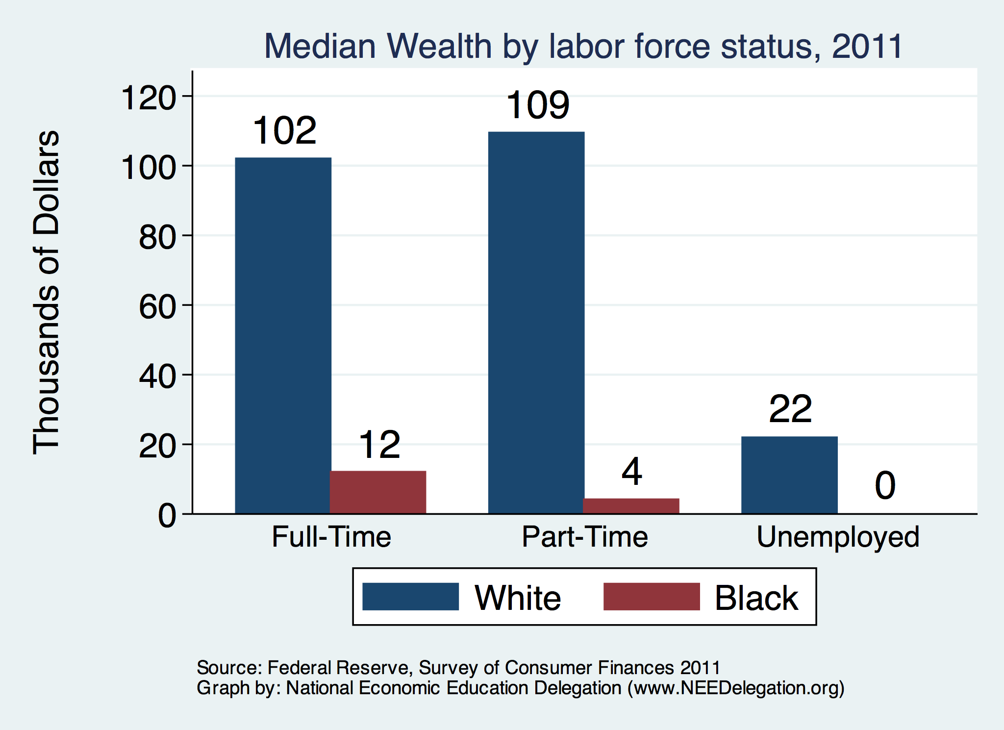
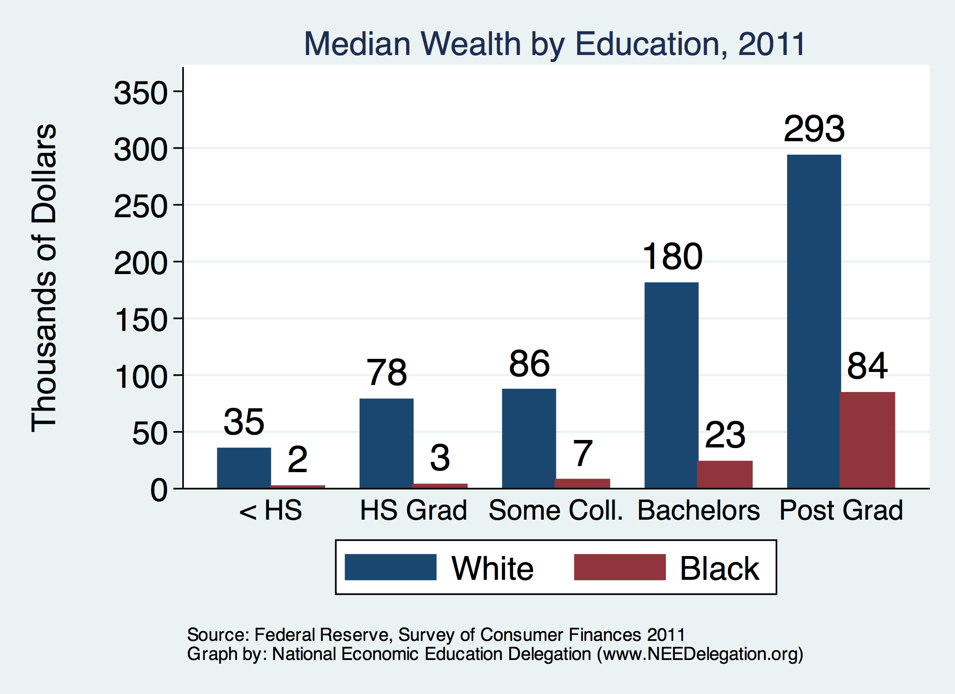
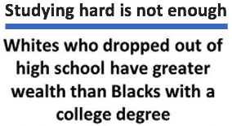
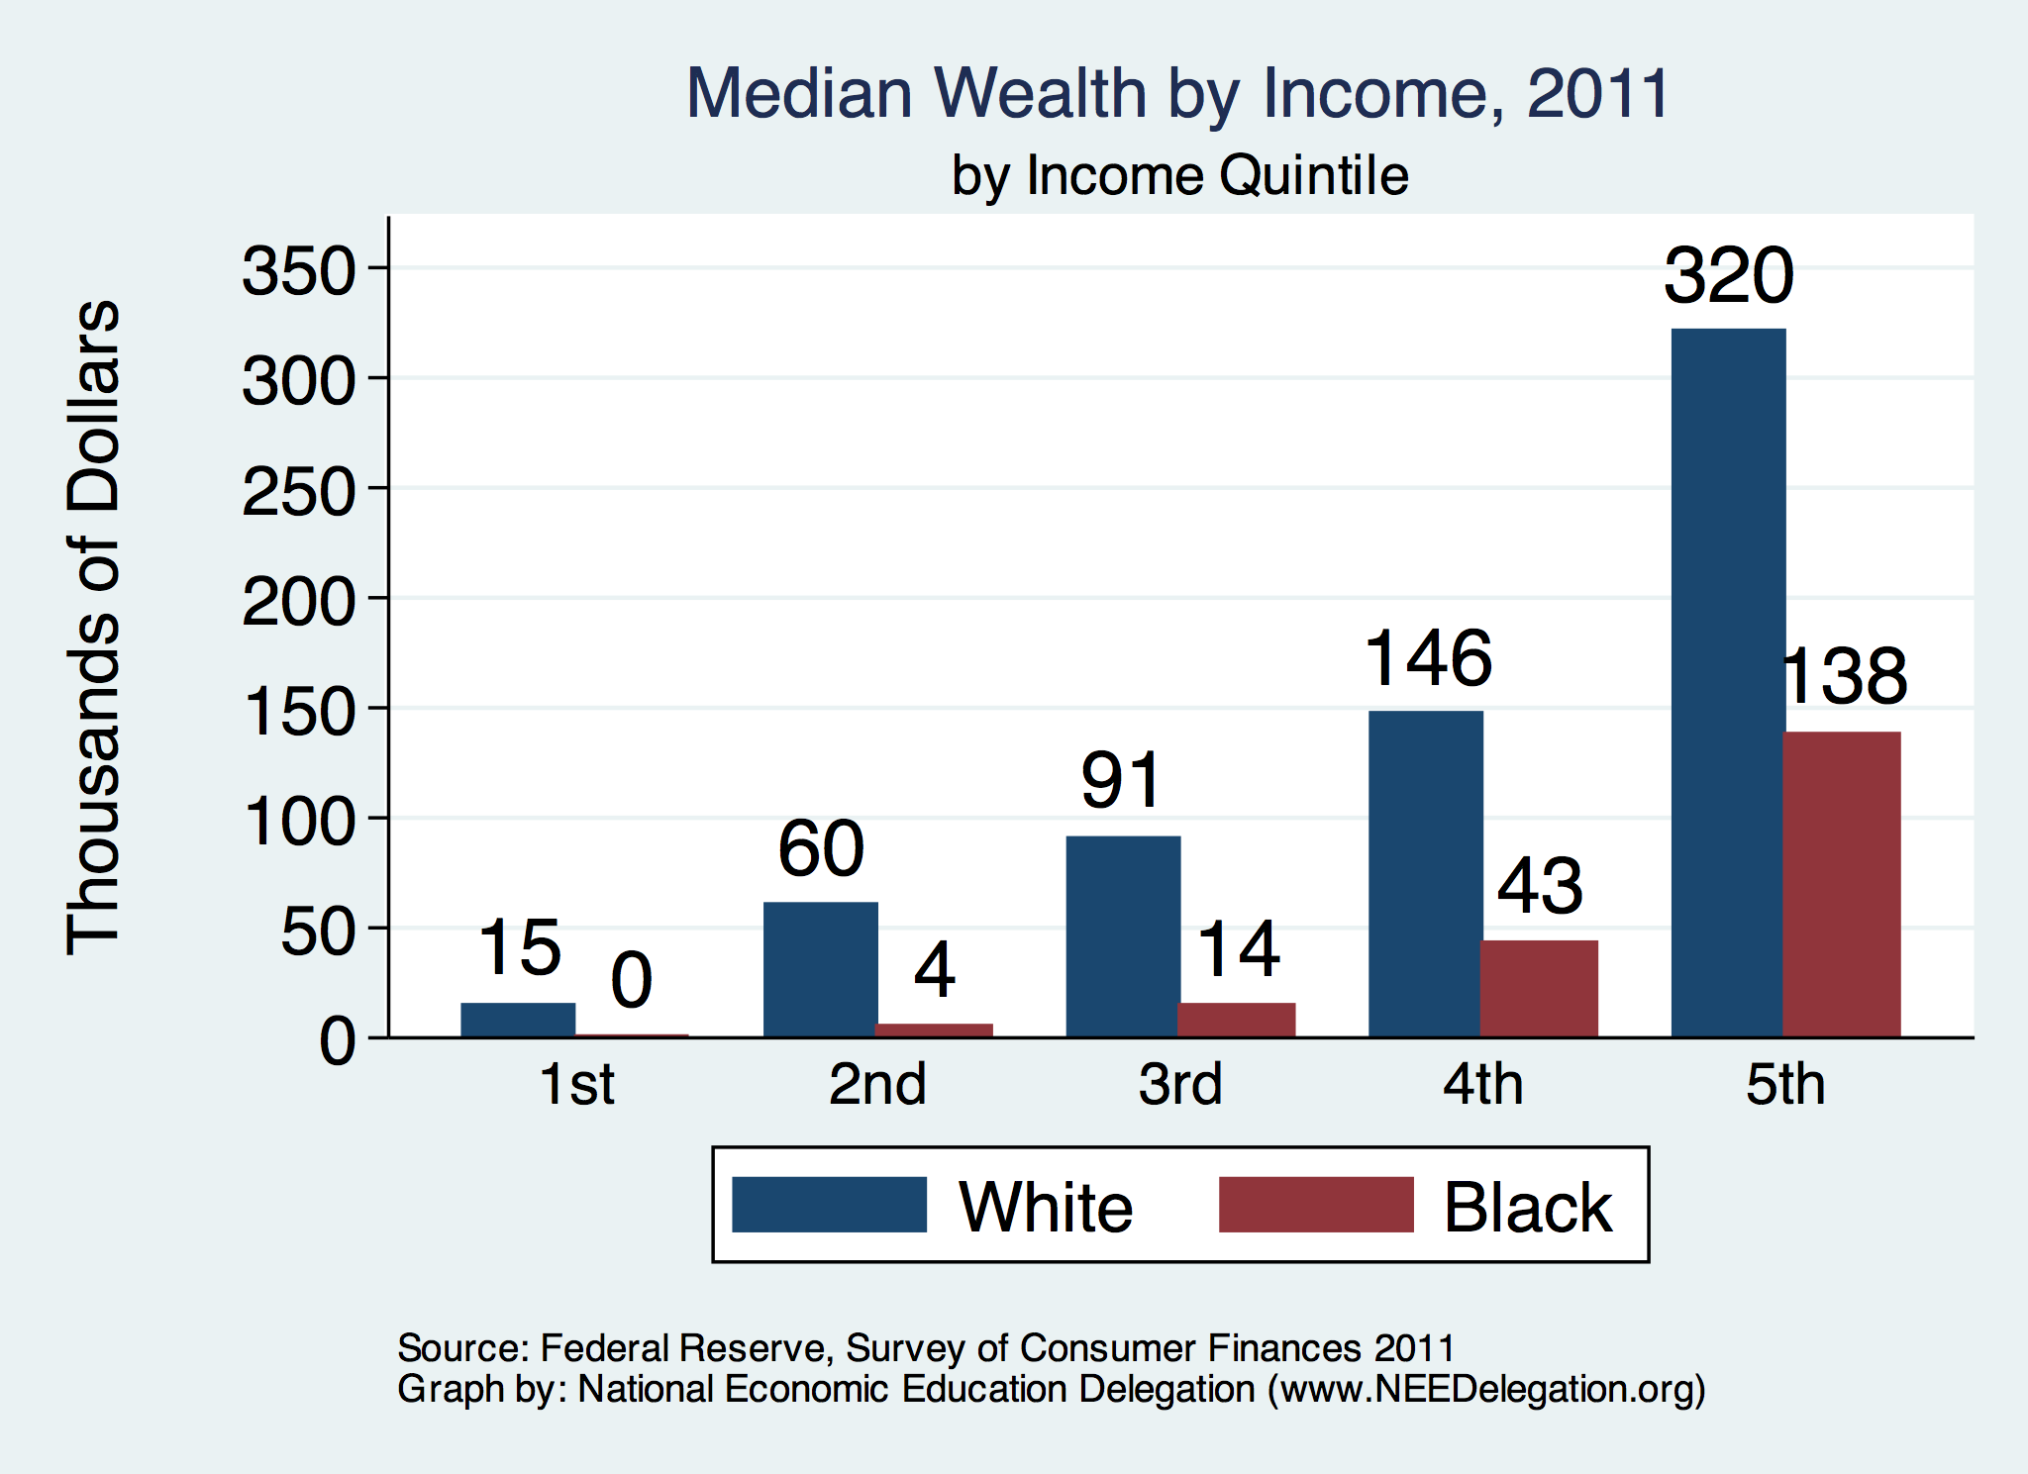

Slide 52
Accounting for the Wealth Gap
30%+ Left
Unaccounted for
Source: https://heller.brandeis.edu/iasp/pdfs/racial-wealth-equity/racial-wealth-gap/roots-widening-racial-wealth-gap.pdf

Slide 53
Policy Options

Slide 54
Categories of Policy Areas
Housing
FHA and redlining
Health Care
Incarceration
Black incarceration rates are very high.
Education
Workforce
Income support and stability
Asset accumulation

Slide 55
Specific Policy Options
Global solutions that affect all source areas
Child Trust Accounts – “Baby Bonds”
Guaranteed minimum income
Addressing racial disparities directly
Reparations
Aggressive affirmative action.
A new Homestead Act.
Heavily investing in Black communities.
Differential tax treatment.
Labor and other laws that address discrimination
Enforce more aggressively and make adjustments where necessary to increase efficacy.
Fundamental reorientation of asset building agenda.

Slide 56
Reform Criminal Justice System
Legal restrictions on the rights of people who have had contact with the criminal justice system, particularly contact resulting in conviction.
Usually placed in civil and regulatory codes, collateral consequences may limit a person’s:
ability to vote
live in public housing
own a firearm
qualify for an occupational license
serve in the military
receive public benefits (Food Stamps, housing vouchers)
sit on a jury
borrow money for college
Legal restrictions on the rights of people who have had contact with the criminal justice system, particularly contact resulting in conviction.
Usually placed in civil and regulatory codes, collateral consequences may limit a person’s:
ability to vote
live in public housing
own a firearm
qualify for an occupational license
serve in the military
receive public benefits (Food Stamps, housing vouchers)
sit on a jury
borrow money for college
Legal restrictions on the rights of people who have had contact with the criminal justice system, particularly contact resulting in conviction.
Usually placed in civil and regulatory codes, collateral consequences may limit a person’s:
ability to vote
live in public housing
qualify for an occupational license
serve in the military
receive public benefits (Food Stamps, housing vouchers)
sit on a jury
borrow money for college

Slide 57
Gov’t Asset Building Policies

Slide 58
Other Concrete Policy Options
Limit the mortgage interest tax deduction and use the revenues to provide a credit for first-time homebuyers.
Establish automatic savings and retirement plans.
Reduce reliance on student loans while supporting success in postsecondary education.
Offer universal children's savings accounts.
Reform safety net program asset tests, which can act as barriers to saving among low-income families.
Source: Urban Institute

Slide 59
Summary
The Black White wealth gap is enormous (2019)
Mean: White wealth is 6.9x Black wealth.
Median: White wealth is 7.8x Black wealth.
There are many explanations in the common narrative.
Many do not stand up to scrutiny.
Government policies have contributed enormously this gap.
Racial dehumanizing permitted these policies.
Wealth endowments (parental wealth) are enormously important for determining own wealth in adulthood.
Policies that address this relationship are most likely to be effective.
Some form of policy intervention is likely necessary if the gap is to be closed.

Slide 60
The Federal Debt: Jon Haveman

Slide 61
Thank you!
Any Questions?
www.NEEDEcon.org
Mike Shor, Ph.D.
Mike.Shor@UConn.edu
Contact NEED: info@NEEDEcon.org
Submit a testimonial: www.NEEDEcon.org/testimonials.php
Become a Friend of NEED: www.NEEDEcon.org/friend.php

