Slide 1
Osher Lifelong Learning Institute, Spring 2022
Contemporary Economic Policy
Bradley University
March-April, 2022
Host: Jon Haveman, Ph.D.
National Economic Education Delegation

Slide 2
Available NEED Topics Include:
Coronavirus Economics
US Economy
Climate Change
Economic Inequality
Economic Mobility
Trade and Globalization
Minimum Wages
Immigration Economics
Housing Policy
Federal Budgets
Federal Debt
Black-White Wealth Gap
Autonomous Vehicles
US Social Policy

Slide 3
Course Outline
Contemporary Economic Policy
Week 1 (3/7): US Economic Update (Geoffrey Woglom, Amherst College)
Week 2 (3/14): Climate Change Economics (Sarah Jacobson, Williams College)
Week 3 (3/21): Federal Debt (Geoffrey Woglom, Amherst College)
Week 4 (3/28): Trade and Globalization (Alan Deardorff, University of Michigan
Week 5 (4/4): The Black-White Wealth Gap (Jon Haveman, NEED)
Week 6 (4/11): Autonomous Vehicles (Jon Haveman, NEED)

Slide 4
The Black-White Wealth Gap
Jon Haveman, Ph.D.
National Economic Education Delegation

Slide 5
Credits and Disclaimer
This slide deck was authored by:
Darrick Hamilton, Ph.D., The New School
Jon Haveman, Ph.D., NEED
This slide deck was reviewed by:
Patrick Mason, Florida State University
Steven Craig, University of Houston
Disclaimer
NEED presentations are designed to be nonpartisan.
It is, however, inevitable that the presenter will be asked for and will provide their own views.
Such views are those of the presenter and not necessarily those of the National Economic Education Delegation (NEED).

Slide 6
Outline
Evidence of disparities
Why wealth is important
Sources of disparities
Policy solutions

Slide 7
Evidence

Slide 8
Evidence of the Gap
Mean is
7x Greater
Median is 8x Greater

Slide 9
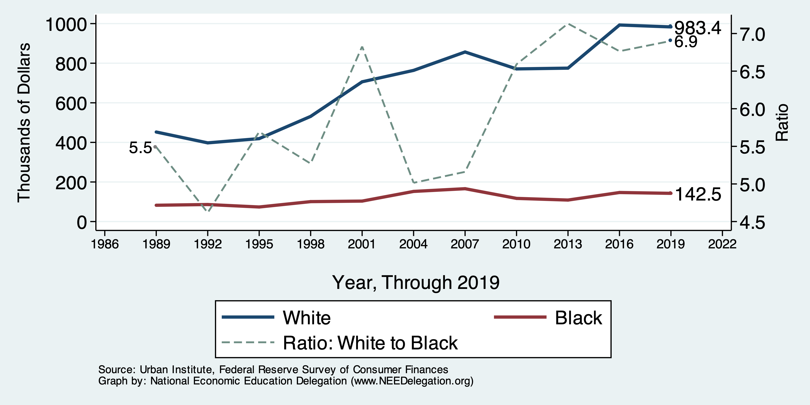
Wealth Gap Over Time: Mean

Slide 10
Wealth is More and More Concentrated
99th Percentile
2016 = 7x 1963
Source: Urban Institute

Slide 11
Overall Wealth Distribution
2019 Overall Median: $121,700

Slide 12
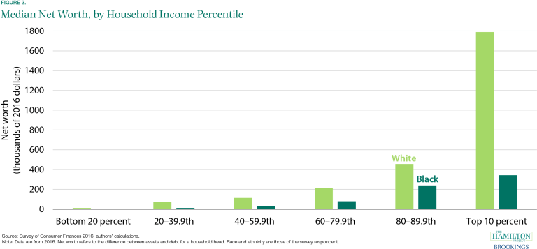
By Household Income

Slide 13
Why Wealth is Important

Slide 14
Household Level Benefits
Choices/Life Agency
Finance high quality education
Living in good neighborhoods
Saving for retirement
Capital to start a business
Withstand financial hardship
Better legal counsel
Exert political influence
Finance costly medical procedure
Bequests
Wealth is iterative
Wealth begets more wealth.
Access to higher return investments.
Wealth transfers across generations.
Wealth is sticky.

Slide 15
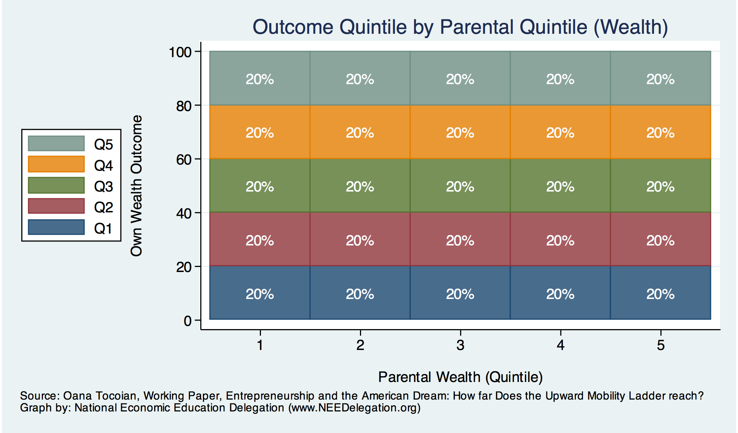
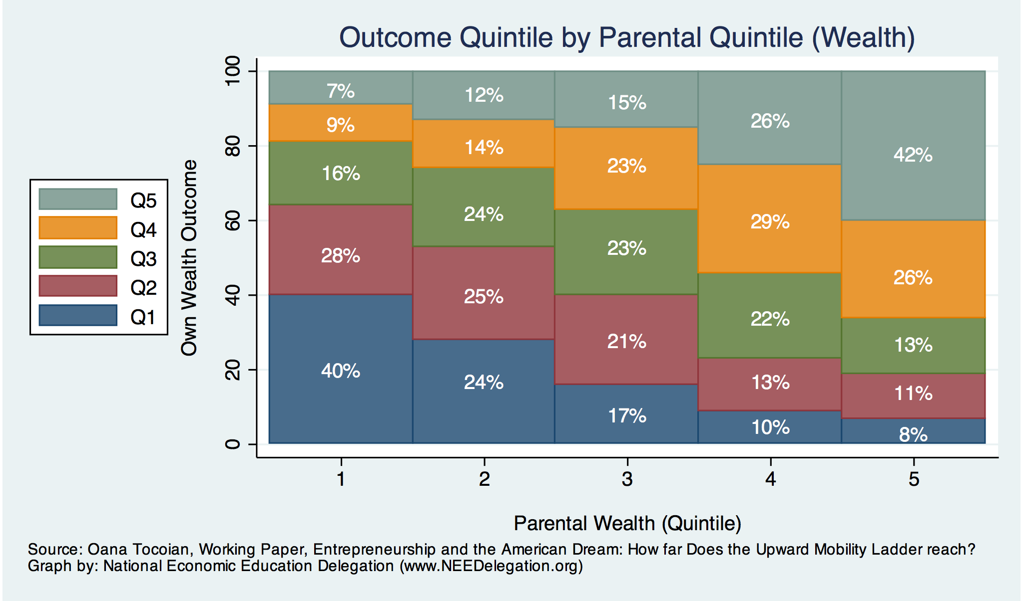
Wealth Mobility

Slide 16
Tangible Benefits for the Broader Economy
More human capital development
Increased entrepreneurship
Healthier labor force
Less social unrest
Less reliance on social programs
Smaller stock of student loans

Slide 17
Sources of Disparities

Slide 18
Events/Policies with Direct Wealth Implications
Slave trade
The first deprivation
Slavery
40 acres (and a mule)
The second deprivation
Discriminatory distribution of land.
Freedmen’s Bank
Lax oversite and dissolution.
Jim Crow Laws & Economic Policy
Convict leasing, debt peonage, chain-gang, sharecropping, and lynching.
Homestead Act
Discriminatory distribution of land.
Land theft and destruction
E.g., Black Wall Street – Tulsa, 1921
GI Bill
Discriminatory access – Levittown
Federal Housing Authority
Redlining
And many more.

Slide 19
Results for Black Families
Much lower accumulation of wealth than among White families.
Implications:
Less financial contribution from parents to children.
More difficult access to higher education.
Less access to capital for business formation.
More likely to live in disadvantaged neighborhoods
Fewer role models.
Less access to quality education.
Disparities in the capacity – availability of resources - to build wealth.

Slide 20
Potential Explanations: Differences in…
Educational attainment
Home ownership
Increased savings
Financial literacy
Entrepreneurship
Soft skills and personal responsibility
Wages
Labor force participation
Family structure
Initial endowment

Slide 21
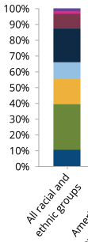
Differences in Educational Attainment, 2017
Source: American Council on Education

Slide 22
Wealth by Educational Attainment
Educational Attainment | Net Worth Median | Net Worth Mean
No High School | $22,800 | $157,200
High School | $67,100 | $249,600
Some College | $66,100 | $340,600
College | $292,100 | $1,511,100
71.0%
16.1%
8.6%
4.3%
Source: Federal Reserve Board, Table data are 2016.

Slide 23
Educational Attainment
Median Household Net Worth by Race and Education
Source: Darity, et al., “What We Get Wrong About Closing the Racial Wealth Gap”

Slide 24
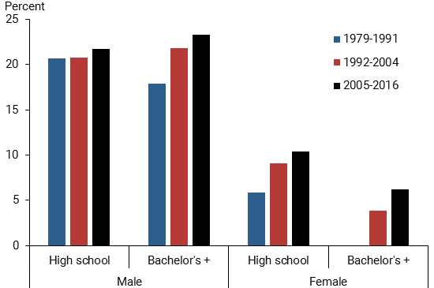
Black-White Earnings Gap by Education
Source: https://www.frbsf.org/economic-research/publications/economic-letter/2017/september/disappointing-facts-about-black-white-wage-gap/

Slide 25
Home Ownership

Slide 26
Home Ownership
Housing Status | Net Worth Median | Net Worth Mean
Renters | $5,200 | $91,100
Owner | $231,400 | $1,034,200

Slide 27
Wealth Equality Through Home Ownership?
Well-documented evidence of historical and ongoing housing and lending discrimination.
What about home prices in minority neighborhoods? Even if they buy, they won’t get the appreciation of White neighborhoods.
Home values are 50% lower in majority Black neighborhoods.
23% after adjusting for quality and amenities.
Source: Brookings, Home ownership while black

Slide 28
What Determines Differences in Home Ownership?
Wealth of parents
Ability to borrow – lending discrimination
At all
On equivalent terms to white borrowers
Local ordinances – housing discrimination
Lower appreciation rates of homes in majority Black communities

Slide 29
Increased Savings
Historical evidence generated by economists ranging from Milton Friedman (1957) to Marjorie Galenson (1972) to Marcus Alexis (1971) to Gittelman and Wolff (2004)…..
All find that after accounting for household income, Blacks have a slightly higher savings rate than Whites.
Risk and reward are higher for White investors
Controlling for income, this is not clear.
Access to and tolerance for higher risk investments is clearly correlated with income.

Slide 30
Financial Literacy
Financial literacy doesn’t matter that much when you don’t have any finances to manage.
Controlling for household income, there is no difference in rates of asset appreciation between Black and White households.

Slide 31
Use of Payday Lenders
Source: Federal Reserve Bank of New York; Survey of Consumer Finances

Slide 32
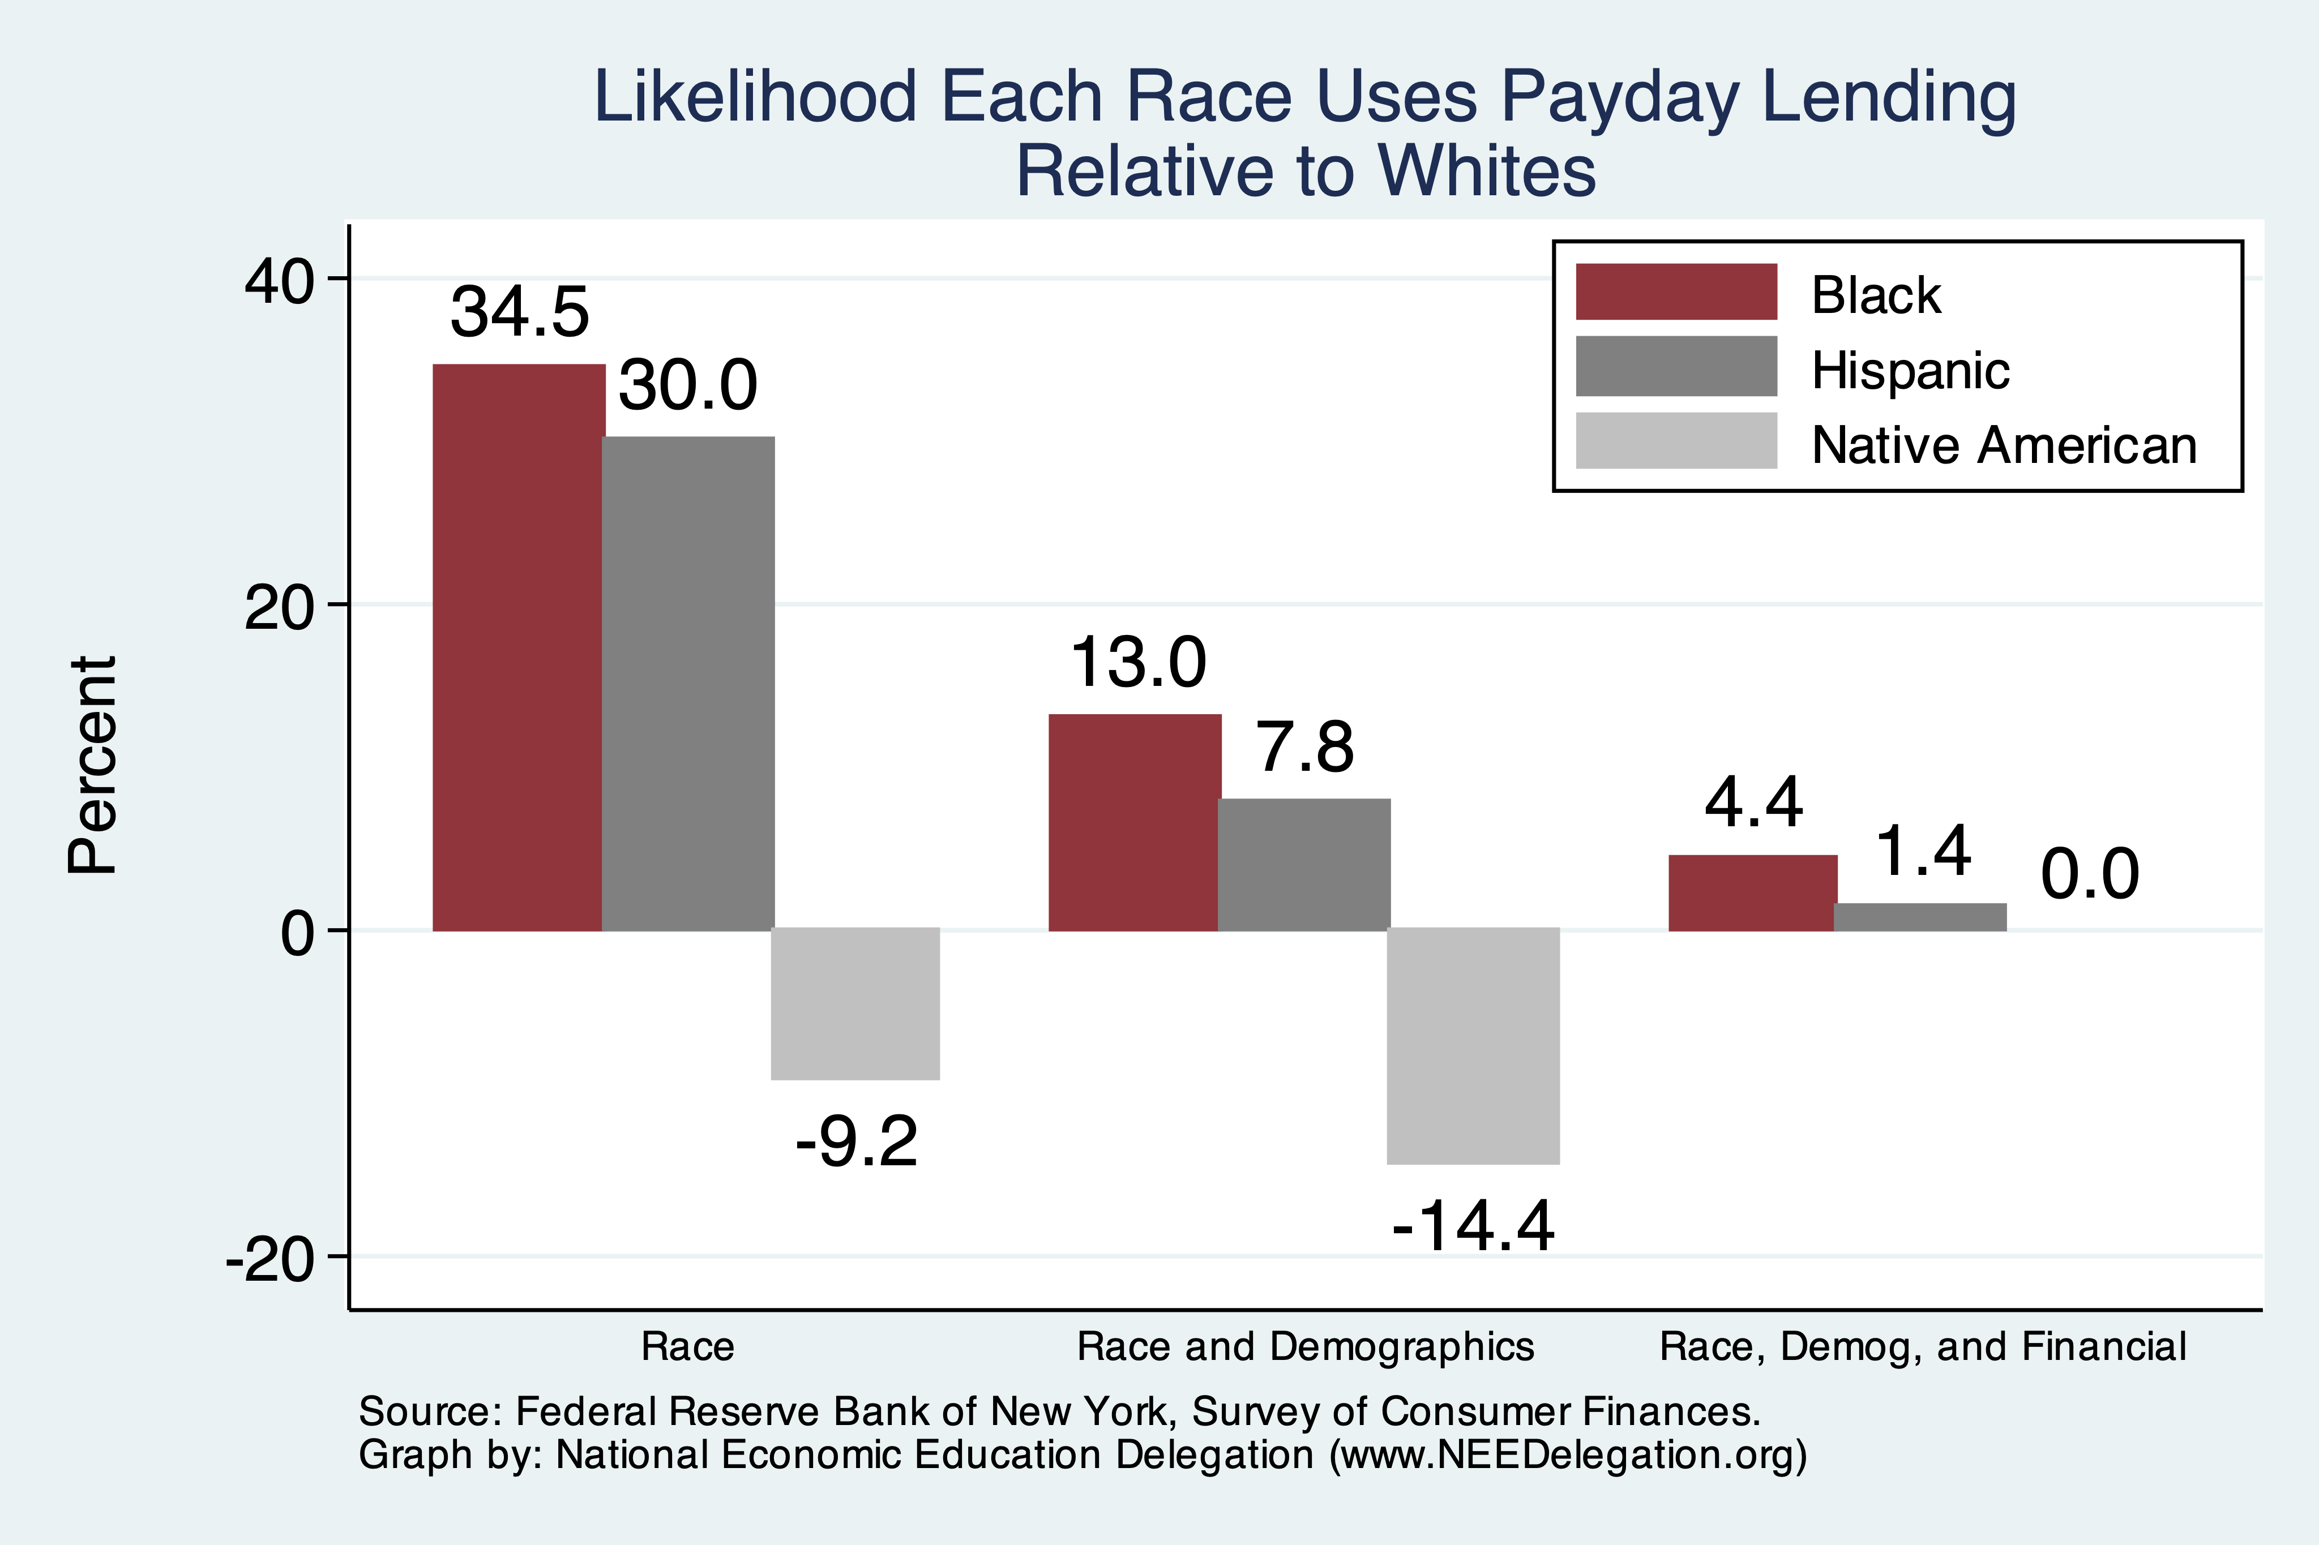
Use of Payday Lenders
Source: Federal Reserve Bank of New York; Survey of Consumer Finances

Slide 33
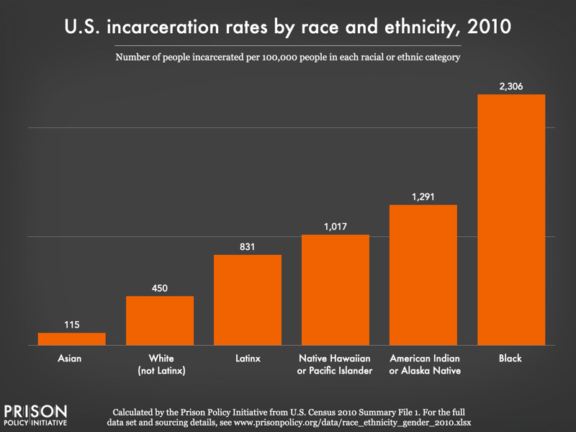
Incarceration Likely Plays A Role

Slide 34
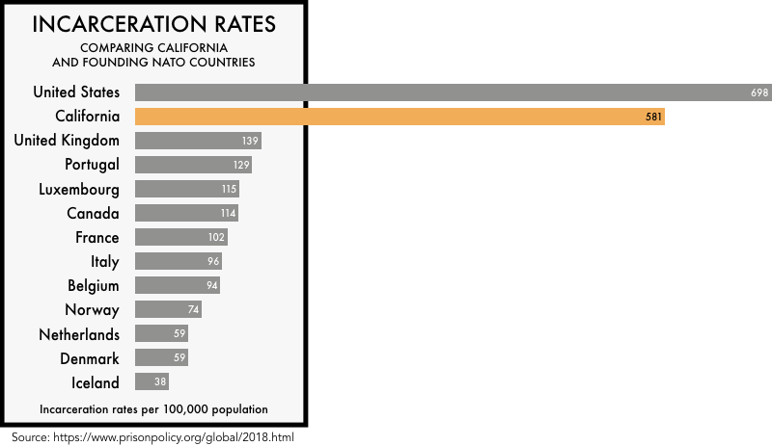

Slide 35
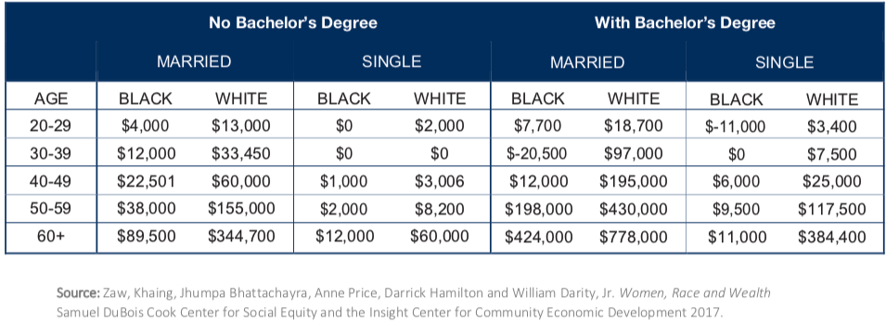
Family Structure

Slide 36
Kids – Household Types

Slide 37
Initial Endowment

Slide 38
What is Fundamentally Responsible?
Individual behaviors?
Structural characteristics of the economy?
History – policy and otherwise?

Slide 39
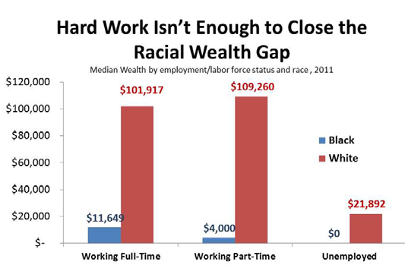
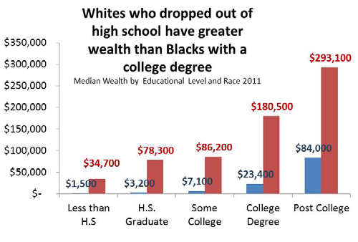
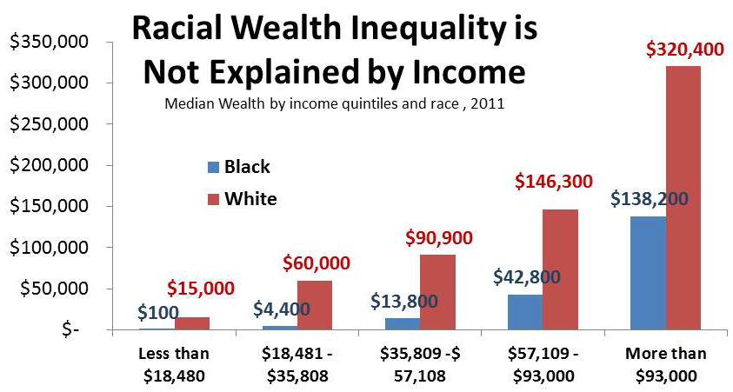
Studying hard is not enough

Slide 40
Accounting for the Wealth Gap
30%+ Left
Unaccounted for
Source: https://heller.brandeis.edu/iasp/pdfs/racial-wealth-equity/racial-wealth-gap/roots-widening-racial-wealth-gap.pdf

Slide 41
Policy Options

Slide 42
Categories of Policy Areas
Housing
FHA and redlining
Health Care
Incarceration
Black incarceration rates are very high.
Transportation
Interstate system
Broadband
Access is inversely related to regional income
Education
Workforce
Income support and stability
Asset accumulation

Slide 43
Gov’t Asset Building Policies

Slide 44
Specific Policy Options
Global solutions that affect all source areas
Child Trust Accounts - ”Baby Bonds”
Guaranteed minimum income
Addressing racial disparities directly
Reparations
Aggressive affirmative action.
A new Homestead Act.
Heavily investing in Black communities.
Labor and other laws that address discrimination
Enforce more aggressively and make adjustments where necessary to increase efficacy.
Fundamental reorientation of asset building agenda.

Slide 45
Other Concrete Policy Options
Limit the mortgage interest tax deduction and use the revenues to provide a credit for first-time homebuyers.
Establish automatic savings and retirement plans.
Reduce reliance on student loans while supporting success in postsecondary education.
Offer universal children's savings accounts.
Reform safety net program asset tests, which can act as barriers to saving among low-income families.
Provide subsidies to promote emergency savings, such as those linked to tax time.
Source: Urban Institute

Slide 46
Buying and Banking Black
Assertion: Marshalling the enormous purchasing power of the Black community will drive progress.
More than $1.3 trillion in buying power.*
Assertion: Banking is a source of wealth creation.
Combining the wealth of Black Americans in Black banks could be a source of wealth creation.
Problem: Multipliers are short circuited.
* Source: https://www.newswise.com/articles/minority-markets-have-3-9-trillion-buying-power

Slide 47
Summary
The Black White wealth gap is enormous (2019)
Mean: White wealth is 6.9x Black wealth.
Median: White wealth is 7.8x Black wealth.
There are many explanations in the common narrative.
Many do not stand up to scrutiny.
Government policies have contributed enormously this gap.
Racial dehumanizing permitted these policies.
Wealth endowments (parental wealth) are enormously important for determining own wealth in adulthood.
Policies that address this relationship are most likely to be effective.
Some form of policy intervention is likely necessary if the gap is to be closed.

Slide 48
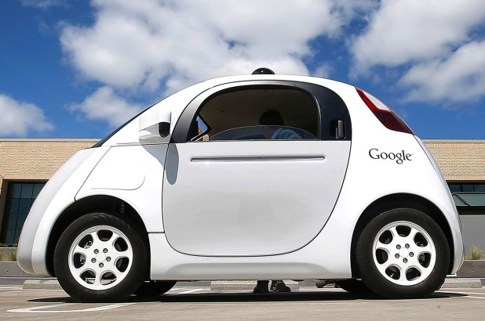
Autonomous Vehicles: Jon Haveman

Slide 49
Thank you!
Any Questions?
www.NEEDelegation.org
Jon Haveman, Ph.D.
Jon@NEEDelegation.org
Contact NEED: info@needelegation.org
Submit a testimonial: www.NEEDelegation.org/testimonials.php

