Slide 1
TIGER 21 Seattle 03 Group, WA Driving Change – Autonomous Vehicles’ Big Impact
National Economic Education Delegation
Jon Haveman, Ph.D.
January 12, 2022

Slide 2
National Economic Education Delegation
Vision
One day, the public discussion of policy issues will be grounded in an accurate perception of the underlying economic principles and data.
Mission
NEED unites the skills and knowledge of a vast network of professional economists to promote understanding of the economics of policy issues in the United States.
NEED Presentations
Are nonpartisan and intended to reflect the consensus of the economics profession.

Slide 3
Who Are We?
Honorary Board: 54 members
2 Fed Chairs: Janet Yellen, Ben Bernanke
6 Chairs Council of Economic Advisers
Furman (D), Rosen (R), Bernanke (R), Yellen (D), Tyson (D), Goolsbee (D)
3 Nobel Prize Winners
Akerlof, Smith, Maskin
Delegates: 640+ members
At all levels of academia and some in government service
All have a Ph.D. in economics
Crowdsource slide decks
Give presentations
Global Partners: 48 Ph.D. Economists
Aid in slide deck development

Slide 4
Available NEED Topics Include:
Coronavirus Economics
Climate Change
Economic Inequality
Economic Mobility
US Social Policy
Trade and Globalization
Minimum Wage
The U.S. Economy
Immigration Economics
Housing Policy
Federal Budgets
Federal Debt
Black-White Wealth Gap
Autonomous Vehicles

Slide 5
Credits and Disclaimer
This slide deck was authored by:
Jon Haveman, NEED
This slide deck was reviewed by:
Ronald Fisher, Michigan State University
William F. Fox, University of Tennessee, Knoxville
Disclaimer
NEED presentations are designed to be nonpartisan.
It is, however, inevitable that the presenter will be asked for and will provide their own views.
Such views are those of the presenter and not necessarily those of the National Economic Education Delegation (NEED).

Slide 6
Outline
Where does the AV path lead?
Transition
Policy/Planning Issues
Major Economic/Development Changes

Slide 7
Autonomous Taxonomy

Slide 8
Growth Path
McKinsey & Company
Notes:
This is the growth path according to McKinsey
I believe that the growth path will vary significantly depending on geography
Kansas – very slow
Bay Area – very fast
But I think that they agree with me on where we are headed
Primary means of transport for both people and goods

Slide 9
McKinsey isn’t Always Spot On
"In 1980, McKinsey & Company was commissioned by AT&T to forecast cell phone penetration in the U.S. by 2000.
The consultant’s prediction, 900,000 subscribers,
was less than 1% of the actual figure, 109 Million.”
Professor Angel Lozano, 2014

Slide 10
40+ Corporations Working On Autonomous Vehicles

Slide 11
WHEN? What do the headlines say?
NVIDIA to introduce level-4 enabling system by 2018
First autonomous Toyota to be available in 2020
Volkswagen expects first self driving cars on the market by 2019
Elon Musk now expects first fully autonomous Tesla by 2019, approved by 2021
Audi to introduce a self-driving car by 2020

Slide 12
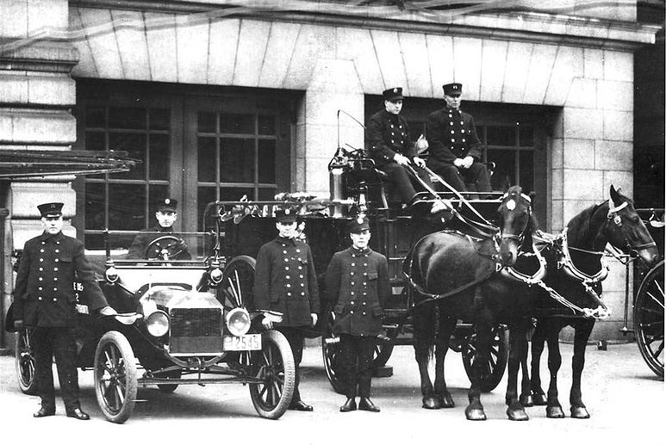
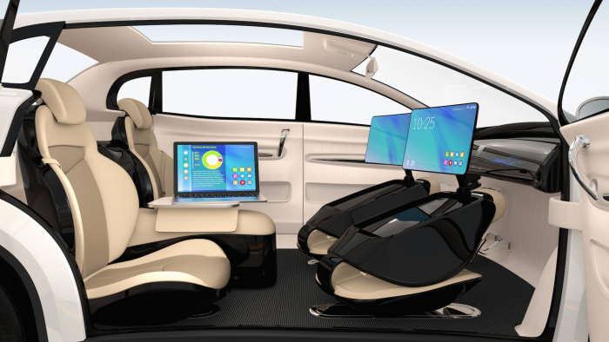
WHEN? What is possible?
By 2025 (?)
Potentially 95% of VMT by 2035.
Last 5% may be very difficult to achieve.
Is this possible?
Horses to cars: 10 years – early 1900s
But adoption of EVs is so slow!
Adoption of AVs will be rapid.

Slide 13
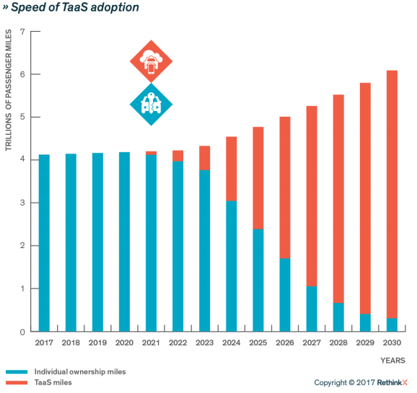
Forecast
Timing may be off.
But the point is:
RAPID ADOPTION!
The Big Unknown

Slide 15
Trucking – Highly Fertile Ground
Long haul trucking is likely the first place we will see it adopted.
Reduces costs associated with drivers.
End run around limits on hours of driving.
Where does it stand?
Lots of trials underway.
TuSimple – actively building a long haul network.
Waymo – focused more on last mile/local delivery.

Slide 16
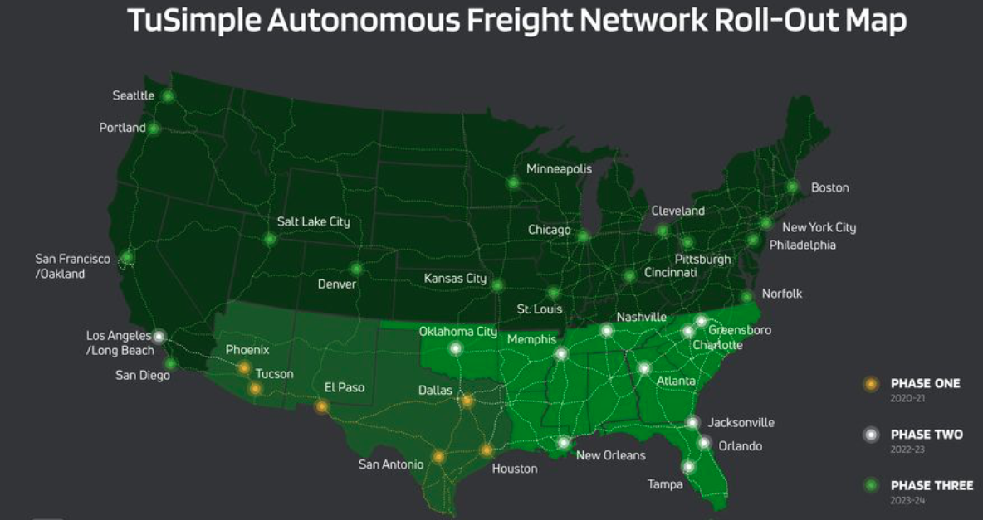

Slide 17
What will the future look like?

Slide 18
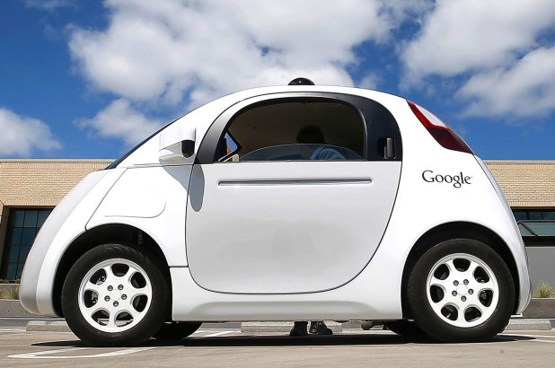
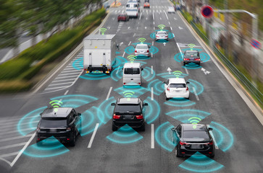
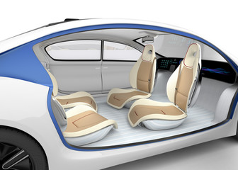
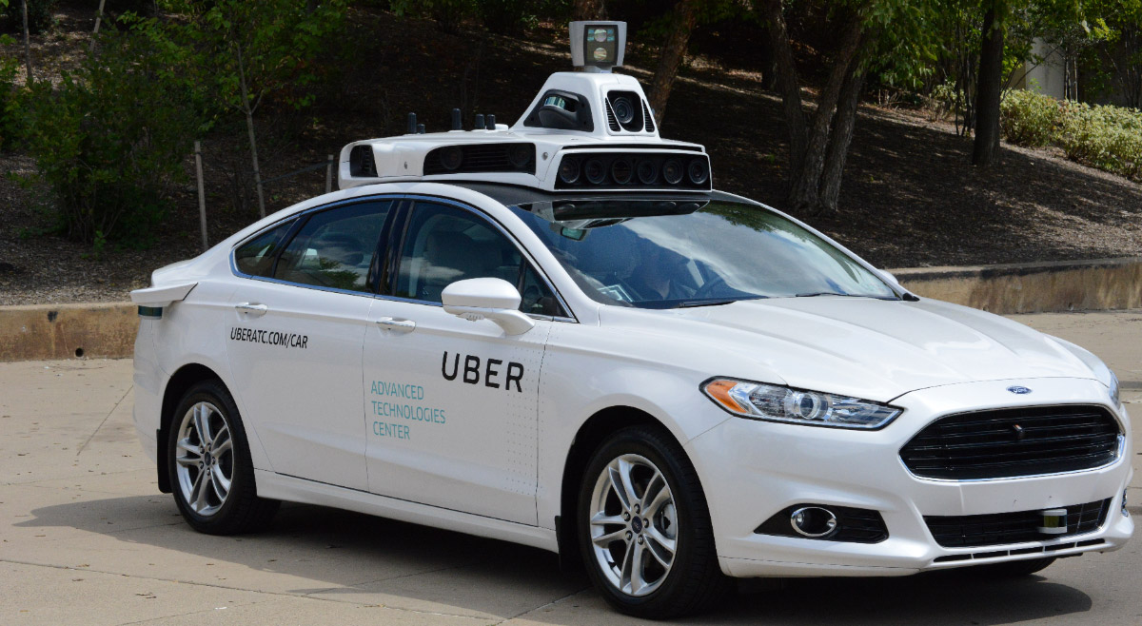
This:

Slide 19
But, will it be:
Heaven?
OR
Hell?

Slide 20
Hell
Primarily individual private car ownership
Much as today.
Internal combustion engines
Why Hell?
Dramatically increased VMT and pollution.
Potentially increased congestion.
Parking

Slide 21
Two Adults and a Child: Morning Miles
Parking
Office 1
1
2
3
4
School
Home
5
7
6
Office 2
And this is just the morning…..

Slide 22
Heaven
Vehicle ownership will be very limited
Private ownership for those with specialized vehicle needs.
Fleet ownership will serve everybody else.
Engines: electric
Not clear when we will get there, but this is the likely model.
2030 for widespread adoption in many regions.

Slide 23
Why is this Heaven?
Not only autonomous, but:
Shared
Connected
Green
Far fewer cars in existence.
Better resource utilization.
VMT could go up or down, but more productive than in Hell.
Congestion effects – unclear, but likely reduced.
Right-sized vehicles, platooning, sharing, V2V communication
Minimal need for parking.

Slide 24
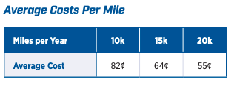
Economics Drives Transition: Private
Adoption dividend for private individuals
Eliminate car ownership
Ave annual cost of owning a car: $9,561 (2020)
Cost per mile will fall: $0.59 to $0.19
Repurpose your garage
$50,000 from transition to bedroom
Time recovery
50% of the King County workforce has a commute in excess of 30 minutes.
Notes:
https://www.investopedia.com/articles/pf/08/cost-car-ownership.asp
.19 – source is TaaS report
$50,000 is my own research

Slide 25
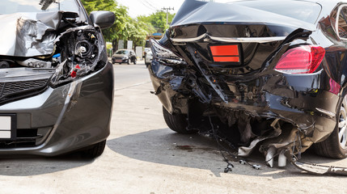
Economics Drives Transition: Public
Economic and social costs associated with human drivers are enormous:
ACCIDENTS:
Drive 25% of congestion.
Result in 40,000 deaths.
And 2 million injuries.
90+% caused by human error.
Increased productivity from not driving.
Costs of human drivers estimated at up to $1.3 TRillion each year

Slide 26
Potential Savings
Morgan Stanley

Slide 27
Encourage Change
Mobility and equity considerations
Elderly/disabled/impoverished
Safety: only way to reduce traffic fatalities is by coordinated effort
Productivity: reduced congestion
Environment: speed transition to electric vehicles
These are all societal benefits that come about too slowly if the private market is left to itself.
Notes:
Think about star trek and Scotty, beam me up! That's the ideal. We think it and we're in another place. Autonomous vehicles don't achieve that, but they free up the time that is still necessary to get from here to there.- they free up the time that is spent on maintenance - huge economies of scale

Slide 28
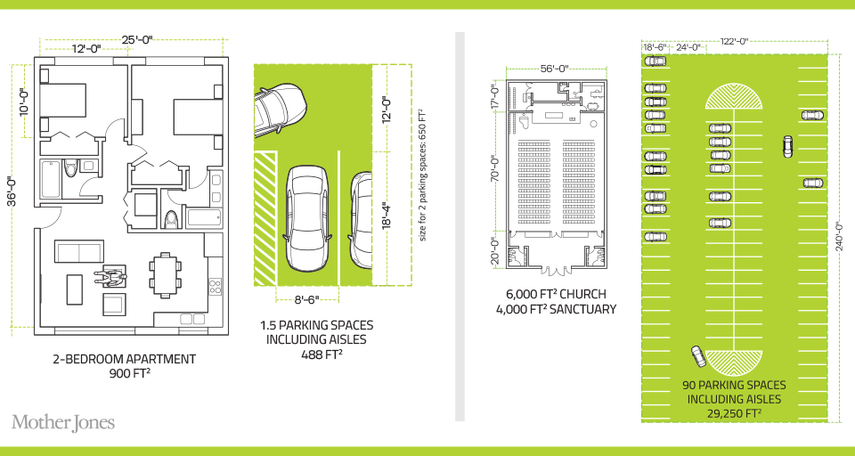
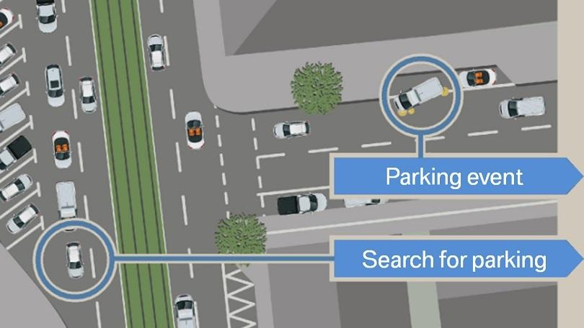
Environment
Notes:
30% of city traffic is due to search for parking

Slide 29
Environmental Implications Depends: Heaven or Hell
Improved resource utilization
More efficient travel
Right sized vehicles
Optimized routes
Reduced congestion
No searching for parking
Increased VMT
Cleaner technologies
Electric
Lighter vehicles
Energy use of onboard electronics
Weight and functional
Increased urban sprawl
Bottom line: push governments at all levels to embrace and to implement policies deterring private vehicle ownership and zero passenger miles
Notes:
Governments determine local zoning, design roadway alignments, invest in new capacity, design parking regulations, set transportation taxes, and invest in data and people to help manage all those decisions. It’s a huge suite of responsibilities, and all apply in new ways around AVs.

Slide 30
What Changes Will This Bring?
Disposable income
Government finances
Transportation demand
Infrastructure
Public transportation
Housing
Employment
Parking
Potentially dramatic improvements in infrastructure planning and maintenance - Data sharing and integration

Slide 31
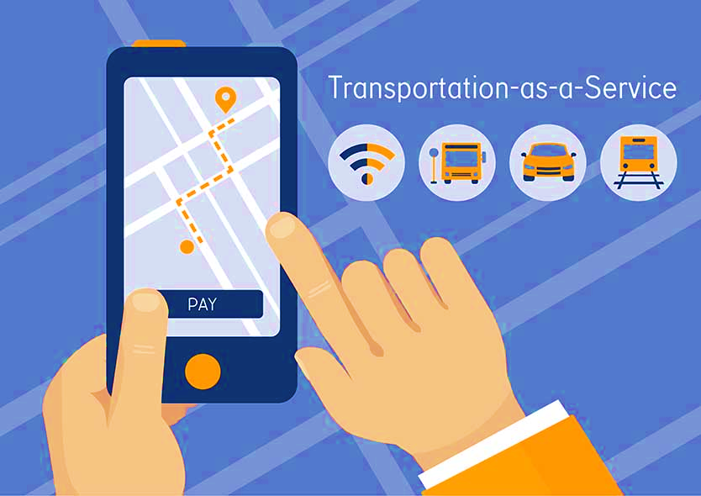
Public Transportation
Ambiguous implications for public transportation
Demand may:
Shrink because of low cost of TaaS
Grow because last mile problem is solved
Extensions may be added through contract with TaaS company

Slide 32
Employment
Massive job displacement/relocation (Millions!):
Drivers of all varieties: truck, taxi, delivery…
Car production jobs, car parts production jobs
Gas station, vehicle repair, and body shop
Police and fire
Health care workers
And so on…

Slide 33
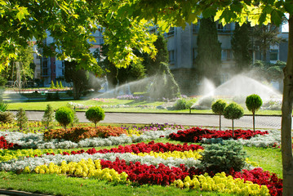
Parking
Greatly reduced demand for parking lots.
Service providers will own parking lots in strategic places.
Street parking will largely be a thing of the past.
More green space in cities
Shopping mall and apartment parking?
Converted to housing?

Slide 34
Freeing Up Urban Space from Parking
Los Angeles: 14% of incorporated land area
200 Square miles
San Francisco: 275,450 on-street parking spaces
Enough to parallel-park a line of cars 60 miles longer than California’s entire 840-mile coastline
Nationwide: (estimate) 500 million spaces
That’s larger than Delaware and Rhode Island combined.
Could be as many as 2 billion (add in Connecticut and Vermont).

Slide 35
Summary of Change
Massive employment upheaval.
Local government finances will look very different.
Housing will be easier to build and more plentiful.
Parking conversions will be commonplace.
Demand for transportation infrastructure will likely decline.
Transportation infrastructure technology will be a booming business.
Demand for public transportation may well decline.
Coming likely sooner rather than later!

Slide 36
Thank you!
Any Questions?
www.NEEDelegation.org
Jon D. Haveman
Jon@NEEDelegation.org
Contact NEED: info@NEEDelegation.org
Submit a testimonial: www.NEEDelegation.org/testimonials.php
Become a Friend of NEED: www.NEEDelegation.org/friend.php

