Slide 1
Osher Lifelong Learning Institute, Summer 2022
Contemporary Economic Policy
Rochester Institute of Technology
July-Aug, 2022
Jon Haveman, Ph.D.
National Economic Education Delegation

Slide 2
Course Outline
Contemporary Economic Policy
Week 1 (7/11): Economic Update (Jon Haveman, NEED)
Week 2 (7/18): Economic Inequality (Christopher Herrington VCU)
Week 3 (7/25): Trade and Globalization (Alan Deardorff, University of Michigan)
Week 4 (8/1): The Black-White Wealth Gap (Mike Shor, UConn)
Week 5 (8/8): Economic Mobility (Jon Haveman, NEED)
Week 6 (8/15): Climate Change Economics (Jon Haveman, NEED)
Week 7 (8/22): Autonomous Vehicles (Jon Haveman, NEED)
Week 8 (8/29): The Black-White Wealth Gap (Mike Shor, Uconn)

Slide 3
Submitting Questions
Please submit questions of clarification in the chat.
I will try to handle them as they come up.
We will do a verbal Q&A once the material has been presented.
OLLI allowing, we can stay beyond the end of class to have further discussion.
Slides will be available from the NEED website tomorrow (https://needelegation.org/delivered_presentations.php)

Slide 4
OLLI – Rochester Institute of Technology Driving Change – Autonomous Vehicles’ Big Impact
National Economic Education Delegation
Jon Haveman, Ph.D.
August 22, 2022

Slide 5
Credits and Disclaimer
This slide deck was authored by:
Jon Haveman, NEED
This slide deck was reviewed by:
Ronald Fisher, Michigan State University
William F. Fox, University of Tennessee, Knoxville
Disclaimer
NEED presentations are designed to be nonpartisan.
It is, however, inevitable that the presenter will be asked for and will provide their own views.
Such views are those of the presenter and not necessarily those of the National Economic Education Delegation (NEED).

Slide 6
Outline
Where does the AV path lead?
Transition
Policy/Planning Issues
Major Economic/Development Changes
Environmental Implications

Slide 7
Autonomous Taxonomy

Slide 8
Growth Path
McKinsey & Company
Notes:
This is the growth path according to McKinsey
I believe that the growth path will vary significantly depending on geography
Kansas – very slow
Bay Area – very fast
But I think that they agree with me on where we are headed
Primary means of transport for both people and goods

Slide 9
McKinsey isn’t Always Spot On
"In 1980, McKinsey & Company was commissioned by AT&T to forecast cell phone penetration in the U.S. by 2000.
The consultant’s prediction, 900,000 subscribers,
was less than 1% of the actual figure, 109 Million.”
Professor Angel Lozano, 2014

Slide 10
Three Important Questions:
When will Transportation as a Service (TaaS) be available?
How quick will the transition be?
What will the future look like?

Slide 11
WHEN? What do the headlines say?
NVIDIA to introduce level-4 enabling system by 2018
First autonomous Toyota to be available in 2020
Volkswagen expects first self driving cars on the market by 2019
Elon Musk now expects first fully autonomous Tesla by 2019, approved by 2021
Audi to introduce a self-driving car by 2020

Slide 12
40+ Corporations Working On Autonomous Vehicles

Slide 13
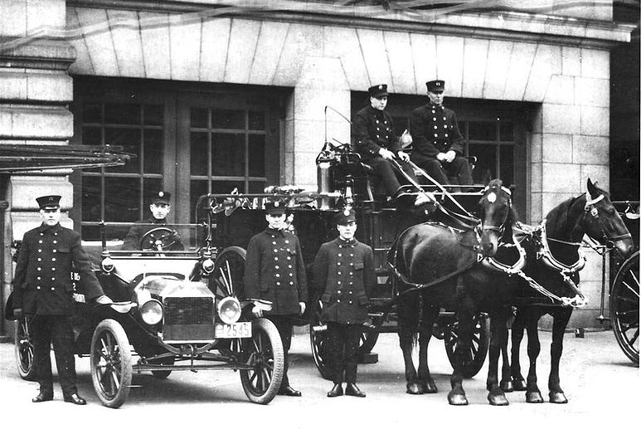
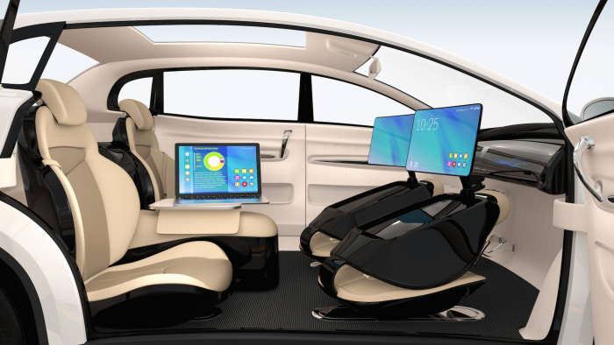
WHEN? What is possible?
By 2025 (?)
Potentially 95% of VMT by 2035.
Last 5% is going to be very difficult to achieve.
Is this possible?
Horses to cars: 10 years – early 1900s
But adoption of EVs is so slow!
Adoption of AVs will be rapid.

Slide 14
Rate of Technology Adoption – Faster!

Slide 15
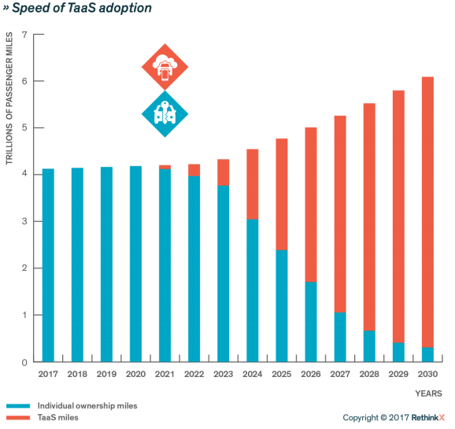
Forecast
Timing may be off.
But the point is:
RAPID ADOPTION!
The Big Unknown

Slide 17
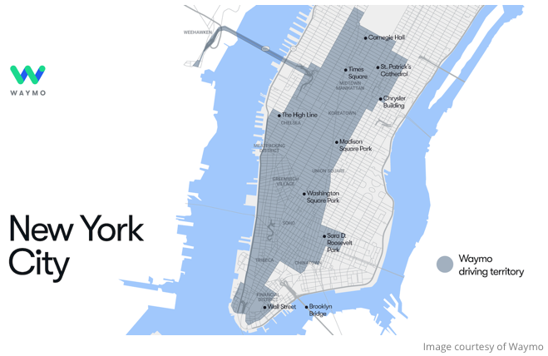
Waymo is in New York!

Slide 18
Trucking – Highly Fertile Ground
Long haul trucking the first place we are seeing it adopted.
Reduces costs associated with drivers.
End run around limits on hours of driving.
Where does it stand?
Lots of trials underway.
TuSimple – actively building a long-haul network.
Waymo – focused more on last mile/local delivery.

Slide 19
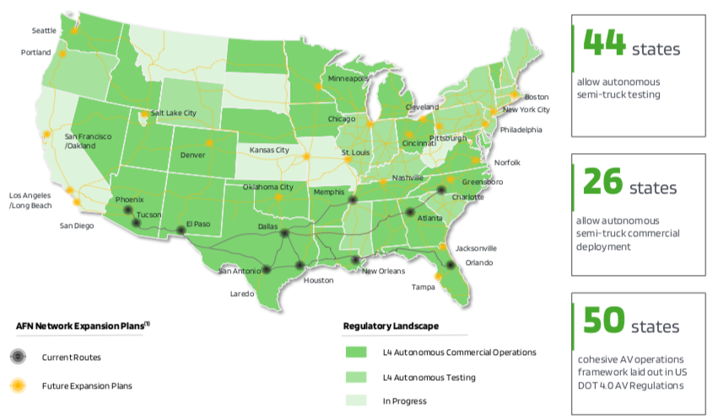
TuSimple Current and Future Routes (Level 4)

Slide 20
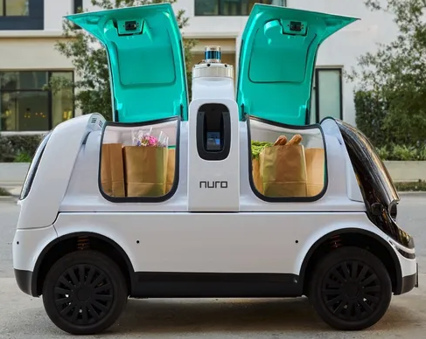
Actively Pursuing Autonomous Local Delivery
Dominos
Walmart
Amazon
CVS Pharmacy
Stop and Shop
Postmates
Kroger
Notes:
https://www.makeuseof.com/companies-testing-self-driving-cars/

Slide 21
What will the future look like?

Slide 22
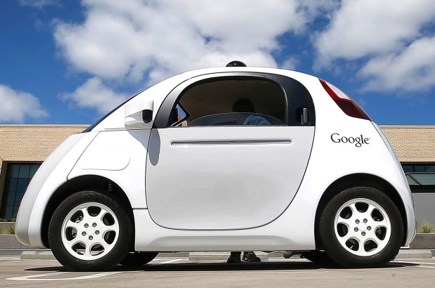
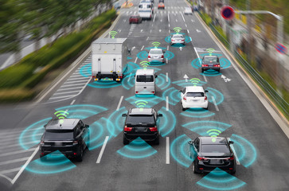
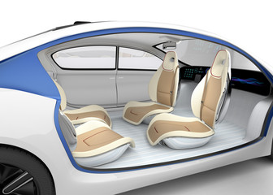
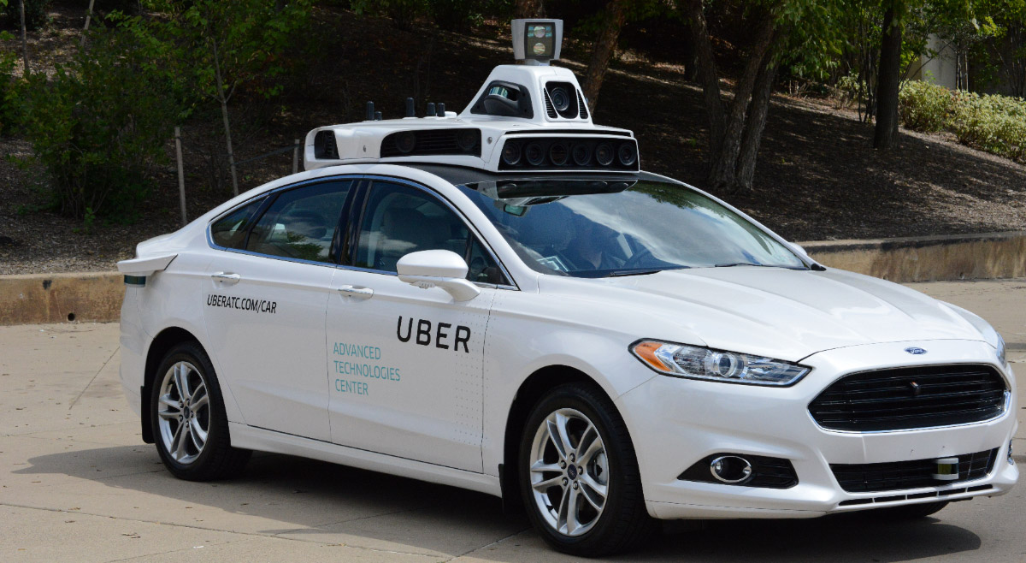
This:

Slide 23
But, will it be:
Heaven?
OR
Hell?

Slide 24
Hell
Primarily individual private car ownership
Much as today.
Internal combustion engines
Why Hell?
Dramatically increased VMT and pollution.
Potentially increased congestion
Parking.

Slide 25
Two Adults and a Child: Morning Miles
Parking
Office 1
1
2
3
4
School
Home
5
7
6
Office 2
And this is just the morning…..

Slide 26
Heaven
Vehicle ownership will be very limited
Private ownership for those with specialized vehicle needs.
Fleet ownership will serve everybody else.
Engines: electric
Insurance: product liability
Not clear when we will get there, but this is the likely model.
2030 for widespread adoption in many regions.

Slide 27
Why is this Heaven?
Not only autonomous, but:
Shared
Connected
Green
Far fewer cars in existence.
Better resource utilization.
VMT could go up or down, but more productive than in Hell.
Congestion effects – unclear, but likely reduced.
Right-sized vehicles, platooning, sharing, V2V communication
Minimal need for parking.

Slide 28
Transition
Short term: Tesla model of highway autonomy
Level 2, adaptive cruise control.
Medium term:
short period of personal vehicle ownership with level 3 capability.
introduction of independent private fleets – Uber, Lyft, Google, nuTonomy, etc., with level 4/5 capability.
Long term:
Personal vehicle ownership is largely a thing of the past.

Slide 29
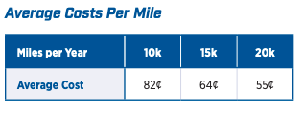
Economics Drives Transition: Private
Adoption dividend for private individuals
Eliminate car ownership
Ave annual cost of owning a car: $9,666 (2021)
Cost per mile will fall: $0.64 to $0.19
Repurpose your garage
$50,000 from transition to bedroom
Time recovery
50% of the San Francisco Bay area workforce has a commute in excess of 30 minutes.
Notes:
https://www.investopedia.com/articles/pf/08/cost-car-ownership.asp
.19 – source is TaaS report
$50,000 is my own research

Slide 30
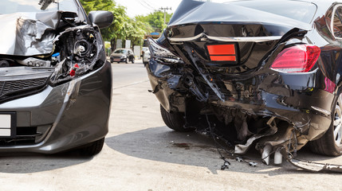
Economics Drives Transition: Public
Economic and social costs associated with human drivers are enormous:
ACCIDENTS:
Drive 25% of congestion.
Result in 40,000 deaths.
And 2 million injuries.
90+% caused by human error.
Increased productivity from not driving.
Costs of human drivers estimated at up to $1.3 TRillion each year

Slide 31
Potential Savings
Morgan Stanley

Slide 32
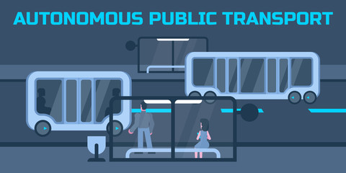
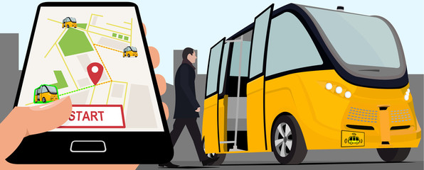
Public Policy/Planning Issues
Government buy-in:
Essential – gov’t must encourage progress
Difficult – because of displacement issue
Important transitional issues:
What infrastructure should be developed?
What to do about public transportation?
What to do with all of the parking spaces?

Slide 33
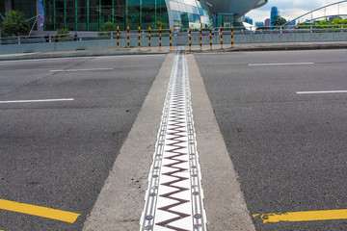
Responding to the coming changes:
Transportation organizations must develop a forecast for adoption in their specific geography
San Francisco – faster than Chicago
Chicago – faster than Fresno
Fresno - faster than Kansas
How does this affect the ROR calculation on projects?
Highway expansion? Public Transportation?

Slide 34
Encourage Change
Mobility and equity considerations.
Elderly/disabled/impoverished
Safety: only way to reduce traffic fatalities is by coordinated effort.
Productivity: reduced congestion.
Environment: speed transition to electric vehicles.
These are all societal benefits that come about too slowly if the private market is left to itself.
Notes:
Think about star trek and Scotty, beam me up! That's the ideal. We think it and we're in another place. Autonomous vehicles don't achieve that, but they free up the time that is still necessary to get from here to there.- they free up the time that is spent on maintenance - huge economies of scale

Slide 35
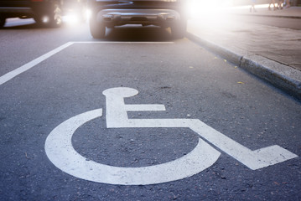
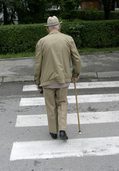
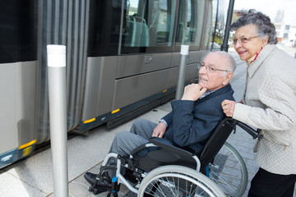
Mobility and Equity
Mobility
Handicapped
Elderly
Lower income
Equity
Public Transportation often does not work well for low-income workers/residential workers
Does not go from residential to residential, but from residential to commercial

Slide 36
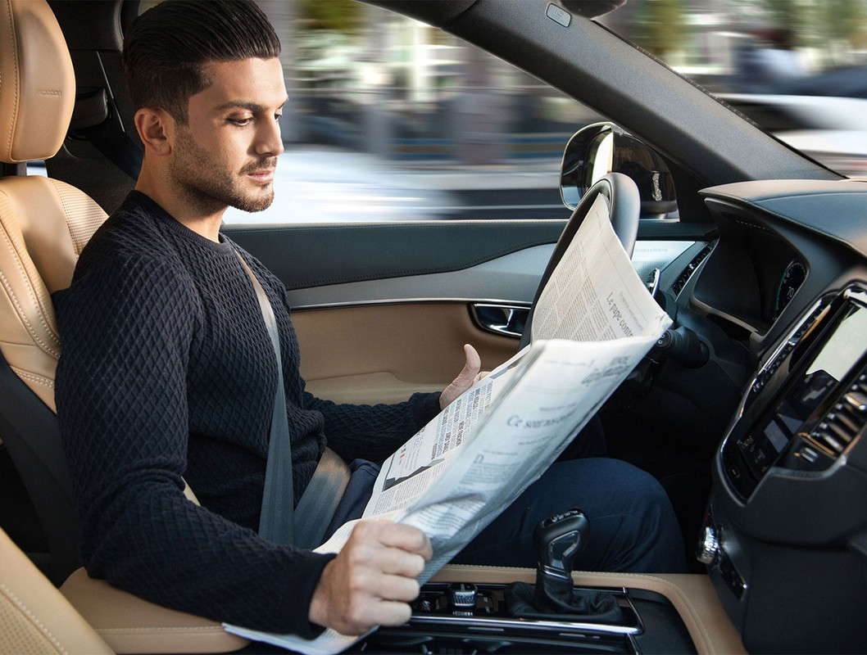
Safety and Productivity

Slide 37
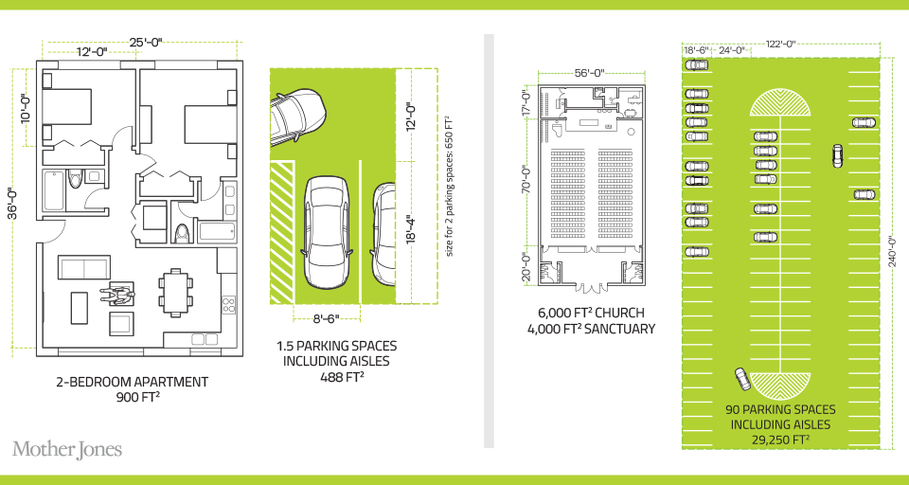
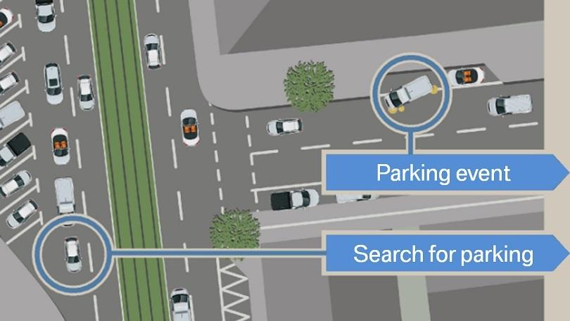
Environment
Notes:
30% of city traffic is due to search for parking

Slide 38
Environmental Implications Depends: Heaven or Hell
Improved resource utilization
More efficient travel
Right sized vehicles
Optimized routes
Reduced congestion
No searching for parking
Increased VMT
Cleaner technologies
Electric
Lighter vehicles
Energy use of onboard electronics
Weight and functional
Increased urban sprawl
Bottom line: push governments at all levels to embrace and to implement policies deterring private vehicle ownership and zero passenger miles
Notes:
Governments determine local zoning, design roadway alignments, invest in new capacity, design parking regulations, set transportation taxes, and invest in data and people to help manage all those decisions. It’s a huge suite of responsibilities, and all apply in new ways around AVs.

Slide 39
Incentives Through Policy and Planning
Allow vehicles equipped with ACC into HOV lanes
Eventual conversion of HOV lanes to ACC/AV lanes
Allow ACC equipped vehicles to travel faster in HOV lanes
Subsidize ACC upgrades
Arguably more concrete benefits than electric vehicles
Sticks: higher costs of vehicle ownership
Registration fees, VMT taxes, etc.
Note: ACC = Adaptive Cruise Control

Slide 40
Interim Summary
Transition is coming very quickly!
Most reports are extremely conservative.
Apply generally, but faster in many regions.
Very important to start incorporating AVs into planning now.
To realize the benefits of AVS.
Sacrifice expansion for maintenance.

Slide 41
What Changes Will This Bring?
Disposable income
Government finances
Transportation
Infrastructure
Public transportation
Employment
Housing
Parking
Potentially dramatic improvements in infrastructure planning and maintenance - Data sharing and integration

Slide 42
Disposable Income
Costs $9,666 to own a car.
Will cost $3,000 to use TaaS.
Net increase in disposable income of > $6,000.
Spread across all households: more than $1 trillion in new spending in the economy.
Major boost to economic activity.
CREATING JOBS!

Slide 43
Government Finances
Government finances thrown for a loop:
Revenues up and down:
Parking revenue, tickets, traffic violation revenues
More commercial, retail and residential space
Less spending on road development
More (maybe less) spent on road maintenance
Fewer road miles
but perhaps more VMT

Slide 44
Transportation
Demand for transportation will likely increase significantly: price falls, demand rises
Commutes may increase in distance, but not necessarily in duration
Zero passenger trips will arise
Deliveries
At the same time, demand for roadway lane-miles will likely decrease
AVs make significantly more efficient use of space
Front to back and side to side

Slide 45
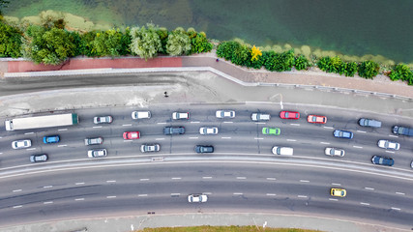
Infrastructure
Focus of transportation infrastructure:
Currently on expansion
Will turn toward:
Maintenance
TaaS providers push for fewer potholes?
Adding technology
Stop lights will be digital as well as visual
Some will disappear: Signs!

Slide 46
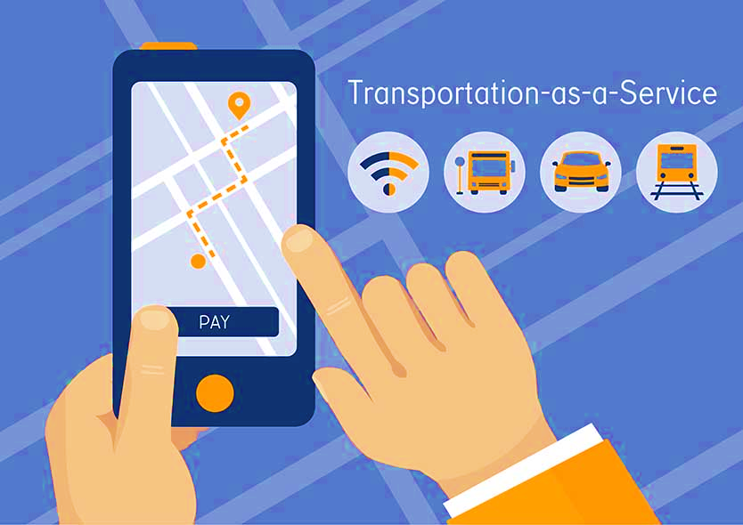
Public Transportation
Ambiguous implications for public transportation
Demand may:
Shrink because of low cost of TaaS
Grow because last mile problem is solved
Extensions may be added through contract with TaaS company

Slide 47
Cautionary Tale From Long Ago
Automobiles impact on rail:
“The increasing dominance of cars was also felt by railway companies, which by June 1894 had to start making pricing concessions for transporting goods, even including free transport.”
- Samuel I. Schwartz, No One at the Wheel, 2018

Slide 48
Employment
Massive job displacement/relocation (Millions!):
Drivers of all varieties: truck, taxi, delivery…
Car production jobs, car parts production jobs
Gas station, vehicle repair, and body shop
Police and fire
Health care workers
And so on…

Slide 49
Employment (con’t)
What jobs will be created?
IT jobs
Retail/Production jobs
??
Always easier to identify things that will go away than to identify what will pop up in its place.
Regardless of where they are created, training programs will be crucial to the transition.

Slide 50
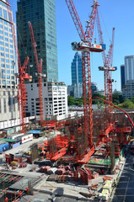
Housing
Housing is suddenly easier to build
Issue of traffic congestion is significantly reduced.
Space for new housing is available where parking lots used to be.
Existing houses can now accommodate more people: garage to bedroom conversions.

Slide 51
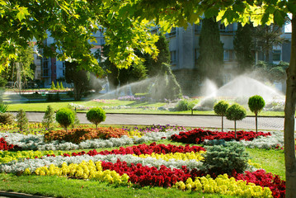
Parking
Greatly reduced demand for parking lots.
Service providers will own parking lots in strategic places.
Where the cost of land is low.
Street parking will largely be a thing of the past.
More green space in cities.
Shopping mall parking will be converted to:
More shopping mall? Housing?
Apartment complexes will convert parking.

Slide 52
Freeing Up Urban Space from Parking
Los Angeles: 14% of incorporated land area
200 Square miles
San Francisco: 275,450 on-street parking spaces
Enough to parallel-park a line of cars 900 miles.
California’s entire coastline is 840-miles.
Enough parking to fill parking lots that would cover the Presidio, Golden Gate Park, and Lake Merced.
Nationwide: (estimate) 500 million spaces
That’s larger than Delaware and Rhode Island combined.
Could be as many as 2 billion (add in Connecticut and Vermont).

Slide 53
Potential Problems and Concerns
Expansion of the electric grid to provide sufficient capacity.
Mining for rare earth minerals for batteries.
Hacking of autonomous vehicles for nefarious purposes.
Competition in service provision in some markets.
And many more…

Slide 54
Summary of Change
Massive employment upheaval.
Local government finances will look very different.
Housing will be easier to build and more plentiful.
Parking conversions will be commonplace.
Demand for transportation infrastructure will likely decline.
Transportation infrastructure technology will be a booming business.
Demand for public transportation may well decline.
Coming likely sooner rather than later!

Slide 55
US Economic Update

Slide 56
Income Inequality: Share of Top 10%
Stock Market Crash
WWII
Housing Bubble
Dot-com Bubble

Slide 57
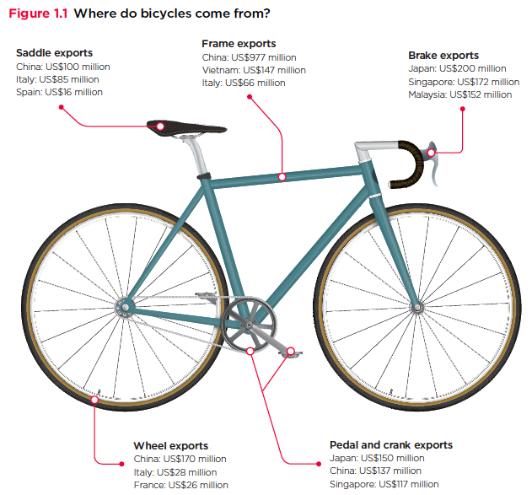
Trade: Bicycle Supply Chain
Source: World Development Report 2020

Slide 58
Mobility
9 out of 10 of those born in the early 1940s could expect to earn more than their parents
1 in 2 Millennials (born after 1980) earn more than their parents.

Slide 59
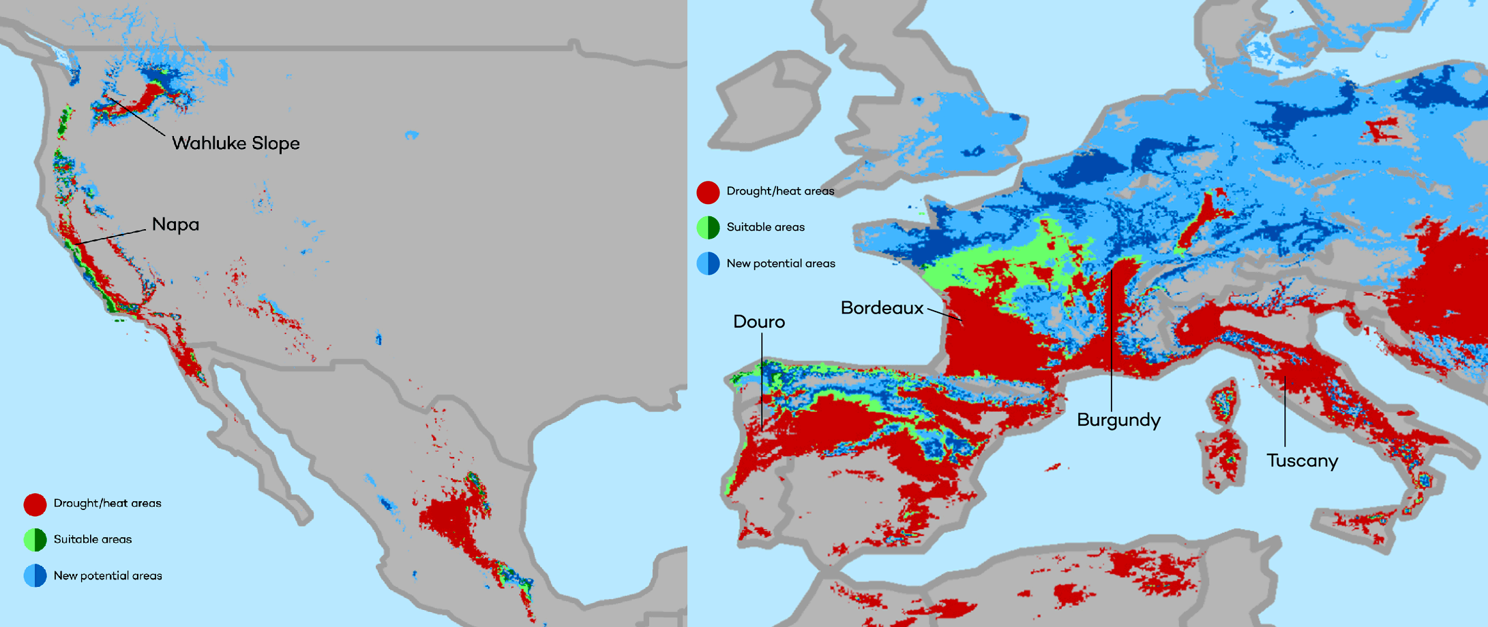
Climate Change Economics
The changing map of the world’s wine-growing regions.

Slide 60
Autonomous Vehicles

Slide 61
The B-W Wealth Gap: Mike Shor
Mean is
7x Greater
Median is 8x Greater

Slide 62
Available NEED Topics Include:
Healthcare Economics
US Economy
Climate Change
Economic Inequality
Economic Mobility
Trade and Globalization
Minimum Wages
Immigration Economics
Housing Policy
Federal Budgets
Federal Debt
Black-White Wealth Gap
Autonomous Vehicles
Healthcare Economics

Slide 63
Thank you!
Any Questions?
www.NEEDelegation.org
Jon D. Haveman
Jon@NEEDelegation.org
Contact NEED: info@NEEDelegation.org
Submit a testimonial: www.NEEDelegation.org/testimonials.php
Become a Friend of NEED: www.NEEDelegation.org/friend.php

