Slide 1
Loch Lomond Yacht Club
Driving Change – Autonomous Vehicles’ Big Impact
National Economic Education Delegation
Jon Haveman, Ph.D.
August 6, 2026

Slide 2
Outline
Where does the AV path lead?
Major Economic/Development Changes and Challenges

Slide 3



Autonomous Taxonomy

Slide 4
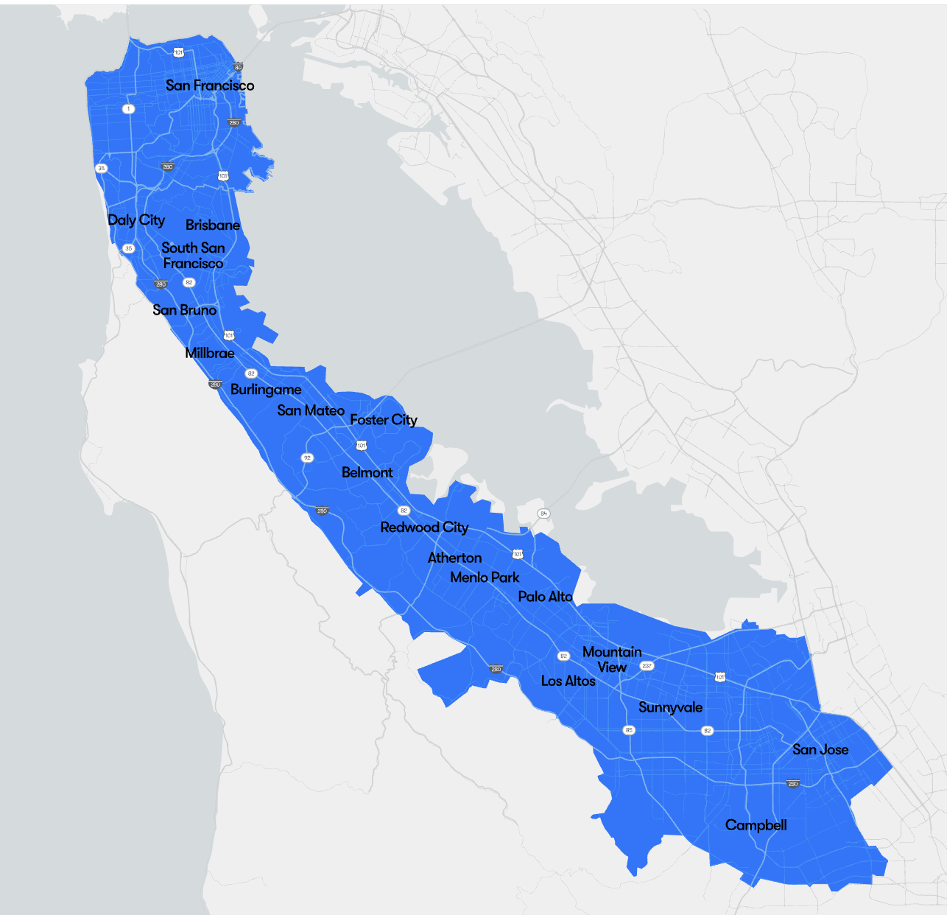
Waymo is Exploring Los Angeles
Waymo is in SF
And in:
Phoenix, AZ
Los Angeles, CA
Austin, TX
Dallas, TX
Houston, TX
San Antonio, TX
Atlanta, GA
Miami, FL
Orlando, FL
Nashville, TN
Source: https://waymo.com/whereyoucango/?section=san-francisco-ca

Slide 5
Three Important Questions:
When will Transportation as a Service (TaaS) be ubiquitously available?
How quick will the transition be?
What will the future look like?

Slide 6

























40+ Corporations Working On Autonomous Vehicles

Slide 7
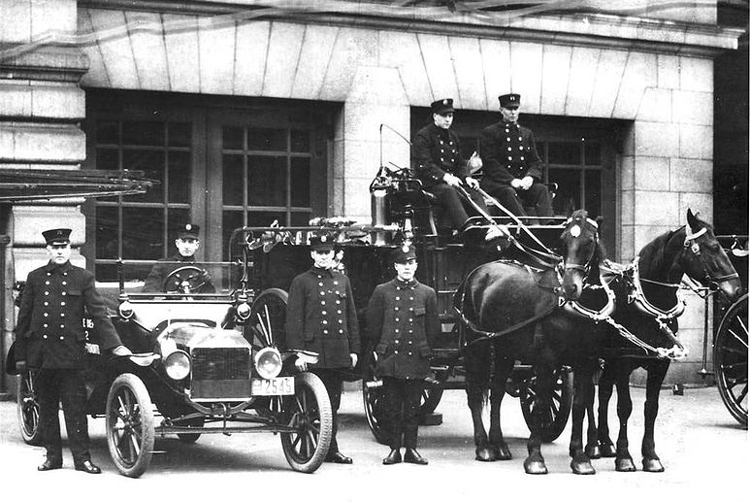
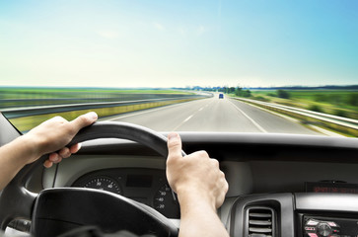
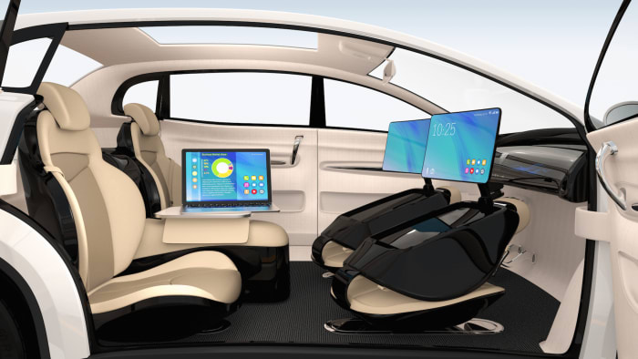
WHEN?
What is possible?
In 2025, significant expansion.
Potentially 95% of VMT by 2035.
  Last 5% may be very difficult to achieve.
Is this possible?
  Horses to cars: 10 years – early 1900s
  But adoption of EVs is so slow!
  Adoption of AVs will be rapid.

Slide 8




Slide 9
Fee-For-Service Autonomous TaaS
Waymo: Phoenix, AZ, Los Angeles, CA, the San Francisco Bay Area, CA, Austin, TX, Dallas, TX, Houston, TX, San Antonio, TX, Atlanta, GA, Miami, FL, and Orlando, FL
Motional: Las Vegas
Arlington, TX: Minibuses – Milo and Drive.ai
More are surely coming soon….

Slide 10
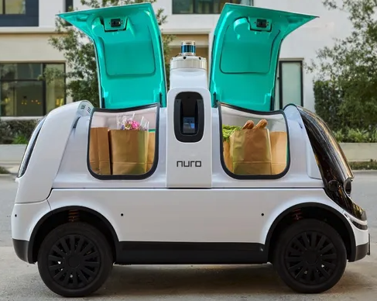
Actively Pursuing Autonomous Local Delivery
Dominos
Walmart
Amazon
CVS Pharmacy
Stop and Shop
Uber Eats
Kroger
Notes:
https://www.makeuseof.com/companies-testing-self-driving-cars/

Slide 11
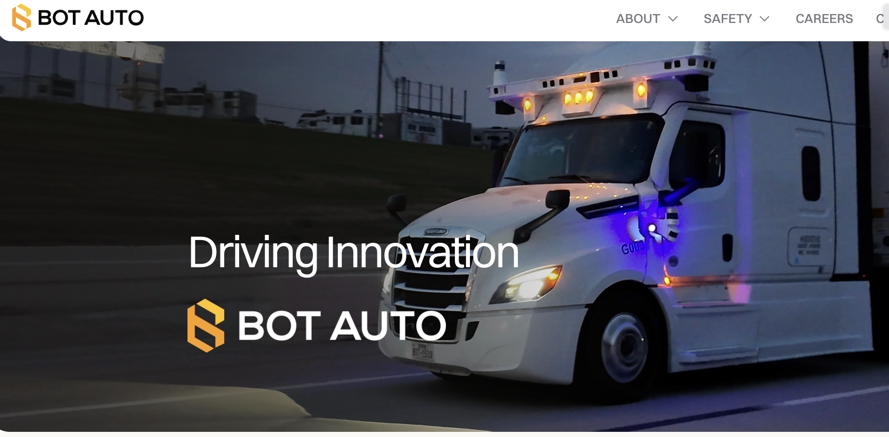
AV Trucking is Taking Off As Well!

Slide 12
What will the future look like?

Slide 13
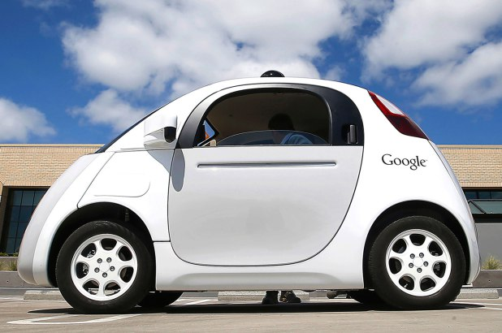
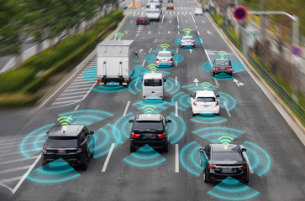
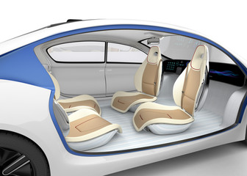

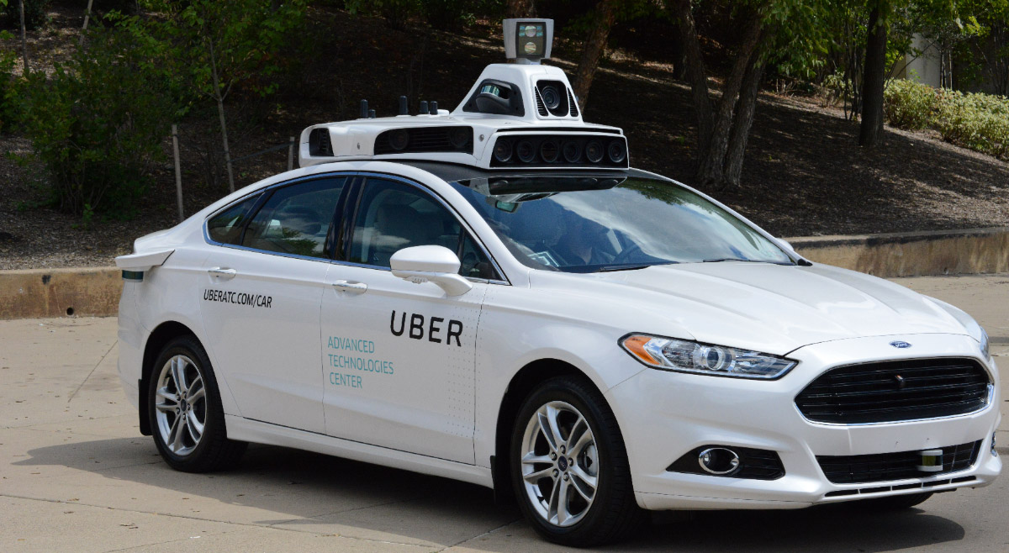
This:

Slide 14
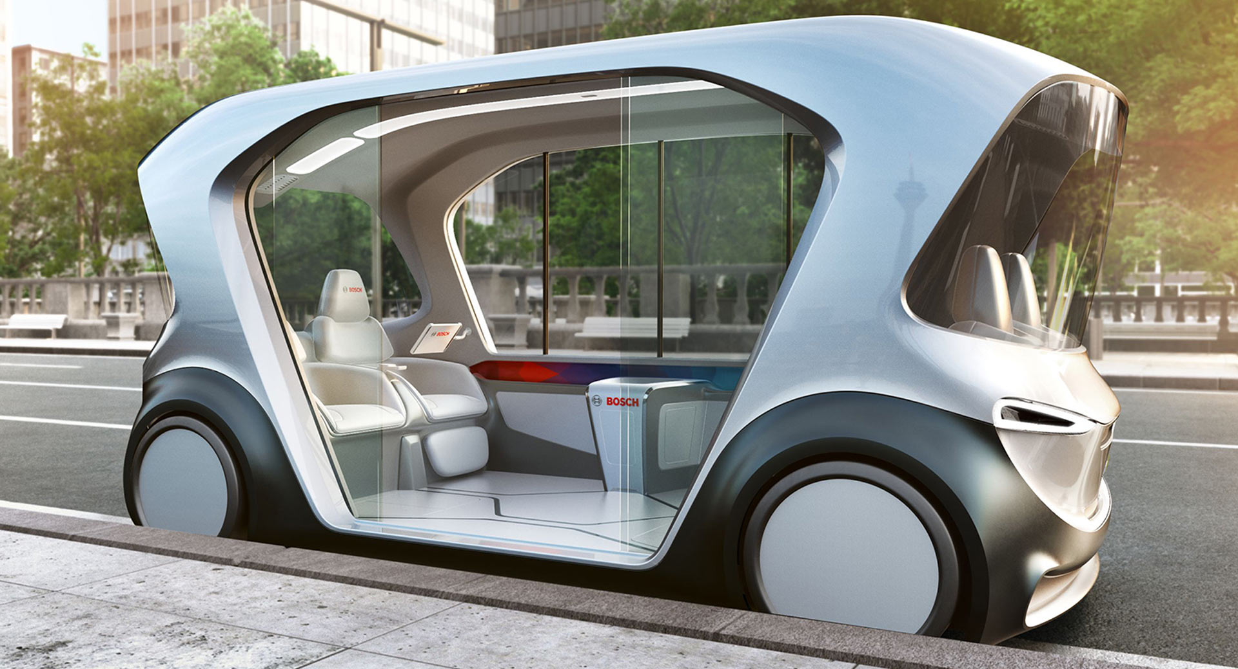
Or This:
https://www.carscoops.com/2018/12/boschs-autonomous-electric-shuttle-concept-aims-future-travel/

Slide 15



But, will it be:
Heaven?
OR
Hell?

Slide 16

Hell
Primarily individual private car ownership
  Much as today.
Internal combustion engines
Why Hell?
  Dramatically increased VMT and pollution.
  Potentially increased congestion.
  Parking

Slide 17
Two Adults and a Child: Morning Miles
Parking
Office 1
1
2
3
4
School
Home
5
7
6
Office 2
And this is just the morning…..

Slide 18

Heaven
Vehicle ownership will be very limited
  Private ownership for those with specialized vehicle needs.
  Fleet ownership will serve everybody else.
Engines: electric
Insurance: product liability
Not clear when we will get there, but this is the likely model.
  2035 for widespread adoption in many regions.

Slide 19
Why is This Heaven?
Not only autonomous, but:
  Shared
  Connected
  Green
Far fewer cars in existence.
  Better resource utilization: steel, rubber, aluminum, and land!
VMT could go up or down, but more productive than in Hell.
Congestion effects – unclear, but likely reduced.
  Right-sized vehicles, platooning, sharing, V2V communication
Minimal need for parking.

Slide 20
Transition
Short term: Tesla model of highway autonomy
  Level 2, adaptive cruise control
Medium term:
  short period of personal vehicle ownership with level 3 capability
  introduction of independent private fleets – Waymo, Uber, Lyft, Google, Aurora, Kodiak, etc., with level 4/5 capability
Long term:
  Personal vehicle ownership is largely a thing of the past (hopefully!).

Slide 21
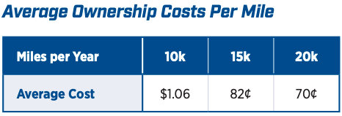
Economics Drives Transition: Private
Adoption dividend for private individuals
  Eliminate car ownership
    Ave annual cost of owning a car: $12,297 (2024)
    Cost per mile will fall: $0.82 to $0.19
  Repurpose your garage
    $50,000 from transition to bedroom
Time recovery
  50% of the SF Bay Area workforce has a commute in excess of 30 minutes.
Notes:
https://www.investopedia.com/articles/pf/08/cost-car-ownership.asp
.19 – source is TaaS report
$50,000 is my own research

Slide 22
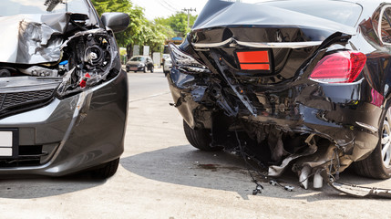

Economics Drives Transition: Public
Economic and social costs associated with human drivers are enormous:
  ACCIDENTS:
    Drive 25% of congestion.
    Result in ~40,000 deaths/yr.
    And 2.5 million injuries/yr.
    90+% caused by human error.
  Increased productivity from not driving.
  Potential savings are estimated to be up to $1.3 TRillion each year.

Slide 23
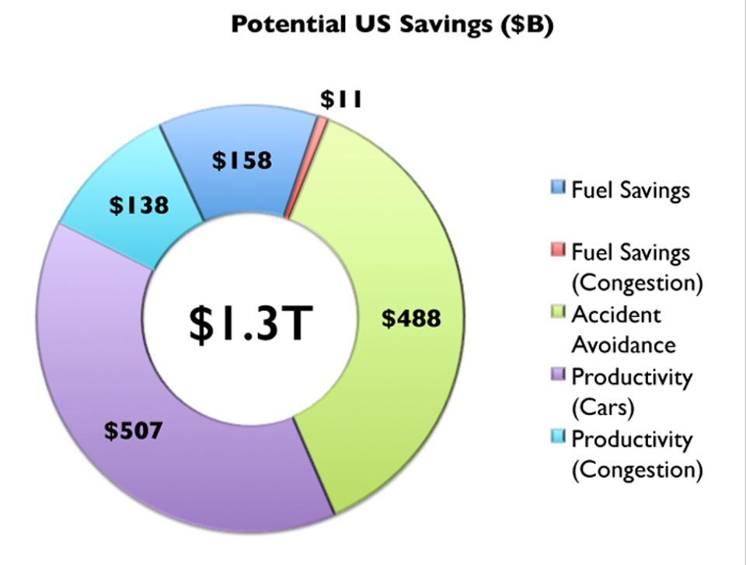
Potential Savings
Morgan Stanley

Slide 24
Government Should Encourage Change
Mobility and equity considerations
  Elderly/disabled/impoverished
Safety: only way to reduce traffic fatalities is by coordinated effort
Productivity: reduced congestion
Environment: speed transition to electric vehicles
These are all societal benefits that come about too slowly
if the private market is left to itself.
Notes:
Think about star trek and Scotty, beam me up! That's the ideal. We think it and we're in another place. Autonomous vehicles don't achieve that, but they free up the time that is still necessary to get from here to there.- they free up the time that is spent on maintenance - huge economies of scale

Slide 25
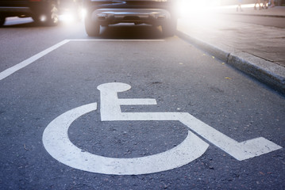

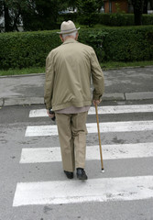

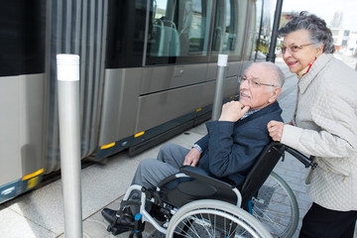
Mobility and Equity
Mobility
  Handicapped
  Elderly
  Lower income
Equity
  Public Transportation often does not work well for low-income workers/residential workers
    Does not go from residential to residential, but from residential to commercial

Slide 26
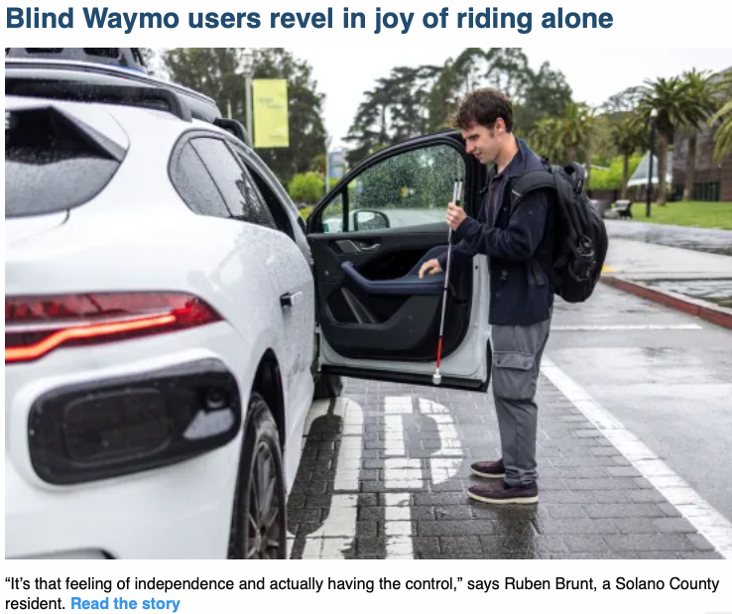
Mobility and Equity

Slide 27
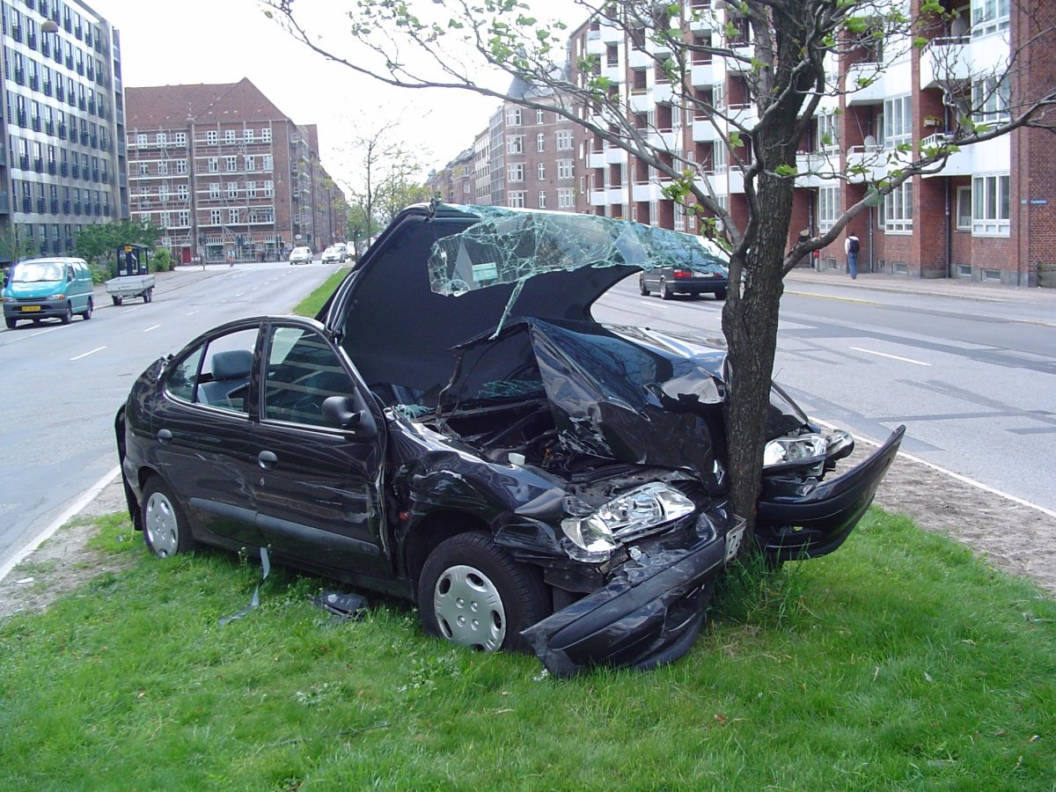
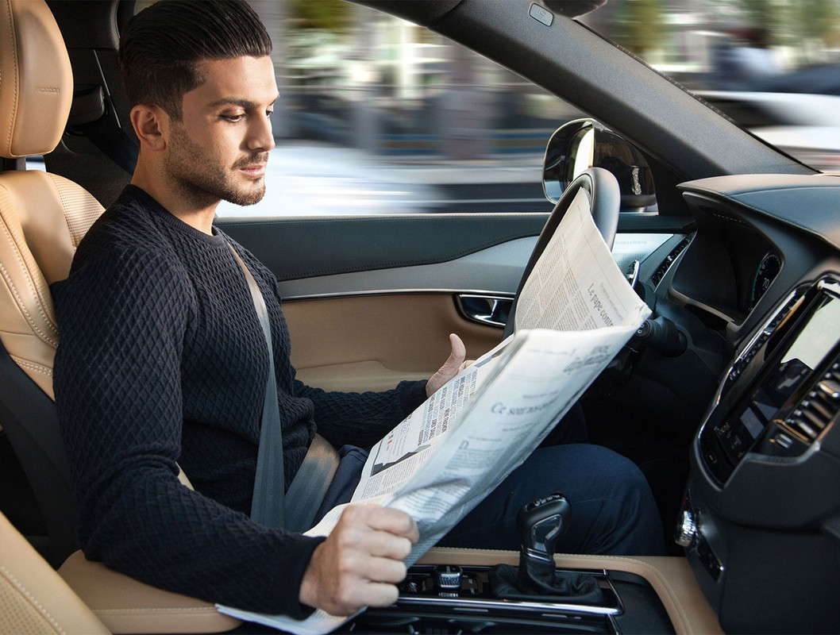
Safety and Productivity

Slide 28
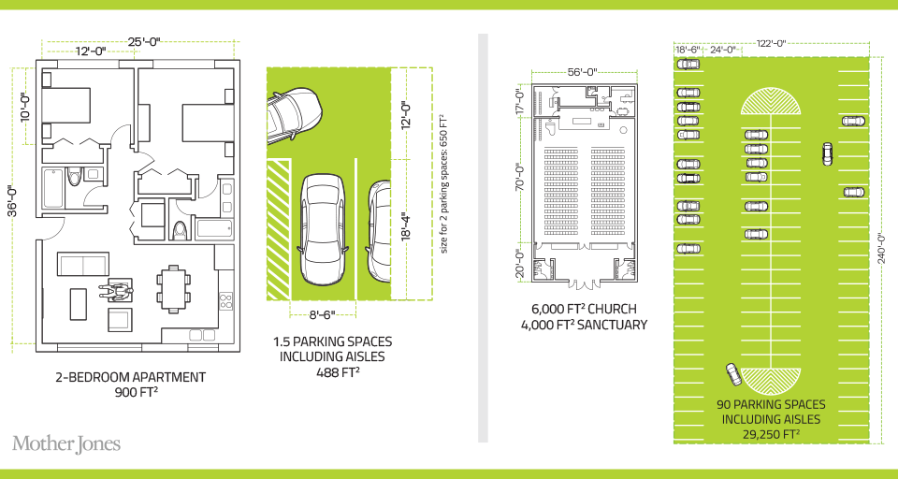
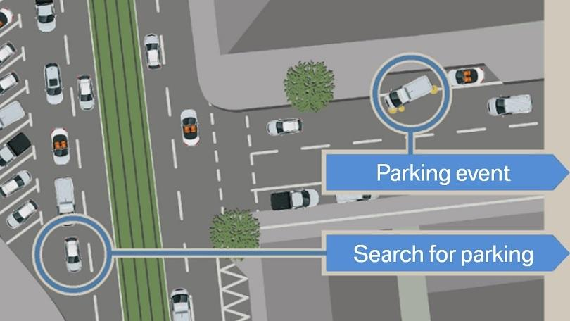
Environment
Notes:
30% of city traffic is due to search for parking

Slide 29
Environmental Implications
Depends: Heaven or Hell
Improved resource utilization
More efficient travel
  Right sized vehicles
  Optimized routes
  Reduced congestion
  No searching for parking
Increased VMT
Cleaner technologies
  Electric
  Lighter vehicles
Energy use of onboard electronics
  Weight and functional
Increased urban sprawl
Bottom line: push governments at all levels to embrace and to implement
policies deterring private vehicle ownership and zero passenger miles
Notes:
Governments determine local zoning, design roadway alignments, invest in new capacity, design parking regulations, set transportation taxes, and invest in data and people to help manage all those decisions. It’s a huge suite of responsibilities, and all apply in new ways around AVs.

Slide 30
What Changes Will This Bring?
Disposable income
Government finances
Transportation demand
Infrastructure
Housing
Public transportation
Employment
Parking
Potentially dramatic improvements in infrastructure planning and maintenance - Data sharing and integration

Slide 31


Disposable Income
Costs $12,297 to own a car.
Will cost $3,000 to use TaaS.
Net increase in disposable income
of > $7,000.
Spread across all households:
more than $1 trillion in new spending in the economy.
Major boost to economic activity.
  CREATING JOBS!
Notes:
https://newsroom.aaa.com/wp-content/uploads/2022/08/2022-YourDrivingCosts-FactSheet-7-1.pdf

Slide 32


Transportation Demand
Demand for transportation will likely increase significantly:
price falls, demand rises
  Commutes may increase in distance, but
  not necessarily in duration.
  Zero passenger trips will arise.
    Deliveries
At the same time, demand for roadway lane-miles will likely decrease
  AVs make significantly more efficient use of space.
  Front to back and side to side.

Slide 33
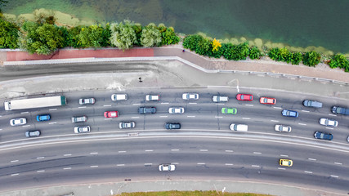
Infrastructure
Focus of transportation infrastructure:
  Currently on expansion
  Will turn toward:
    Maintenance
      Signage and striping has to be robust
      TaaS providers push for fewer potholes?
    Adding technology
      Stop lights will be digital as well as visual
  Some will disappear: Signs!

Slide 34
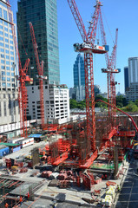

Housing
Housing is suddenly easier to build
  Issue of traffic congestion is significantly reduced.
  Space for new housing is available where parking lots used to be.
Existing houses can now accommodate more people:
garage to bedroom conversions.

Slide 35
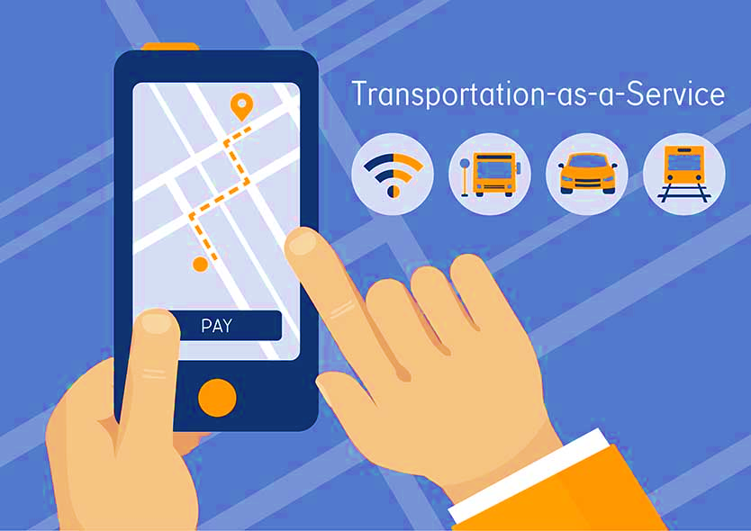
Public Transportation
Ambiguous implications for public transportation
Demand may:
  Shrink because of low cost of TaaS
  Grow because last mile problem is solved
Extensions may be added through contract with TaaS company

Slide 36

Employment
Massive job displacement/relocation (Millions!):
  Drivers of all varieties: truck, taxi, delivery…
  Car production jobs, car parts production jobs
  Gas station, vehicle repair, and body shop
  Police and fire
  Health care workers
  And so on…

Slide 37

Employment (con’t)
What jobs will be created?
  IT jobs
  Retail/Production jobs
  ??
Always easier to identify things that will go away than to identify what will pop up in its place.
Regardless of where they are created, training programs will be crucial to the transition.

Slide 38
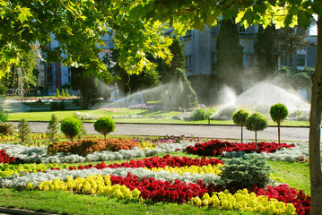
Parking
Greatly reduced demand for parking lots.
Service providers will own parking lots in strategic places.
  Where the cost of land is low.
Street parking will largely be a thing of the past.
  More green space in cities.
Shopping mall parking will be converted to:
  More shopping mall? Housing?
Apartment complexes will convert parking.

Slide 39
Freeing Up Urban Space from Parking
Los Angeles: 14% of incorporated land area
  200 Square miles
San Francisco: 275,450 on-street parking spaces
  Enough to parallel-park a line of cars 900 miles.
    California’s entire coastline is 840-miles.
  Enough parking to cover the Presidio, Golden Gate Park, and Lake Merced.
Nationwide: (estimate) 500 million spaces
  That’s larger than Delaware and Rhode Island combined.
  Could be as many as 2 billion (add in Connecticut and Vermont).

Slide 40
Summary of Change
Massive employment upheaval.
Housing will be easier to build and more plentiful.
Parking conversions will be commonplace.
Demand for transportation infrastructure will likely decline.
Demand for public transportation may well decline.
Coming likely sooner rather than later!

Slide 41
Thank you!
Any Questions?
www.NEEDEcon.org
Jon D. Haveman
Jon@NEEDEcon.org
Contact NEED: info@NEEDEcon.org
Submit a testimonial: www.NEEDEcon.org/testimonials.php
Become a Friend of NEED: www.NEEDEcon.org/friend.php

