Slide 1
Osher Lifelong Learning Institute, Winter 2026
Contemporary Economic Policy Issues
Berkshire Community College
Host: Geoffrey Woglom, Director
National Economic Education Delegation

Slide 2
Course Schedule
Contemporary Economic Policy Issues
  Week 1 (1/23): Economic Update & Central Bank Independence Geoffrey Woglom, Amherst College
  Week 2 (1/30): Federal Debt and Deficits, Kathryn Wilson Kent State University
  Week 3 (2/6): Climate Change Economics Sarah Jacobson, Williams College
  Week 4 (2/13): An Introduction to Cryptocurrencies, Geoffrey Woglom, Amherst College
  Week 5 (2/20): Saving Social Security, Jon Haveman, Executive Director NEED
  Week 6 (2/27): AI and Inequality, Geoffrey Woglom, Amherst College

Slide 3
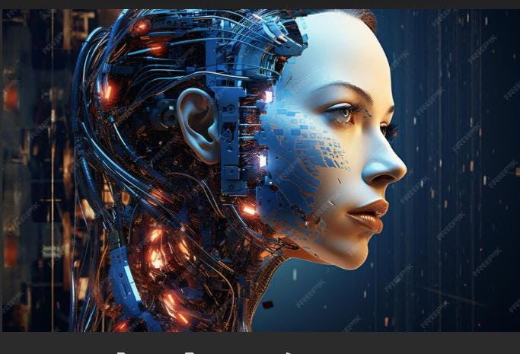
Artificial Intelligence and Inequality
February 27, 2026
Geoffrey Woglom,
Emeritus Professor, Amherst College
“Is College Worth It?”
Geoffrey Woglom, Amherst College, emeritus
February, 13, 2024

Slide 4
Outline
Lessons from 2 episodes Technological Changes during the 20th Century.
What is the current state of AI?
How will the adoption of this technology affect inequality.
Spoiler Alert: No One Really Knows?
Recent Evidence on the Effects of AI.
Implications for our grandchildren’s future.
I will not discuss the possibility of an “AI Takeover” of humanity

Slide 5
TwoMajor Shifts in Employment
https://www.visualcapitalist.com/visualizing-150-years-of-u-s-employment-history/

Slide 6
Out of Agriculture
D. Autor, C. Goldin, and L. Katz, Extending the Race between Education and Technology” AEA Papers and Proceedings 2020, 110: 347–351
Technology increases the demand for skilled workers tending into raise their wages.
Education increases the supply of skilled workers tending to lower their wages.
Example: Shift from agriculture to manufacturing in the late 19th and early 20th centuries: Increasing demand for high school graduates

Slide 7
Historical Returns to Education
High School Movement
Autor, Goldin and Katz

Slide 8
Early 20th Century Technology Adjustment
Four Keys to Success:
New technology created jobs in new sectors where labor was more productive. (e.g., Model T).
Wealthier nation could afford the new schooling and afford to buy the new goods.
Farm workers were geographically mobile to move to the new jobs.
Increase in educational attainment increased the supply of workers for new jobs.

Slide 9
Lessons of the Effects of Technology
Some of the new technologies substituted for existing labor automating jobs (cotton picking machines, 1943).
Some of the new technologies augmented labor increasing jobs (Black & Decker mass produced pistol grip electric drills in 1917).
Some new technologies created new goods and more new jobs (electrical engineers with the development of the electric grid).
New technologies increased wealth and increased the demand for all types of labor; GDP per capita increased by 80% between 1900 and 1929).

Slide 10
Early20th Century Technologies Were GPT
General Purpose Technologies (GPT) are foundational innovations that affect many sectors of the economy.
  Electricity.
  Automobiles.
  Transistors.
These GPTs did substitute for some labor, but augmented most labor and created many new occupations and industries.

Slide 11
The Abrupt Increase in Inequality
Source: Arloc Sherman, Danilo Trisi, and Joseph Cureton, “A Guide to Statistics on Historical Trends in Income Inequality,”
Center on Budget and Policy Priorities, Policy Futures, Dec. 11, 2024.
Notes:
Slide taken from page 10, Chad Stone, Danilo Trisi, Arloc Sherman, and Roderick Taylor, “A Guide to Statistics on Historical Trends in Income Inequality,” May 15, 2018

Slide 12
Recent Experience of Technology & Wage Inequality
Acemoglu (Nobel 2024) & Restrepo:
“We document that between 50% and 70% of changes in the U.S. wage structure over the last four decades are accounted for by relative wage declines of worker groups specialized in routine tasks in industries experiencing rapid automation.”
What Characterized industries experiencing rapid automation?
Econometrica, Vol. 90, No. 5 (September, 2022), 1973–2016

Slide 13
David Autor and Labor Market Polarization
https://www.hamiltonproject.org/wp-content/uploads/2023/01/The_Polarization_of_Job_Opportunities_in_the_US_Labor_Market-_Implications_for_Employment_and_Earnings.pdf

Slide 14
Causes of Polarization in the Early 21st Century
Automation substituted machines for labor for routine work; e.g., bookkeeping, clerical work and repetitive production work – middle skill jobs. Thereby lowering the demand for these workers.
As a result, the relative demand for two kinds of nonroutine work rose;
  Abstract tasks such as problem solving, intuition and persuasion; many of these jobs, but not all require formal training and/or a college degree.
  Manual tasks requiring little formal education such as janitors, home health aide workers, construction laborers.

Slide 15
Polarization and Wage Inequality
High-skilled jobs requiring a college education increased as well as wages.
Conversely, middle-skilled jobs fell along with wages.
Low-skilled jobs demand rose, but the supply of workers also rose as displaced middle skilled workers found low skill jobs.
Race between the demand and supply of high-skilled workers was won by demand during this period.
How will this story change with the introduction of AI?

Slide 16
What is Artificial Intelligence?
Definition: The capacity of machines to simulate intelligent behavior. Such as learning, problem solving, reasoning, perception and decision making.
Machine Learning (ML): Train computer to do a specific task by reinforcement.
Alpha-Go and Alpha-Go Zero: 2016 beats World Champ. https://deepmind.google/research/projects/alphago/
Reading Mammograms “…urgent efforts should be made to integrate AI-supported mammography into screening guidelines and to promote the widespread adoption of AI in mammography screening programs. (https://www.nature.com/articles/s41591-024-03408-6)

Slide 17
Generative AI: ChatGPT et. al.
Generative AI and Large Language Models (LLM): Train computers on massive amounts of data to predict patterns, and use these predictions to generate “new” content.
It is still a kind of reinforcement, but the “game” is to predict what word, image, music comes next.
You play the “game” by providing a prompt in natural language; e.g.
  “What is a neural network?
  “Perplexity:”A neural network is a computational system inspired by the structure and function of biological brains, designed to recognize patterns and learn from data by adjusting connections between artificial "neurons" arranged in layers.

Slide 18

“New” Content
Examples:
“Write a paper about the causes of the civil war.” (?)
“Create a picture of Norwich terriers playing bridge.”
Deep Fakes.

Slide 19
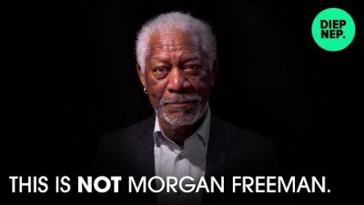

Slide 20

Funny, but Scary Too

Slide 21


Augmentation or Automation?
AI Actress Tilly Norwood

Slide 22
US Investment in AI is Exploding
https://hai.stanford.edu/ai-index/2025-ai-index-report

Slide 23
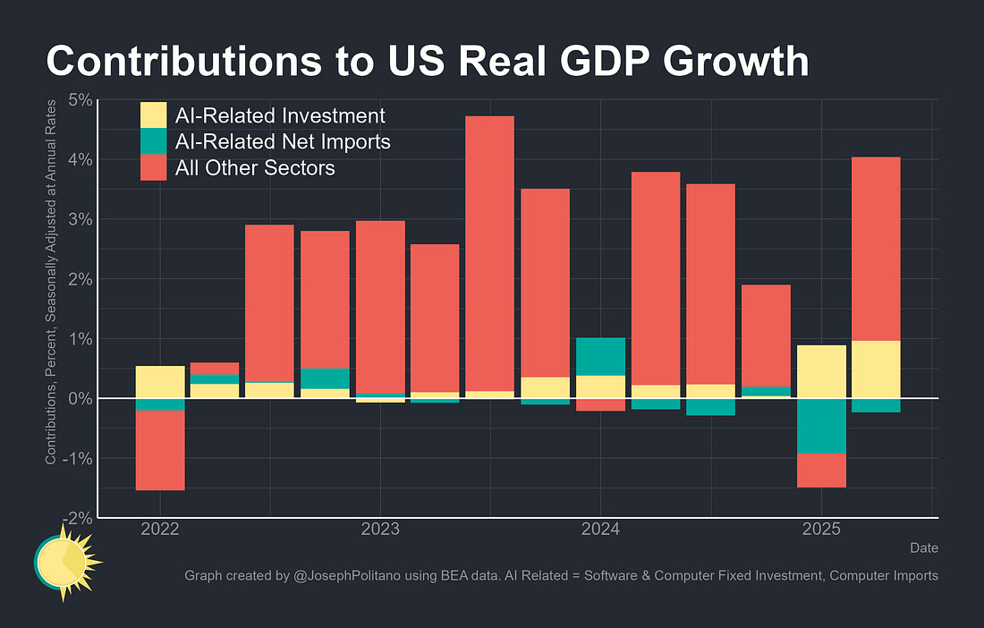
AI Investment is Driving GDP Growth

Slide 24
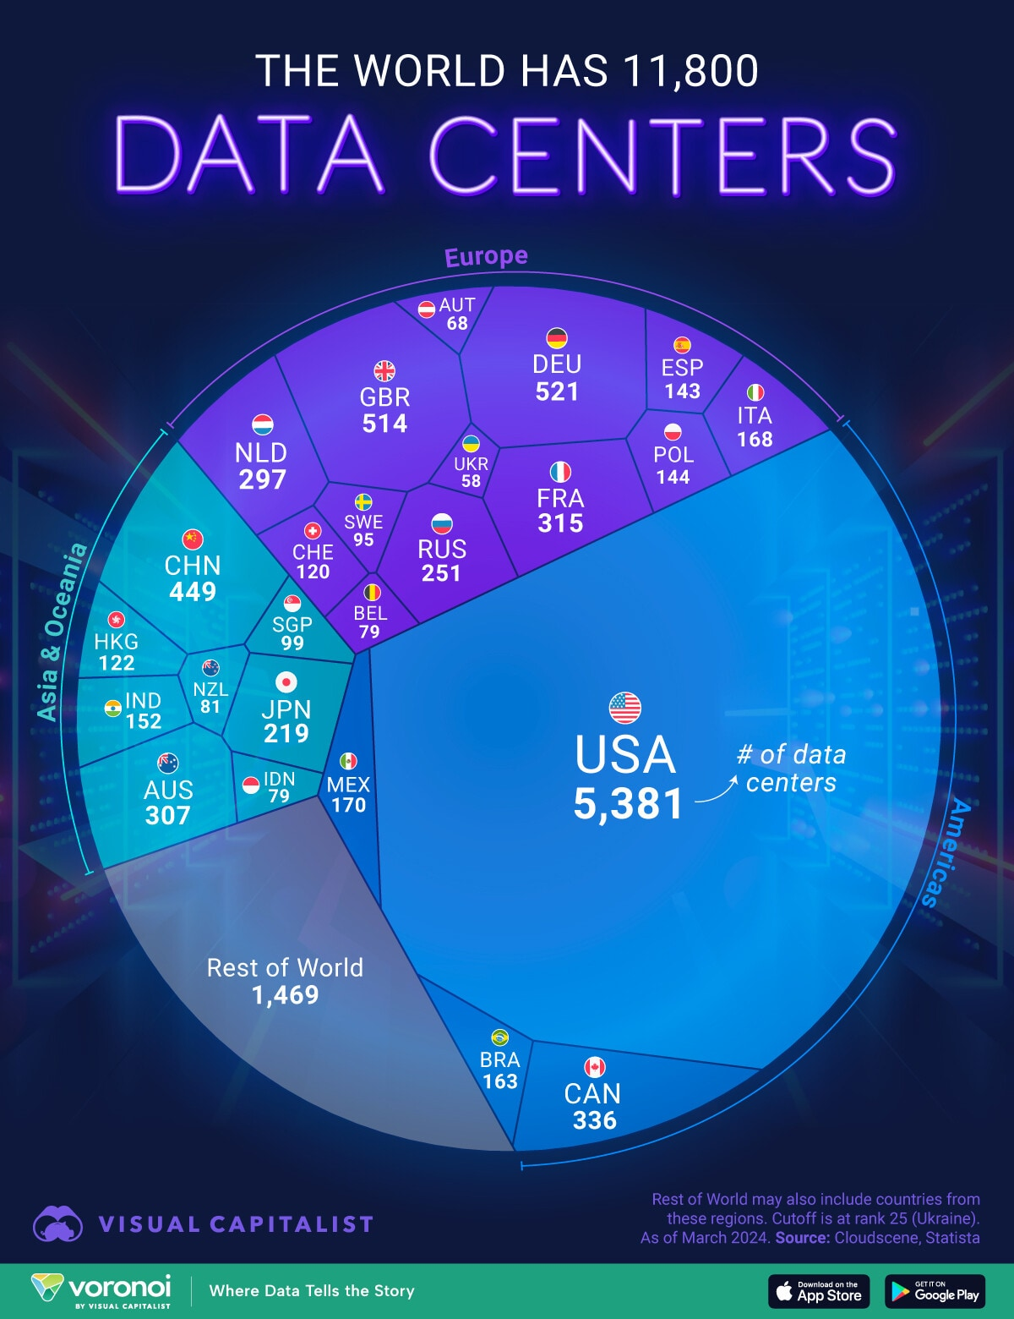
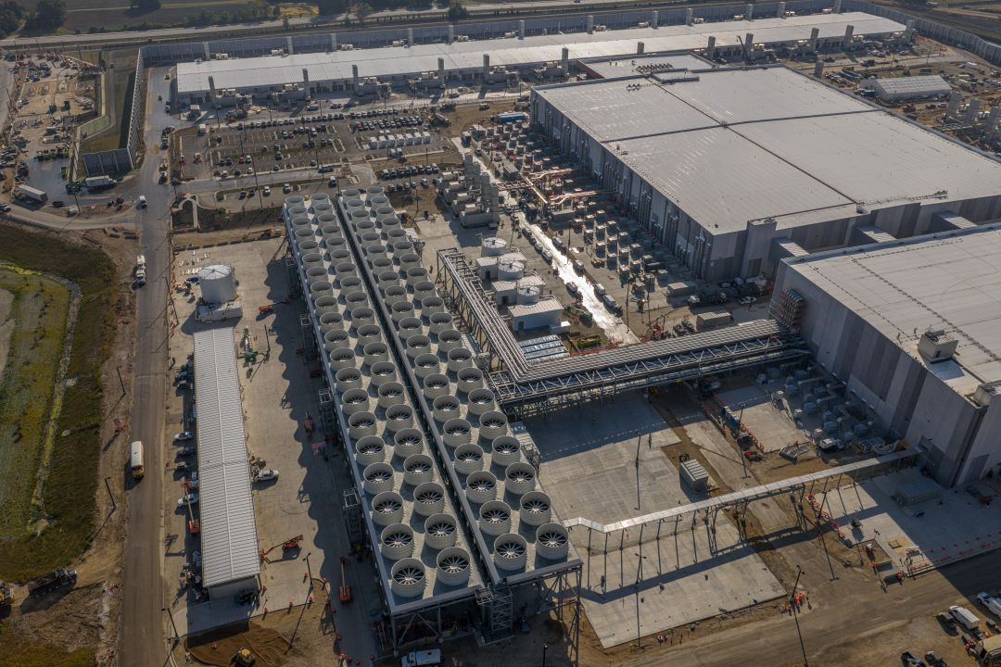
Data Centers

Slide 25
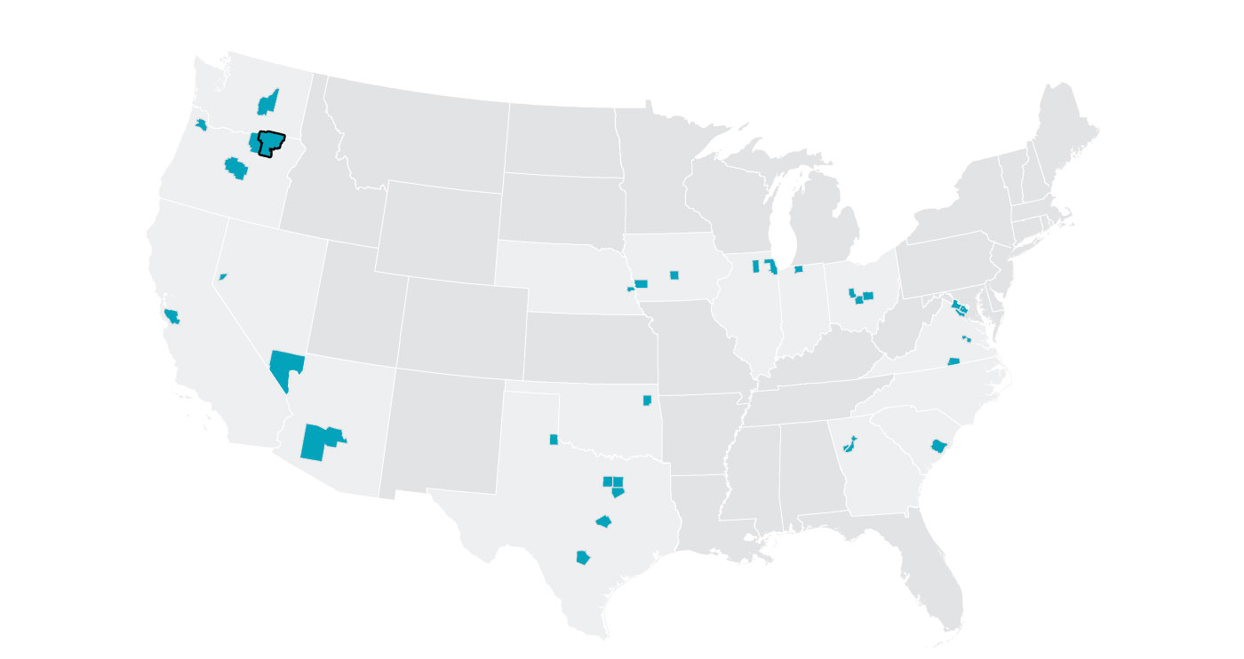
33 Counties Account for 72% of Data Centers
Source: Goldman Sachs from the WSJ,1/4/2025

Slide 26
And, It Has Only Just Begun
One Nuclear power plant adds about 1 Gigawatt in electric capacity
https://www.eia.gov/energyexplained/nuclear/us-nuclear-industry.php
https://www.mckinsey.com/industries/technology-media-and-telecommunications/our-insights/the-cost-of-compute-a-7-trillion-dollar-race-to-scale-data-centers#/

Slide 27
Bitcoin Miners & Data Centers
Bitcoin mining uses many of the same high-powered chips as AI
Miners have 6.3 GW of capacity with 2.5 under construction.
Wired, 12/9/2025: “America’s Biggest Bitcoin Miners are Pivoting to AI”

Slide 28
AI Is Getting “Smarter”
Eloundo, Manning, Mishkin, Rock (2023) https://ar5iv.labs.arxiv.org/html/2303.10130

Slide 29
AI Usage is Growing
Gallup, December 2025

Slide 30
ChatGPT and Tasks

Slide 31
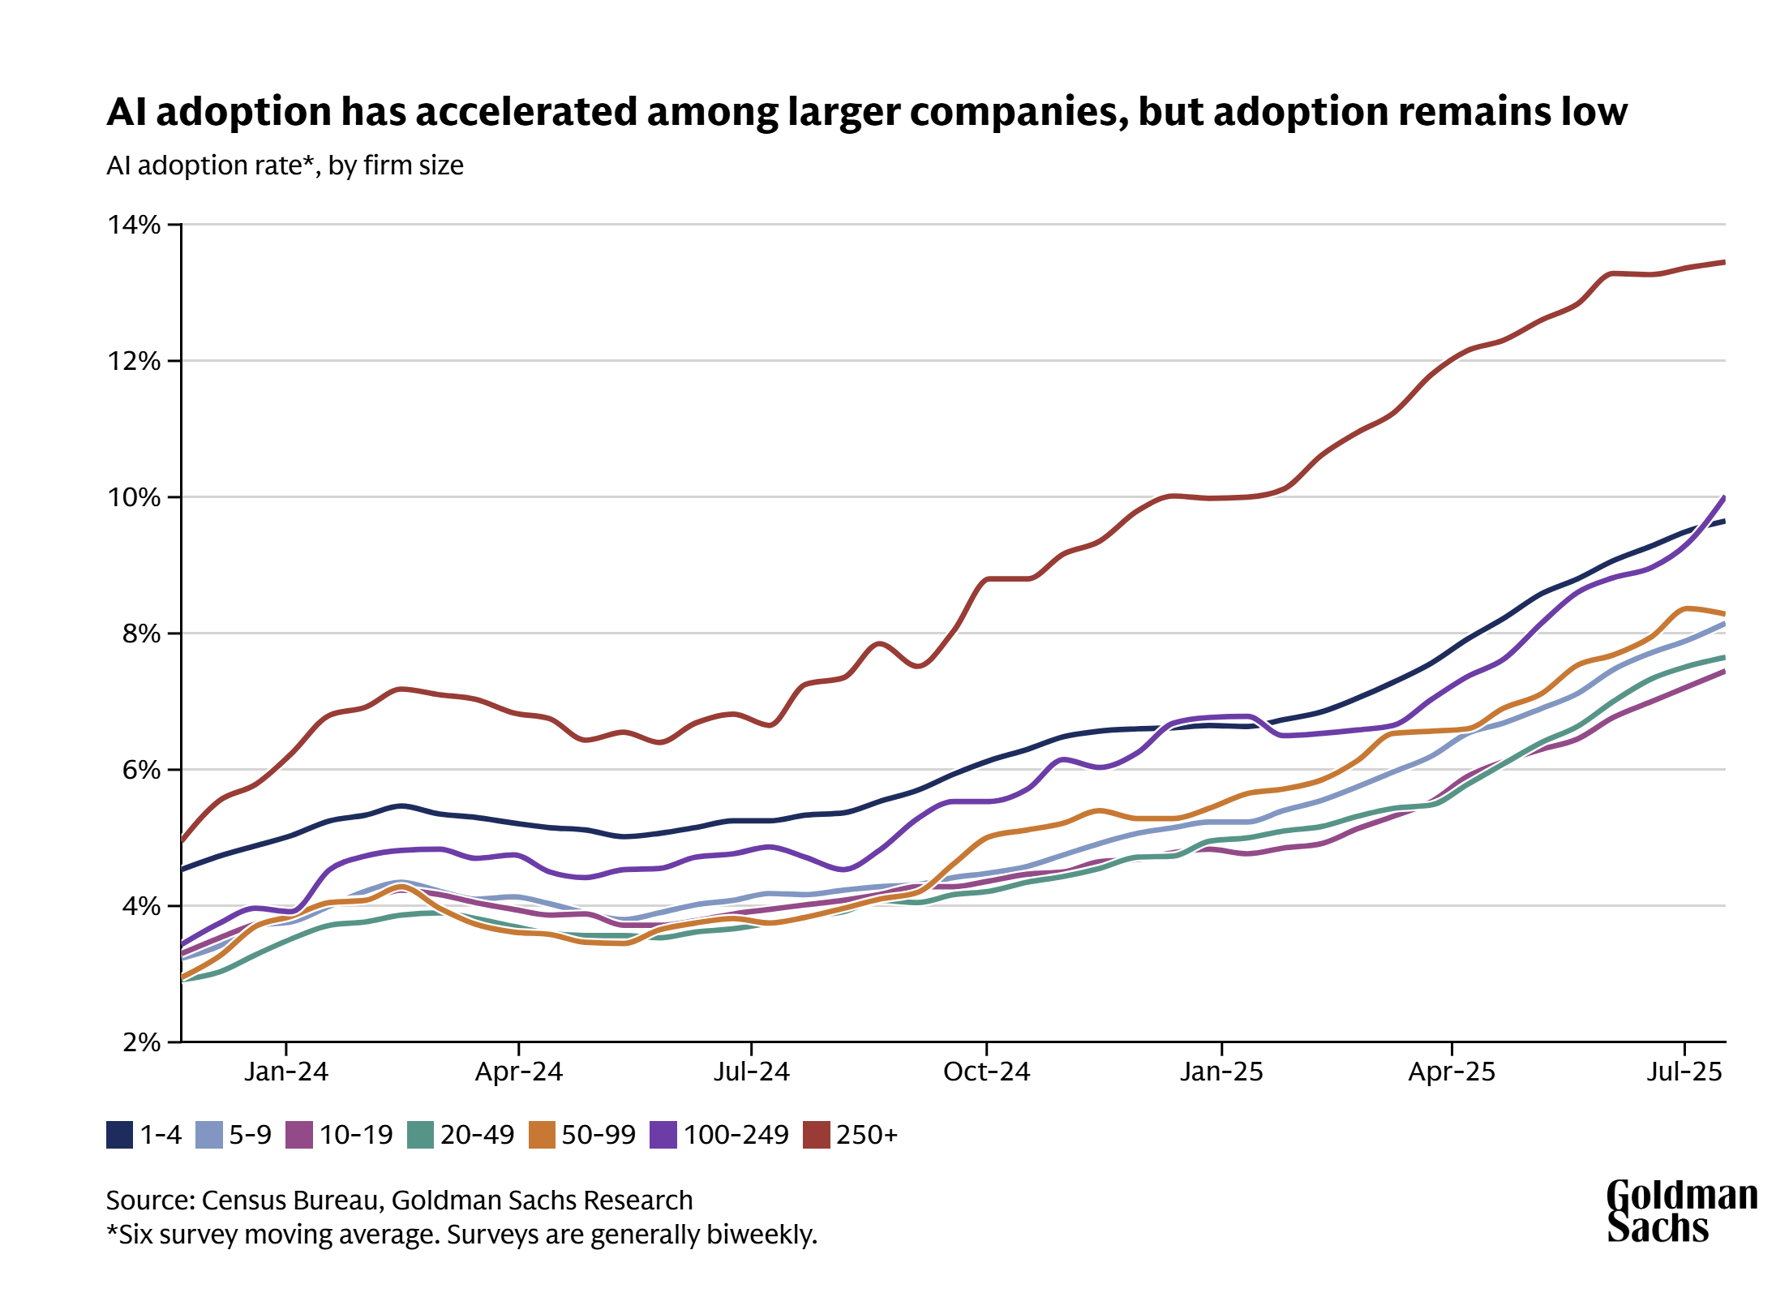
AI is Making it into the Workplace (slowly)
https://www.goldmansachs.com/insights/articles/how-will-ai-affect-the-global-workforce

Slide 32
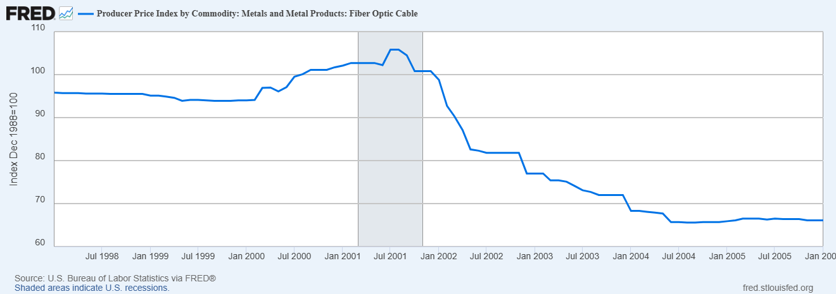
Cautionary Tale: “The Internet Changes Everything”

Slide 33
What is the Big Deal?
Robert Solow Paradox, 1987: “You can see the computer age everywhere but in the productivity statistics.”
The Economist May 2025 Echo: “Why AI hasn’t taken my job?”
But the resolution of the Solow Paradox occurred in the late 1990s with a surge of productivity growth!

Slide 34
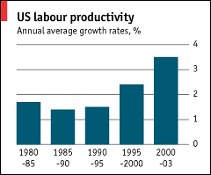
Paradox Resolved

Slide 35
How Will AI Automation Be Different?
Polyani ‘s Paradox: “We can know more than we can tell”
Tacit knowledge: Tasks humans accomplish effortlessly yet cannot be explained by a set of rules: How do we recognize a piece of furniture as a chair?
In contrast to codified knowledge or “book learning:” Instruction Manual.
Do ML models have tacit knowledge.

Slide 36
The Coming Disruption: The View from Microsoft
AI is Most Applicable
AI is Least Applicable
https://www.microsoft.com/en-us/research/publication/working-with-ai-measuring-the-occupational-implications-of-generative-ai/

Slide 37
The Coming Disruption: The View from Microsoft
https://www.microsoft.com/en-us/research/publication/working-with-ai-measuring-the-occupational-implications-of-generative-ai/

Slide 38
But is It Augmentation or Substitution?
Specific Occupations:
  Interpreters with the highest applicability score of .49?
  Substitution.
  How about Writers and Authors with a sore of .45?
  Technical Writers, probably substitution.
  Creative Writers, possibly augmentation.

Slide 39
Examples of Augmentation and Substitution
Augmentation: Air Traffic Controller. AI processes flight data while leaving decisions to humans, keeping wages high.
Substitution: AI can increase the number of cases where a customers’ problem can be solved without human involvement, lowering demand for humans and their wages.
https://www-economist-com/finance-and-economics/2025/02/13/how-ai-will-divide-the-best-from-the-rest

Slide 40
Canaries in the Coal Mine?
Brynjolfsson, Chandar and Chen, August 26, 2025. Stanford economists systematic investigation of employment effects of AI using detailed payroll data from 1/21 to 7/25
https://digitaleconomy.stanford.edu/wp-content/uploads/2025/08/Canaries_BrynjolfssonChandarChen.pdf

Slide 41
What Explains The Difference?
Remember Two Kinds of Knowledge?
  Codified knowledge: “book learning” from formal education
  Tacit Knowledge: idiosyncratic tips and tricks that accumulate with experience.
What kind of knowledge is AI better at?
What kind of knowledge is more important for a programmer; for a stock clerk?
What kind of knowledge is more likely to be augmented by AI?

Slide 42
Wage Polarization with AI
Early 21st Century Technology: Machines substitute for humans in routine work.
AI Technology: AI substitutes for humans in work that requires codified skills.
What is the difference?
Ask a computer programmer.
AI polarization will displace workers further up the traditional levels of skill.

Slide 43
One estimate of Possible Effects

Slide 44
Evidence of Augmentation?
AI Searches “Augmentative”
AI Searches “Automative”
Brynjolfsson et.al., “Entry-level employment has declined in applications of AI that automate work, with muted changes for augmentation.

Slide 45
But, There is Some Evidence of AI Augmentation

Slide 46
Brynjolfsson et.al. Conclusion
“The adoption of new technologies typically leads to heterogeneous effects across workers, resulting in an adjustment period as workers reallocate from displaced forms of work to new forms with growing labor demand (Autor et al., 2024). Such endogenous adjustment may already be happening with AI, with emerging evidence of shifts in college majors away from AI-exposed categories such as computer science (Horowitch, 2025). Past transitions such as the IT revolution ultimately led to robust growth in employment and real wages following physical and human capital adjustments, with some workers benefiting more than others (Bresnahan et al., 2002; Brynjolfsson et al., 2021).
Tracking employment trends on an ongoing basis will help determine if the adjustment to AI follows a similar pattern.”
Optimistic or Pessimistic?

Slide 47
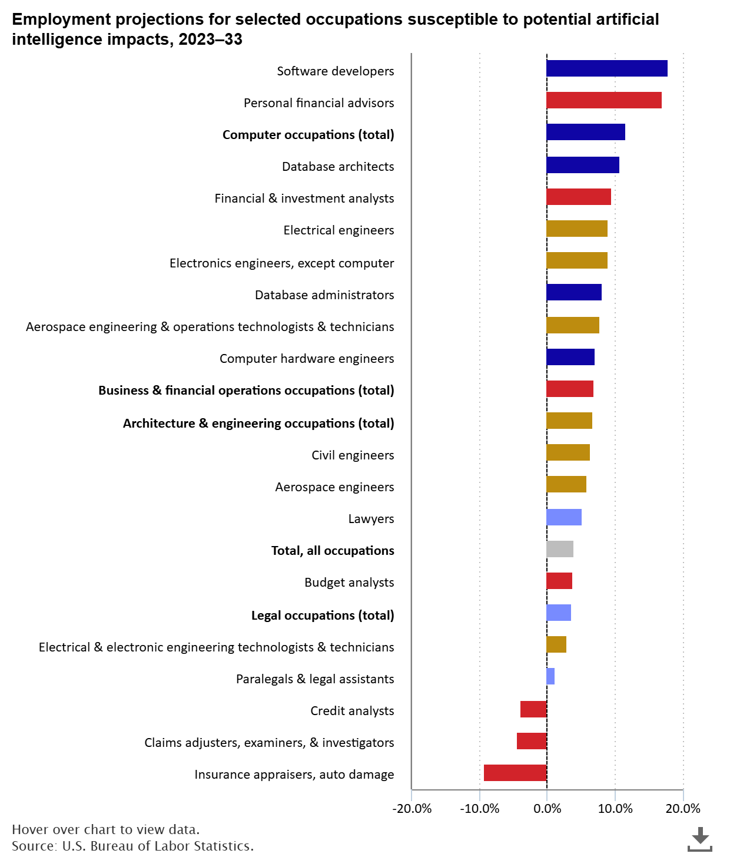
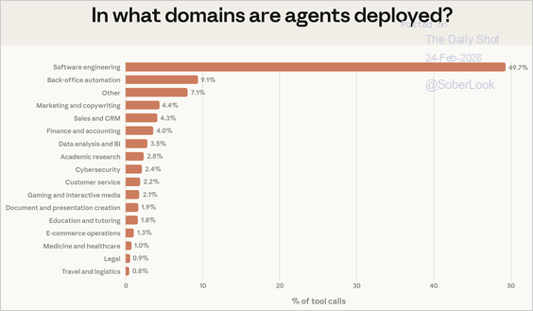
But the Evidence is Contradictory!
Source: @AnthropicAI

Slide 48
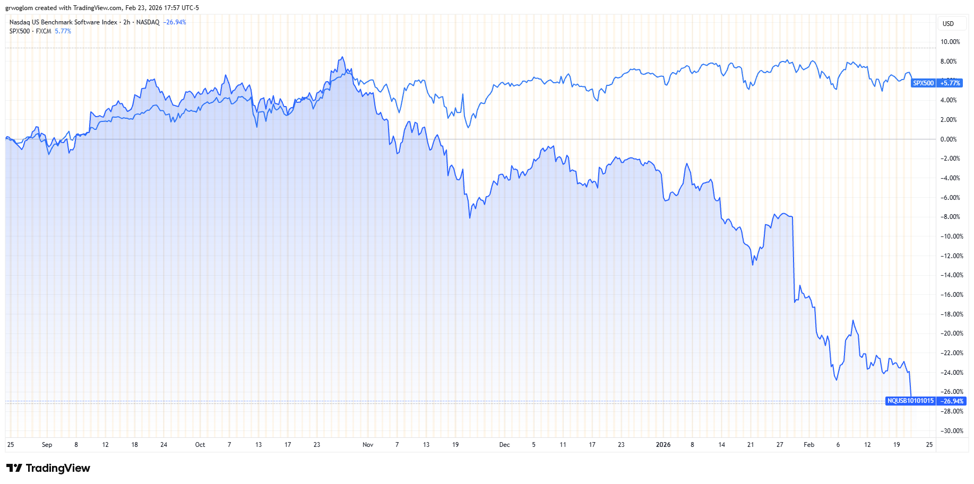
Stock Market “Prediction”

Slide 49
I Couldn’t Say It Better
Yale Budget Lab, “Evaluating the Impact of AI on the Labor Market: Current State of Affairs,” 1/28/2026
Summary:
While anxiety over the effects of AI on today’s labor market is widespread, our data suggests it remains largely speculative. The picture of AI’s impact on the labor market that emerges from our data is one that largely reflects stability, not major disruption at an economy-wide level. While generative AI looks likely to join the ranks of transformative, general purpose technologies, it is too soon to tell how disruptive the technology will be to jobs. The lack of widespread impacts at this early stage is not unlike the pace of change with previous periods of technological disruption

Slide 50
Suppose the Future of AI is a “Big Deal”
Imagine that computer expertise substitutes for human expertise, so that the only work left for humans is unskilled and low paying
But, the productivity of computers is so great that we live in a world of abundance.
Keynes (1930) Economic Possibilities for our Grandchildren
  I draw the conclusion that, assuming no important wars and no important increase in population [climate change?], the economic problem [scarcity] may be solved [in 100 years].
  Thus, for the first time …man will be faced with his real, his permanent problem-how to use his freedom from pressing economic cares, how to occupy the leisure…, to live wisely and agreeably and well.

Slide 51
Problems with Keynes’ Vision
How do people lead meaningful lives without meaningful work?
Given that the value of human skill is eliminated, how do we manage to share the abundance? Will the owners of AI resources be more like Bill Gates or Elon Musk?
David Autor on a podcast has described the Musk case as a Mad Max scenario: “The more likely scenario to me looks much more like Mad Max: Fury Road, where everybody is competing over a few remaining resources that aren’t controlled by some warlord somewhere.” (https://podcasts.apple.com/us/podcast/david-autor-on-ais-impact-on-jobs-expertise-and-labor/id1677184070?i=1000715406677)

Slide 52
Autor (and Neil Thompson)’s Hope
“Scenario 1: We can’t imagine the jobs of the future” (paraphrased)
The augmentation of human expertise can operate through several channels.
Technology creates demand for new human expertise, 60 percent of employment in 2018 was found in occupations that didn’t exist in 1940.
Many tools collaborate with experts. Brynjolfson et.al. found that AI-customer service tools substantially improve junior agents – by accelerating their path to mastery
https://www.digitalistpapers.com/vol2/autorthompson

Slide 53
Autor (and Neil Thompson)’s Fear
“Scenario 2: Human Labor Loses all Scarcity Value”(Keynes’ vision)… A world without labor scarcity… would pose three surpassing social challenges…”
A crisis of social organization and human purpose.
A huge income distribution problem.
How does democracy function without the perception that citizen voters both contribute to and benefit from economic activity.

Slide 54
“Hedging Our Bets” against Scenario 2
Universal Basic Capital (as opposed to Income) Grant: giving every person a meaningful ownership stake in productive assets at birth.
Wage Insurance to support workers transitioning into different jobs.
Using AI and artificial reality tools to enable displaced workers to master new expertise by doing (simulations) rather than studying.

Slide 55
I Hate to End Pessimistically
How do we maintain “standards” in the face of fierce competition
Anthropic and the Pentagon: No use of “Claude” for massive surveillance or autonomous lethal weapons.

Slide 56
Let’s Hear from You!
Geoffrey Woglom
grwoglom@amherst.edu
Contact NEED: Info@NEEDEcon.org
Submit a testimonial: www.NEEDEcon.org/testimonials.php
Support NEED: www.NEEDEcon.org/donate.php

